Slide 1
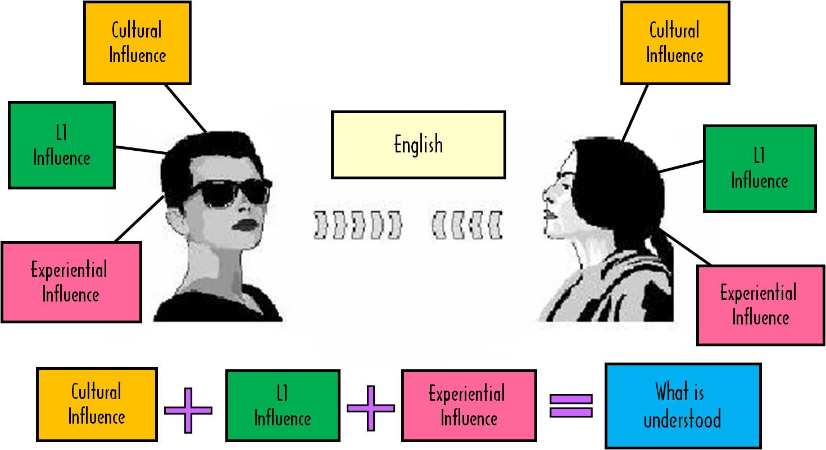
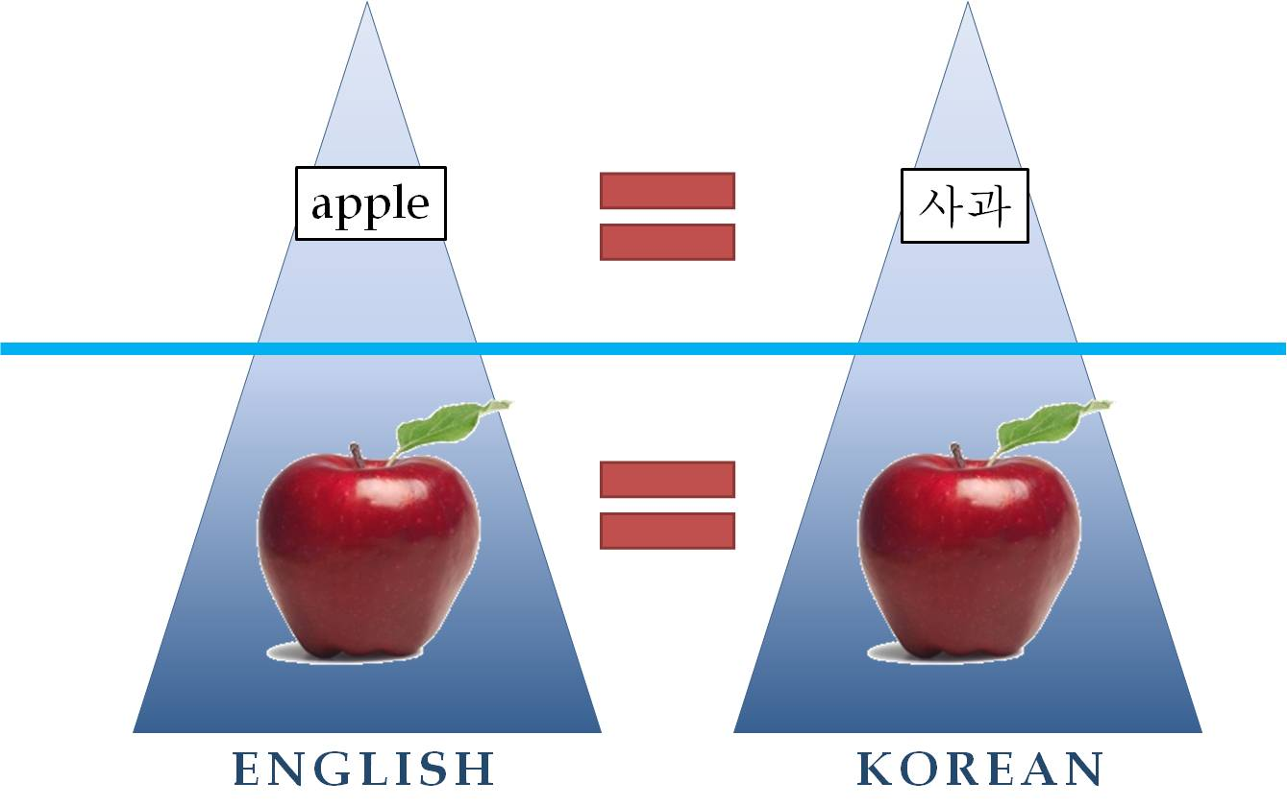
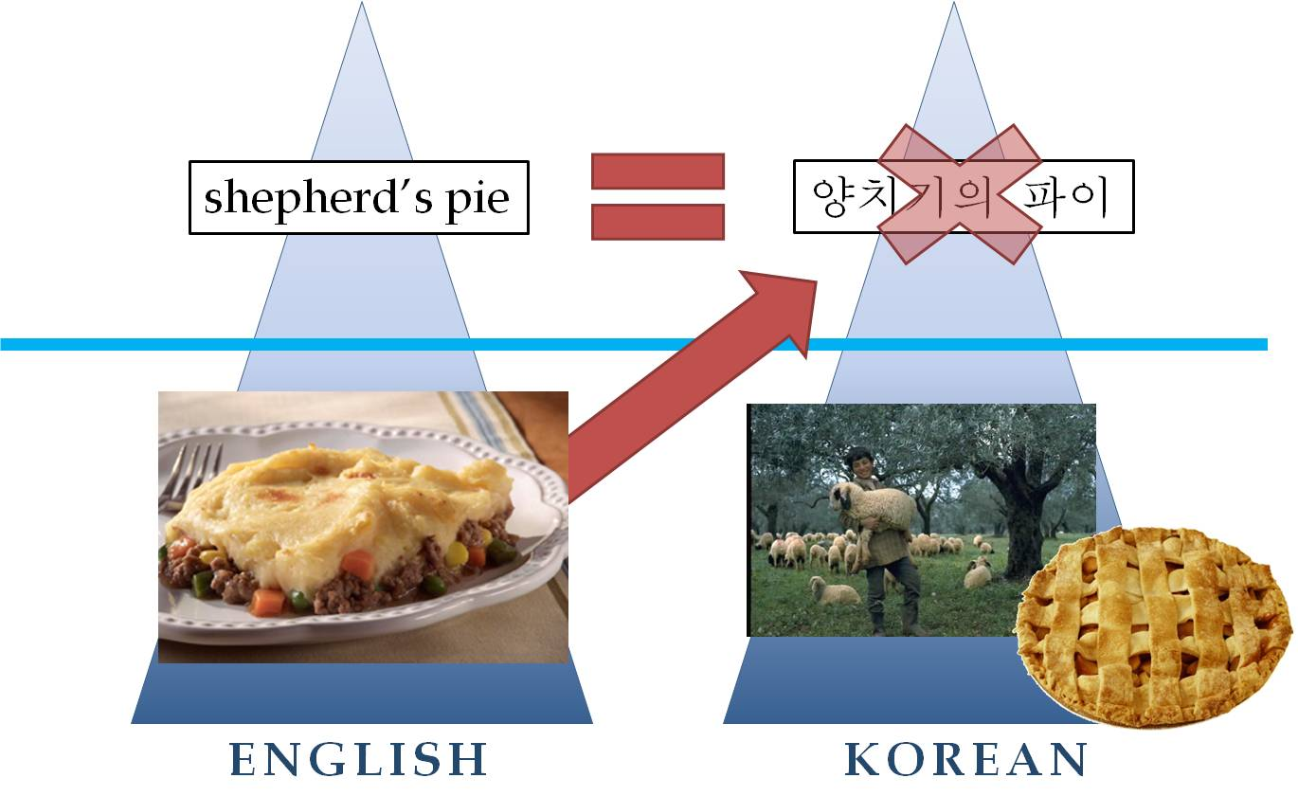
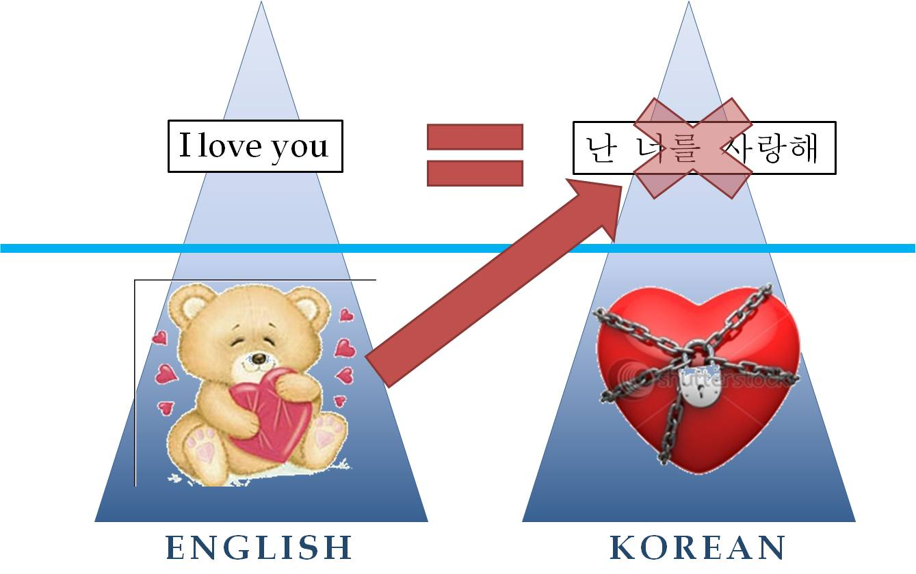
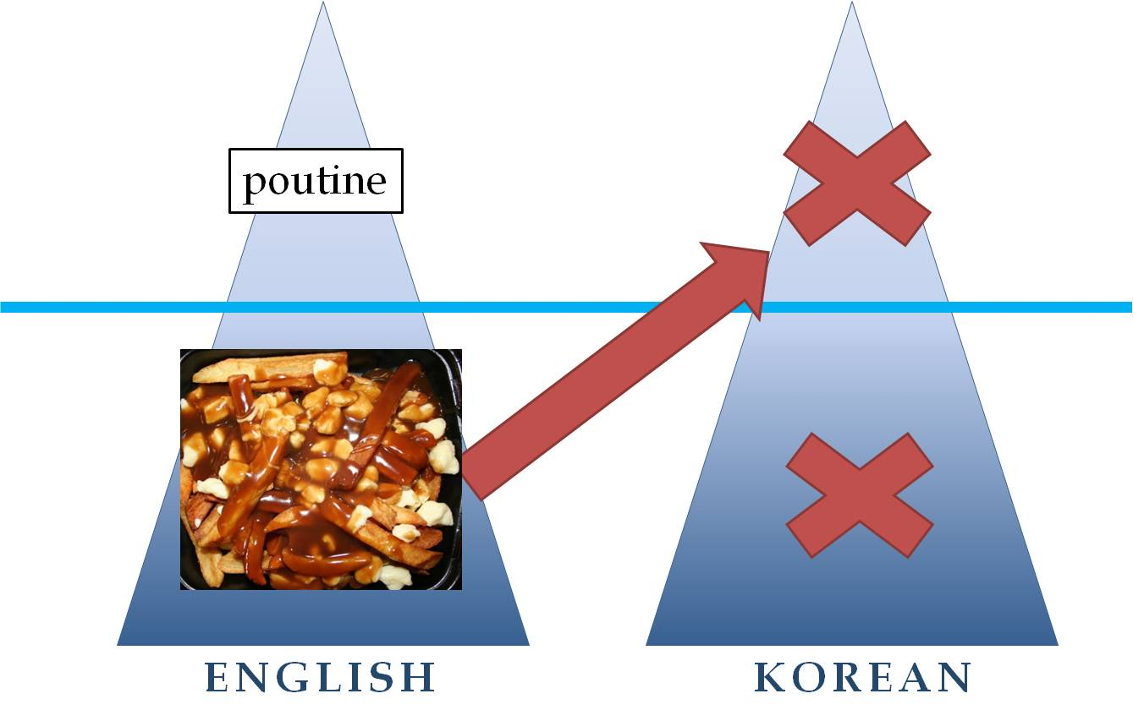
George Whitehead & Grace Hwang
Gyeonggi-do Institute for Foreign Language Education
Rationale for the Model
Widespread classroom translation practices continue to focus on word-to-word memorization often leading to inaccuracies and long-term misunderstandings of the L2 language.
Iceberg Representations
Iceberg: represents the relationship between language and meaning in a single language.
Language: represents written/spoken words and phrases in a set language.
Meaning: represents the contextual meaning of words and phrases in a set language.
Language
Language
Aims of the Model
To raise awareness of some risky, common practices in classroom translation that often lead to learners' inaccurate understanding of the target language.
To propose a set of mental steps teachers can follow in order to provide more accurate and complete use of translation in the L2 classroom.
Meaning
Meaning
Implications
When only surface level information is conveyed, there may be an incomplete transfer of meaning, resulting in unintentional, incomplete knowledge and understanding of the target language.
It is important for teachers to comprehend the contextual meaning of the content they are teaching in order to provide accurate and complete information to their learners.
Contextual meanings may differ depending on the background of the speaker.
NOTE: If teachers can teach the target language using comprehensible L2, then it is strongly recommend that this be their first choice.
Applying the Double Iceberg Model
Comprehend the English meaning of the word or phrase in the context you are teaching it.
Avoid teaching multiple definitions as the context will give you the correct meaning to teach.
Decide on what method would be the clearest and fastest to teach the contextual meaning to your learners. (ie. Visual aids, English synonyms, antonyms, examples, L1)
If the teacher decides to teach the meaning using L1, consider the type of word-meaning relationship that exists between the target language and learners L1.
English
Korean
Relationship | Description | Teaching Approach
1:1 | The word or phrase meaning being translated from English has a perfect word or phrase match in Korean. English word + meaning = Korean word + meaning | Word to word translation
Fake 1:1 | Type A In context, the words can be translated literally at the surface level, however, this results in a mismatch between the contextual meaning of the target language and the meaning in L1. | Target language meaning to L1 match and/or explanation of word meaning
 | Type B On the surface, the words appear to have a perfect 1:1 relationship; however, slight differences exists in meaning. (Word meaning differs in different language and cultures).
1:0 | English word and meaning has no direct match in Korean, and therefore, requires an explanation of meaning. | Explanation
Table 1. Word Meaning relationship
1:1 Relationship
Fake 1:1 Relationship (A)
Fake 1:1 Relationship (B)
1:0 Relationship

