Slide 1
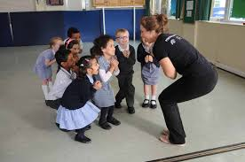
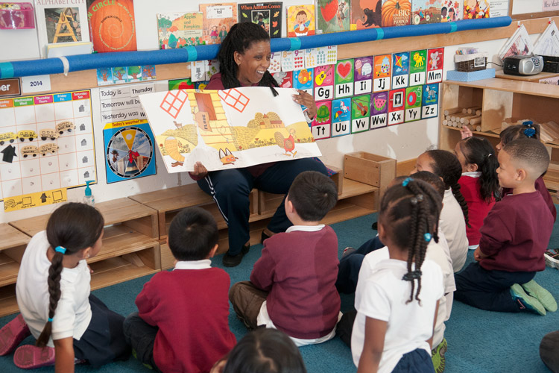
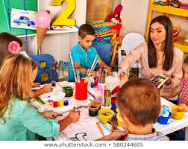
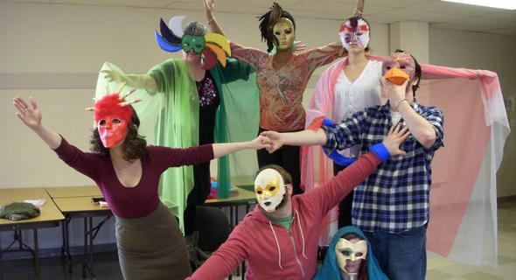
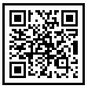
Ready, Action! Implementing Story drama into EFL English classroom
What is Story drama?
Procedure
Findings
Reading storybooks has proven to be one of the best ways to promote second language acquisition in young learners.
A combination of storybooks and drama techniques, Story drama, enables kids to see beyond the books while role-playing and improvising the originals.
Gaining interest
Simple explanation of this activity is goes to here. Simple explanation of this activity is goes to here. Simple explanation of this activity is goes to here.
Future directions will be discussed which aim to provide attendees with practical ways that can adopt story drama methodology with English storybooks in their classrooms.
Through this presentation attendees will gain a deeper understanding of the Story drama teaching skills and its influences on English language education in South Korea.
As well as an increased awareness of current trends of teaching English creatively using Story drama.
Storybook reading
Simple explanation of this activity is goes to here. Simple explanation of this activity is goes to here. Simple explanation of this activity is goes to here.
Story Drama in EFL
English classrooms in South Korea. Attendees will be guided through the major issues and benefits that have arisen as a result of Story drama.
Obstacles that English teachers have when teaching Story drama in EFL settings.
Future directions will be discussed which aim to provide attendees with practical ways that can adopt story drama methodology with English storybooks in their classrooms.
Through this presentation attendees will gain a deeper understanding of the Story drama teaching skills and its influences on English language education in South Korea.
Art activity
Simple explanation of this activity is goes to here. Simple explanation of this activity is goes to here. Simple explanation of this activity is goes to here.
Discussion
Participants will be given the opportunity of acknowledging the benefits, obstacles and other issues in teaching through story drama.
Drama activity
Simple explanation of this activity is goes to here. Simple explanation of this activity is goes to here. Simple explanation of this activity is goes to here.
References
Scan to view this poster later:
Notes:
To change this poster, replace our sample content with your own. Or, if you'd rather start from a clean slate, press the New Slide button on the Home tab to insert a new page. Now enter your text and pictures in the empty placeholders. If you need more placeholders for titles, subtitles or body text, copy any of the existing placeholders, then drag the new one into place.

