Slide 1
Extensive Reading
An Introductory Course
for Middle School Free Semesters

Slide 2
Introduction
Why ER in the Classroom?
Reading is a source of enjoyment and learning (Nation, 2008).
CSAT drives Korean high schools’ EFL into intensive reading (IR) only, causing loss of reading pleasure.
Middle school textbooks provides neither enough input for skill development nor pleasure reading.

Slide 3
Introduction
Intensive Reading | Extensive Reading
Short/Challenging Text | Long/Easy Text
Full understanding | General Understanding
Language focus | Meaning focus
Test focus | Pleasure focus
Skill building | Fluency building

Slide 4
Introduction
ER
Supplementary
Curriculum
Increasing Amount of input
Enjoyment of Reading
Comprehension Skill building

Slide 5
Needs Analysis
1. Target learners
1st graders of co-ed middle school, Gyeong-gi area
Required to take 1 elective out of four-skill integrated regular English courses throughout the Free Semester
2. Methods
A student questionnaire
Diagnostic tests
Indirect test: Macmillan Readers Level Test
Direct test: KET (Key English Test) by the Cambridge English Qualifications

Slide 6
Needs Analysis
3. Results
Needs
General English Proficiency improvement
In-class reading time
Lacks
Guessing unknown vocabulary
Finding gist & details
Text structures
Wants
10-20 minutes reading time
Reading with small groups on the same level
Different genres and topics
Various types of after-reading activities

Slide 7
Needs Analysis
4. Learning Priorities
More meaning-focused reading input to increase reading fluency
In-class reading on the students’ different reading levels
Orientation and a guided-reading stage are needed.
Enjoyable after-reading activities
Vocabulary activities to build up students’ vocabulary knowledge

Slide 8
Course Summary
Course name | ER Introductory Program for Free Semester Elective
Learners | Year 1
Description | A bridge program for novice readers to ER
Content: | Graded stories (fictions/non-fiction)
Skill/system | Reading / Vocabulary. Discourse
Duration | 8 Units per term / 2-hour weekly class per unit

Slide 9
Course Aims
Increase reading skills and fluency
Develop word recognition ability.
Know how to choose appropriate reading materials.
Positive attitudes toward reading and become independent readers.
Motivate creative and critical thinking through a variety of activities.

Slide 10
Scope & Sequence
Course introduction |  |  | Aims, Materials & Tasks, Assessments, and Class rules
Module 1: Class readers
 | Book Choice | Text |  | Pre-/While-Reading | Post-R. 1 | Vocab. | Post-R. 2 | Class Share
Unit 1 | N/A | Foundation Reading Library (FRL) Level 2 “A New Guitar” |  | -Reading back-cover blurb -Target vocabulary preview -Reading & comprehension check | After-reading exercises | Vocab. exercises worksheet | N/A | Sharing feeling about story reading
Unit 2 | N/A | FRL Level 3. “A Good Friend” |  | -Reading the back-cover blurb -Target Vocabulary Preview -Silent Reading -Making flash cards for vocabulary exercise | Graphic organizer: ‘Story Map’ | Vocab. game :flash card | Priming task for Drama: Creating Yoko & Mom’s argument | Drama: “Mom, let me go!”

Slide 11
Scope & Sequence
Module 2: Reading Circles (RC)
 | Book Choice | Text | Pre-/While-Reading | Post-R. 1 | Vocab. | Post-R. 2 | Class Share
Unit 3 | N/A | FRL collections Level 2,4,6 | -Predicting story from the back-cover blurb -Target vocab. preview -Silent reading | -RC Role sheets -Story discussion | Vocabulary game with word Master | Making Storyboard | Storyboard presentation
Unit 4 | Group | FRL collections Level 2–7 |  |  |  | Creating a book trailer | Watching Book trailers
Module 3: Topic-based RC
 | Book Choice | Text | Pre-/While-Reading | Post-R. 1 | Vocab. | Post-R. 2 | Class Share
Unit 5 | Group | T’s collection : Family | -Reading the back-cover blurb - Predicting story from title and illustrations -Silent reading | -RC Role sheets -Story discussion | Vocabulary discussion with word Master | Write book Report1 | Oral book report: 4/3/2 activity
Unit 6 |  | T’s collection : Famous people
 |  |  |  |  |  | Interviews “Guess who?” | Report the interview

Slide 12
Scope & Sequence
Module 3: Topic-based RC
 | Book Choice | Text | Pre-/While-Reading | Post-R. 1 | Vocab. | Post-R. 2 | Class Share
Unit 5 | Group | T’s collection : Family | -Reading the back-cover blurb - Predicting story from title and illustrations -Silent Reading | -RC Role sheets -Story discussion | Vocabulary discussion with word Master | Write book report 1 | Oral book report: 4/3/2 activity
Unit 6 |  | T’s collection : Famous people |  |  |  | Interviews for “Guess who?” | Report the interview
Module 4: Individual Reading
 | Book Choice | Text | Pre-/While-Reading | Post-R. 1 | Vocab. | Post-R. 2 | Class Share
Unit 7 | Individual | Library collection | -Discussing different levels and genres - Predicting story from title and illustrations -Reading the back-cover blurb -Silent Reading | Reading rate: Timed repeated reading | Listing in Glossary | Write book report 2 | Oral book report in group
Unit 8
 |  |  |  |  |  | Writing a book recommendation | Report recommendation Post it on the book

Slide 13
Materials
Material Design Principles (Nation & Macalister, 2010, p. 39).
Motivation
eliciting genuine interest toward book reading.
Balance by Four strands
meaning-focused input
Comprehensible input
level-appropriate reading
language-focused learning
meaning-focused output
fluency activities
Fluency
easy Vocabulary & structures

Slide 14
Materials
Main Reading Texts : Graded Readers
Module 1/2
Teacher-selected reading text
Module 2/3
Reading circles
Module 4
Individual reading
Class readers & Reading circles
Student-selected (as a group)
Student-selected (individually)

Slide 15
Materials
Additional Materials
1. Reading Log
Date | Book Title | Reading Level | Reading Time | Level |  |  | Book Rating |  |  | Pages | Comments
 |  |  |  | Too easy | Good level | Too difficult | Good | Fair | Poor
Total Reading Time |  |  |  | Total Pages

Slide 16
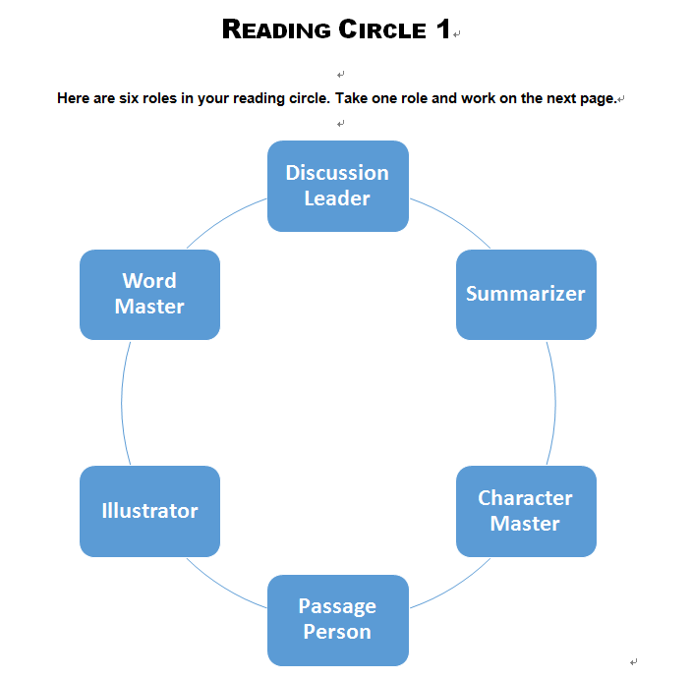
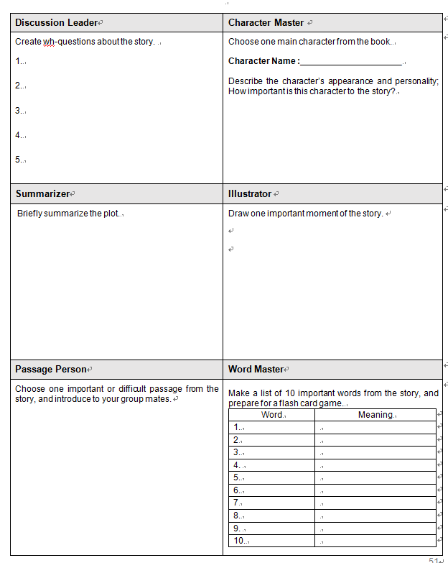
Materials
Additional Materials
2. Reading Circle Worksheet

Slide 17
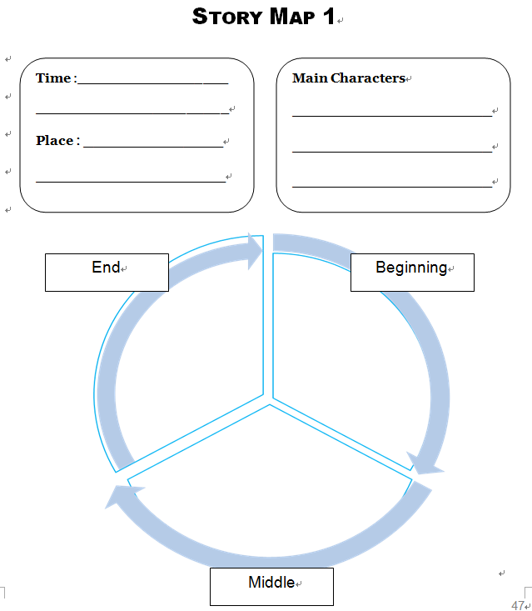
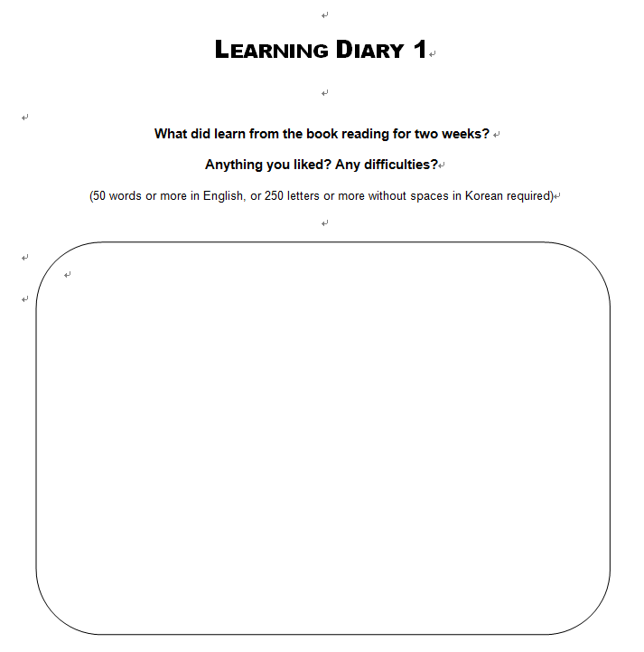
Materials
Additional Materials
2. Reading Portfolio Templates

Slide 18
Conclusion
This course will help learners become familiar with English book reading and guide them to select appropriate reading materials for their levels and interests.
The stages of all the in-class reading and activities are carefully designed to help students naturally accustomed to reading and selecting books during the course.
Increased input outside the textbooks and various post-reading activities may develop students’ critical thinking and reading skills required in higher education.
Deliberate vocabulary learning may build vocabulary knowledge and recognition skill.
Students can build reading habit and eventually become autonomous readers through this course.

Slide 19
References
Bamford, J., & Day, R. R. (1998). Extensive reading in the second language classroom. Cambridge, UK: Cambridge University Press.
Brown, H. D. (2014). Principles of language learning and teaching (6th ed.). New York: Pearson Education.
Cirocki, A. (2013). The reading portfolio: A tool for both learning and assessment in the secondary school EFL classroom. International Journal of Innovation in English Language Teaching and Research, 2(2), 223-241.
Day, R. R., & Bamford, J. (2004). Extensive reading activities for teaching language. Cambridge, UK: Cambridge University Press.
Day, R. R., & Bamford, J. (2002). Top ten principles for teaching extensive reading. Reading in a Foreign Language, 14(2), 136–141. Retrieved from http://www.nflrc.hawaii.edu/RFL/October2002/day/day.html
Day, R. et al. (2015). Extensive reading. Oxford, UK: Oxford University Press.
Fujita, K., & Noro, T. (2009). The effects of 10-minute extensive reading on the reading speed, comprehension and motivation of Japanses hight school EFL learners. Annual Review of English Language Education in Japan, 20, 21–30.
Grabe, W. (2010). Reading in a second language: Moving from theory to practice. Cambridge, UK: Cambridge University Press.

Slide 20
References
Hughes, A. (2003). Testing for language teachers. Cambridge, UK: Cambridge University Press.
Larsen-Freeman, D., & Anderson, M. (2011). Techniques & principles in language teaching (3rd ed.). Oxford, UK: Oxford University Press.
Nation, P. (2001). Learning vocabulary in another language. Cambridge, UK: Cambridge University Press. Retrieved from http://linkinghub.elsevier.com/retrieve/pii/S0889490602000145
Nation, P. (2008). Extensive reading. In Teaching ESL / EFL reading and writing (pp. 49–60). New York, NY: Routledge.
Nation, P., & Macalister, J. (2010). Language curriculum design. New York, NY: Routledge.
Richards, J. C. (2007). Curriculum development in language teaching. Cambridge, UK: Cambridge University Press.
Robb, L. (2000). Teaching reading in middle school. New York: Scholastic Inc.

Slide 21
Thank you

