Slide 1
Qualitative Interview Research Design
Deciding on a purpose (who, what, where, when, why, how)

Slide 2
First Steps In Designing A Qualitative Study
Deciding on what to investigate
Thinking about why it is important
Based on problem analysis
Arises from previous studies
Guided by literature review
Determined by who will use the research results
Deciding who to study
Deciding how you will approach the study and how you will collect data
Deciding when and where you will collect data

Slide 3
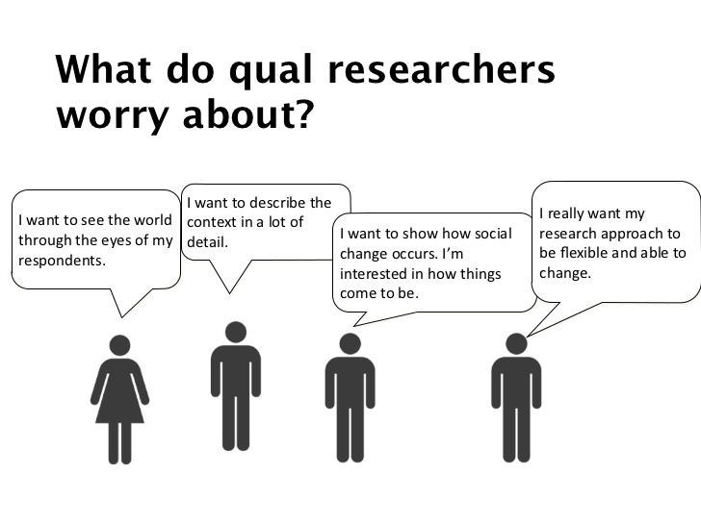
Designing a Qualitative Study
What
Why
Who
How
When
Where

Slide 4
What? And Why?
What topics are important to you?
What topics are you interested in?
What is the context of your study?
What exactly do you want to know or know more about?
What do you want to understand better?
What do you want to help others understand?
Why do you want to investigate it?
Why is it important?

Slide 5
Who?
Who will be the best participants for this study?
Who do you want to explore?
What participant group or groups will give you the best insight?
How many perspectives do you need?
How many participants?
How will you find participants for your study?

Slide 6
How?
How will you approach the study?
Narrative, Phenomenologically, Ethnographically, Case Study, Action Research
Why are you choosing this approach?
How will you collect data?
One-on-one interviews?
Focus groups?
Are there other data collection strategies you could use to increase the credibility of your findings?
Survey
Observation
Journal entries

Slide 7
Where & When?
Where will your data collection take place?
In a classroom, online, at a coffee shop etc.?
When will the data be collected?
Before class, during class, after class, outside of class, single time, over a long period of time

Slide 8
Finding quality resources
In order to design a quality study, you need to know your topic well!

Slide 9
Key Points
It is impossible to design a quality study if you do not know well about what you are researching.
What exactly does your topic of focus entail?
What have other people said about the topic?
What work has been done regarding the topic?
What have others found?
What is the current situation regarding the topic?

Slide 10
Tips: finding resources
UBC library (online and offline)
Google scholar
OASIS
ResearchGate
Academia
Start with a search for recent articles (within the last 10 years max)
Look at relevant articles’ references to lead you to other good resources
Make sure your resources are reliable (https://www.scimagojr.com/)
Not acceptable: news articles, blogs, Wikipedia, MA theses
Acceptable: peer-reviewed journal articles, academic books, PhD theses, conference papers

Slide 11
Quality sources
Peer-reviewed articles, books, or book chapters
Be careful of predatory publishers (Beall’s list - https://beallslist.net/)
You can check if the journal is of quality here: https://www.scimagojr.com/

Slide 12
Task
What academic topics are you interested in?
Write down as many as you can think of
Pick the topic that you are most passionate about, something that you really want to know more about.

Slide 13
Task 1
Tips
Try to find sources that are recent.
Start with most recent and work backwards.
Use one paper to lead you to other relevant papers. ( Reference section)
Find and download 3 recent quality resources that are closely related to a topic you are interested in.

Slide 14
Task
Find 3 articles on your topic of interest
Read the introduction and literature review.
Summarize the key points that are common in the articles you read.
Think about why your research is important based on what you have read
What is the literature missing (hole in the literature) that your research can contribute to?

