Slide 1
Remembering New words

Slide 2
After we teach the words and concept check…
Are we done?

Slide 4
“It’s not what you say or do that ultimately matters…It is what you get the students to do as a result of what you said and did that counts.”
(Archer, Feldman, & Kinsella, 2008)
Notes:
As teachers, we lay the groundwork and set the stage for active learning within an inviting, safe environment wherein children are safe in taking risks.

Slide 5
How are words remembered
long-term

Slide 6
In your experience
What helped you to remember the new words you learned?

Slide 7
Present the words in a memorable way
Shocking and/ or humorous examples are easier to remember that simple textbook like sentences.
Connect the examples you give to students interests.
Instead of using personal pronouns (I, He, She, We etc.) use popular celebrities or characters that the students are interested in.

Slide 8
Samples
a) I exercise regularly.
b) BTS members eat samgyupsal regularly.
c) Aiyu drinks coffee at Paul Bassett (next to IGSE) regularly.

Slide 9
TASK: Make These into more memorable examples
They adore pop music.
The boy was ashamed of his grade on the test.
The suspect was caught by the police.
He is seeking a job right now.
There was a car advertisement on the billboard.

Slide 10
Out of Sight Out of Mind
If the learners do not repeatedly see the words, they will be forgotten.
They need to be repeated in your lessons over a period of time.
At the beginning more repetition more frequently.
Then spaced repetition.
Quizzes using combining both old and newly learned words.
They need to be in a place of reference.
Word journal/ Word wall/ Classroom decorations/ Posters / etc.

Slide 11
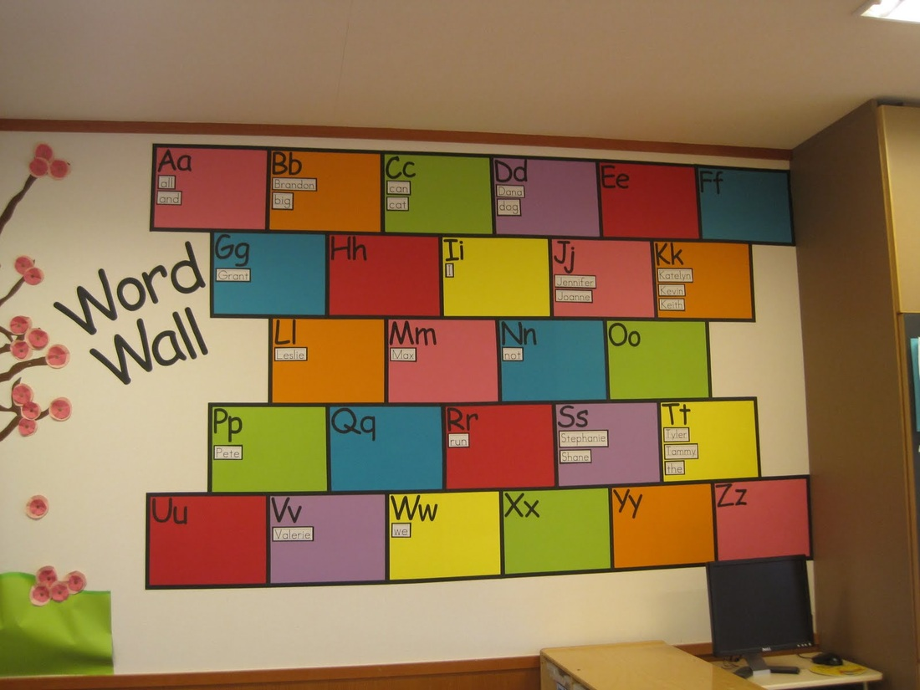
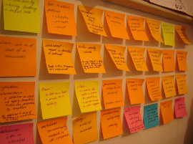
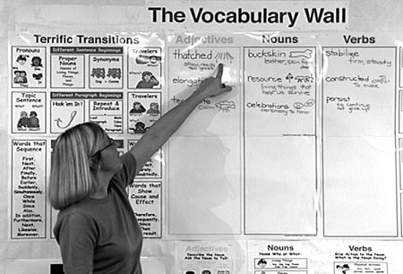
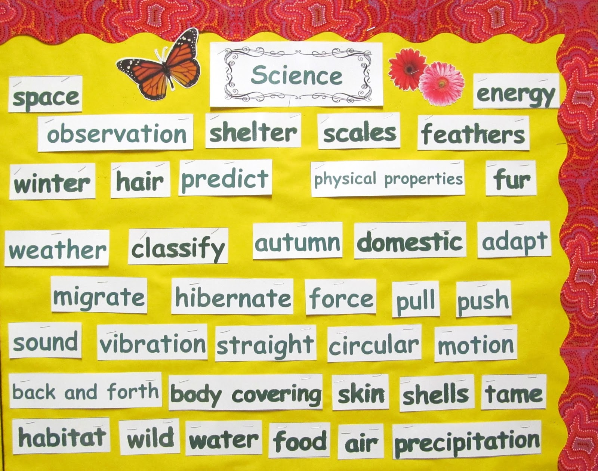

Slide 12
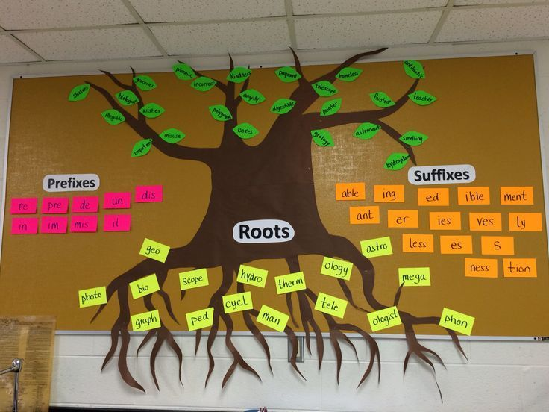

Slide 13
Use them or lose them
Students need a chance to use and reuse the new words in order for long-term retention and faster retrieval.

Slide 14
Out of class
Give students tasks which require referencing/ using the new words outside of class.
Too much time between seeing/ using the words can result in retention loss.

Slide 15
Personalization
Give students the time to personalize the new words to their own lives and experiences.
Insert the words into meaningful projects/ activities
Get them to link it to a meaningful situation or context which they value.
Get them to personalize it by illustrating/ summarizing/ writing examples in a vocabulary journal.
We remember things that are personally connected to us.

Slide 16
Personal Vocabulary Journals

Slide 17
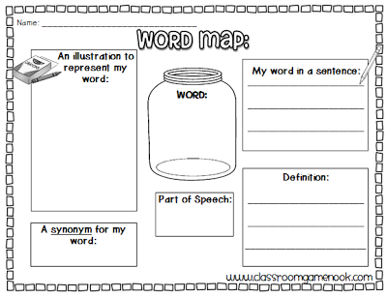

Slide 18
Personal Vocabulary Journal Sample

Slide 24
Vocabulary Activities
Activities & Worksheets

Slide 25
Worksheets

Slide 26
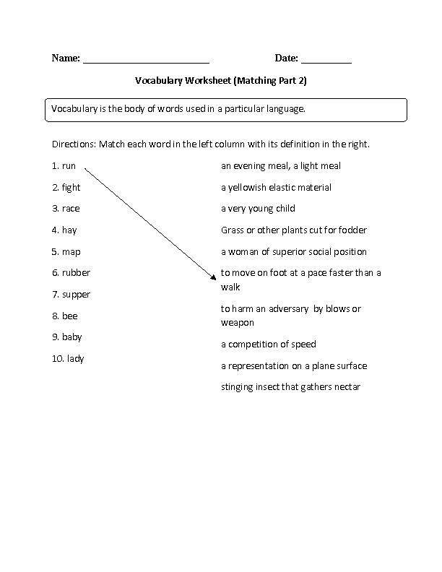
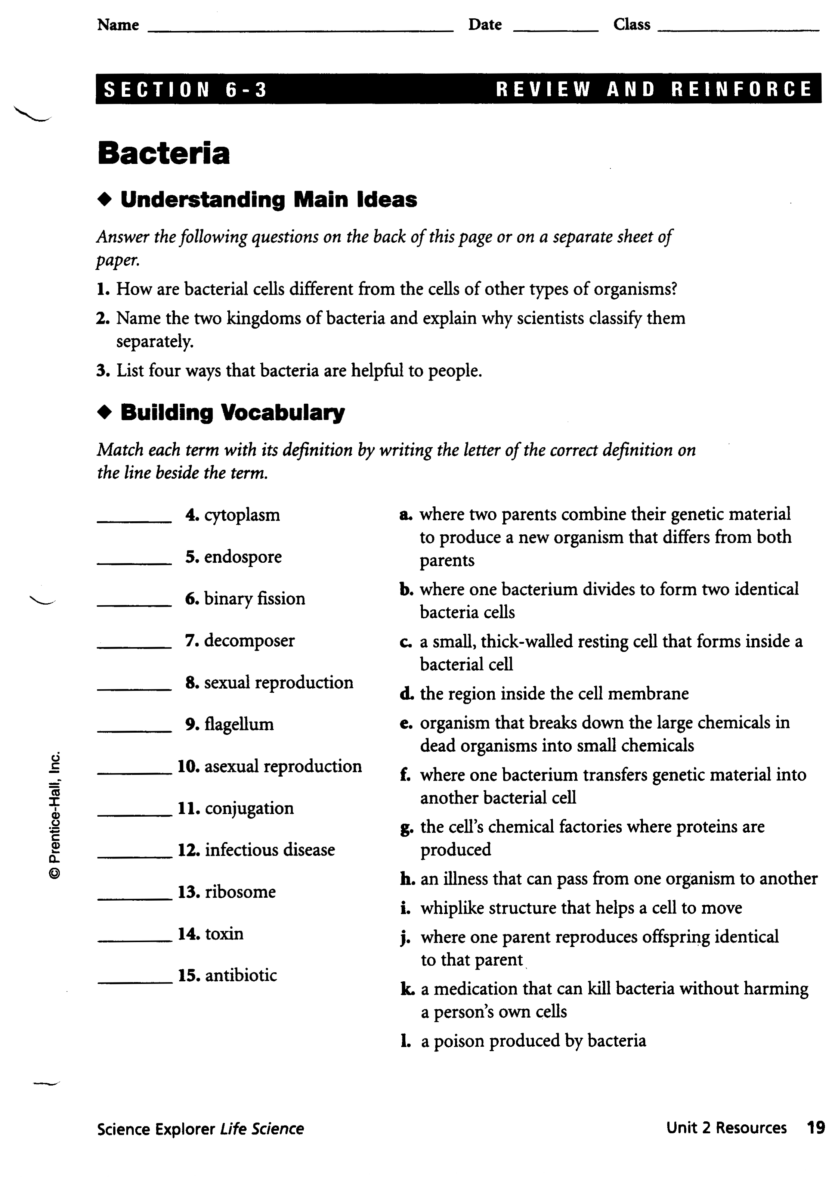

Slide 27
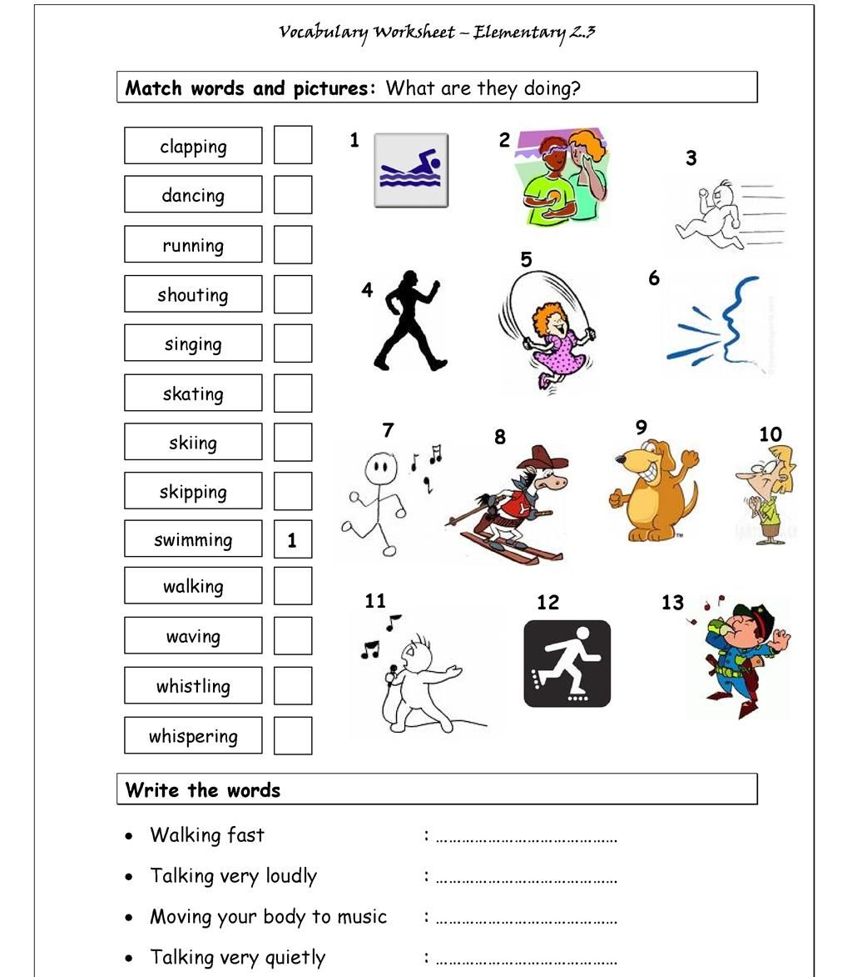

Slide 28
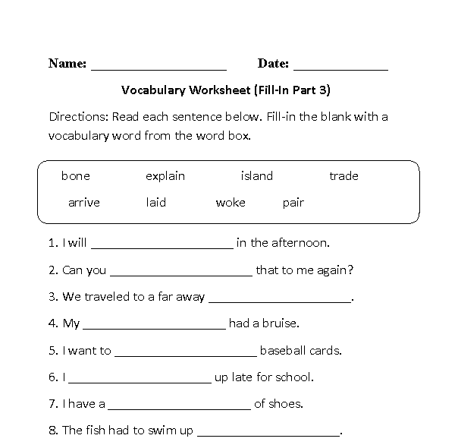

Slide 29
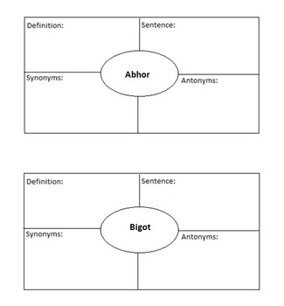
Word
Word

Slide 30
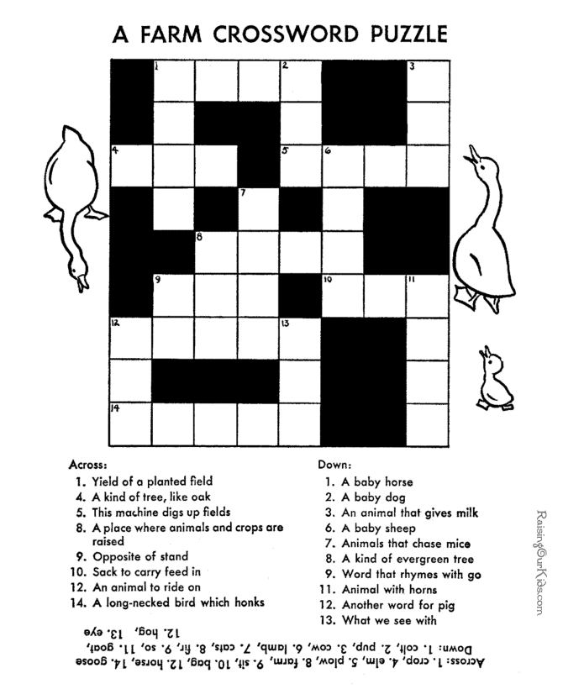
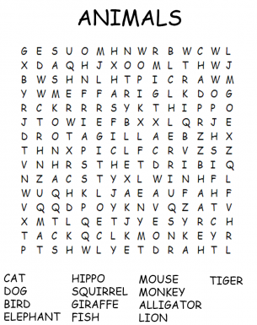
www.puzzlemaker.com

Slide 32
Action Relay

Slide 33
Chopstick spelling

Slide 34
Troll Bridge

Slide 35
Golden bell

Slide 36
Hotseat

Slide 37
Task
Select and Present one vocabulary activity of your choice.
You can find it on the internet.
It can be one that you experienced as a learner.
It can be one that you used as a teacher.
It can be a PPT game, board game, activity, or worksheet.
It can focus on Form, Use, Meaning, Pronunciation, or a combination.
You will share your vocabulary activity with your classmates next class.
http://www.eslcafe.com/idea/index.cgi?Vocabulary:
https://www.flocabulary.com/vocabulary-mini-games/

