Slide 1
Relevance and Relatability in ELT Materials
George E.K. Whitehead

Slide 2
Compelling materials
One problem with a lot of current material is that it is boring (the complete opposite of compelling)
Our job when creating ELT materials is to try to them compelling to students through the content, organization, and visual appeal.
Compelling materials lead to greater overall motivation in learners

Slide 3
Compelling Input
“Compelling means that the input is so interesting, you forget it is in another language.”
(Krashen, 2011, 2015)

Slide 4
Relating the material
Country
Students
Individuals
wants
age
people
language
interests
needs
interests
life experiences
culture & customs

Slide 5
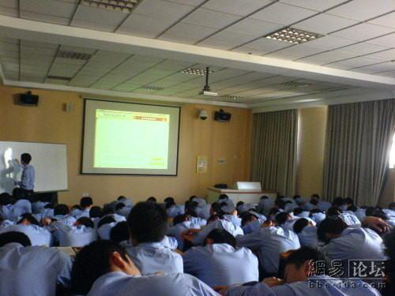
The Issues at Hand

Slide 6
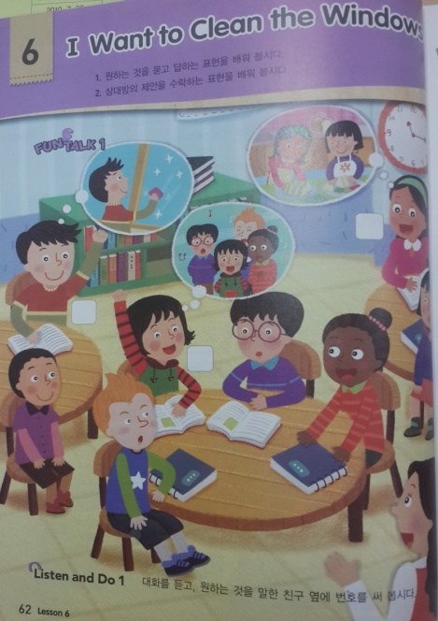
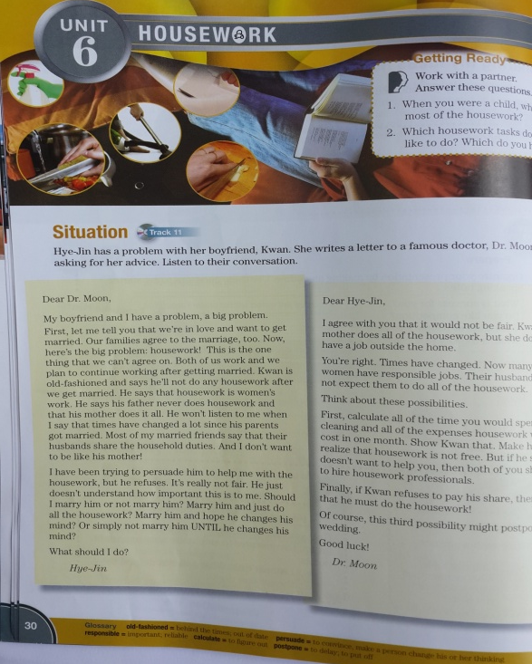
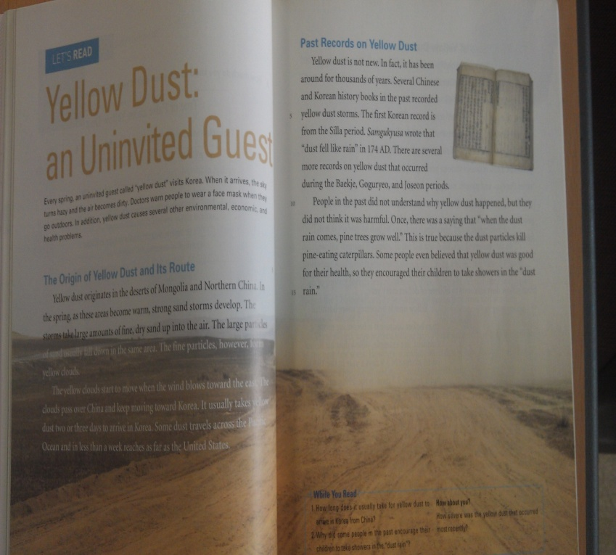
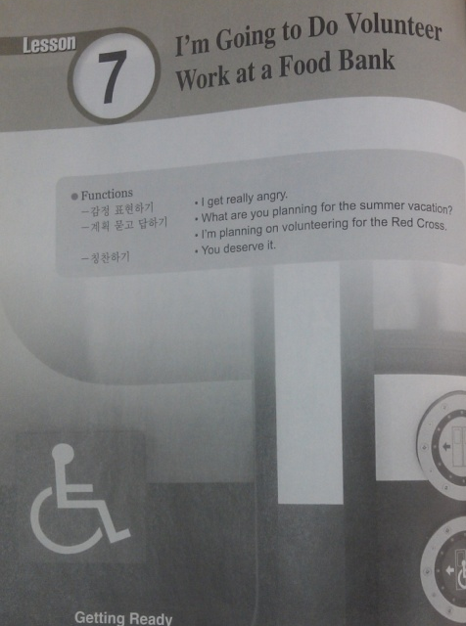
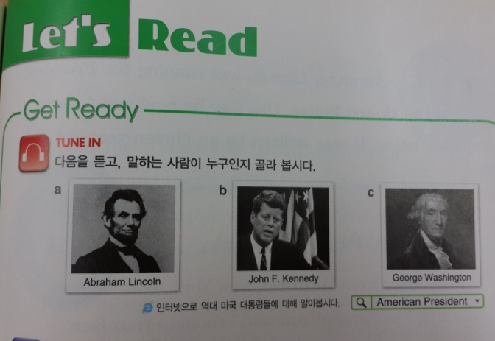

Slide 7
Creating Compelling Lessons

Slide 8
How can you make your lessons more compelling?
Unfortunately…
30% is the content
70% is how the content is delivered by the teacher.

Slide 9
Planning Materials

Slide 10
DO: Put yourself in the students position
Plan things from their perspective.
Ask yourself, if I were them would It be relevant, relatable, interesting?
Would I be excited when the teacher showed us it?
If you don’t know what is relevant, relatable, and interesting to them, ASK!!

Slide 11
DO NOT: plan from only your point Of View & assume that it is compelling
Just because you like it does not mean they will like it.
Be careful of using outdated topics/material/ characters.
Do not force what you like on the students
Don’t be offended if they don’t find it interesting… change it!

Slide 12
Compelling or Not

Slide 13
Who is compelling?

Slide 15
TASK
Make a list of “Who” would be compelling to your students right now.
Select a certain age group or grade.
Think of at least 5 people or characters.

Slide 16
What is compelling?

Slide 18
Compelling Examples

Slide 19
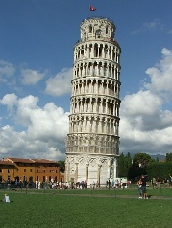
Which of the following sentences is the most compelling?
a)I have been to Italy.
b) She has eaten a spider.
c) Kim Yuna has won a gold medal.
d) Muzi and Con have kissed a gorilla.

Slide 20
Compelling topics
If you were on a textbook development team and had to choose topics for 8 Chapters what topics would you choose?
Work with your group and think of 8 topics.

Slide 21
Compelling topics
How did you decide on those topics?

Slide 22
Needs analysis

Slide 23
Needs analysis
One of the basic assumptions of curriculum development is that a sound educational program should be based on an analysis of learners' needs.
Procedures used to collect information about learners' needs are known as needs analysis.

Slide 24
Good materials
To be relevant, relatable, and interesting to learners the content has to cater to their learning needs.
It must take into consideration stakeholders’…
purpose and aims for learning English (for business, for a test, to emigrate, for general English development etc.)
language level
preferred way to learn (individual work, groupwork, teacher-centered, student-centered etc. )
Interests/ Age / Experiences

Slide 25
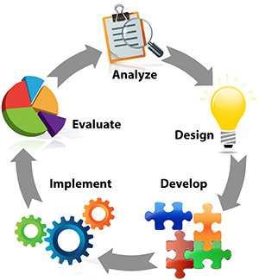
Developing your own needs analysis

Slide 26
Application Task: needs analysis
Create a needs analysis for a group or students of your choice to find out what is relevant, relatable, and interesting to them.
As homework, try to find a student that age and have them answer your questions (this can be done in their L1 rather than English)

Slide 27
The End
Email: prof.gwhitehead@gmail.com
URL: profgwhitehead.weebly.com
Facebook: https://www.facebook.com/groups/gifle/

Slide 28
References
Krashen, S. (2015). The end of motivation. New Routes, 55, 25-29.
Krashen, S. (2011). The compelling ( not just interesting) input hypothesis. The English Connection (KOTESOL), 15 (3), 1.
Prodromou, L. (1999). How to be a boring teacher. English Teaching professional, 12, 16-18.

Slide 29
