Slide 1
REFERENCING

Slide 2
plagiarism
Passing off someone else’s work as your own whether deliberate or not.
Copy and paste
Paraphrasing their words but not referencing them
Using tables or graphics without reference
Submitting someone else’s work

Slide 3
When to reference
When you copy something directly
When you have not written it yourself
When you are borrowing someone else’s idea.
When you want to add proof for the statement you are making.
When you want to provide examples

Slide 4
Samples
Globally, more people are learning and teaching English than ever before, and English has become the most commonly used lingua franca of the world (Crystal, 2003; Jenkins, 2015).
There are now a variety of contexts in which English is being taught, and great diversity in terms of the people who are teaching and learning it (Alsagoff et al., 2012; Matsuda & Matsuda, 2018).
The situation at present is quite different from that of the past where English language teachers were mostly native speakers of the language from predominantly Western countries (Howatt & Widdowson, 2004).
As a result of the global spread of English, a major change has occurred in the contexts in which the English language is taught and learned. English language education is now flourishing in countries and contexts where English is not the dominant language of social interaction, and language classes are being taught by local teachers of those countries whose first language is often not English (Canagarajah, 1999).

Slide 5
More samples
For pre-service language teacher education to be successful in what Kumaravadivelu (2012) refers to as the ‘global era’, traditional approaches to teacher preparation need to be re-examined to find more effective approaches that can cater to the knowledge, skills, and abilities language teachers need within their specific teaching environment.
Kumaravadivelu (2001) calls attention to the crucial importance of ‘particularity’ in teacher education programmes, which he describes as “…sensitive to a particular group of teachers teaching a particular group of learners pursuing a particular set of goals within a particular institutional context embedded in a particular sociocultural milieu” (p. 538).

Slide 6
APA 7th Edition
https://owl.purdue.edu/owl/research_and_citation/apa_style/apa_style_introduction.html

Slide 7
Directly copied
As stated by Whitehead (2017), “ Only a small number of studies have investigated the washback of high-stakes tests in South Korea and have primarily focused on the negative washback effects of the English portion of the CSAT.” (p.129).
“ Only a small number of studies have investigated the washback of high-stakes tests in South Korea and have primarily focused on the negative washback effects of the English portion of the CSAT.” (Whitehead, 2016, p. 129).

Slide 8
Paraphrased or Borrowed idea
For references to ideas that are not copied exactly (author last name, year)
As Krashen (1982) argues, comprehensible input and output are key ingredients in the development of a second language.

Slide 9
Examples
For multiple authors put them in alphabetical order (author, year; author, year; author, year)
Many studies have examined extensive reading ( Amy, 2012; Betty, 2011; Carol, 2016; Zola & Minz, 2015)
For more than 2 authors use et al. when using parentheses.
(Lee, Smith, Uhm, & Park, 2020) X
(Lee et al., 2020) O

Slide 10
Supporting your claims
Today, speakers of English as a second or foreign language far outnumber those speak it as their mother tongue (Crystal, 2015).
In Korean high-school classrooms, students are rarely motivated (Lee, 2009).
Prove it!

Slide 11
Tips for easier referencing
scholar.google.com → ”
Hunting on scholar.google.com for other papers who have cited that paper and finding it in their reference section.
crossref.org (doi)
Software: Mendeley, Endnote, Refworks etc.

Slide 12
Additional details
In main text with 2 authors write it like this
Author and Author (year) OR (author & author, year)
Examples:
Oh and Kim(2019) reported….
Language teachers metacognition plays a key role in exemplary classroom practices (Lee & Kim, 2020)
For more than 2 authors use the following
First Author et al.
Example:
Smith et al. (2022) found…
Students must be persistent in their language learning efforts (Smith et al., 2022)

Slide 13
Referencing Detective activity

Slide 14
REFERENCING
TROUBLESHOOTING

Slide 15
Questions…
As cited in (name, as cited in…)
Referencing others references in your lit card
Directly referencing… when and why do we directly reference?
It is almost always better to paraphrase unless you are providing a definition or key phrase from someone else’s work.

Slide 16
What do you do in the following situation?
Moradkhani, S., Akbari, R., Ghafar Samar, R., & Kiany, G. R. (2013). English language teacher educators’ pedagogical knowledge base: The macro and micro categories. Australian Journal of Teacher Education, 38(10),123-141. ( the following excerpt comes from page 123)
Teacher educators are normally the people who make a significant contribution to “the total ecology of teacher education” (Lunenberg, Korthagen, & Swennen, 2005, p. 588). Their role may be described as that of a mediator who bridges the gap between top level policy makers at the national and/or local domain and teachers as the grass roots who put the educational decisions into practice. As a result, they need to meet the knowledge and performance standards set by political bodies (Bullough, 2001) and demonstrate these standards in practice (Lunenberg et al., 2005).

Slide 17
Thinking time..
Farrell, T. S. (2015). Second language teacher education: A reality check. In International perspectives on English language teacher education (pp. 1-15). Palgrave Macmillan, London. ( the following excerpt comes from page 4)
Learning to teach in the first year is thus a complex process for novice teachers to go through (Bruckerhoff & Carlson, 1995; Featherstone, 1993; Solomon, Worthy & Carter, 1993) because they are faced with specific challenges that must be addressed if they are not to abandon the profession after only a short period of time (Varah, Theune, & Parker, 1986). It is important to ask how second language teacher education programs could bridge this gap more effectively and thus better prepare novice teachers for the challenges they may face in the first years teaching.

Slide 18
Making a reference list
References
Bax, S. (2003). The end of CLT: A context approach to language teaching. ELT Journal, 57(3), 278–287. doi: https://doi.org/10.1093/elt/57.3.278
Brown, H. D. (2007). Principles of language learning and teaching (5th ed.). Pearson-Longman.
Choi, I. C. (2008). The impact of EFL testing on EFL education in Korea. Language Testing, 25(1), 39-62. doi: 10.1177/0265532207083744
Knight, P. (2007). The development of EFL methodology. In C. Candlin. & N. Mercer (Eds.), English language teaching in its social contexts (pp. 147-166). Routledge.

Slide 19
Making a reference list
Reference Detective (Find the mistakes or missing information)
Bax, S (2003)The end of CLT: A context approach to language teaching. ELT Journal, 57, 278–287. doi: https://doi.org/10.1093/elt/57.3.278
Brown, H. D. (2007). Principles of Language Learning and Teaching (5th ed.). New York, NY: Pearson-Longman.
Choi, I.C. (2008). The impact of EFL testing on EFL education in Korea. Language testing 25(1), 39. doi: 10.1177/0265532207083744
Knight, P. (2007). The development of EFL methodology. In Candlin, C. and Mercer, N. (eds.), English language teaching in its social contexts (pp. 147-166). Routledge

Slide 20
How to get citation information
https://scholar.google.com
https://academic.naver.com/
https://www.crossref.org/

Slide 21
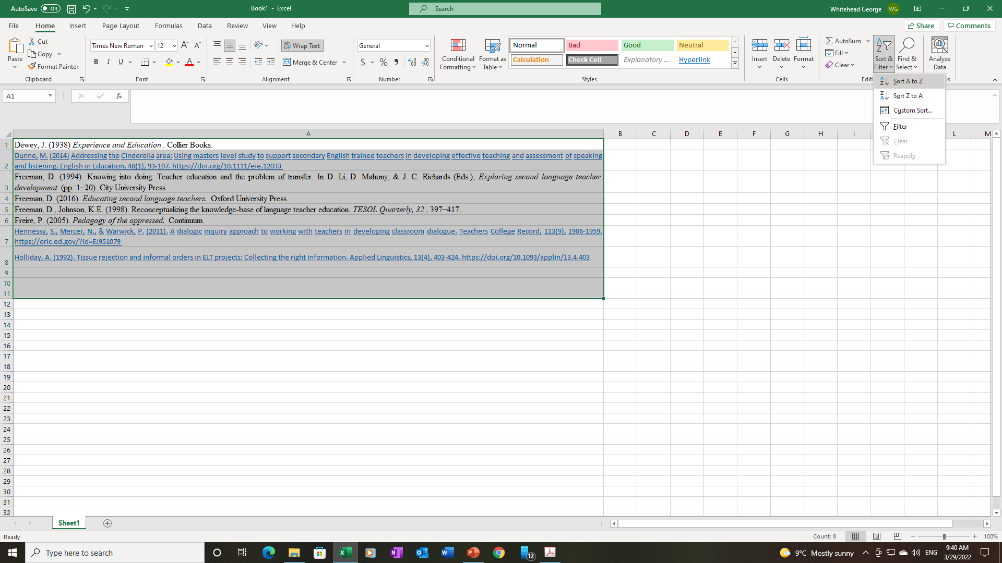
Using Excel to order alphabetically
Copy and paste all references in any order to Excel spreadsheet
Click the Sort & Filter button
Click Sort A to Z

Slide 22
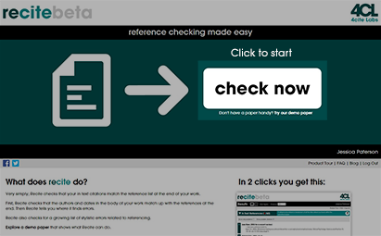
Check reference formatting
Reciteworks.com

Slide 23
Today’s Task
2 articles
References

Slide 24
GAME
Write and Reference Game
Who ? ( What researcher?)
Investigated what? (topic area?)
With who? (participants?)
Where (context of the study?)
What did they find? (summary of findings)

Slide 25
Abstract Summary
Whitehead & Hiver (2016) investigated the effects of high-stakes testing washback on the teaching practices of public school secondary teachers in South Korea. Twenty in-service teachers were interviewed and additional classroom observation was conducted over the course of 3 months. It was found that teachers focused primarily on the teaching of reading and test taking strategies, and neglected a focus on productive skills stemming from the narrow receptive objectives of the Korean SAT.

