Slide 1
Qualitative Research Methods
Course Introduction

Slide 2
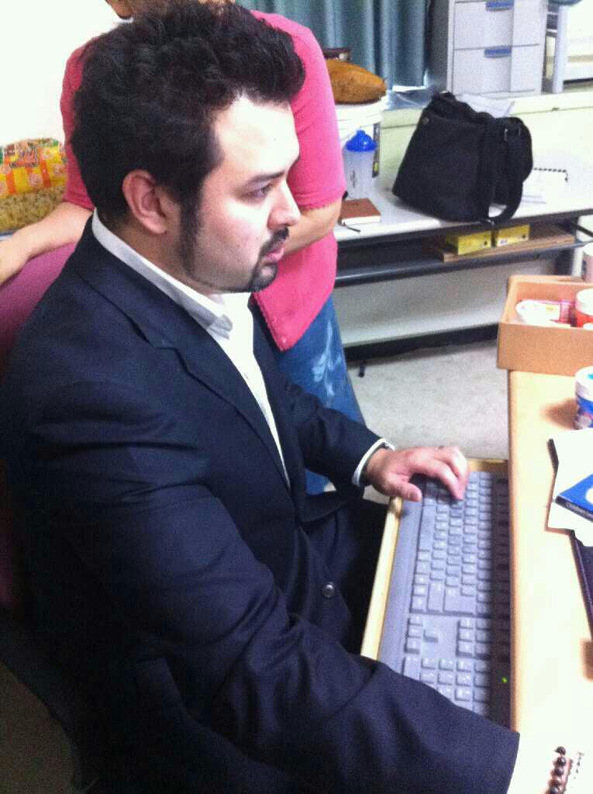
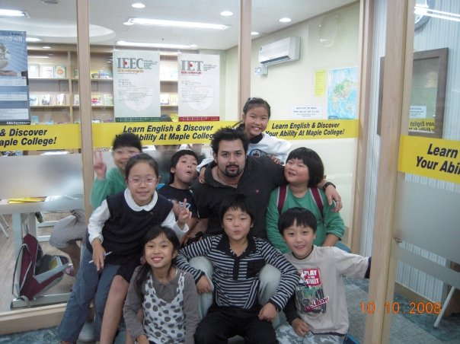
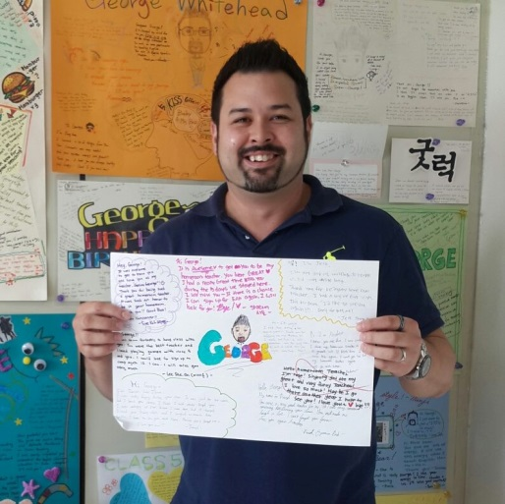
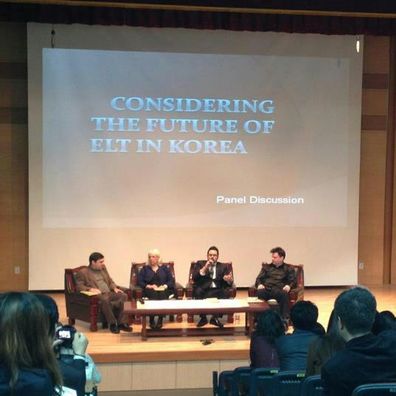
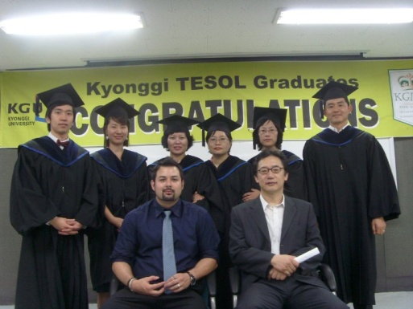
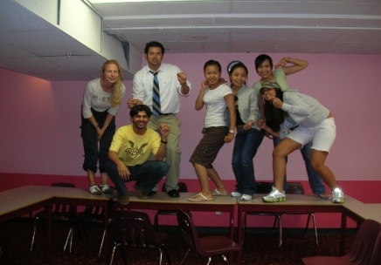
About me
George Elliott Koichi Whitehead
경일
Prof.G

Slide 3
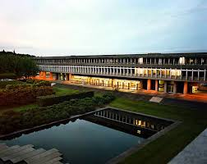
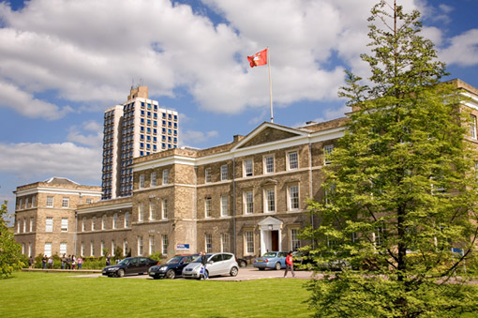
Associates of Arts
BA Linguistics
Certificate for Teaching ESL Linguistics
MA TEFL/ TESL
PhD Education (in progress)

Slide 4
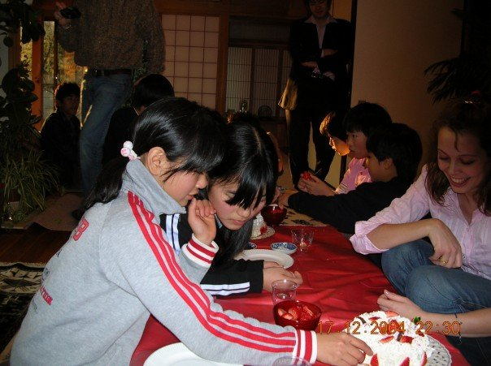
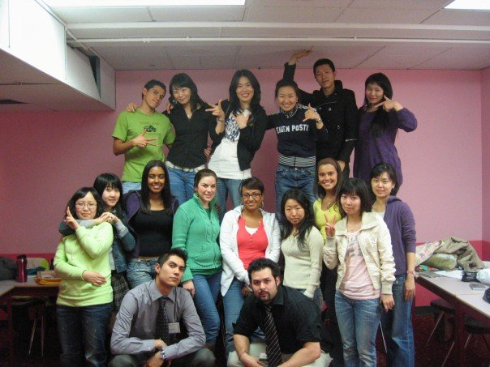
My 16 Year Career
The beginning…

Slide 5
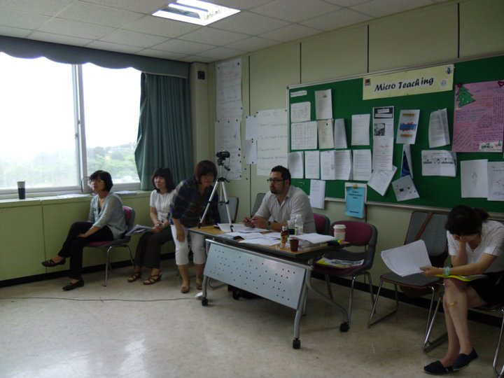
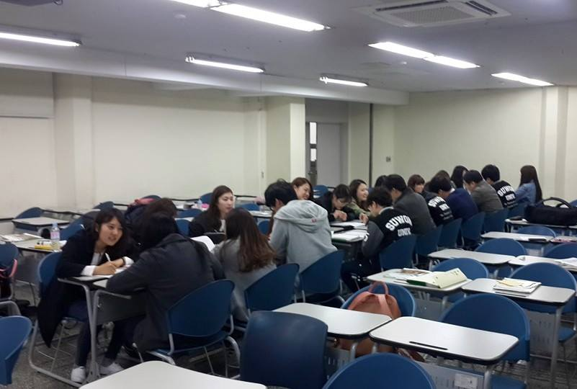
My 14 Year Career continued..

Slide 6
My 14 Year Career continued..

Slide 7
Additional Work
Darakwon Publishing (Author, Editor, Advisor)
Books
Gang, Y.S., Kim, H.D., Whitehead, G., Goo, Y.S., Gwon, H.Y., Han, G., & Hong, G.M. (2018). Middle School English 1. Seoul, South Korea: Darakwon.
Gang, Y.S., Kim, H.D., Whitehead, G., Goo, Y.S., Gwon, H.Y., Han, G., & Hong, G.M. (2019). Middle School English 2. Seoul, South Korea: Darakwon.
Gang, Y.S., Kim, H.D., Whitehead, G., Goo, Y.S., Gwon, H.Y., Han, G., & Hong, G.M. (2020). Middle School English 3. Seoul, South Korea: Darakwon.
KSAT

Slide 8
Journal Publications
Hiver, P., & Whitehead, G. (2018). Teaching metacognitively: Adaptive inside-out thinking in the L2 classroom. In C. Bjørke, M. Dypedahl, & Å. Haukås (Eds.), Metacognition in Language Learning and Teaching. New York, NY: Routledge.
Hiver, P., & Whitehead, G. (2018). Sites of struggle: The co-construction of language teacher agency and teacher identity through classroom practice. System [Special Issue] Interdisciplinarity in Language Teacher Agency: Theoretical and Analytical Explorations.
Whitehead, G. (2017). Teachers’ voices: Obstacles to communicative language teaching in South Korea. Asian EFL Journal, 18 (4).
Whitehead, G. (2016). The rise and fall of the National English Ability Test: Examining Korean high school English teachers’ perspectives. Asian EFL Journal, 19(4). 124-155.
Greenier, V., & Whitehead, G. (2016). Towards a model of teacher leadership in ELT: Authentic leadership in classroom practice. RELC Journal, 47(1), 79-95 DOI: 10.1177/0033688216631203.

Slide 9
Reviewing & Editing
Asian EFL Journal - Editor/ Reviewer (https://www.asian-efl-journal.com/)
Asian ESP Journal – Editor/ Reviewer (https://www.asian-esp-journal.com/)
System – Guest reviewer (https://www.journals.elsevier.com/system)

Slide 10
Ask George!

Slide 11
Contact
Website: profgwhitehead.weebly.com
Email: prof.gwhitehead@gmail.com

Slide 12
Qualitative Research Methods
with Prof. George E.K. Whitehead

Slide 13
The course
Through this course you will:
gain deeper insight into your own epistemological and ontological perspectives.
develop a deeper understanding of core principles, approaches, and procedures of qualitative research.
familiarize yourself with various qualitative data collection strategies.
develop the ability to analyze qualitative data.
develop higher confidence in designing and conducting your own qualitative research.

Slide 14
Course Overview
Interviews, focus groups
Piloting an interview & transcribing
Observations overview
Observation practice
Data analysis: Introduction to coding
Coding Practice & Interpretation
Revising & Finalizing portfolio research design
Wrap-up
Introduction to Qualitative Research
The nature of research
Epistemology and ontology
Approaches to qualitative research: narrative, phenomenological, ethnographic, case study, action research, grounded theory
Research design: Deciding on a purpose
Developing research questions
Data collection strategies overview

Slide 15
Course Evaluation
Attendance 20 %
Participation, Professionalism, Excellence 20 %
Assignments 20 %
Research portfolio 40 %
Total 100 %

Slide 16
Attendance (20%)
*Attendance includes being here on time prepared for class.
Late
5 mins. after the start of class = late
Late = 1 point deduction in attendance
Absent
More than 30 mins. = absent
Absence = 2 point deduction in attendance
**Absence and tardiness will only be excused if a valid reason and/or a doctors note is provided.

Slide 17
Participation, Professionalism, Excellence (20%)
*Participation includes all classroom tasks i.e. projects, performances, discussions etc., as well as attention, attitude.
*Professionalism is the way you conduct yourself in class and with your professor.
*5 excellence points are reserved and rewarded for exceptional effort.
Some ways to get excellence points:
Always here on time for class
Outstanding effort during class
Helping others in class
Outstanding classwork or homework

Slide 18
Assignments (20%)
Assignments: weekly or bi-weekly short assignments will be given to practice what we have learned in class.
*Assignments include both in class and out of class assignments.

Slide 19
Final portfolio (40%)
Your portfolio is a collection of your epistemological and ontological views, your research rationale, research questions, research design, research questions, interview schedule, transcriptions, observation data, coding, and discussion.
All of these tasks will be done in class but can be revised before submitting your final portfolio.

Slide 20
Additional Details and Information & Course Materials
Homepage: profgwhitehead.weebly.com

