Slide 1
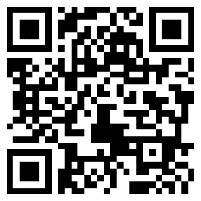
Qualitative Research Interviewing in Education: Theories and Methods
LLED 503 Course Introduction

Slide 2
Course Materials
profgwhitehead.weebly.com
UBC Canvas

Slide 3
The course
Through this course you will:
develop a deeper understanding of the background and rationale for quantitative and qualitative approaches to research.
familiarize yourself with background theory and rationale for qualitative interviewing.
refine your abilities to plan and conduct different kinds of qualitative interviews.
develop the ability to analyze qualitative interview data.
develop higher confidence in designing and conducting your own qualitative research study in which interviewing is a main data collection strategy.

Slide 4
Course Overview
Introductions: Exploring the Nature of Qualitative Research and Interviewing
Getting Situated: Exploring Ontological, Epistemological, and Methodological Assumptions
Approaches to Qualitative Inquiry
Designing Qualitative Interview Studies
Formulating Research Questions
Introduction to One-on-one Interviews and Focus Groups
Designing Interview Questions & Protocols
Ethical Considerations & Participant Recruitment
Doing One-on-one Interviews: Practice and Reflection
Doing Focus Groups: Practice and Reflection
Transcribing Interviews
Analyzing Interviews: Profiles and Themes

Slide 5
Course Readings
The following texts are available online through the UBC library:
Roulston, K. (2010). Reflective interviewing: A guide to theory and practice. Sage. [required]
Seidman, I. (2019). Interviewing as qualitative research: A guide for researchers in education and the social sciences (5th ed.). Teachers college press. [required]

Slide 6
Course Readings
The following texts are available online through the UBC library:
Roulston, K. (2010). Reflective interviewing: A guide to theory and practice. Sage. [required]
Seidman, I. (2019). Interviewing as qualitative research: A guide for researchers in education and the social sciences (5th ed.). Teachers college press. [required]

Slide 7
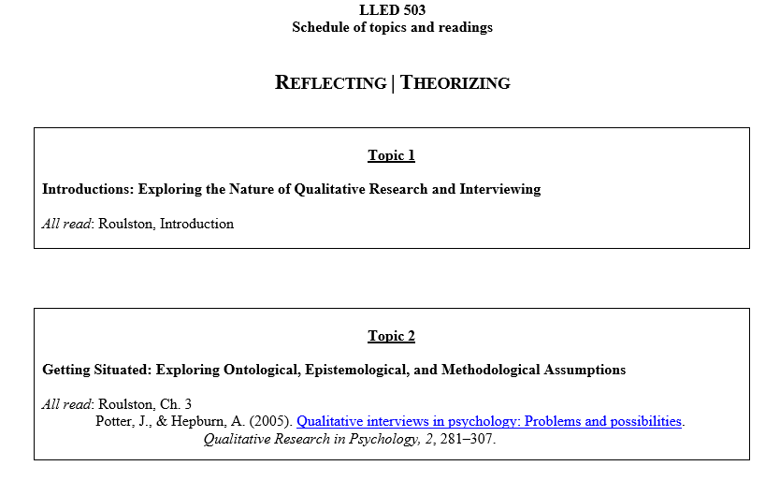

Slide 8
Course Evaluation
1. Class engagement 15%
2. Assignment 1: Mock qualitative research plan draft 15%
3. Assignment 2: Interview schedule and protocol draft/ Ethics forms 15%
4. Assignment 3: One-on-one interview and focus group practice 15%
5. Final Interview with instructor: One-on-one interview 20%
6. Final portfolio 20%
Total 100%

Slide 9
Class Engagement
Includes attendance and engagement in class
Attendance
Late (5 minutes +) – 1% deduction
Absent – 2% deduction
Engagement
Active participation in lesson discussions and activities
Completed assigned course readings for the topic
Ask questions (in-class or privately)
Engage in a professional and respectful manner with peers and course instructor

Slide 10
Assignment 1: Mock qualitative research plan draft
Over the first few weeks of the course, you will be filling in different sections of a mock research plan.
To be submitted prior to crafting interview schedules and protocol.
The mock plan will include:
your research area of focus
rationale for the focus of this study and an explanation of what it will contribute to the field
an outline of the possible participants and rationale for their inclusion
a description of the data collection strategies you will use along with a rationale for your choice of these strategies

Slide 11
Assignment 2: Interview schedule and protocol draft/ Ethics forms
Includes:
Interview questions
Outline of your interview procedures
Study information sheet and consent form
To be submitted prior to conducting interviews with peers

Slide 12
Assignment 3: One-on-one interview and focus group practice
You will conduct and transcribe a set of 2 interviews with classmates and with a larger focus group of 3-4 participants.
Each of you will lead a total of 3 sessions as the researcher (2 x one-on-one, 1 x focus group).
Provide a reflective report that describes your interview experience and outlines specific things that went well and areas that may require improvement.

Slide 13
Final Interview with instructor: One-on-one interview
You will practice recruiting and conducting an ethical 10–15 minute interview with your instructor.
Practicing all of the steps you have learned in the course
Note: You may use the same interview schedule that you have created and refined during the course.

Slide 14
Final portfolio
Final copies of the following which incorporate feedback that you received during the course
Mock qualitative research plan
Interview schedule(s) and protocol
Participant information sheet and consent form
Transcriptions of interviews and focus groups conducted
Data analysis (coding set)

Slide 15
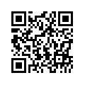
Additional Details and Information & Course Materials
Homepage: profgwhitehead.weebly.com

Slide 16
Contact
Email: g.whitehead@ubc.ca
Office: PCN 3008
Phone: 604.822.6987

