Slide 1
Pursuing a Doctoral Degree
Key Considerations

Slide 2
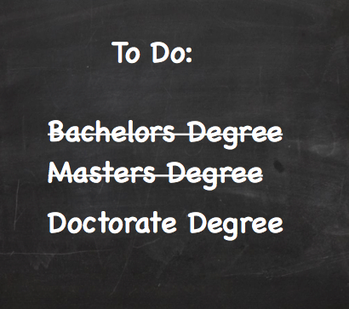
Things to consider
EdD vs. PhD
Part-time vs. Full-time
Online vs. Offline
In Korea vs. Abroad
What school do I choose?
How do I apply?

Slide 3
EdD vs PhD
What’s the difference?

Slide 4
EdD | PhD in Education
Designed for practitioners pursuing educational leadership roles | Prepares graduates for research and post secondary teaching roles
Practice focus | Research focus
Best suited for experienced educators and mid- to senior-level working professionals who want to lead and implement change within their organization. | Best suited for individuals who want to pursue a career in academia or research at the university level.
Focus on understanding and resolving problems of policy/ practice. | Focus on mastering a specific topic. PhD candidates conduct original research in the hopes of driving change in their field
Dean, Educational Administration, Principal, Teacher Educator | University Professor, Researcher, Education Director. Policy Researcher

Slide 5
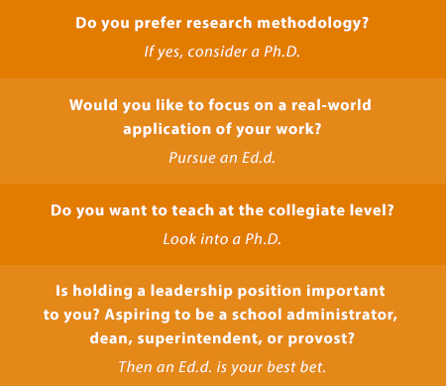
EdD
PhD
Consider your career path | Professional leadership | Education & Research
Consider the focus | Problem and solution focused | Independent research focus
Time | 4-7 Years | 3-4 Years
Future job | Educational Leadership, Administration | Researcher, Academic

Slide 6
Part-time vs. Full-time

Slide 7
Part-time vs. Full-time
Full-time
For those who are not currently working
For those who can spend 5-8 hours a day on doctoral work (like a full-time job)
Full-time students can finish doctoral work in around 3-4 years
Part-time
For those with jobs
For those who do not have the time to treat doctoral work like a full time job
Part-time students can finish their doctoral work in 5-7 years

Slide 8
Online vs. Offline

Slide 9
Online vs. Offline
Online
For those who want to do most of the work by distance ( still requires visits to the university)
For those who are good at self managing, organizing, and self motivation
For those who are unable to attend university in person due to family or work obligations
Offline
For those who would like access to a lot of peer and faculty support
For those who are able to go to campus regularly ( 3-5 days a week)
For those who would like more more structure

Slide 10
Note
Doctoral students are expected to be independent.
Whichever path you choose most of the work is going to be up to you.
You should not expect supervisors to manage everything.

Slide 11
Benefits & Drawbacks
Online
Benefits | Drawbacks
Can do from the comfort of your home | Little to no peer interaction/ support
Can work at your own pace | Hard to attend workshops and university events/ Time differences for Online events
Learn to self-manage well | Can fall off schedule if you are not good at self managing
Offline
Benefits | Drawbacks
Peer and group support | You have to be there
Can check in with supervisor easily | Schedule may be more demanding
You can get have access to everything on campus

Slide 12
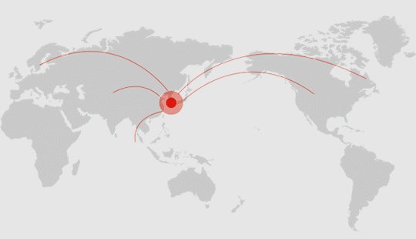
Choosing and applying to a school

Slide 13
Korea or Abroad
Depends where you want to work in the future.
Consider that at present, field experts mostly reside outside of Korea.
Most high ranking Universities in Education exist abroad.
The more recognized your doctoral university is internationally the more opportunities you will have both inside and outside Korea.

Slide 14
What school do I choose?
It is more important to consider your supervisor than your school.
Know what you want to study.
Look a supervisor who is well known in the research area you want to pursue.
Do some research on potential supervisors, make a list of your top choices.
A well known supervisor will also help you network with other big names which can create a strong professional network during your studies.
Consider cost, location, program requirements as well.
Ask a professor for recommendations.

Slide 15
How to apply
Go to the university website that you are applying to
Look at their deadlines and required documents
Write a research proposal ( Around 3000 words)
a working title and key words
a summary of the aims and objectives of your research
an outline of the ways you meet these aims and objectives, referring to research methods and specific resources you use
evidence of your awareness of relevant literature and theoretical approaches
an overview of the expected outcomes and the original contribution your research will make to existing bodies of knowledge
a brief statement on how your research interests tie in with those found in the department, school or centre
Academic reference letters (usually 2)
CV
Personal statement
Transcripts
IELTS, TOEFL or Pearson, and the test must be less than three years old at the time of admission

Slide 16
Additional things to consider
Have a clear idea of a topic you want to study before going any further.
Choose a topic that you are passionate about, you are going to spend years reading and writing about it!
Pursuing a doctoral degree is a huge investment of time and often money (look for scholarships!).
It is 3-7 years of constant daily work ( but you still have free time if you manage yourself well ☺.
It is physically and mentally demanding.
Many doctoral student at some point thinks about quitting.
It is important to find a good life balance that you can maintain long-term.
At the doctoral level it is about finding things out on your own.
Just a degree alone is often not enough to get a good job.
Publications
Presentations
Networking
Before applying for a PhD think about why you are doing it? How will it help your future? What are you future plans after graduating?

Slide 17
When not to pursue a doctorate
If you don’t like self studying.
If you complain about having homework.
If you get behind on work often.
If you are poor at self management and motivation.
If you have no topic of study in mind.
If you have no clear reason why you are doing it.

Slide 18
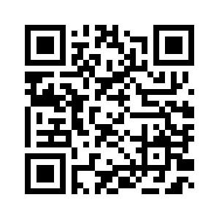
Materials
All of today’s materials can be downloaded from my website
profgwhitehead.weebly.com

