Slide 1
Making it Work
Adapted Project Based Learning for South Korean English Classrooms

Slide 2
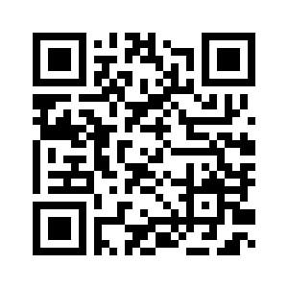
Notice
All of today’s materials can be downloaded from my website
profgwhitehead.weebly.com

Slide 3
Today’s Workshop
Introduction to Project Based Learning
Background
What it is
What it looks like
Applying PBL to the Korean context
Designing/Planning PBL lessons

Slide 4
Some background on PBL
John Dewey initially promoted the idea of "learning by doing“
‘‘Doing projects’’ is a long-standing tradition in American education.
Hands on learning
Educational research has advanced this idea of teaching and learning into a methodology known as "project-based learning“.
PBL responds to the need for education to adapt to a changing world (21st century skills)

Slide 5
21st Century Skills
What skills do you feel are important to succeed in our world today?

Slide 7
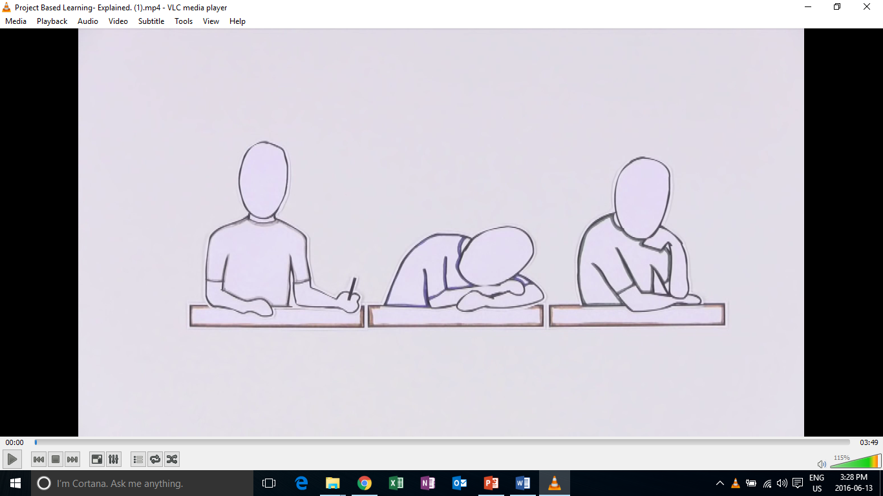
Introduction to PBL

Slide 8
Original PBL Flow
1) Entry event ( Reading, Video, Story, Discussion, Pictures, etc.)
2) Teacher gives students a driving question (Kind of like a research question)
3) The students take time discussing the driving question and thinking about a project they can do
4) Each group chooses their own project
5) Students work on the project in groups
6) Students present their project
7) Students get feedback
8) Students present again

Slide 9
PBL in Action

Slide 10
Education in the 21st Century
Passively learning, memorizing facts, and being tested on factual knowledge is no longer sufficient to prepare students to survive in today's world.
In the 21st century factual knowledge can be found at the tip of your fingers. It is knowing how to apply knowledge that has become essential.
Schools need to focus more on developing applicable life skills. Skills that can help them thrive in the 21st century.

Slide 11
What is project based learning?
Project-based learning if founded in the beliefs that students learn best by experiencing and dealing with real-world issues that are meaningful to them .
"One of the major advantages of project work is that it makes school more like real life. It's an in-depth investigation of a real-world topic worthy of children's attention and effort.“
-EDUCATION RESEARCHER SYLVIA CHARD

Slide 12
What does PBL involve?
students focused on real-world meaningful issues and problem solving
Skills that transfer outside of the classroom
increased student control over his or her learning
teachers serving as coaches and facilitators of inquiry and reflection
students collaborating in pairs or groups
(Barron & Darling-Hammond, 2008; Thomas, 2000)

Slide 13
Learning Outcomes
PBL vs. Traditional instruction
PBL increases long-term retention of content, helps students perform as well as or better than traditional learners in high-stakes tests, improves problem-solving and collaboration skills, and improves students' attitudes towards learning (Strobel & van Barneveld, 2009; Walker & Leary, 2009).
Schools where PBL is practiced find a decline in absenteeism, an increase in cooperative learning skills, and improvement in student achievement. When technology is used to promote critical thinking and communication, these benefits are enhanced.

Slide 14
Discussion
What are some obstacles to PBL in your teaching context?

Slide 15
Designing PBL Lessons

Slide 16
Original PBL Flow
1) Entry event ( Reading, Video, Story, Discussion, Pictures, etc.)
2) Teacher gives students a driving question (Kind of like a research question)
3) The students take time discussing the driving question and thinking about a project they can do
4) Each group chooses their own project
5) Students work on the project in groups
6) Students present their project
7) Students get feedback
8) Students present again

Slide 17
PBL Lesson Example
Students watch a video, read, or see pictures about global warming.
Teacher discusses the topic with students
Teacher puts the driving question on the board “ What daily actions of humans are contributing most to global warming?” (Students discuss)
Teacher then asks students to think about “ what can your group do to raise other students awareness of this trash issue?”
Some groups choose a video, some choose a poster, one groups chooses brochure
They create it
They present/share it
They get feedback and revise
Present again

Slide 18
Revised PBL for Korean English Classrooms
Entry event
Discussion of the topic & problem that will be focused on
Teacher gives the students a project to do
Students work on the project in groups
Students present the project

Slide 19
Teacher’s job
Technology
What is a problem or issue related to the topic that is relevant and relatable to my students?
What kind of project can students do to address the problem?
How will they present it?
How will it be assessed?

Slide 20
Project task ideas (try to think of more)
Design
A new product
A new way of doing something
A better something (menu, phone, etc.)
Make/ Create
A plan
A poster
A storybook
A brochure
An advertisement
A video
A play/ drama
Build
A model
A structure
Write
A letter
A poem
A short story
A book
A speech
Rewrite something
Prepare
To present your ideas
To debate
To teach a lesson

Slide 21
General Topics from Textbooks
What are some general topics of themes that you cover in your classes or that are in the textbooks you use?

Slide 22
Food
Travel
Health & Beauty
Other?
What is a problem or issue related to the topic that is relevant and relatable to my students?
What kind of project can students do to address the problem?
How will they present it?
How will it be assessed?
TIP:
Think about issues in your school, community, current events, student’s lives and interests.

Slide 23
How will it be presented?
As a presentation in front of the class
A performance
As a video
Group to group
Roundtable
Panel
Jigsaw
Gallery walk
Rotation fair (my favorite)
TIP:(graphic organizer for audience)

Slide 24
Assessment in PBL Lessons

Slide 25
Performative
Based on 21st century skills

Slide 26
When to assess…
The process
The product
The presentation
As a whole

Slide 27
Analytic Vs. Holistic Rubrics
Analytic rubrics list the criteria for an assignment and describe these criteria in varying levels of quality.
A holistic rubric describes the attributes of each grade or level. It gives an overall score rather than breaking things down and scoring each criteria.
Most student work will likely fit into more than one category for different criteria. The scorer must choose the grade that best fits the student performance.

Slide 28
Analytic Rubric Sample

Slide 29
Holistic Rubric Sample

Slide 30
When to assess…
During the process?
What can be assessed?
The product?
What can be assessed?
The presentation
What can be assessed?

Slide 31
What can be assessed?
In the process
Collaboration
Participation
Use of L2
The product
Language accuracy
Organization
Design
Creativity
Overall quality
The presentation
Comprehensibility
Accuracy
Organization/Flow

Slide 32
Blank Rubric
Criteria | 4 | 3 | 2 | 1 | Student’s Score

Slide 33
Wording
Always
Often
Sometimes
Rarely
Never
Above expectations/ requirements
Meets expectations/ requirements
Does not meet expectations/ requirements
Excellent
Very good
Satisfactory
Less than satisfactory
Exceptional
Satisfactory
Needs work
High level
Satisfactory level
Unsatisfactory level
Less than/ more than x number of something

Slide 34
5 | 4 | 3 | 2 | 1
Always | Often | Sometimes | Rarely | Never
Above |  | Meets |  | Does not meet
Excellent | Very good | Satisfactory | Less than satisfactory | Poor
Exceptional |  | Satisfactory |  | Needs work
High level |  | Satisfactory level |  | Low level
Less that 3 mistakes |  | 3-5 mistakes |  | More than 5 mistakes
More than 5 times |  | 3-5 times |  | Less than 3 times

Slide 35
Application Time
Designing projects for your classrooms

Slide 36
TASK
With your group choose a chapter from a textbook of your choice. Design a project based lesson for a chapter following PBL guidelines. Think about:
Entry events (Video, Readings, Main chapter theme, Dialogue, Discussions etc.)
Real-world problem and connection to students
Project details (Specifics of the project)
How learners will share their projects
How it will be assessed

Slide 37
Useful Websites
www.bie.org
http://www.leadingpbl.org/w/page/24328306/PBL%20Gallery
https://21centuryedtech.wordpress.com/2013/09/15/the-pbl-super-highway-over-45-links-to-great-project-based-learning/
http://www.elltoolbox.com/pbl.html
http://www.mrsoshouse.com/pbl/pblin.html

Slide 38
Thank you for your participation
George E.K. Whitehead
Email: gekw@hufs.ac.kr
Website: profgwhitehead.weebly.com
Facebook group: English language education in South Korea

