Slide 1
Project Based Learning
with Professor George E.K. Whitehead
Course Introduction

Slide 2
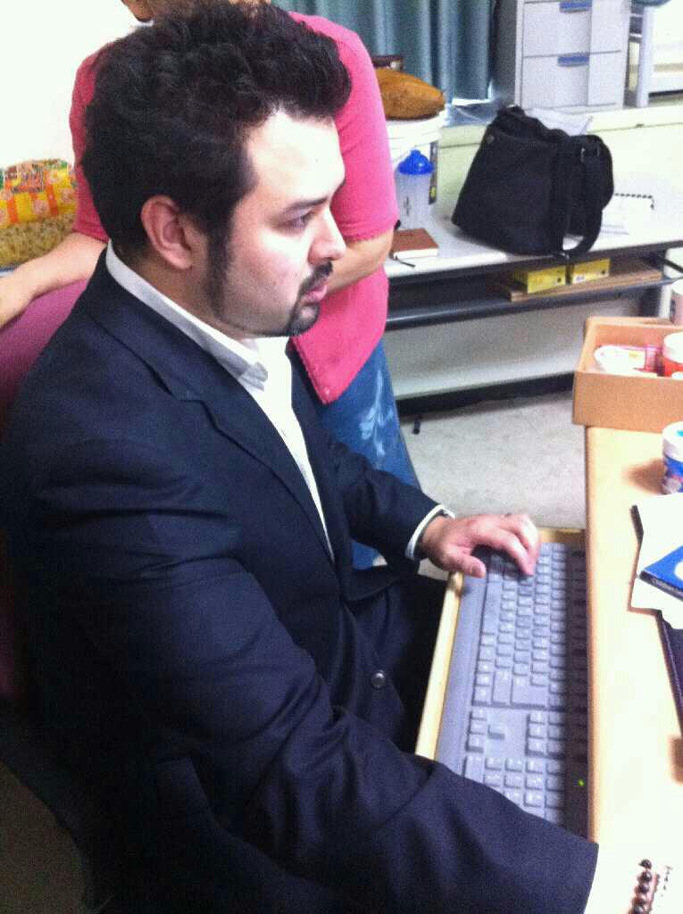
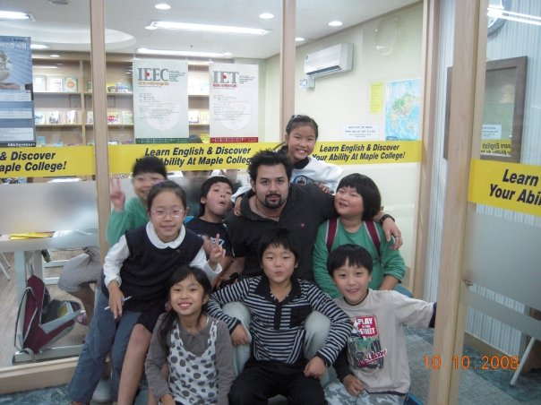
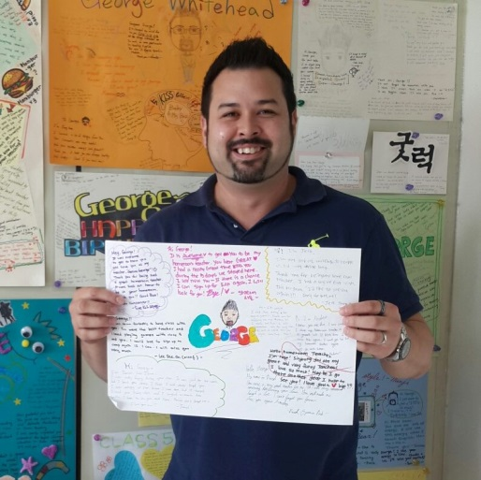
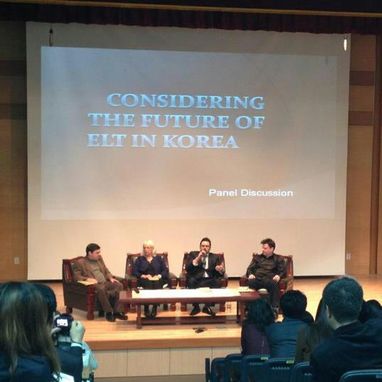
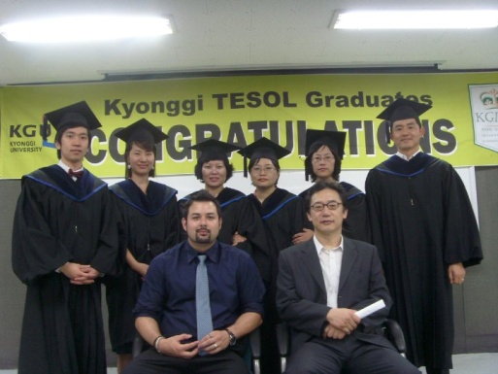
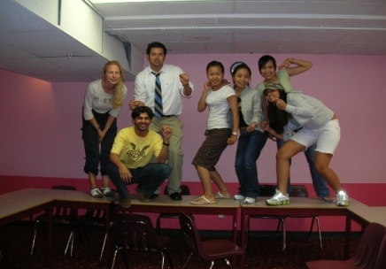
About me
George E.K. Whitehead
경일
Prof. W

Slide 3
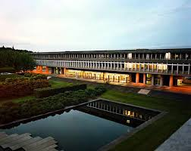
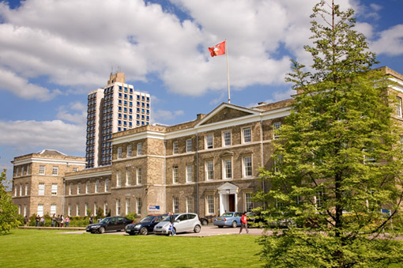
Associates of Arts
BA Linguistics
Certificate for Teaching ESL Linguistics
MA TEFL/ TESL
PhD Education (candidate)

Slide 4
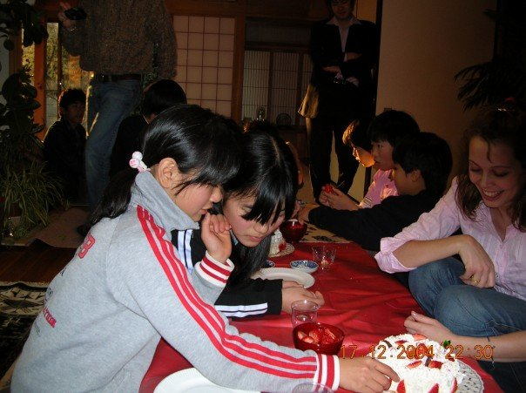
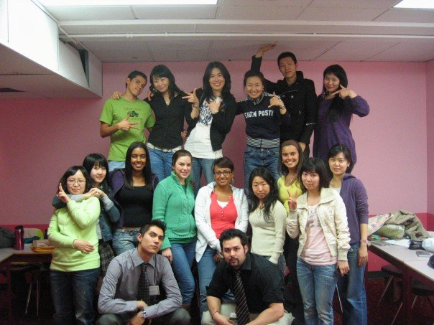
My 20 Year Career
The beginning…

Slide 5
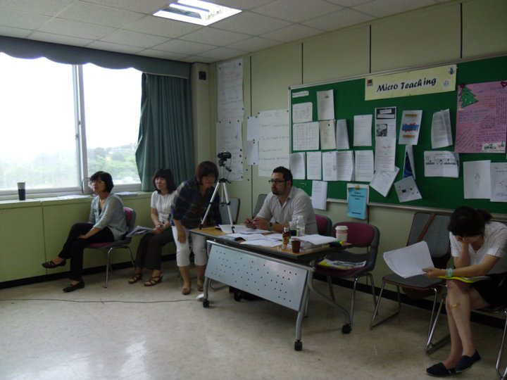
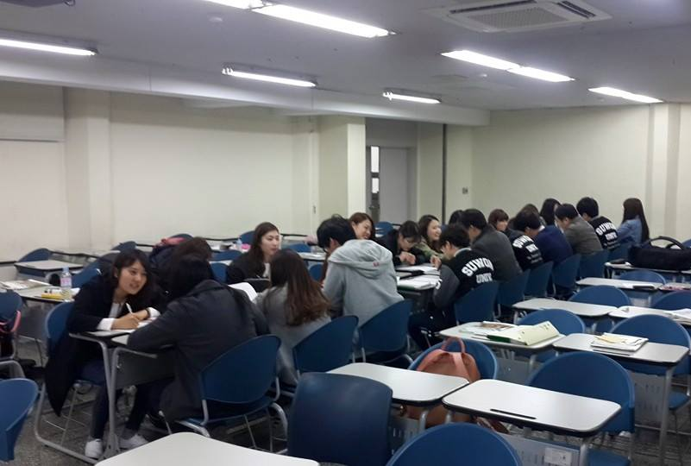
My 20 Year Career continued..

Slide 6
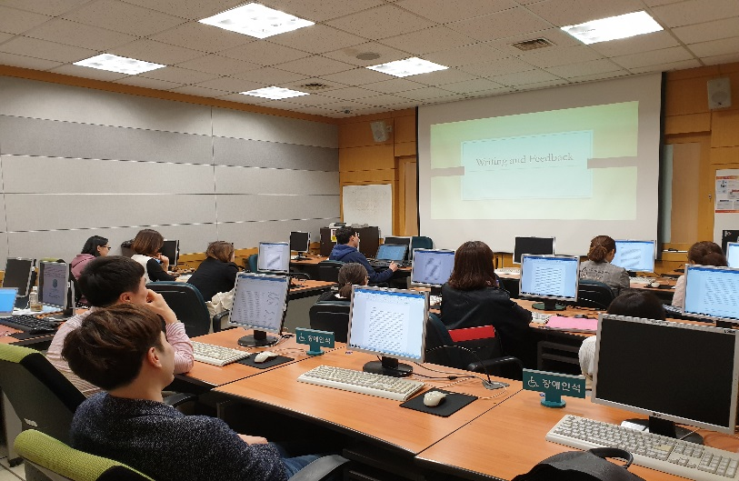
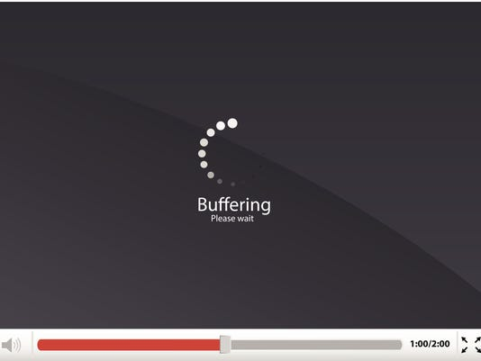
My 20 Year Career continued..

Slide 7
Additional Work
Darakwon Publishing (Author, Editor, Advisor)
Gang, Y.S., Kim, H.D., Whitehead, G., Goo, Y.S., Gwon, H.Y., Han, G., & Hong, G.M. (2018). Middle School English 1. Seoul, South Korea: Darakwon.
Gang, Y.S., Kim, H.D., Whitehead, G., Goo, Y.S., Gwon, H.Y., Han, G., & Hong, G.M. (2019). Middle School English 2. Seoul, South Korea: Darakwon.
Gang, Y.S., Kim, H.D., Whitehead, G., Goo, Y.S., Gwon, H.Y., Han, G., & Hong, G.M. (2019). Middle School English 3. Seoul, South Korea: Darakwon.
KSAT

Slide 8
Journal Publications
Whitehead, G. (in press). The makings of a language teacher. In W. Renandya, & F. Debora (Eds.), Inspirational Stories from English Language Classrooms. Malang, Indonesia: TEFLIN.
Whitehead, G., & Greenier, V. (2019). Beyond good teaching practices: Exploring learners' views of teacher leadership in English language classrooms. TESOL Quarterly.
Whitehead, G., Ramos, I., & Coates, A. (2019). Developing effective teacher talk: A critical self-examination of an ESP syllabus designed for in-service teachers. Journal of Asia TEFL. 16 (1), 178-199.
Hiver, P., & Whitehead, G. (2018). Sites of struggle: Classroom practice and the complex dynamic entanglement of language teacher agency and identity. System, 79, 70-80. doi: https://doi.org/10.1016/j.system.2018.04.015
Whitehead, G. (2017). Teachers’ voices: Obstacles to communicative language teaching in South Korea. Asian EFL Journal, 19(4), 5–31.
Whitehead, G. (2016). The rise and fall of the National English Ability Test: Examining Korean high school English teachers’ perspectives. Asian EFL Journal, 18(4). 124–155.
Greenier, V., & Whitehead, G. (2016). Towards a model of teacher leadership in ELT: Authentic leadership in classroom practice. RELC Journal, 47(1), 79–95. doi: 10.1177/0033688216631203.

Slide 9
Reviewing & Editing
Asian EFL Journal - Editor/ Reviewer
Asian ESP Journal – Editor/ Reviewer
System – Guest reviewer
Current Psychology – Guest reviewer
Journal of Multilingual and Multicultural Development – Guest reviewer

Slide 10
Ask George!

Slide 11
The course
This course is designed to: 1. introduce you to the key features of project-based learning.
2. push you to critically reflect on the practicality of PBL in your classroom.
3. experience PBL as learners and as teachers.
4.help you develop your own PBL lessons in connection with the content you are currently teaching.

Slide 12
Course Outline
Introduction to Project Based Learning
Key Aspects of PBL
PBL in the Korean Context
Evaluating PBL
Applying PBL

Slide 13
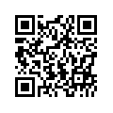
Additional Details and Information
Homepage: profgwhitehead.weebly.com

Slide 14
Useful Websites
www.bie.org
http://www.leadingpbl.org/w/page/24328306/PBL%20Gallery
https://21centuryedtech.wordpress.com/2013/09/15/the-pbl-super-highway-over-45-links-to-great-project-based-learning/
http://www.elltoolbox.com/pbl.html
http://www.mrsoshouse.com/pbl/pblin.html

