Slide 1
PROJECT BASED LEARNING
Introduction

Slide 2
Getting Ready
KWL (Know, Want to Know, Learn)
  What do you know about Project Based Learning (PBL)?
  What do you want to know about PBL?
Are there any specific questions you have about Project Based Learning (PBL)?

Slide 3
Some background on PBL
John Dewey initially promoted the idea of "learning by doing“
‘‘Doing projects’’ is a long-standing tradition in American education.
Hands on learning
Educational research has advanced this idea of teaching and learning into a methodology known as "project-based learning“.
PBL responds to the need for education to adapt to a changing world (21st century skills)

Slide 4

WARNING
Projects and PBL are not always the same.
PBL has specific guidelines.

Slide 5

21st Century Skills
In your opinions, what skills do you think are important to succeed in our world today?

Slide 6
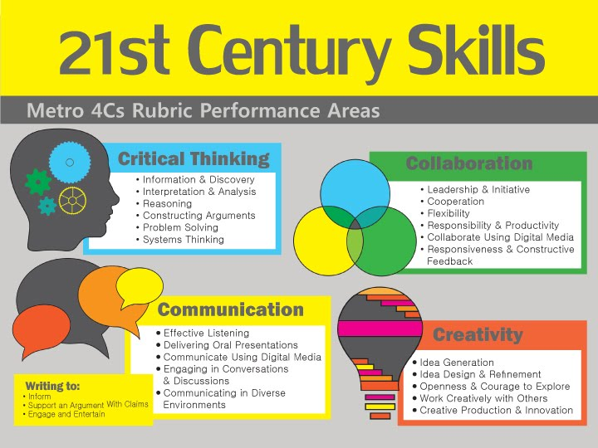

Slide 7
21st Century Skills
Critical thinking
Creativity
Collaboration
Communication
Information literacy
Media literacy
Technology literacy
Flexibility
Leadership
Initiative
Productivity
Social skills
https://www.aeseducation.com/career-readiness/what-are-21st-century-skills

Slide 8
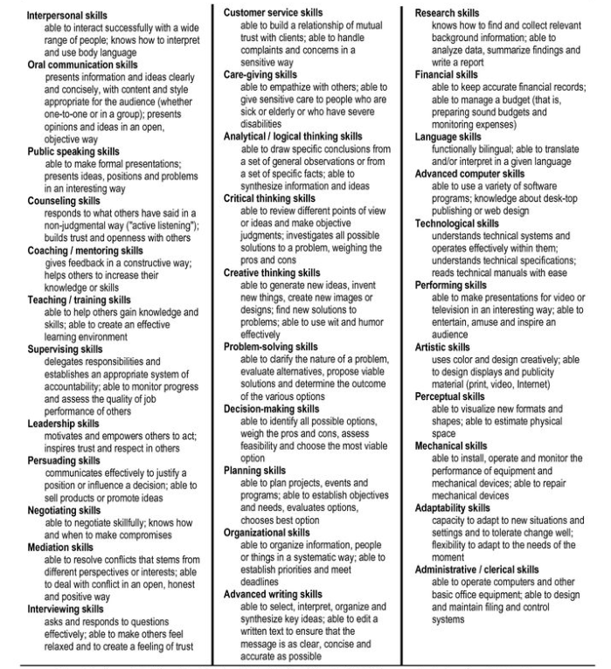
For a more comprehensive list
www.profgwhitehead.weebly.com

Slide 9
Project Based Learning

Slide 10
Original PBL Flow
1) Entry event ( Reading, Video, Story, Discussion, Pictures, etc.)
2) Teacher gives students a driving question (Kind of like a research question)
3) The students take time discussing the driving question and thinking about a project they can do
4) Each group chooses their own project
5) Students work on the project in groups
6) Students present their project
7) Students get feedback
8) Students present again

Slide 11
Driving Questions
Question | Targeted problem
In what ways… | Is the problem happening? Is the problem getting worse? the problem be made better? do A & B differ?
How…
Why…
What is contributing to… | the problem?
What is being done to resolve/ address…

Slide 12
PBL Story
A 10th grade group of students are preparing to send care packages to a local nursing home and senior community center.
The students are answering the question, “How can we help our community?” Early in the project, youth discussed what they thought this question means and ways to answer it.
They decided to create care packages because of recent news reports. Since then, they have interviewed elderly family members as to identify useful items, and they have done some internet searches to find what common supplies elderly individuals often need.
They will deliver the care packages and give hand-written letters to those at the nursing home.

Slide 13
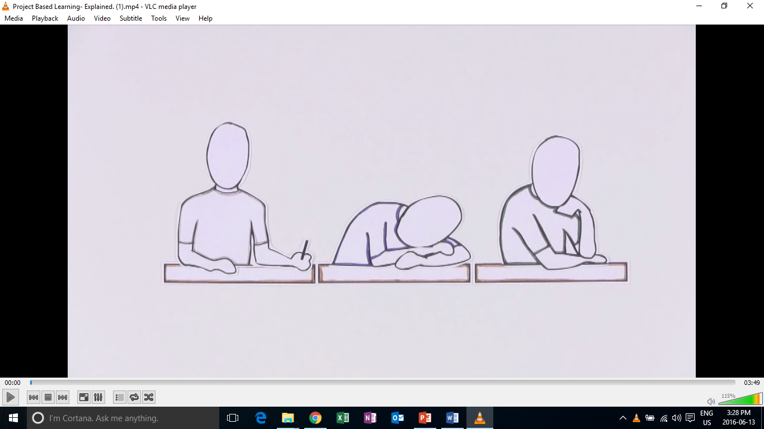
Introduction to PBL

Slide 14
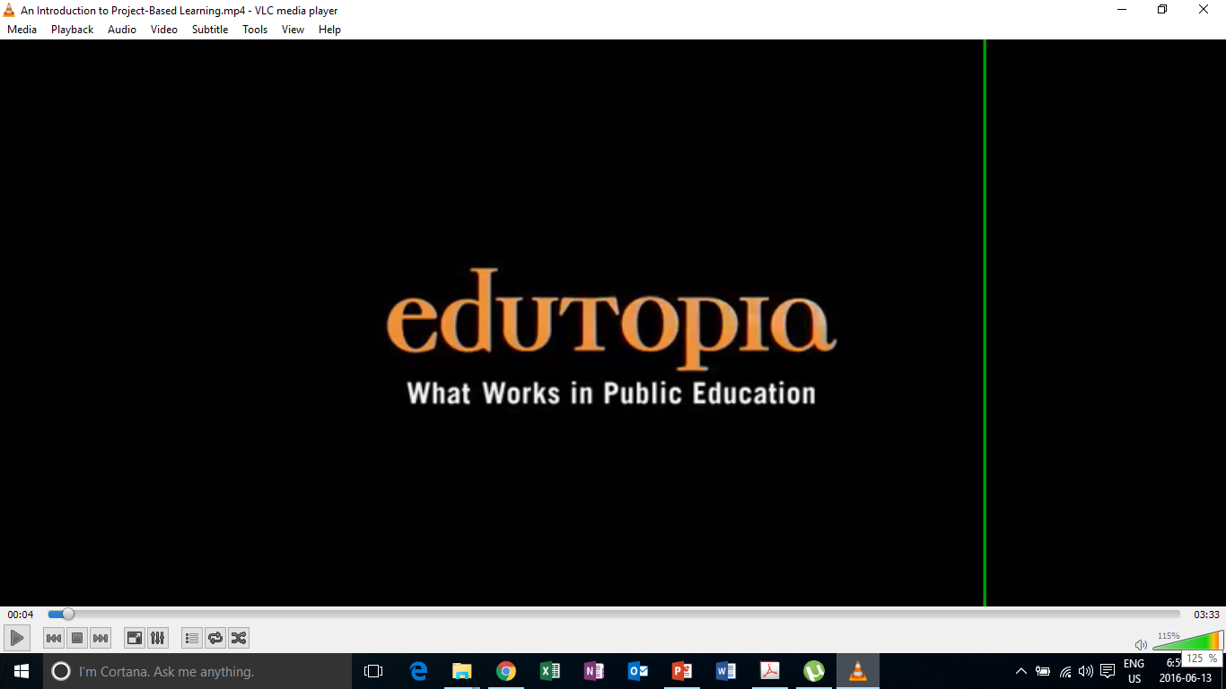
PBL in Action

Slide 15
Education in the 21st Century
The old-school model of passively learning facts and reciting them out of context is no longer sufficient to prepare students to survive in today's world.
Addressing real-world issues or problems requires that students have both fundamental skills (reading, writing, and math) and 21st century skills (teamwork, problem solving, research gathering, time management, information synthesizing, utilizing high tech tools).

Slide 16
What is project based learning?
Project-based learning if founded in the beliefs that students learn best by experiencing and dealing with real-world issues that are meaningful to them .
"One of the major advantages of project work is that it makes school more like real life. It's an in-depth investigation of a real-world topic worthy of children's attention and effort.“
-EDUCATION RESEARCHER SYLVIA CHARD

Slide 17
What does PBL involve?
students focus on real-world meaningful issues and problem solving
researching things on their own
skills that transfer outside of the classroom ( i.e. Critical thinking, Collaboration, Cooperation, Creativity)
increased student control over his or her learning
teachers serving as coaches and facilitators of inquiry and reflection
students working in pairs or groups
(Barron & Darling-Hammond, 2008; Thomas, 2000)

Slide 18
Research Findings
PBL vs. Traditional instruction
  PBL increases long-term retention of content, helps students perform as well as or better than traditional learners in high-stakes tests, improves problem-solving and collaboration skills, and improves students' attitudes towards learning (Strobel & van Barneveld, 2009; Walker & Leary, 2009).
  Schools where PBL is practiced find a decline in absenteeism, an increase in cooperative learning skills, and improvement in student achievement. When technology is used to promote critical thinking and communication, these benefits are enhanced.

Slide 19
Project Based Learning
PBL experience

Slide 20
Topic (English Education)
Real-world problems
  Many students are demotivated to learn English
  Many students still have low proficiency even after many years of study.

Slide 21
Driving questions
What can teachers do to motivate learners and at the same time foster language proficiency?

Slide 22
Project design questions
What can students do/ create/ design to address some of the issues in the current education system?

Slide 23
Reflection
Positive and negative points of PBL?
Challenges you face?
Additional questions?

Slide 24
Revised PBL
Borrowing principles

Slide 25
Original PBL Flow
1) Entry event ( Reading, Video, Story, Discussion, Pictures, etc.)
2) Teacher gives students a driving question (Kind of like a research question)
3) The students take time discussing the driving question and thinking about a project they can do
4) Each group chooses their own project
5) Students work on the project in groups
6) Students present their project
7) Students get feedback
8) Students present again

Slide 26
PBL Lesson Example
Students watch a video, read, or see pictures about global warming.
Teacher discusses the topic with students
Teacher puts the driving question on the board “ What daily actions of humans are contributing most to global warming?” (students discuss & research)
Teacher then asks students to think about “ what can your group do to raise other students’ awareness of this trash issue?”
Some groups choose a video, some choose a poster, one groups chooses brochure
They create it
They present/share it
They get feedback and revise
Present again

Slide 27
The InSipp flow
3 to 6 hours
Introduce the topic
  Generate interest
  Activate background knowledge
  Make the topic relevant and relatable to students
Survey activity (4-3-2)
Input of content and/or language
Project based on the topic
Presentation of the project

Slide 28
General Revised PBL Framework
Entry event (pictures, video, listening, reading, etc.)
  Discussion of the topic & problem that will be focused on
  Relate/ connect to students lives
Teacher provides input about the topic or issue
Teacher gives the students a project to do related to the issues discussed
Students work on the project in groups
Students present the project

Slide 29
Revised PBL Walkthrough

Slide 30
Teacher’s job - Walkthrough
TOPIC: Technology
What is a problem or issue related to the topic that is relevant and relatable to my students?
What kind of project can students do to address the problem?
How will they present it?
How will it be assessed?

Slide 31
Project ideas
Design
a new product
a new way of doing something
a better something (menu, phone, etc.)
Make/ Create
a plan/ schedule
a poster
a storybook
a brochure
an advertisement
a video
a play/ drama
Build
a model
a structure
Write
a letter
a poem
a short story
a speech
an essay
Prepare
To debate
To be a panel member
To teach a lesson
To counsel others
A photo essay
Conduct
A mini research project
`

Slide 32
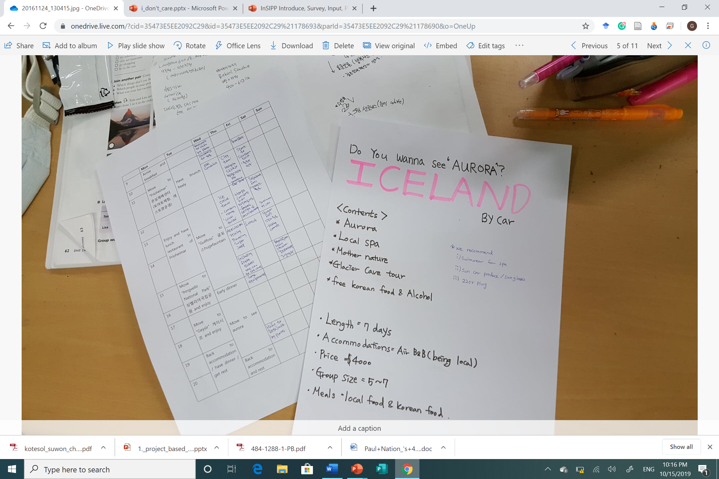
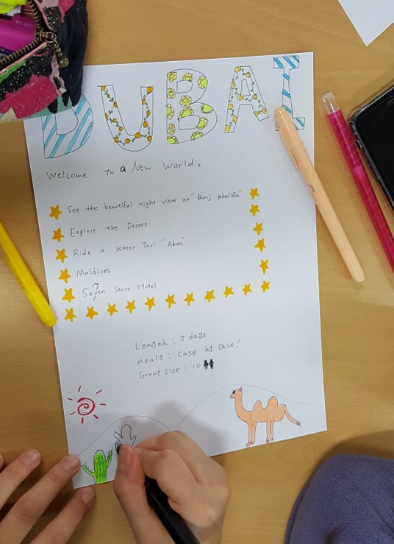
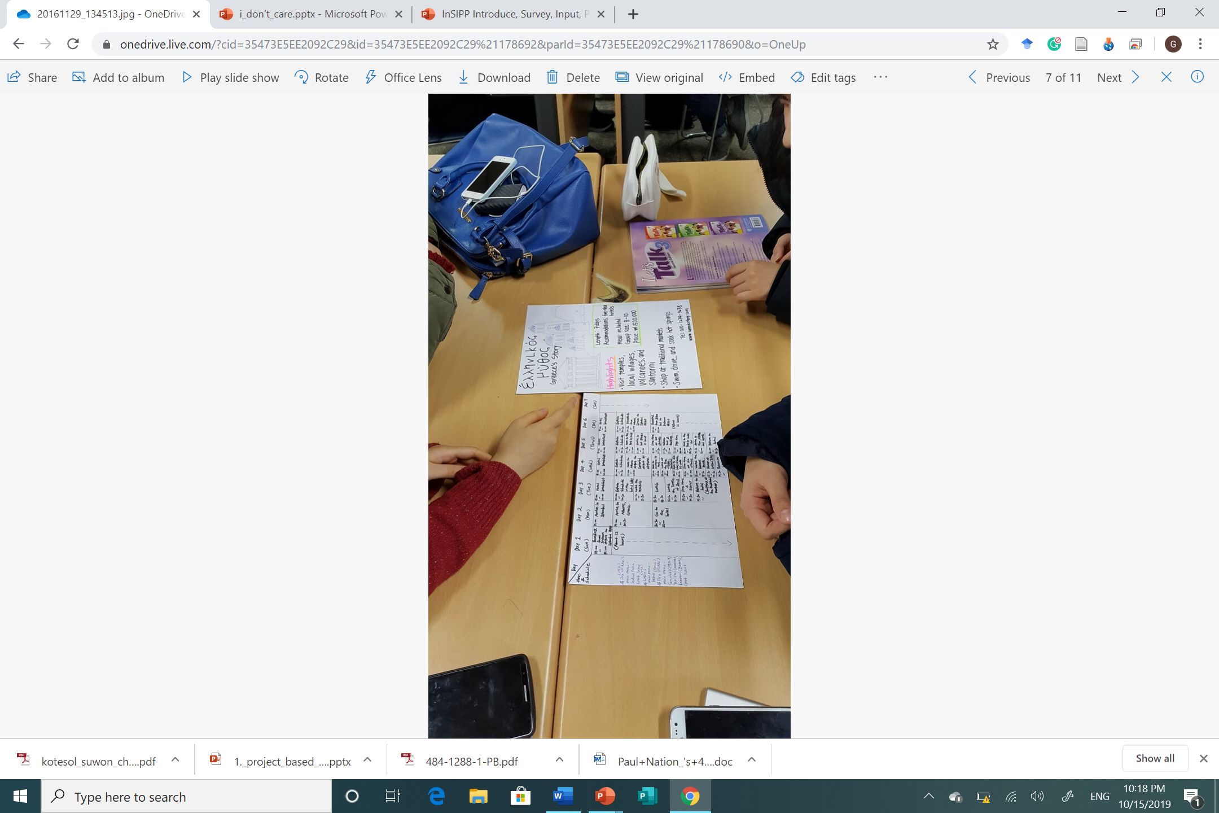

Slide 33
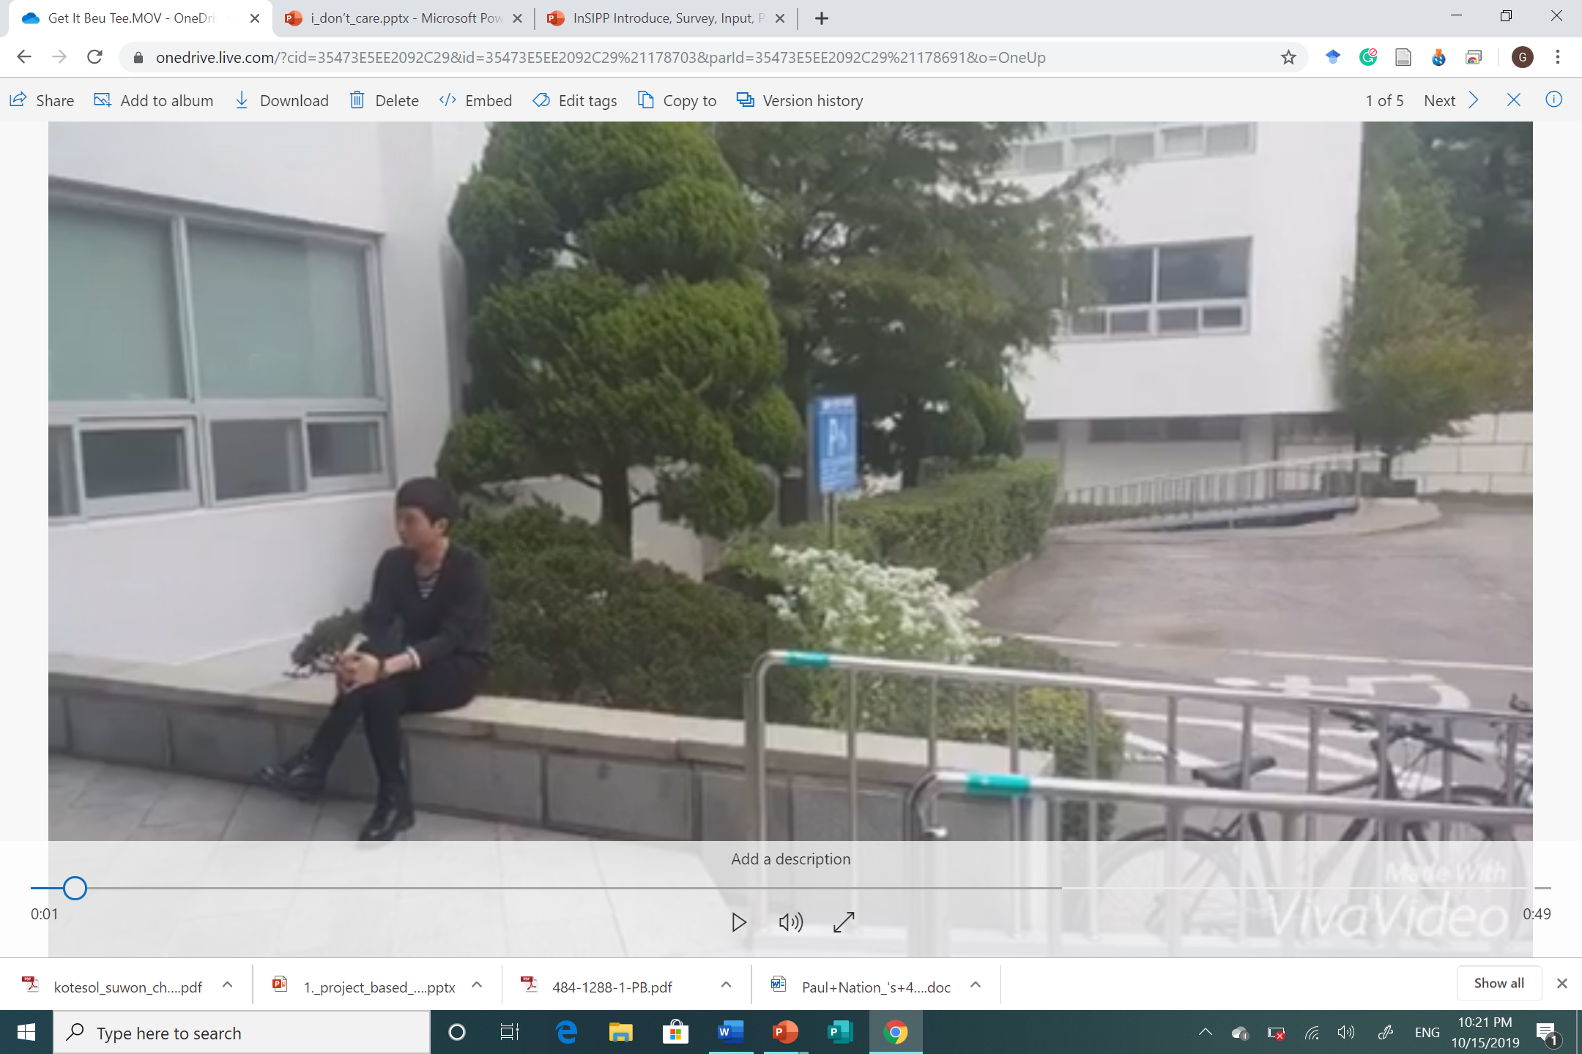
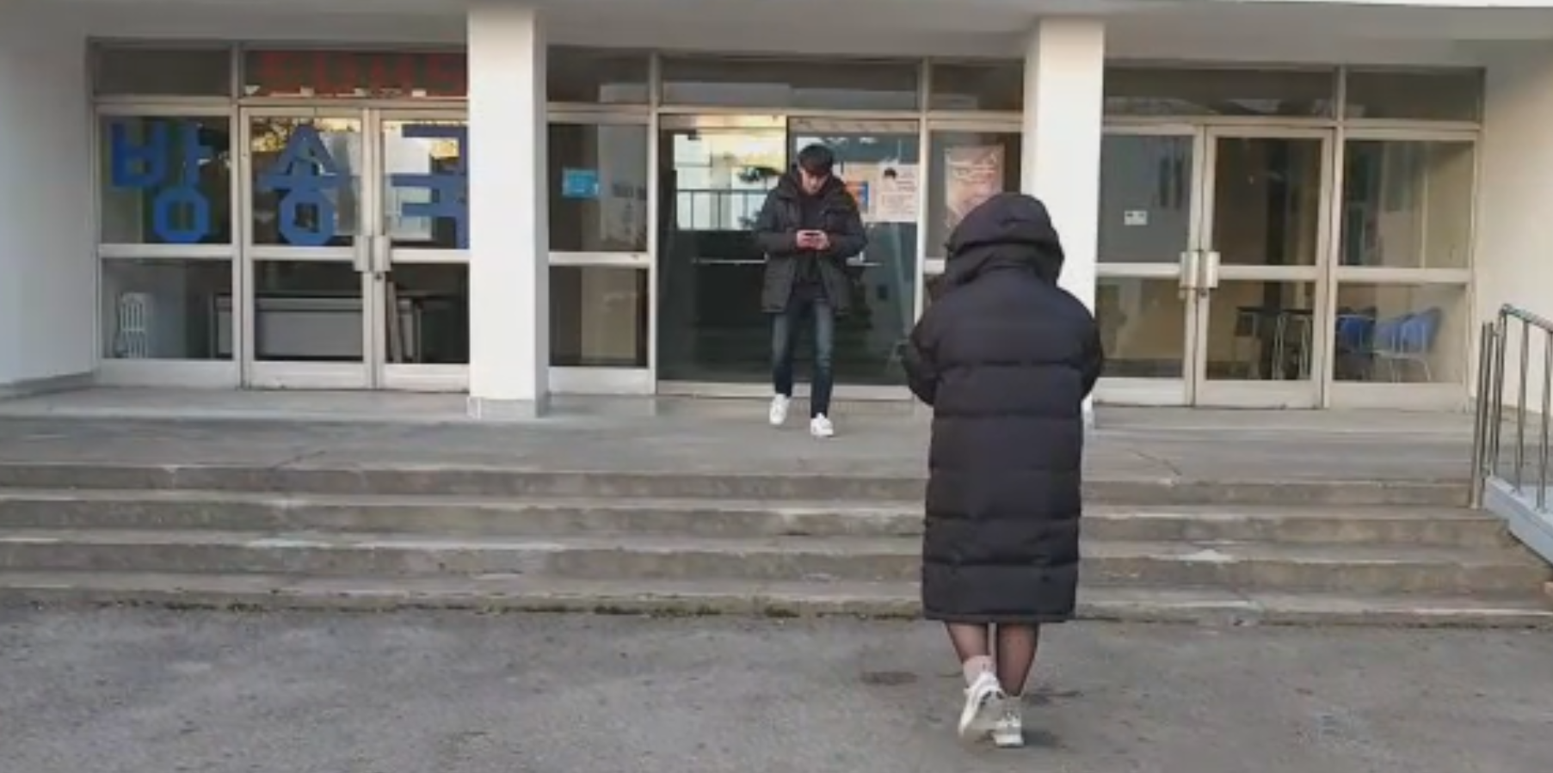
Student created videos (UCC)

Slide 34
How will it be presented?
As a presentation in front of the class
A performance
As a video
Group to group
Roundtable
Panel
Jigsaw
Gallery walk
Rotation fair (my favorite)
TIP:(graphic organizer for audience)

Slide 35
General Topics from Textbooks
What are some general topics of themes that you cover in your classes or that are in the textbooks you use?

Slide 36
Food
Travel
Health & Beauty
Other?
What is a problem or issue related to the topic that is relevant and relatable to my students?
What kind of project can students do to address the problem?
How will they present it?
How will it be assessed?
TIP:
Think about issues in your school, community, current events, student’s lives and interests.

Slide 37
Assessment in PBL Lessons

Slide 38
Performative
This assessment measures how well students apply their knowledge, skills, and abilities to authentic problems.

Slide 39
When to assess…
The process
The product
The presentation
As a whole

Slide 40
Analytic Vs. Holistic Rubrics
Analytic rubrics list the criteria for an assignment and describe these criteria in varying levels of quality.
A holistic rubric describes the attributes of each grade or level. It gives an overall score rather than breaking things down and scoring each criteria.
  Most student work will likely fit into more than one category for different criteria. The scorer must choose the grade that best fits the student performance.

Slide 41
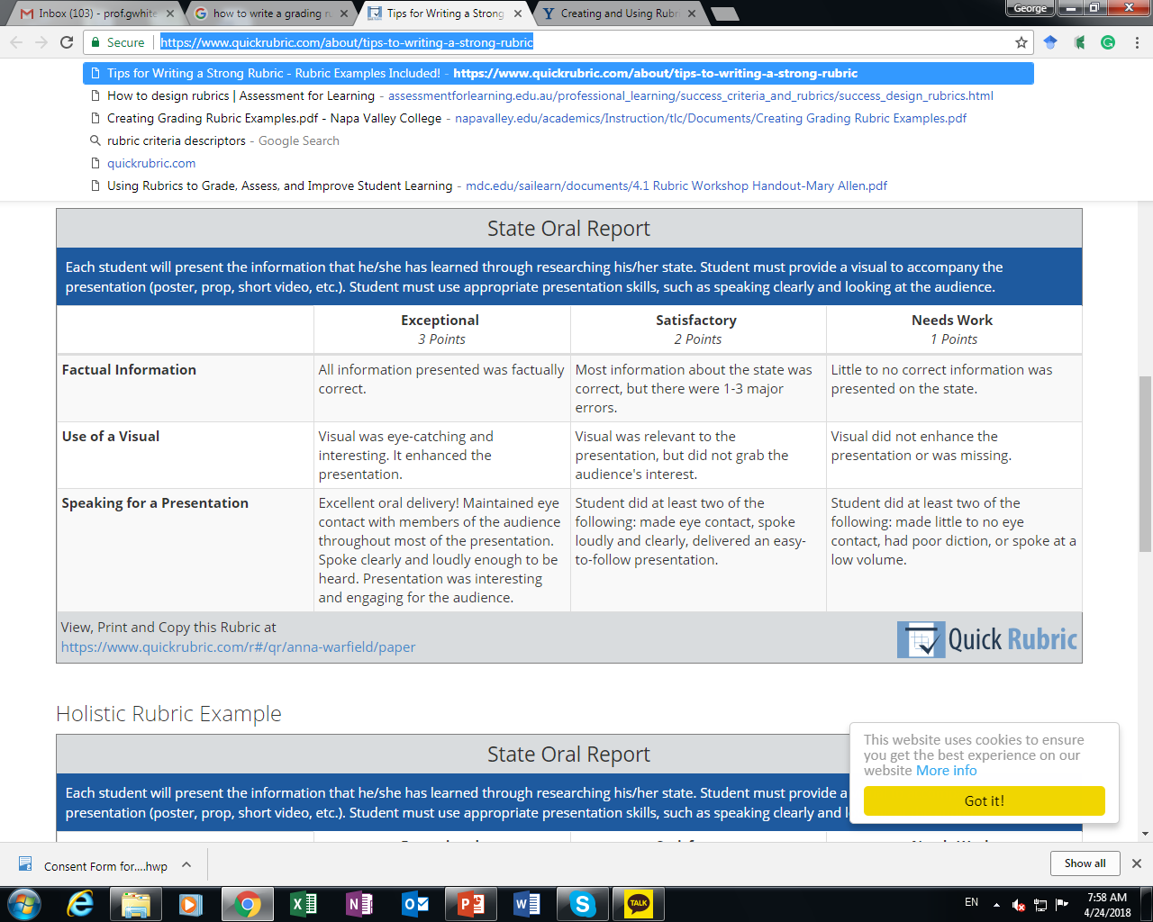
Analytic Rubric Sample

Slide 42
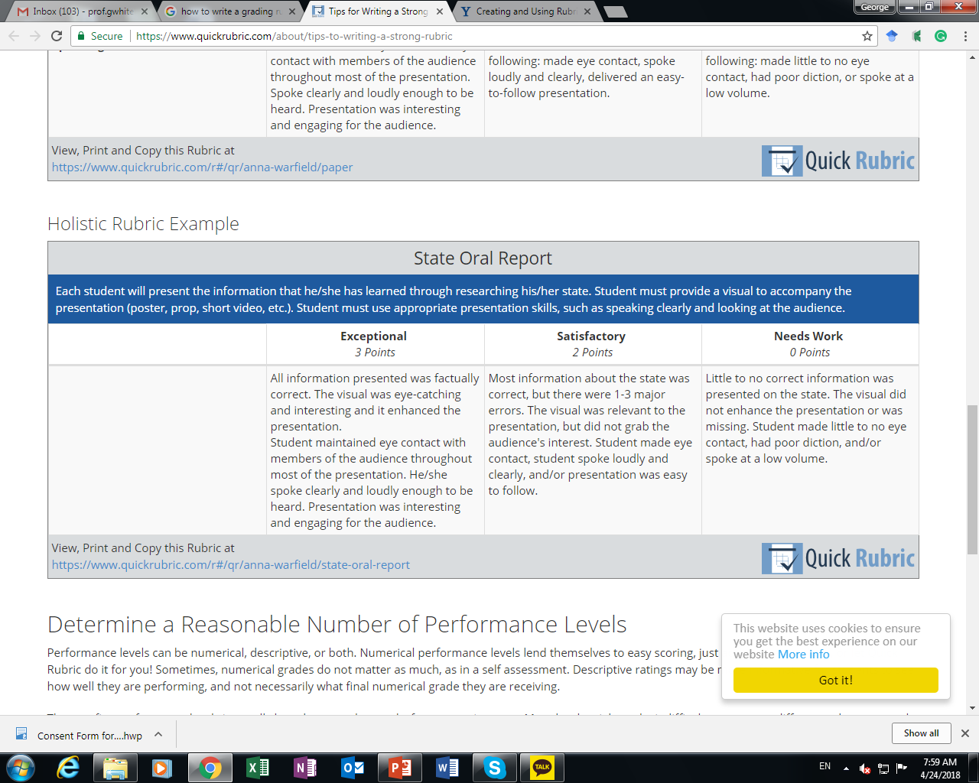
Holistic Rubric Sample

Slide 43
When to assess…
During the process?
  What can be assessed?
The product?
  What can be assessed?
The presentation
  What can be assessed?

Slide 44
What can be assessed?
In the process
  Collaboration
  Participation
  Use of L2
The product
  Language accuracy
  Organization
  Design
  Creativity
  Overall quality
The presentation
  Comprehensibility
  Accuracy
  Organization/Flow

Slide 45
Blank Rubric
Criteria | 4 | 3 | 2 | 1 | Student’s Score

Slide 46
Wording
Always
Often
Sometimes
Rarely
Never
Above expectations/ requirements
Meets expectations/ requirements
Does not meet expectations/ requirements
Excellent
Very good
Satisfactory
Less than satisfactory
Exceptional
Satisfactory
Needs work
High level
Satisfactory level
Low level
Less than/ more than x number of something

Slide 47
5 | 4 | 3 | 2 | 1
Always | Often | Sometimes | Rarely | Never
Above |  | Meets |  | Does not meet
Excellent | Very good | Satisfactory | Less than satisfactory | Poor
Exceptional |  | Satisfactory |  | Needs work
High level |  | Satisfactory level |  | Low level
Less that 3 mistakes |  | 3-5 mistakes |  | More than 5 mistakes
More than 5 times |  | 3-5 times |  | Less than 3 times

Slide 48
Keys to Successful Projects

Slide 49

Key 1: Meaningful projects
Many students find schoolwork meaningless because they don’t perceive a need to know what they’re being taught. Students must perceive the work as personally meaningful. (Relevant, Relatable, Interesting)

Slide 50
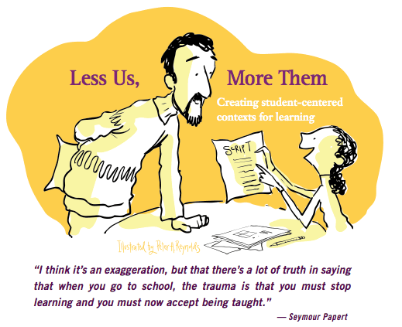
Key 2: Student-centered
Don’t be over controlling
Let students work things out by themselves. (planning, finding information, etc.)
From guide to Facilitator

Slide 51

Key 3: Time (Enough but not too much)
It is important to give students enough time to generate and share their ideas with one another. However, without any time constraints learners may have a hard time getting things done. Monitor time closely and adjust the time as needed by learners.

Slide 52

Key 4: Sharing
When students know that the work they are creating in a project will be shared they usually put more effort into things as their pride is at stake. Projects can be shared in may different ways, varying the ways in which projects are shared can add diversity to the process.

Slide 53
Sample Projects

Slide 54
Critical Thinking
UNIT: The Community
  1. Choose a name for your city (in groups of 4)
  2. Make a list of important places in the city and put them in alphabetical order
  3. Make a map of your city and mark where the important places are

Slide 55
Critical Thinking
UNIT: Jobs
  1. Each group will get a job card
  2. Individually make a job advertisement for that job
  3. You should include a job description , salary (based on real world information )and the types of people you want to recruit.
  4. Share your job advertisement individually in front of the class

Slide 56
Project
Designing projects for your classrooms

Slide 57
Project
With your group choose 2 chapters from a public-school textbook of your choice. Create a project for the chapters following PBL guidelines. Think about:
  What is a problem or issue related to the topic that is relevant and relatable to my students?
  What kind of project can students do to address the problem?
  How will they present it?
  How will it be assessed?
You will share your PBL lessons in a PBL fair and receive comments and feedback from your peers and professor

Slide 58
Things to ask yourself
Is the problem/ issue you are presenting relevant, relatable, and interesting to the students?
  How can you make them feel personally connected to the issue are presenting?
Are students going to be interested in the project you have selected?
How long will each stage of the lesson take?
How long will you give them to complete the project?

Slide 59
Project
With your group choose 2 chapters from a public-school textbook of your choice. Create a project for the chapters following PBL guidelines. Think about:
  What is a problem or issue related to the topic that is relevant and relatable to my students?
  What kind of project can students do to address the problem?
  How will they present it?
  How will it be assessed?
You will share your PBL lessons in a PBL fair and receive comments and feedback from your peers and professor

Slide 60
Project ideas
Design
a new product
a new way of doing something
a better something (menu, phone, etc.)
Make/ Create
a plan/ schedule
a poster
a storybook
a brochure
an advertisement
a video
a play/ drama
Build
a model
a structure
Write
a letter
a poem
a short story
a speech
an essay
Prepare
To debate
To be a panel member
To teach a lesson
To counsel others
A photo essay
Conduct
A mini research project
`

Slide 61
How will it be presented?
As a presentation in front of the class
A performance
As a video
Group to group
Roundtable
Panel
Jigsaw
Gallery walk
Rotation fair (my favorite)
TIP:(graphic organizer for audience)

Slide 62
What can be assessed?
In the process
  Collaboration
  Participation
  Use of L2
The product
  Language accuracy
  Organization
  Design
  Creativity
  Overall quality
The presentation
  Comprehensibility
  Accuracy
  Organization/Flow

Slide 63
Project Fair
Presentations and feedback

Slide 64
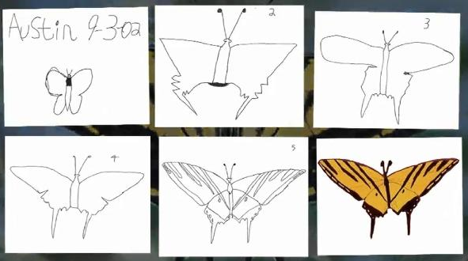
Austin’s Butterfly

Slide 65
Revisions
Reflecting on your project
Redrafting your original design
Refining your project
Building Excellence in Student Work (Austin’s Butterfly)

Slide 66
Final Reflection
Practicality of implementation

Slide 67
Reflection
How can teachers implement PBL in English language classrooms in South Korea?
  How practical do you think PBL is in the Korean context (very practical, somewhat practical, not practical)? Why?
  What are some of the possible difficulties with using PBL in your classroom?
  How could these difficulties be resolved?

Slide 68
Thank you and good luck!
Professor George E.K. Whitehead
  Dept. of ELT Chair
  Hankuk University of Foreign Studies (Graduate School of TESOL)
  http://tesolgs.hufs.ac.kr/
Email: gekw@hufs.ac.kr
Facebook group: https://www.facebook.com/groups/ELEsouthkorea
Homepage: profgwhitehead.weebly.com

Slide 69
Useful Websites
www.bie.org
http://www.leadingpbl.org/w/page/24328306/PBL%20Gallery
https://21centuryedtech.wordpress.com/2013/09/15/the-pbl-super-highway-over-45-links-to-great-project-based-learning/
http://www.elltoolbox.com/pbl.html
http://www.mrsoshouse.com/pbl/pblin.html

