Slide 1
Social Media for your Career
Linked-in

Slide 2
Resume vs. CV
What is the difference between a resume and a CV?

Slide 3
Summary

Slide 4
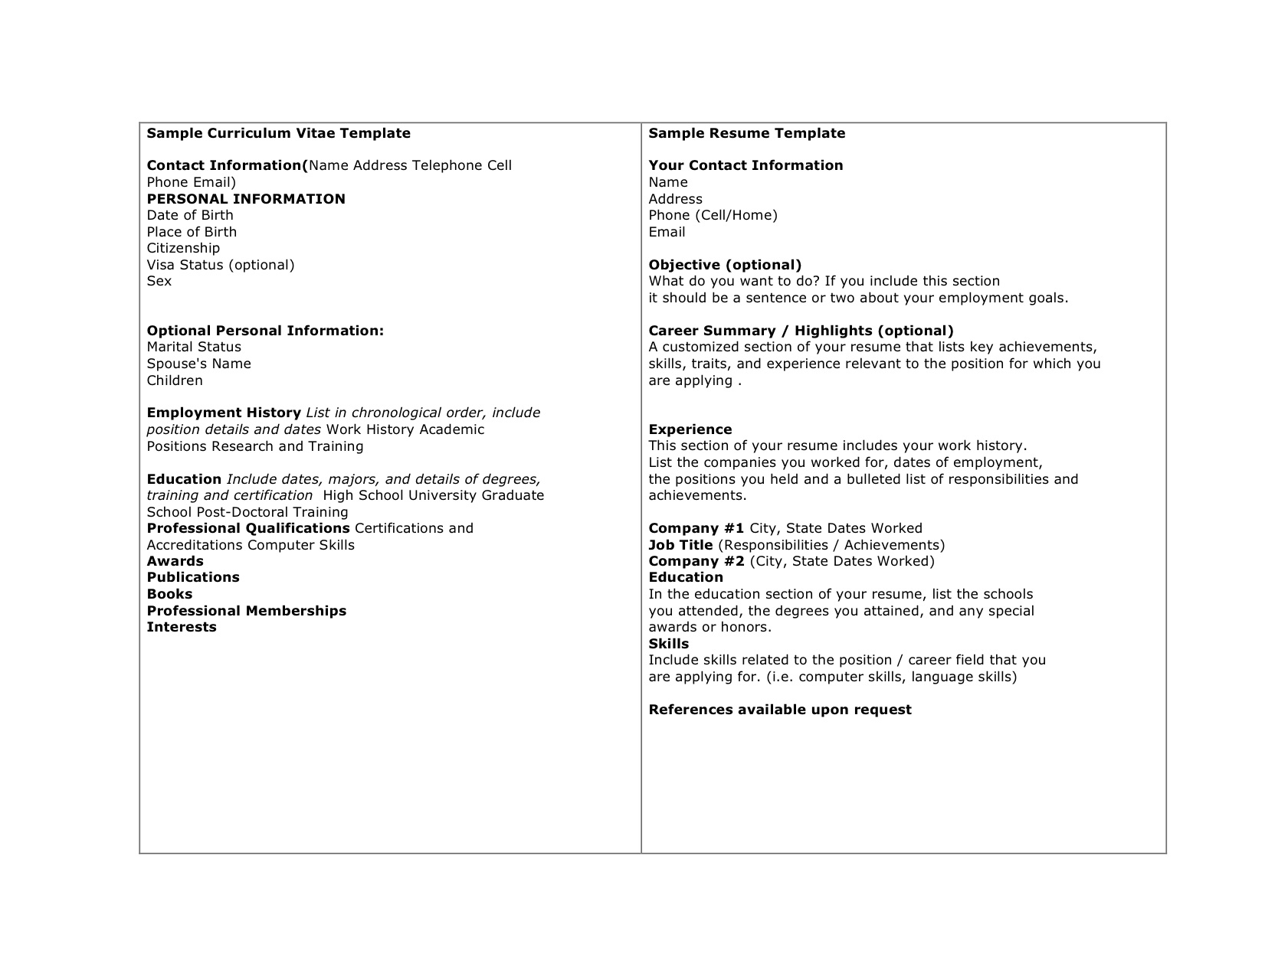
Examples

Slide 5
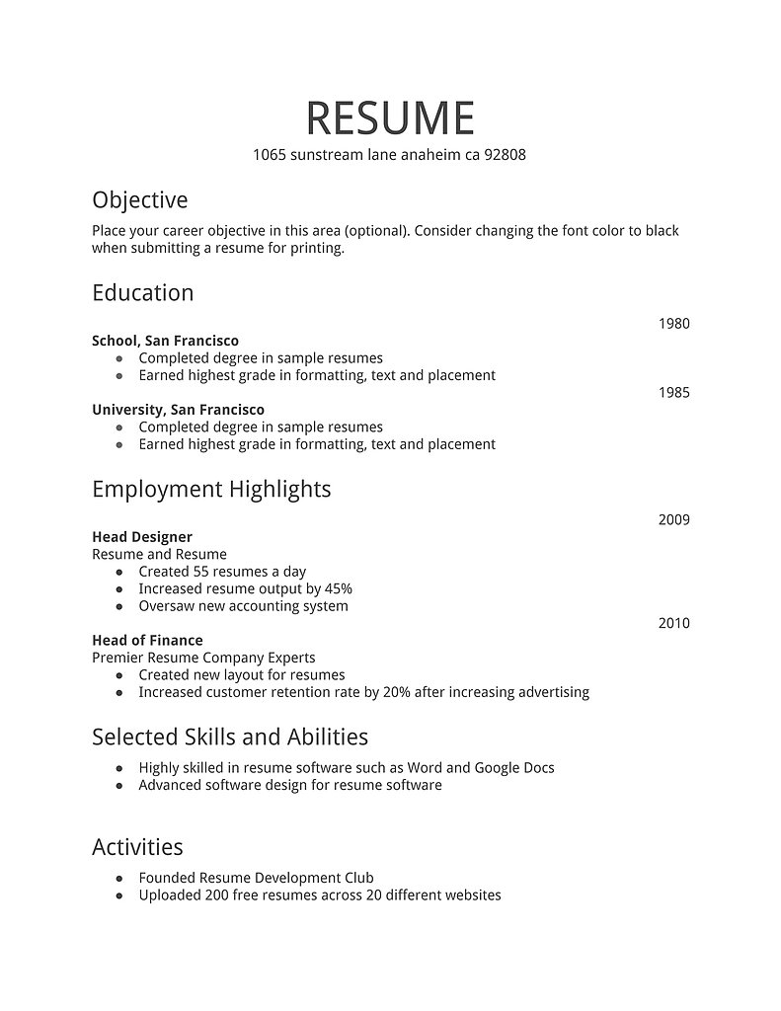

Slide 6
George’s CV sample

Slide 7
Creating a Resume/ CV
www.cvmkr.com
https://templates.office.com/en-CA/TM00002110?auth=1
http://www.gotresumebuilder.com

Slide 8
Linkedin

Slide 9
Cover Letter
What is a cover letter?
Why is it important?

Slide 10
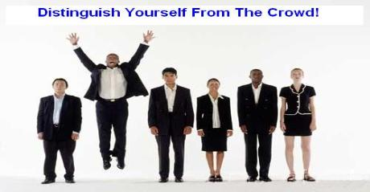
WHY A COVER LETTER?
A well-written
cover letter distinguishes
your application.

Slide 11
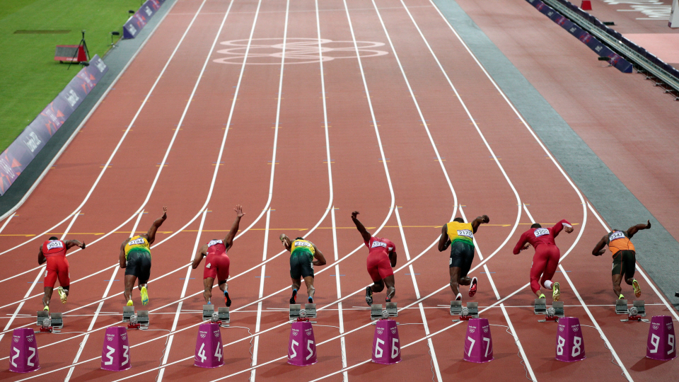
J O B
The Basics to
start you off
No more than 1 page
Standard fonts, size between 10-14, single spaced
Print on Quality paper either white or off white
Make a pdf. if emailing to avoid track changes showing up
Strive for neatness and personality

Slide 12
USE KEYWORDS
from the job description in your
Cover Letter and Resume
Some skill keywords include: wrote, planned, programmed, designed, provided, created, built, enabled, taught and trained.
Some results oriented keywords include: increased, reduced, redesigned, upgraded, initiated, implemented, generated and produced.
Some recognition related keywords include: honored, awarded, promoted, selected, lauded for, recognized, chosen and credited.

Slide 13
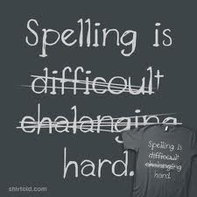
Do’s and Don’ts of writing a cover letter
DON’T SEND
A Cover letter with errors
DO CHECK
Grammar & spelling

Slide 14
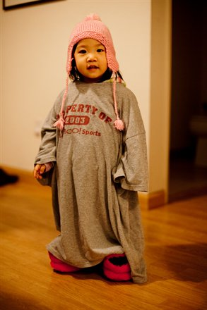
DON’T SEND A Generic cover letter This is not one size fits all!! DO MENTION The Job you are applying for Skills, Experiences and Qualities that would best let you STAND OUT at this job.

Slide 15
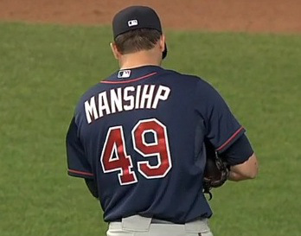
DON’T SEND A letter with the incorrect contact
Or company
DO Address it to the right person
Make sure you use the right company name

Slide 16
DON’T USE
Informal greetings
Ex, Hey, What’s up? DO USE
Dear Human Resources Manager
or a woman as Ms. not Mrs.
Or
Dear Sir or Madam

Slide 17
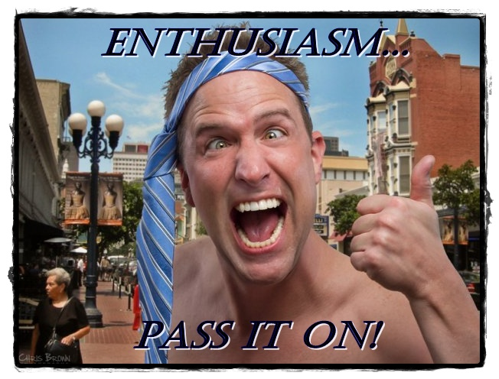
DON’T Have it too short or too long Too short = No Enthusiasm Too long = Over bearing DO No longer than 3 to 5 paragraphs and no more than 6 lines in each one.

Slide 18
SAMPLE
First Name Last Name Address City, State, Zip Code Phone Number Cell Phone Number Email
Name or
Title or Human Resource Manager Company Address City, State, Zip Code
Date
Dear Hiring Manager, or Ms. Smith
I am interested in the summer position at Super Store advertised in The Huntsville Times.
I have excellent communication skills and an aptitude for customer service. My past experience as a volunteer at Huntsville Hospital made it necessary for me to focus on providing quality customer service, and also enabled me to work with all types of people.
I believe that my communication skills, customer service abilities, and positive work ethic would make me an asset to your store.
Thank you for your consideration. I can be reached at email address or 256-222-2222. I look forward to hearing from you soon.
Sincerely,
Your Signature Your Typed Name
Your Contact Info
Employer Contact
Information
Date
Greeting
Introduction
What you offer them
What happens now
and close

Slide 19
THINGS TO REMEMBER
Cover Letters are Important
Include Keywords
Follow the Do’s and Don’ts for Cover Letter Content

Slide 20
http://www.youthcentral.vic.gov.au/jobs-careers/applying-for-jobs/cover-letter-no-work-experience
http://www.totaljobs.com/careers-advice/cv-and-cover-letter/cover-letter-examples-graduate

