Slide 1
Social Media for your Career
Linked-in

Slide 2
Resume vs. CV
What is the difference between a resume and a CV?

Slide 3
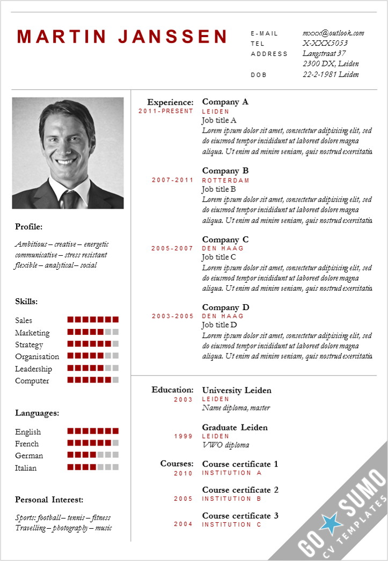
Resume
Resume is a French word meaning “summary”
It is a summary of a person’s education, skills, and work experience
It is usually 1 page long and maximum 2 pages

Slide 4
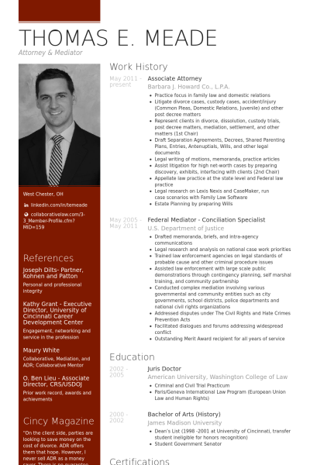
C.V. – Curriculum Vitae
Curriculum Vitae is Latin for “course of life.”
It is more detailed than a resume
Often more than 2 pages
Outlines everything the applicant has done or achieved

Slide 5
George’s CV sample
http://profgwhitehead.weebly.com/uploads/4/7/9/3/47931813/george_whitehead_cv.pdf

Slide 6
Creating a Resume/ CV
https://novoresume.com/
www.cvmkr.com

Slide 8
Cover Letter
What is a cover letter?
Why is it important?

Slide 10
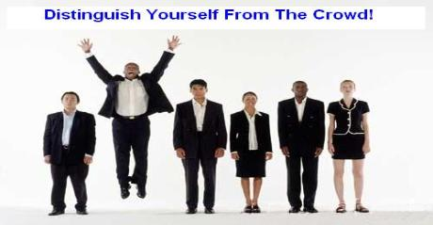
Purpose of a cover letter
Helps you to stand out from other applicants
Allows you to explain why they should consider you for the position
Why you would be a good choice
Outlines your skills and abilities

Slide 11
Basics
No more than 1 page
Times Roman Font, 12 pt., single spaced
Make a pdf. if emailing to avoid others modifying it
Strive for neatness and showing your personality

Slide 12
Use Key Words
Some skill keywords include: wrote, planned, programmed, designed, provided, created, built, enabled, taught and trained.
Some results oriented keywords include: increased, reduced, redesigned, upgraded, initiated, implemented, generated and produced.
Some recognition related keywords include: honored, awarded, promoted, selected, lauded for, recognized, chosen and credited.

Slide 13
Checklist
Did you check it for errors?
Did you mention skills and qualities that will make you stand out?
Did you use formal language? Dear ________ Sincerely, __________

Slide 14
SAMPLE
First Name Last Name Address City, State, Zip Code Phone Number Cell Phone Number Email
Name or
Title or Human Resource Manager Company Address City, State, Zip Code
Date
Dear Hiring Manager, or Ms. Smith
I am interested in the summer position at Super Store advertised in The Huntsville Times.
I have excellent communication skills and an aptitude for customer service. My past experience as a volunteer at Huntsville Hospital made it necessary for me to focus on providing quality customer service, and also enabled me to work with all types of people.
I believe that my communication skills, customer service abilities, and positive work ethic would make me an asset to your store.
Thank you for your consideration. I can be reached at email address or 256-222-2222. I look forward to hearing from you soon.
Sincerely,
Your Signature Your Typed Name
Your Contact Info
Employer Contact
Information
Date
Greeting
Introduction
What you offer them
What happens now
and close

Slide 15
https://www.cover-letter-now.com/
http://www.youthcentral.vic.gov.au/jobs-careers/applying-for-jobs/cover-letter-no-work-experience
http://www.totaljobs.com/careers-advice/cv-and-cover-letter/cover-letter-examples-graduate

