Slide 1
Presenting and discussing findings

Slide 2
Thesis Chapters
Chapter 1 - Introduction
Chapter 2 – Literature Review
Chapter 3 – Research Methodology and Design
Chapter 4 – Findings
Chapter 5 – Discussion
Chapter 6 – Conclusion
References
Appendices

Slide 3
findings

Slide 4
Findings
Presents what was found in your data analysis in relation to your research questions
States the facts
Does not include your opinion or interpretation

Slide 5
How to write up the findings
Summarize the main findings
Illustrate them with figures, graphs, and tables when possible
Describe each of the main findings, guiding the reader through the observations that are most relevant and important to answering your research questions.

Slide 6
Quantitative vs. qualitative

Slide 7
Quantitative vs. qualitative
Quantitative studies will present numbers and results of statistical tests in the findings sections
Qualitative studies will present excerpts from the data ( quotes from interviews, excerpts from written responses etc.)

Slide 8
Tip
Present the findings in order of your research questions.
Example:
RQ 1: In what ways do learners see language teachers as leaders?
RQ 2: From learners' vantage point, what specific (personal and pedagogical) features and characteristics contribute to good language teacher leadership?

Slide 9
Quantitative results

Slide 10
Types of quantitative studies
Descriptive - ( percentage, mean, median, mode, frequency, range)
Correlation – ( relationship between variables)
Experimental – ( controlling variables, cause and effect, treatment result)

Slide 11
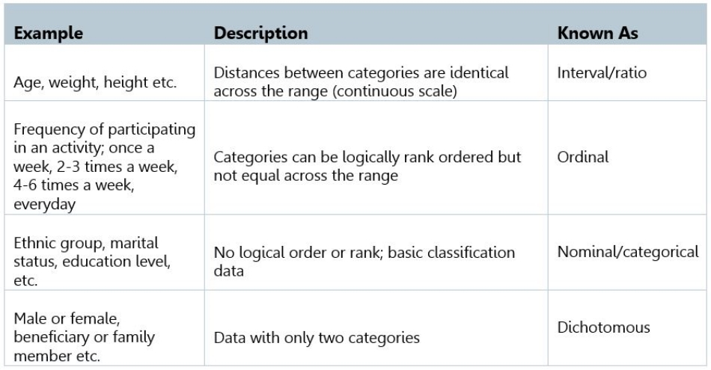
Types of quantitative data

Slide 12
Quantitative Example
Example
You issued questionnaires to 200 working adults. 93 adults said they were most unhappy because they did not have much savings. 54 said they were worried about the economy, 46 said they were dissatisfied with their jobs, and 42 said they did not have work-life balance. 12 said they were unhappy with the government.
The Data:
93 = 46.5%; 54 = 27%; 46 = 23%; 42 = 21%
Findings/ Results
Most of the respondents (46.5%) said they were most unhappy because they did not save as much as they should. Also, 27% of them said they were most unhappy because they were worried about the economy, 23% were dissatisfied with their jobs, while 21% said did not have work-life balance. In addition, a minority (6%) said they were most unhappy because of the government.

Slide 13
Presenting findings visually

Slide 14
When to use what
Text | Tables | Chart
Use when your key findings include only a few data points. | Use when your key findings lie in structured numeric information (more than three or four numbers) | Use when your key points lie in the relationships between numbers -- demonstrating trends or making comparisons.

Slide 15
tables

Slide 16
Simple table Example
During your English classes, how much of your speaking is in English on average?

Slide 17
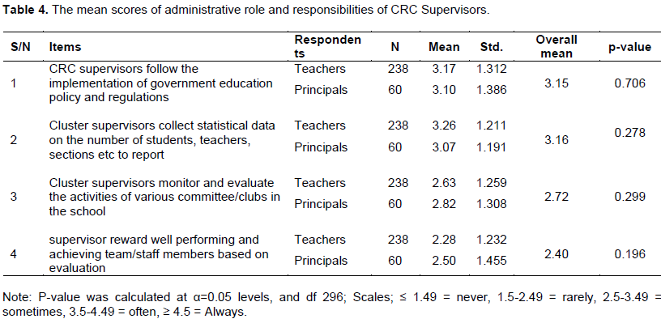
A more advanced table

Slide 18
charts

Slide 19
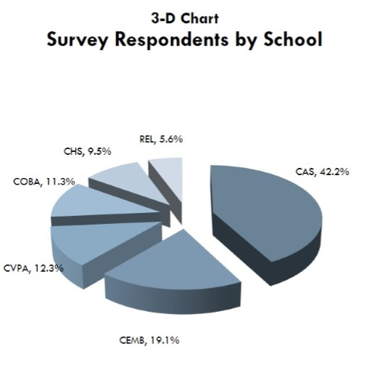
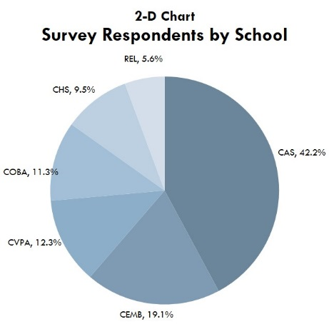
Pie Chart
Pie Charts work best for general findings (rather than nuanced differences) and are best understood with no more than five or six slices. They can only be used to show parts of a whole (if all parts total 100%).

Slide 20
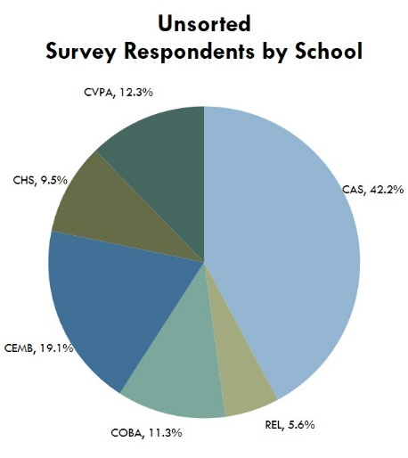
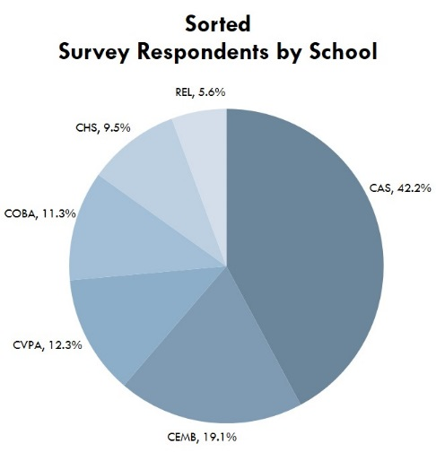
Pie chart tips
As with other graphics, remember to sort your data before finalizing and stay away from 3-D formats.
Dark to light hues of the same color communicate more clearly than a variety of colors.
Always include labels or a legend as well as percentages for each slice.

Slide 21
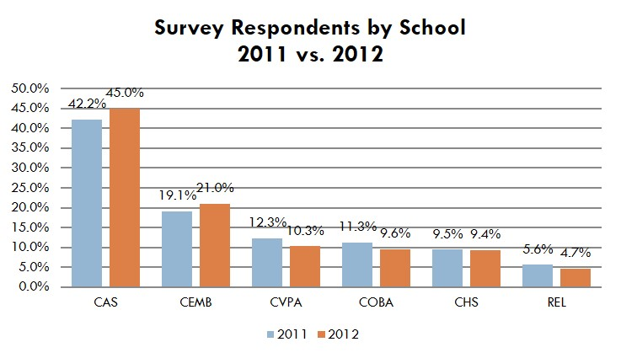
Bar graphs
Bar graphs are often more effective than pie charts, particularly for comparing data directly.

Slide 22
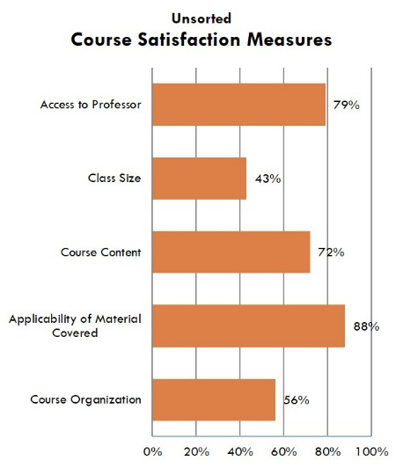
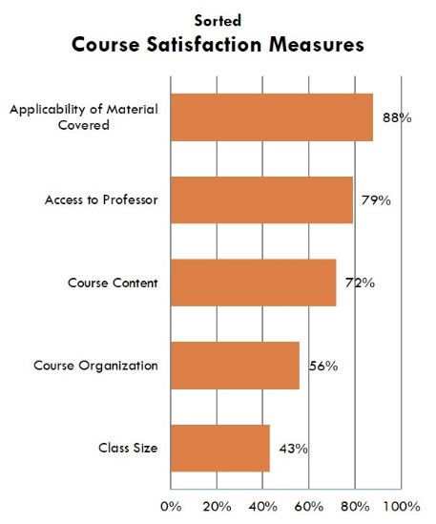
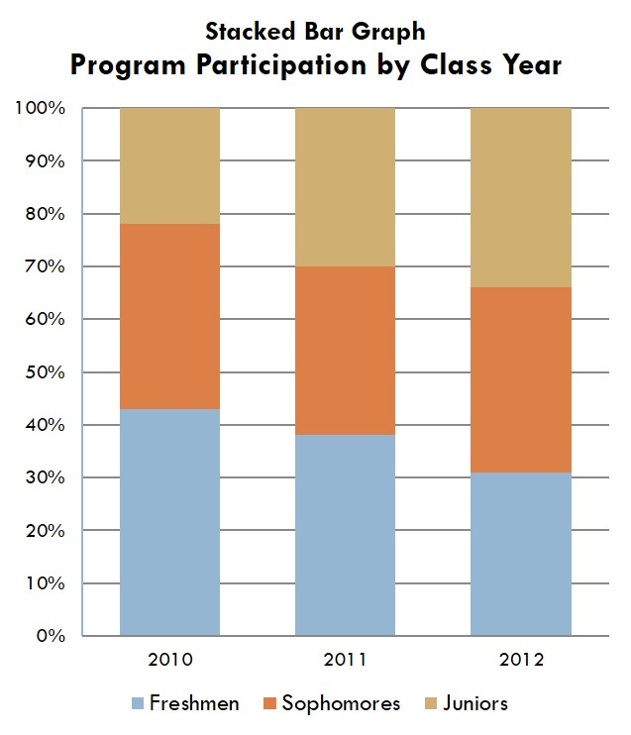
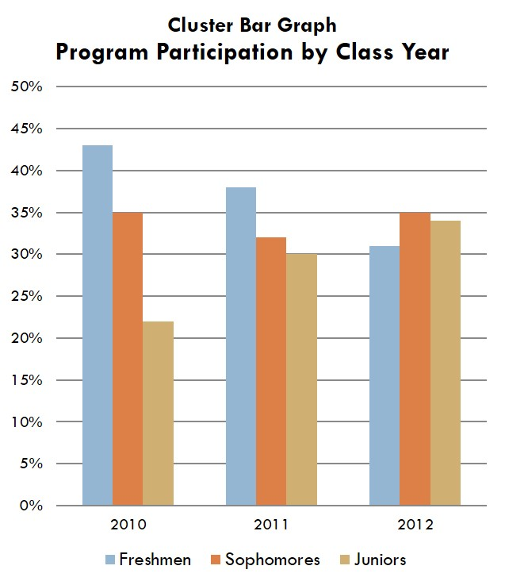
Bar graphs
As with other graphics, remember to sort your data before finalizing and stay away from 3-D formats.
If you are reporting on several different series of data, clustered bar graphs are often clearer than stacked bar graphs.

Slide 23
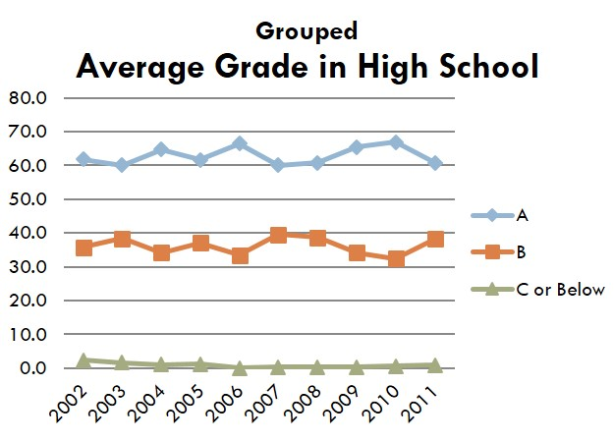
Line graphs
Line graphs are most effective in presenting five or more data points over a period of time.

Slide 24
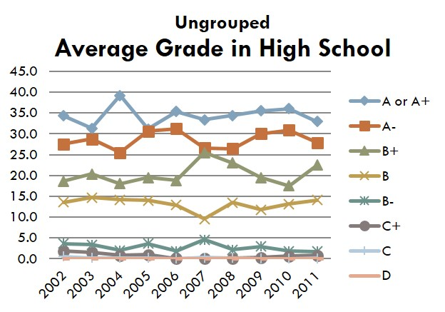
Line graphs
As with other graphics, remember to sort your data before finalizing and stay away from 3-D formats.
Typically, the horizontal axis (x-axis) denotes time and the vertical axis (y-axis) denotes the frequencies of what is measured.
If more than one line appears on your graph, differentiate the lines by style, color, or plotting symbols.
More than five (and sometimes even four) lines can lead to confusion, working against the clarity you are trying to achieve by using the graph. When possible, group for clarity.

Slide 25
Practice

Slide 26
Visually represent the following findings
You issued questionnaires about causes for life dissatisfaction to 200 working adults. 93 adults said they were most unhappy because they did not have much savings. 54 said they were worried about the economy, 46 said they were dissatisfied with their jobs, and 42 said they did not have work-life balance. 12 said they were unhappy with the government.

Slide 27
Visually represent the following findings
Over one-quarter (28%) of U.S. adults say American food is what they are most likely to choose if they had the choice to go out to a restaurant and eat one type of food. Just under one-quarter (22%) say that they would most likely choose Italian while 17 percent would choose Mexican while 16 percent would choose Chinese if they had the choice to go out to a restaurant. Japanese is the next choice as seven percent say they would choose this type of cuisine. Much further down the list are Indian (2% say they would choose) and then French and Middle Eastern cuisine (1% would choose each). Finally, four percent say they would choose another type of food.

Slide 28
Working with quantitative data
You surveyed 26 Korean teachers asking them when L1 is useful for them in their English classrooms. 1 person said that Korean is useful to establish rapport with their students. 8 people said that Korean is helpful to manage the class. 11 people said it is useful when explaining the meaning of difficult reading texts to students. 4 people said that using Korean is helpful to check students understanding of class content. 12 people said that they use Korean when explaining difficult grammar because their English ability is not good enough to explain and students comprehension of English is not good enough to understand. 10 people said that they use Korean when giving instructions for an activity so that students can clearly understand what to do.
TASK: Visually present the findings and rewrite what I have written here.

Slide 29
Survey results (N=64)
TASK: Visually present the findings and write a short paragraph.

Slide 30
Qualitative results

Slide 31
Qualitative example

Slide 32
Sample

Slide 33
practice

Slide 34
Task
Look at the following simplified data set and try to write a paragraph or 2 presenting the findings. You may use direct quotes from the data to exemplify what you are talking about.

Slide 36
discussion

Slide 37
overview
The Discussion is considered the heart of the paper.
It is the place where you interpret your findings and explain what your results mean.
It is the place where you can add your own voice to the paper.

Slide 38
A good discussion section also…
Describes how the study’s findings relate to previous findings
Discusses insights/ implications
For various stakeholders
Draws conclusions and provides recommendations for the field based on the findings.

Slide 39
Discussion
What do the findings mean in relation to my research question(s)?
How do the findings relate the literature review?
What are the implications of your findings for the field and for whom?

Slide 40
common mistakes people make when writing their discussion section
Simply repeating their results section, with little reference to existing literature.
Making conclusions that cannot be made from their data — you need to be able to differentiate between strong and weak results (do not exaggerate your findings).
Focusing too much on the limitations of the study, which can make readers question the relevance of the work. In contrast, some can completely forget to acknowledge the limitations of their study.
Repeating what was already said in the introduction without linking it to the results.
Providing no conclusions.
Introducing topics that were not covered by the study’s results/findings.
https://unstick.me/write-good-discussion-section/

Slide 41
A possible sequence
refer to your research question(s)
provide the answer
justify it with relevant results
link your work to the work of others
talk about what the implications of the findings are and for whom

Slide 42
Quantitative study example
Overall, we found that listeners who were speakers of outer and expanding circle varieties attained significantly better scores on iBT listening passages produced with American, British, or Indian English accents, relative to those passages produced with South African, Mexican, or Chinese English accents. However, we also found that TOEFL listening passages produced with inner circle accent varieties resulted in higher scores than those produced with an Indian English accent. In sum, when degree of speaker comprehensibility was excluded as a factor, the following hierarchy emerged with respect to the comprehension of materials presented in the target English accents, from highest comprehension scores to lowest comprehension scores: American, British > Indian > Chinese, Mexican, South African. (Note that in this study, the > symbol indicates a significant difference.)
Listeners’ stronger performances on materials spoken with American or British accents might be explained on the basis of listener familiarity with particular accents (see Gass & Varonis, 1984). For example, it can reasonably be assumed that the participants in our study would have had the greatest exposure to these two most dominant models, whereas their experience with the other varieties would be much less, except in cases where a given listener was a speaker of one of those varieties (see Major, Fitzmaurice, Bunta, & Balasubramanian, 2005).

Slide 43
Qualitative study example
The data suggests that for a language teacher to be perceived as a good leader by students, they must possess various leadership qualities, however, it is not just the individual characteristics alone that are important in the perception of a good leader. Good language teacher leadership is suggested to emerge from the inter-relationship and interaction between the various characteristics with the common goal of fostering positive feelings towards language learning, and engaging, and motivating learners to develop themselves (linguistically and personally) both inside and outside the classroom. What students see as good language teacher leadership has less to do with the teachers reaching targets and products of learning, and more with the development of students' interpersonal and intellectual development through positive relationships with their teachers. They point to the difference between managing students' learning, and instilling within students the confidence and satisfaction of learning for themselves.
Hence, throughout the themes of passion, rapport, purpose, and balance & flexibility, core principles of already existing leadership models are evident. For example…

Slide 44
Tip
Look at studies that are similar to your own
Look at their results and discussion sections
Use that as a template for your writing your own results and discussion.

Slide 45
Try to write a brief discussion of your findings
You surveyed 26 Korean teachers asking them when L1 is useful for them in their English classrooms. 1 person said that Korean is useful to establish rapport with their students. 8 people said that Korean is helpful to manage the class. 11 people said it is useful when explaining the meaning of difficult reading texts to students. 4 people said that using Korean is helpful to check students understanding of class content. 12 people said that they use Korean when explaining difficult grammar because their English ability is not good enough to explain and students comprehension of English is not good enough to understand. 10 people said that they use Korean when giving instructions for an activity so that students can clearly understand what to do.

