Slide 1
What are you doing?
What were you doing?

Slide 2
am/is/are + Ving
What is he doing?
she
they
it
I
we

Slide 3
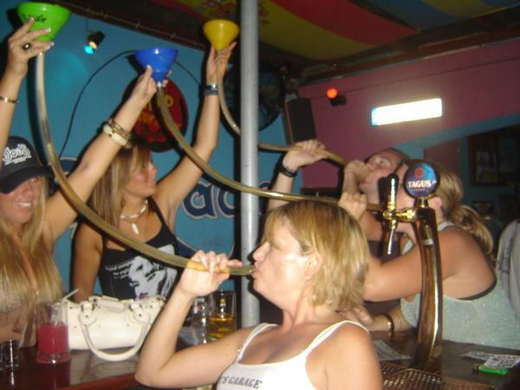

Slide 5
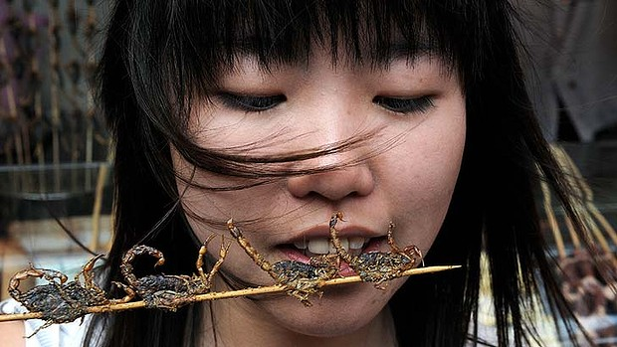

Slide 6
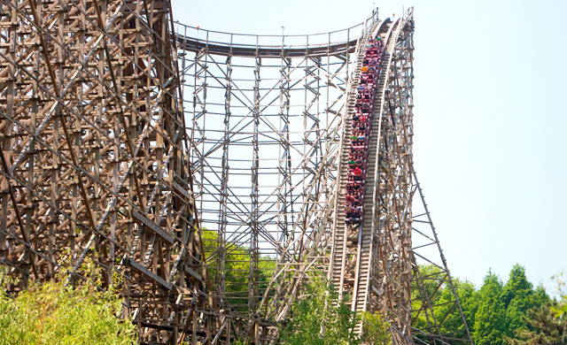

Slide 9
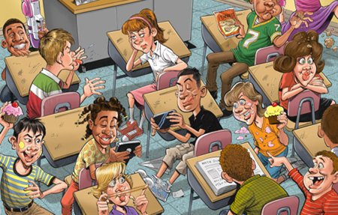
What is happening? Write 5 sentences

Slide 10
was/were + Ving
What was she doing?
he
they
it
I
we

Slide 11
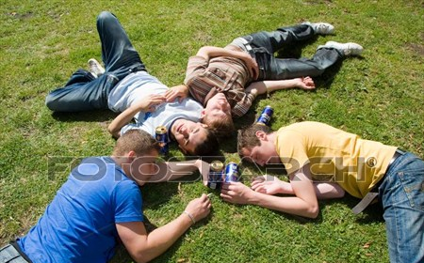
Before
Now

Slide 12
Before
Now

Slide 13
Before
Now

Slide 14
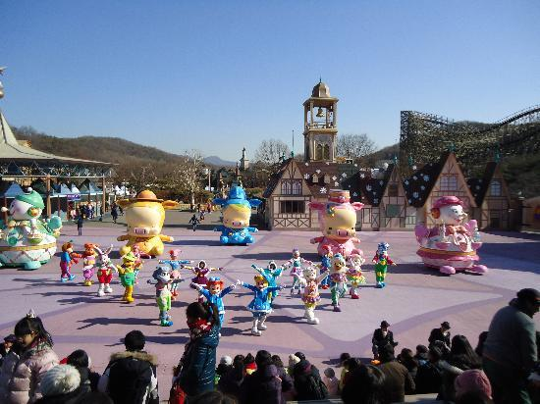
Before
Now

Slide 15
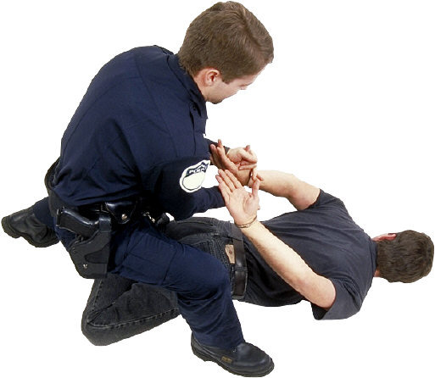
Before
Now

Slide 16
Before
Now

Slide 17
Before: What was happening? Change your sentences to past progressive

Slide 18
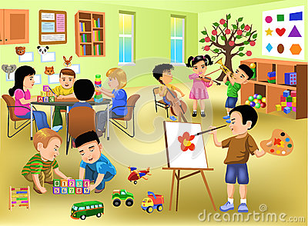
Now: What is happening? Before: What was happening?

Slide 19
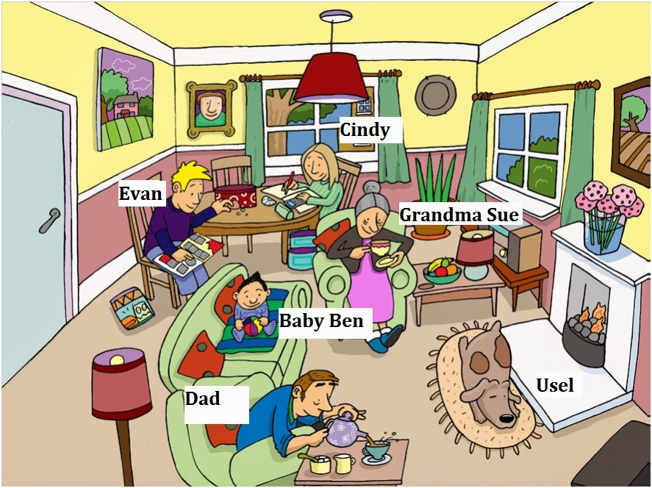

Slide 20
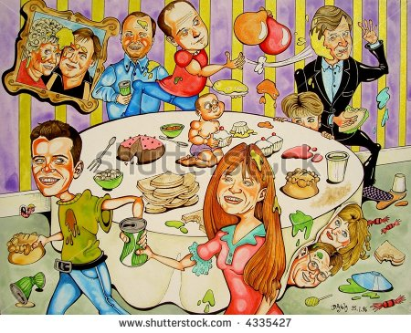

Slide 21
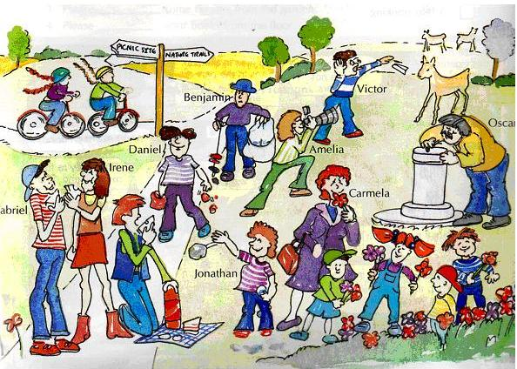

Slide 22
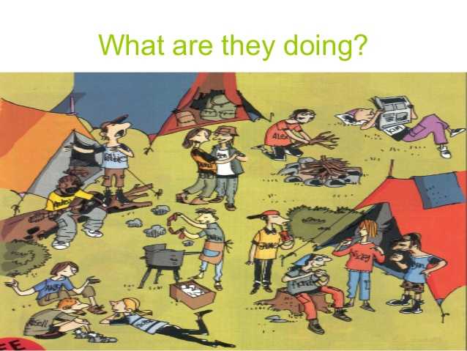

Slide 23
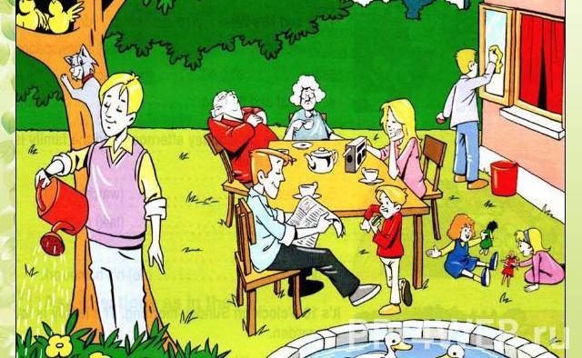

Slide 24
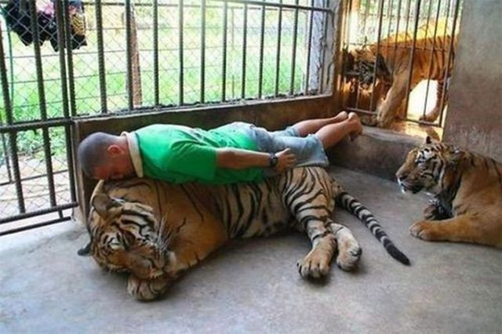

Slide 25
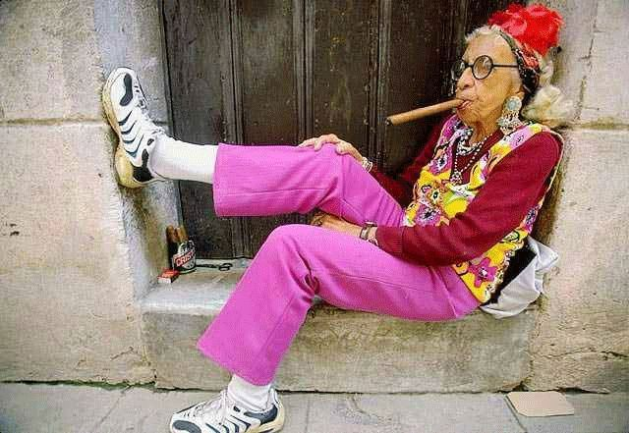

Slide 26
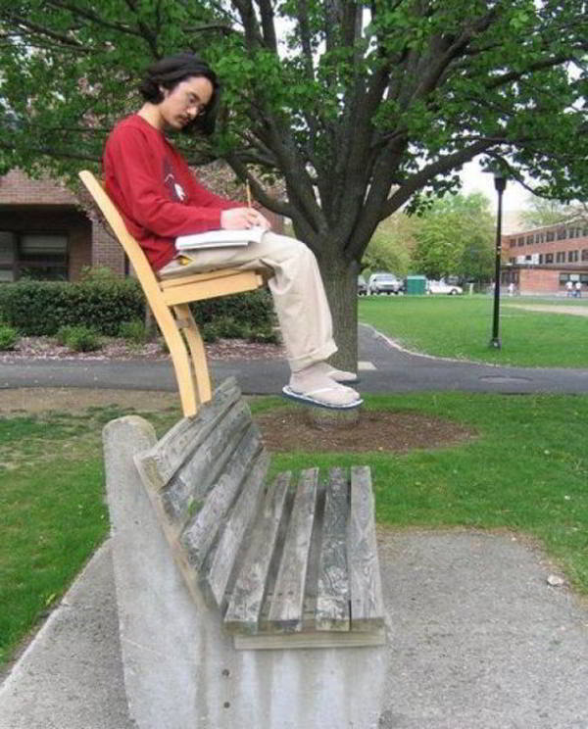

Slide 27
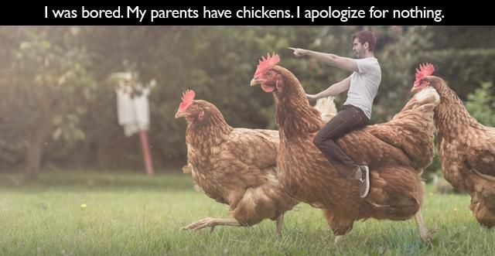

Slide 28
