Slide 1
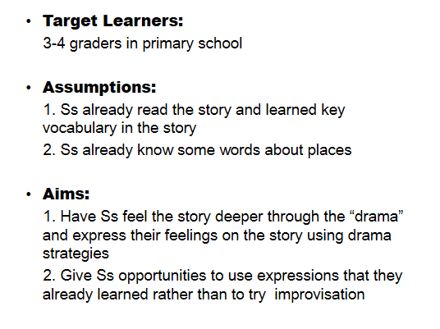
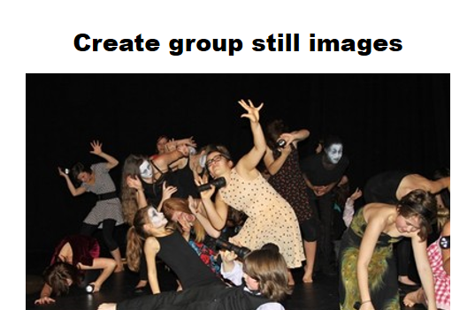
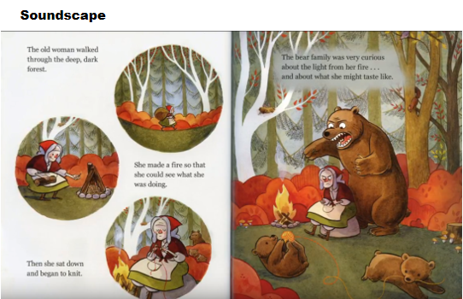
Ready, Action! Explore ‘Story Drama’ and Have Fun
INTRODUCTION
MATERIALS
CONCLUSIONS
Nowadays, drama is considered as a good approach for language learning because learners can learn the language in a meaningful context. Through drama, learners have the opportunity to express themselves, and they can use language meaningfully.
Drama is powerful because it makes learning exciting, challenging, relevant to real-life concerns, and enjoyable.
.
It takes time for teachers to construct a fictional world and, in drama, there are many ways to effect what is called, “building belief” (Wagner 1999). If you’re your class time is limited, these introductory activities can be done the day before in preparation for entering the story.
There is no rule that a teacher has to follow the structure word for word, as long as he or she feels confident about the main points. As teacher in role, you give students the information they need and suggest or introduce the implications of that information.
When working in role, the less you say, the more your students are pressed into speech.
OBJECTIVES
To create authentic communication contexts
To increase the fluency and confidence of the students’ speech
To generate new classroom relationships
To develop students’ oral communication skills in the non-threatening environment
To promote authentic language use between students and the teacher as well as between students
REFERENCES
McCaslin, N. (1997). Creative Drama in the Primary Grades: A Handbook for Teachers. Studio City, CA: Players Press.
Miller, C., & Saxton, J. (2004). Into the Story: Language in Action through Drama. Portsmouth, NH: Heinemann.
WHY?
The drama class offers a rich opportunity for practice in both oral and written communication. Because drama deals with ideas and literature, vocabularies are enlarged, and the ability to express thoughts clearly is strengthened. Interpretation of characters brings color to the voice and melody to the speech, as players take a variety of roles.
Drama is a social art form that requires another to have affect and effect. Students can learn the value of community, empathy, and shared meaning through drama.
CONTACT

