Slide 1
Self-Reflection: Getting Situated
Exploring your “possible selves” as a teacher

Slide 2
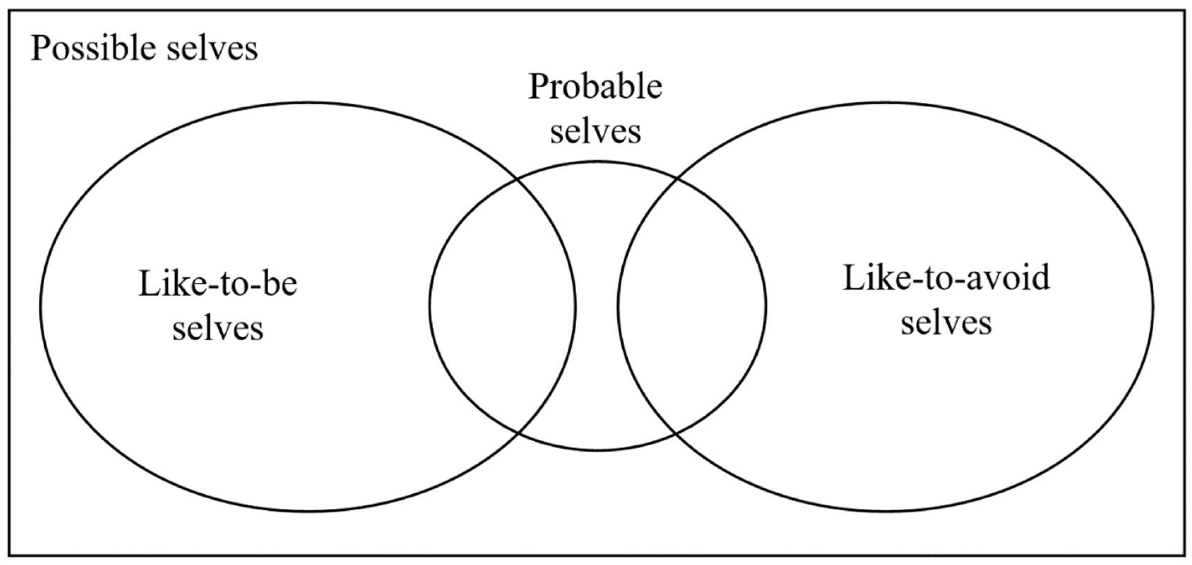
What are “possible selves”?
Possible selves represent individuals' ideas of what they might become, what they would like to become, and what they are afraid of becoming, and thus provide a conceptual link between cognition and motivation.
Possible selves are important, first, because they function as incentives for future behavior (i.e., they are selves to be approached or avoided) and second, because they provide an evaluative and interpretive context for the current view of self.
Markus, H., & Nurius, P. (1986). Possible selves. American psychologist, 41(9), 954.

Slide 3
Reflecting on your “selves”

Slide 4
Warm-up
With your group make a list of things you really like and dislike about your current job.

Slide 5
Your teaching “selves”
The teacher I am now | The teacher I fear of becoming | My ideal teaching self

Slide 6
The teacher I am now
Describe in detail the kind of teacher you are right now.
What are your current strengths and limitations?
How do you conduct your classes?
How do you and your students feel when you conduct your classes?
How do you feel about your teaching overall? Are you the teacher you want to be or wanted to be when you started teaching English? Why or why not?
How does your teaching context impact the teacher you are right now?

Slide 7
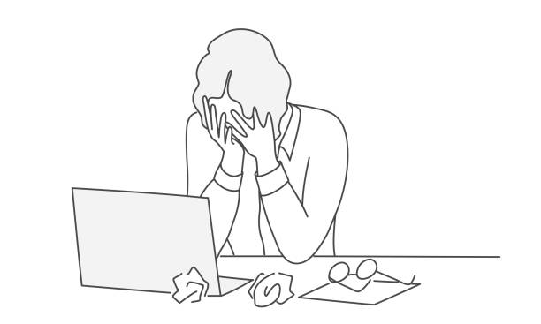
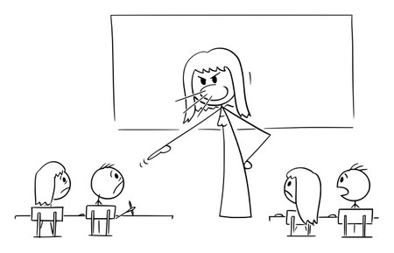
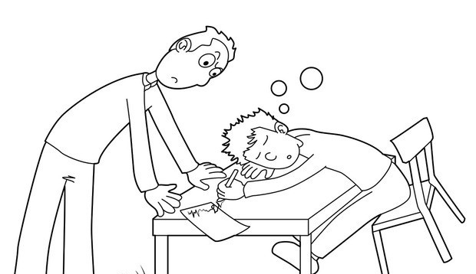
The teacher I fear becoming
Describe in detail the kind of teacher you fear becoming and want to avoid.
Think about how you don’t want to feel or act as well as how you don’t want your students to feel or act.
Why do you fear becoming this teacher? Why do you want to avoid becoming like this?

Slide 8
My ideal teaching self
Describe in detail the kind of teacher you want to be in the future.
What kind of classes do you want to provide?
What kind of knowledge, skills, and abilities do you want to possess?
How do you want to feel and act?
How do you want your students to feel and act?

Slide 9
Action plan
What are some things you can do to get closer to your ideal self?
What actions can you take to improve the current areas of weakness you have in your teaching?
How can you overcome current obstacles in your teaching context that stand in your way of reaching your ideal self?
How can you avoid your feared self?

