Slide 1
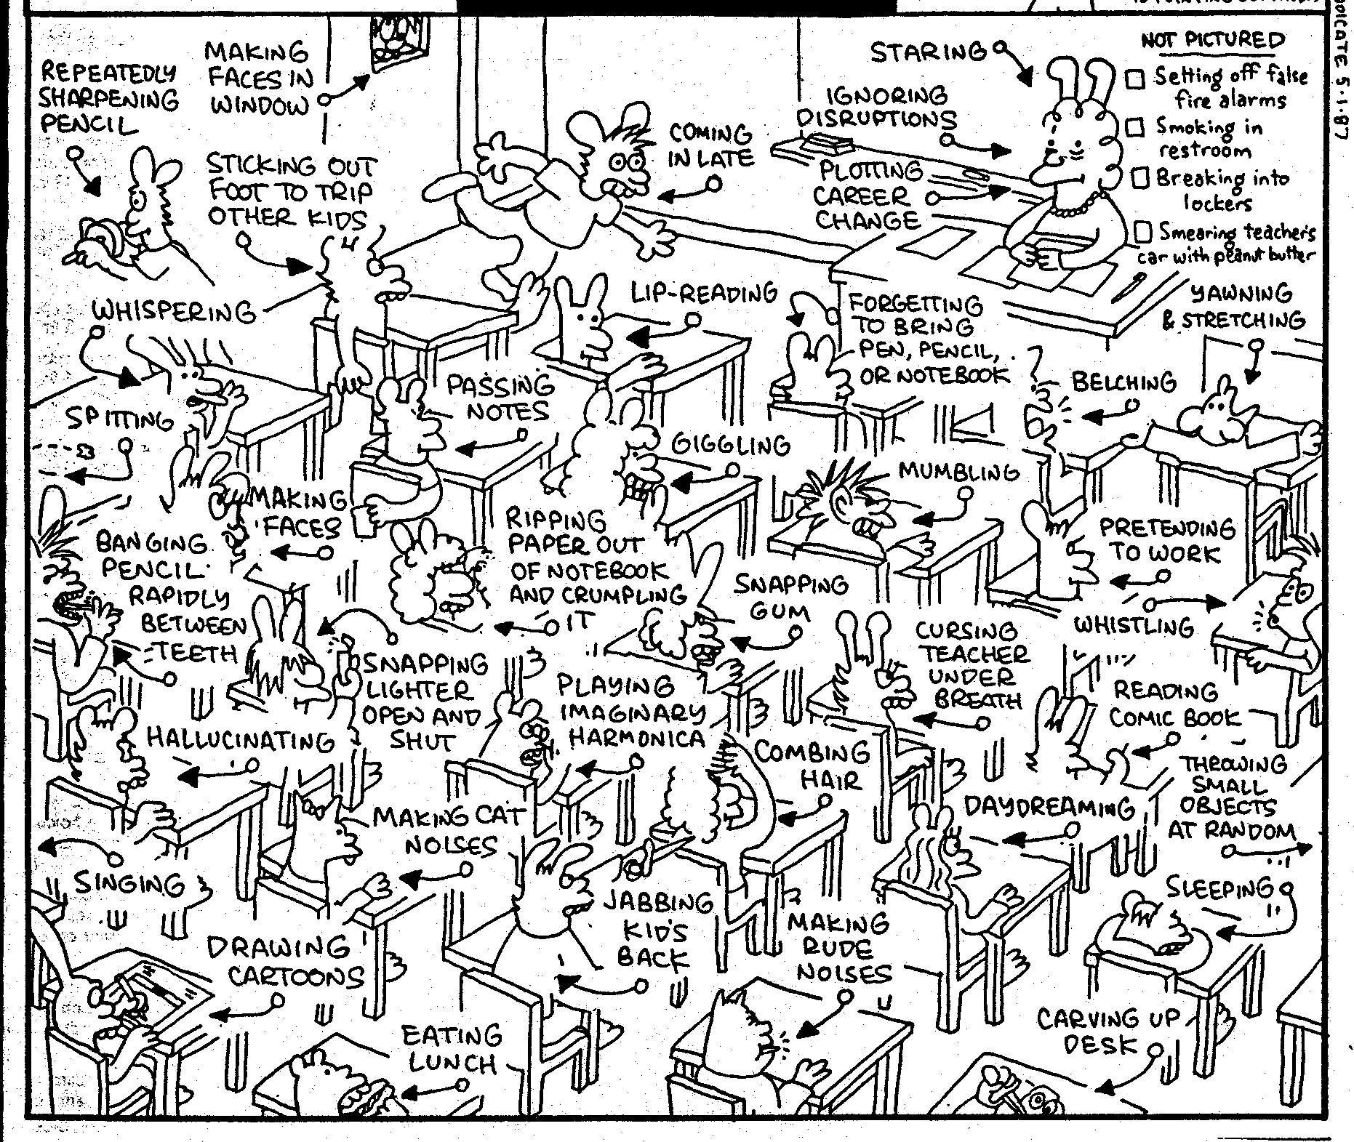
Positive Classroom Management Techniques

Slide 2
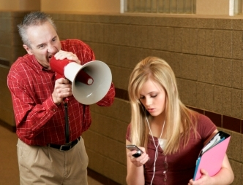
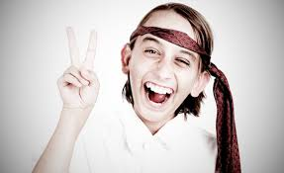
Difficulties in getting students’ attention
Disruptive students
Common classroom problems
Boredom
What else?

Slide 3
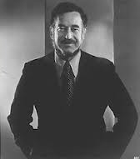
“As a teacher, I possess tremendous power to make a student’s life miserable or joyous. I can be a tool of torture or an instrument of inspiration. I can humiliate or humor, hurt or heal.”
Dr. Haim G. Ginott

Slide 4
Dealing with Misbehaviour

Slide 5
Techniques to Avoid
Yelling at students
Humiliating students
Losing your temper
Corporal punishment
Consequences unrelated to actions
Scaring students into compliance
Threatening

Slide 6
Helpful tools to utilize
Mutual respect approach
Making promises
Attention grabbers
Limited choice
Natural consequence

Slide 7
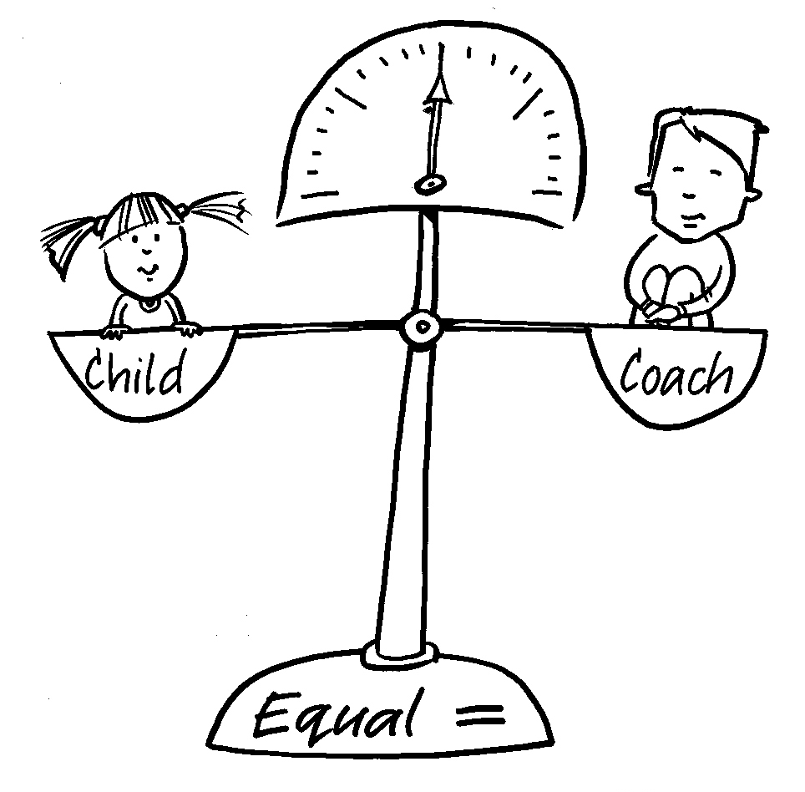
Mutual Respect
Student
Teacher
Mutual respect incorporates attitudes of
Rapport
Empathy
Understanding and respecting others
Taking responsibility and ownership of the problem.

Slide 8
Mutual Respect
If you have established mutual respect in the classroom, the following, fairly personal disciplinary techniques work well:
Withdrawal – silence, the heavy/sad look
Humanistic ‘I’ Messages – the teacher expresses his or her feelings in three parts.
Begin with a description of the misbehavior ‘When you talk while I am talking…’,
Describe the effect that this behavior has on the teacher, ‘I have to stop teaching’,
End with the feeling that it generates ‘this frustrates me.’ Most of us have heard the ‘headache’ complaint from teachers at some point, and for some of us it made a difference!

Slide 9
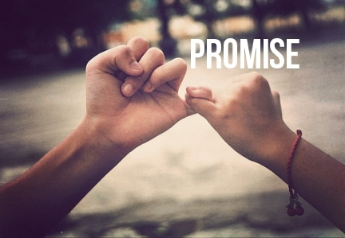
Making promises
In certain situations, it may be helpful to strike a deal with students. By making a deal, this makes students responsible for upholding their end of the deal.

Slide 10
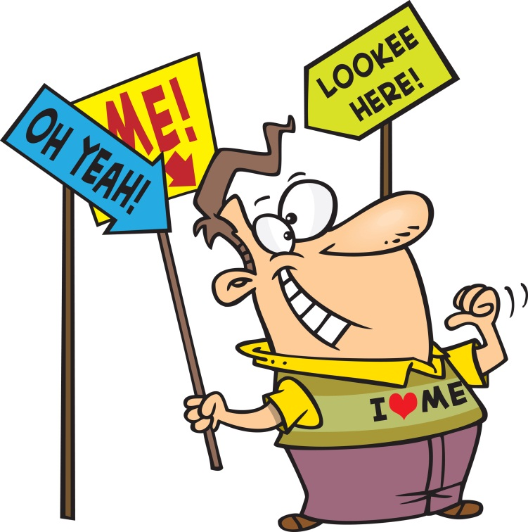
Attention Grabbing
At the beginning of the semester, it may be helpful to agree upon a certain attention grabbing signal. This will save the teacher from wasting time by yelling, screaming and/or hitting things.
Technique tips:
Repetition is necessary
Continue and increase until all students are paying attention
No thinking should be required

Slide 11
Attention Grabbing
Action
Type 1: I SAY - YOU DO!
Type 2: I DO - YOU SAY!
Type 3: I DO - YOU DO

Slide 12
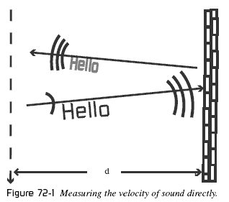
Attention Grabbing
Verbal
I SAY - YOU SAY, I SAY SAY - YOU SAY SAY
>>These techniques require repetition and intonation<<

Slide 13
Attention Grabbing
Signal (gesture, lights, silence, sound)
I DO A SIGN - YOU DO THE SIGN
I DO A SIGN - YOU BE QUIET
Teacher raises their hand in the air → Students notice and also raise their hands until all students have their hands raised
Teacher turns the lights off and waits for silence
Teacher is silent signaling for the students to be silent
Sound to signal for attention

Slide 14
Making promises
If you do A I’ll do B.. Deal or no deal?
If you work hard for another 5 minutes we can take a break.. Deal or no deal?
If I do A, do you promise to do B?
If we play a game now, do you promise to work hard for the rest of class?

Slide 15
Limited Choices
You can do A or B… Which one do you want to do?
Both choices solve the issue at hand without threatening.
SITUATION: A student is playing with their phone during class.
Good Example: You can stop playing with your phone or you can give it to me… which one do you want to do?
Bad Example: You can stop playing with your phone or I will call your parents… which one do you want?

Slide 16
Examples of Limited Choice
민아, talk with your group appropriately, or work privately at your desk.
수현, stop yelling out the answers, or I will never ask you another question.
Do your work quietly or get out.
Work together quietly or you will have to sit separately today.
You can wake up and do the work now or you can sleep and do it as homework.

Slide 17
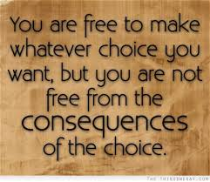
Logical Consequence: nicely threatening (^_^)
If you do A…. I’m sorry but I have to do B… I don’t want to do that but I have to.
KEY POINT: the consequence must relate to the problem and solve it!
If we don’t finish this in class, I’m sorry but you will have to do it as homework.. I don’t want to give you homework but I’ll have to if you don’t finish…
Try it out!
A student continues to use Kakao talk even after you warned them once.
A student continues to talk to his friend rather than pay attention to your lesson.

Slide 18
What management technique would you use in the following situations?
A student often does not bring in homework on time.
A student is constantly disrupting the class by asking the teacher personal questions.
A student is sleeping in class.
A student is refusing to work with another student.
Students are very tired and really want to take a break. They can not concentrate on your teaching because they are so tired.

Slide 19
Discipline MODEL | DESCRIPTION | ADVANTAGES | DISADVANTAGES
Strictness (Excessive control) | Rules and consequences Order without freedom No choices You do it because I said so
Permissiveness (No Limits) | Freedom without proper order Unlimited choices You can do anything with anything you want
Positive Discipline (Firmness with dignity and respect) | Freedom with order Limited choices You can choose within limits that show respect for all.

Slide 20
Discipline MODEL | DESCRIPTION | ADVANTAGES | DISADVANTAGES
Strictness (Excessive control) | Rules and consequences Order without freedom No choices You do it because I said so | Efficient Instant results Clear system Orderly | Easily escalates into power struggle and severe consequences. Learners depend on teacher to make decisions for them.
Permissiveness (No Limits) | Freedom without proper order Unlimited choices You can do anything with anything you want | It may seem fun temporarily. | Lack of order hinders learning. Students may feel that no one really cares. There is a lack of security without clear leadership.
Positive Discipline (Firmness with dignity and respect) | Freedom with order Limited choices You can choose within limits that show respect for all. | More agreeable and acceptance of system since students are so involved in the process. Long term results. | Doesn’t usually work immediately. Takes time for training.

Slide 21
 | POSITIVE REINFORCEMENT | DISCIPLINARY ACTIONS
YOUNGER LEARNERS | Verbal encouragement Reward positive behavior Spend individual time with each student Special student of the day/week Give responsibilities and roles Stickers-carefully determine how/when you will use stickers Stamps Collectable points – individual, group, class –work towards a goal Seating arrangement (special chair, sit with friend) | Removed points Removed privileges Seating arrangement (special chair close to T) Warning system Time out Name on board Stand quietly

Slide 22
 | POSITIVE REINFORCEMENT | DISCIPLINARY ACTIONS
OLDER LEARNERS | Verbal encouragement Recognize strengths and efforts privately Collectable points –individual, class Certificates of achievement Mystery Box: pick a reward from mystery box Help teach | Detentions Warning system Seating arrangement (separate from friends) Removed privileges Extra homework/duties Stand at the back Hands up

