Slide 1
Planning a Speaking/ Listening Lesson
Project Work

Slide 2
Task
To write a lesson plan and create materials for a 50 minute speaking/ listening lesson based on a textbook unit of your choice.
It can focus on speaking
I can focus on listening
It can integrate both

Slide 3
Details
You will work in teams to collaboratively create the lesson and materials for it. (Developing your own 21st century skills)
Each of you will be required to teach an equal portion of it 15 minutes each.
You must decide who will teach what portion
Tip: The easiest way is to have 3 activities.
You can reduce the first 5 minutes (which is usually attendance checking and greeting etc.) to less than a minute.
You can cut the activities a little bit shorter than a normal class to save time since this is just a demonstration. If you are over your allotted time I may cut the activity for you so that all of your groupmates have an equal share.

Slide 4
Steps
Group making
Choose a book to use for your planning
Select a Unit and the content you will use to plan your lesson
It can be a follow up to the reading section
It can be based on the Unit topic
It can take any approach we have learned in this course
PBL
PPP
Task-feedback
Fusion
Fill in a lesson plan
Prepare the materials (practical! Do not over do it)
Teach it

Slide 5
Schedule
Lotto (today https://www.classtools.net/random-name-picker/)
Planning and preparation will continue next class
You will teach either 2 or 3 weeks from now based on your lotto luck
You will submit your files in your final portfolio so you have time to revise/ finalize them after your teach.

Slide 6
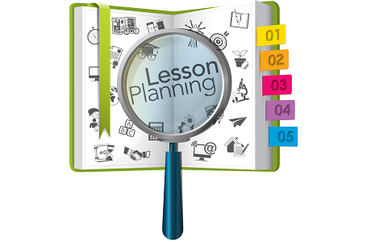
Lesson Plan

Slide 7
Lesson Plan

Slide 8
Lesson Plan

Slide 9
Lesson Plan

Slide 10
How much detail?
A lesson plan should be detailed enough that a substitute teacher could follow it without any difficulty.

Slide 11
What I am looking for
Practical implementation of things we have covered in this class (As far back as the beginning)
Demonstration of understanding of course content
Demonstration of being able to practically apply what we have learned to a teaching situation
Peer collaboration and support

Slide 12
What I am NOT looking for
Impractical materials
Impractical lessons
Lessons that take a very long time to prepare and create materials for

