Slide 1
PROJECT BASED LEARNING
Introduction

Slide 2
Some background on PBL
John Dewey initially promoted the idea of "learning by doing“
‘‘Doing projects’’ is a long-standing tradition in American education.
Hands on learning
Educational research has advanced this idea of teaching and learning into a methodology known as "project-based learning“.
PBL responds to the need for education to adapt to a changing world (21st century skills)

Slide 3

WARNING
Projects and PBL are not always the same.
PBL follows specific principles and has specific guidelines.

Slide 4
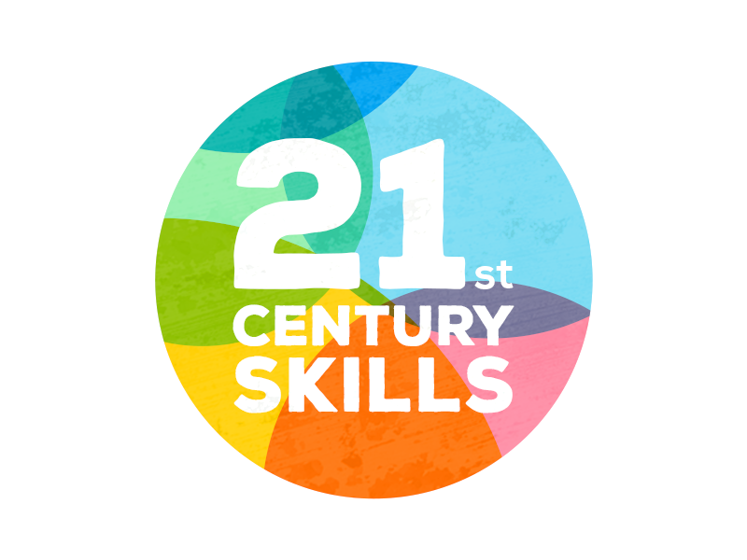
21st Century Skills
In your opinions, what skills do you think are important to succeed in our world today?

Slide 5
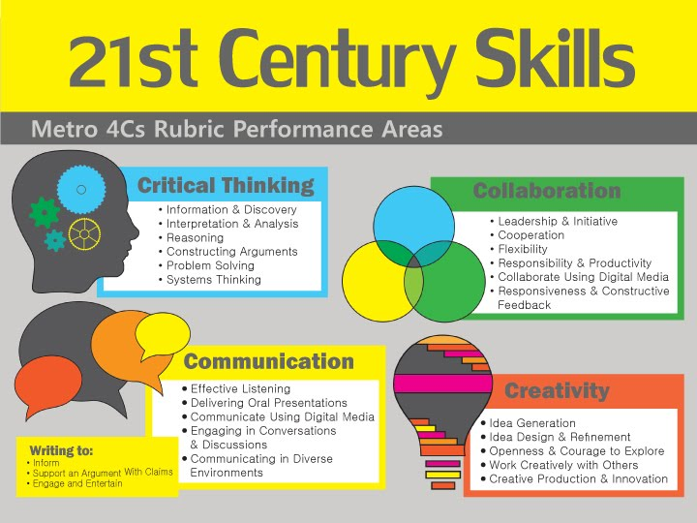

Slide 6
21st Century Skills
Critical thinking
Creativity
Collaboration
Communication
Information literacy
Media literacy
Technology literacy
Flexibility
Leadership
Initiative
Productivity
Social skills
https://www.aeseducation.com/career-readiness/what-are-21st-century-skills

Slide 7
Project Based Learning

Slide 8
Original PBL Flow
1) Entry event ( Reading, Video, Story, Discussion, Pictures, etc.)
2) Teacher gives students a driving question (Kind of like a research question)
3) The students take time discussing the driving question and thinking about a project they can do
4) Each group chooses their own project
5) Students work on the project in groups
6) Students present their project
7) Students get feedback
8) Students present again

Slide 9
PBL Story
A 10th grade group of students are preparing to send care packages to a local nursing home and senior community center.
The students are answering the question, “How can we help our community?” Early in the project, youth discussed what they thought this question means and ways to answer it.
They decided to create care packages because of recent news reports. Since then, they have interviewed elderly family members as to identify useful items, and they have done some internet searches to find what common supplies elderly individuals often need.
They will deliver the care packages and give hand-written letters to those at the nursing home.

Slide 10
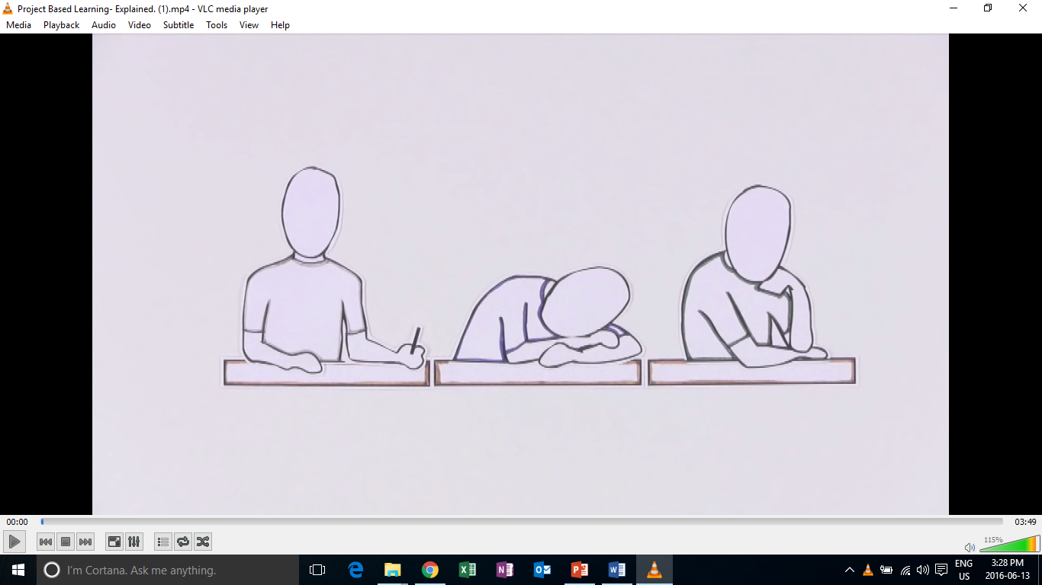
Introduction to PBL

Slide 11
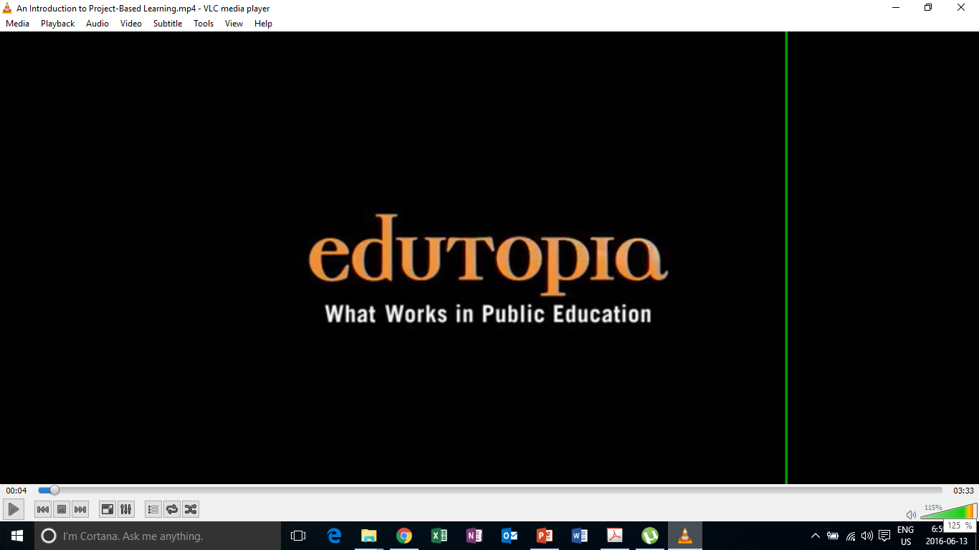
PBL in Action

Slide 12
Education in the 21st Century
The old-school model of passively learning facts and reciting them out of context is no longer sufficient to prepare students to survive in today's world.
Solving highly complex problems requires that students have both fundamental skills (reading, writing, math, science, etc. ) and 21st century skills.

Slide 13
What is project based learning?
Project-based learning if founded in the beliefs that students learn best by experiencing and dealing with real-world issues that are meaningful to them .
"One of the major advantages of project work is that it makes school more like real life. It's an in-depth investigation of a real-world topic worthy of children's attention and effort.“
-EDUCATION RESEARCHER SYLVIA CHARD

Slide 14
What does PBL involve?
students focused on real-world meaningful issues and problem solving
Skills that transfer outside of the classroom
increased student control over his or her learning
teachers serving as coaches and facilitators of inquiry and reflection
students (usually, but not always) working in pairs or groups
(Barron & Darling-Hammond, 2008; Thomas, 2000)

Slide 15
Research Findings
PBL vs. Traditional instruction
  PBL increases long-term retention of content, helps students perform as well as or better than traditional learners in high-stakes tests, improves problem-solving and collaboration skills, and improves students' attitudes towards learning (Strobel & van Barneveld, 2009; Walker & Leary, 2009).
  Schools where PBL is practiced find a decline in absenteeism, an increase in cooperative learning skills, and improvement in student achievement. When technology is used to promote critical thinking and communication, these benefits are enhanced.

Slide 16
Creating a Project

Slide 17
Original PBL Flow
1) Entry event ( Reading, Video, Story, Discussion, Pictures, etc.)
2) Teacher gives students a driving question (Kind of like a research question)
3) The students take time discussing the driving question and thinking about a project they can do
4) Each group chooses their own project
5) Students work on the project in groups
6) Students present their project
7) Students get feedback
8) Students present again

Slide 18
PBL Lesson Example
Students watch a video, read, or see pictures about global warming.
Teacher discusses the topic with students
Teacher puts the driving question on the board “ What daily actions of humans are contributing most to global warming?” (Students discuss)
Teacher then asks students to think about “ what can your group do to raise other students awareness of this trash issue?”
Some groups choose a video, some choose a poster, one groups chooses brochure
They create it
They present/share it
They get feedback and revise
Present again

Slide 19
Critical Thinking
Can you think of any possible problems that may exist if you try to implement PBL in the South Korean context?

Slide 20
Revised PBL
For Non-Western Contexts

Slide 21
Revised PBL Option
Entry event
  Discussion of the topic & problem that will be focused on
  Present language of learning (if needed)
    Note: Mainly language through learning will occur
Teacher gives the students a project to do
  Present language for learning
Students work on the project in groups
Students present the project

Slide 22
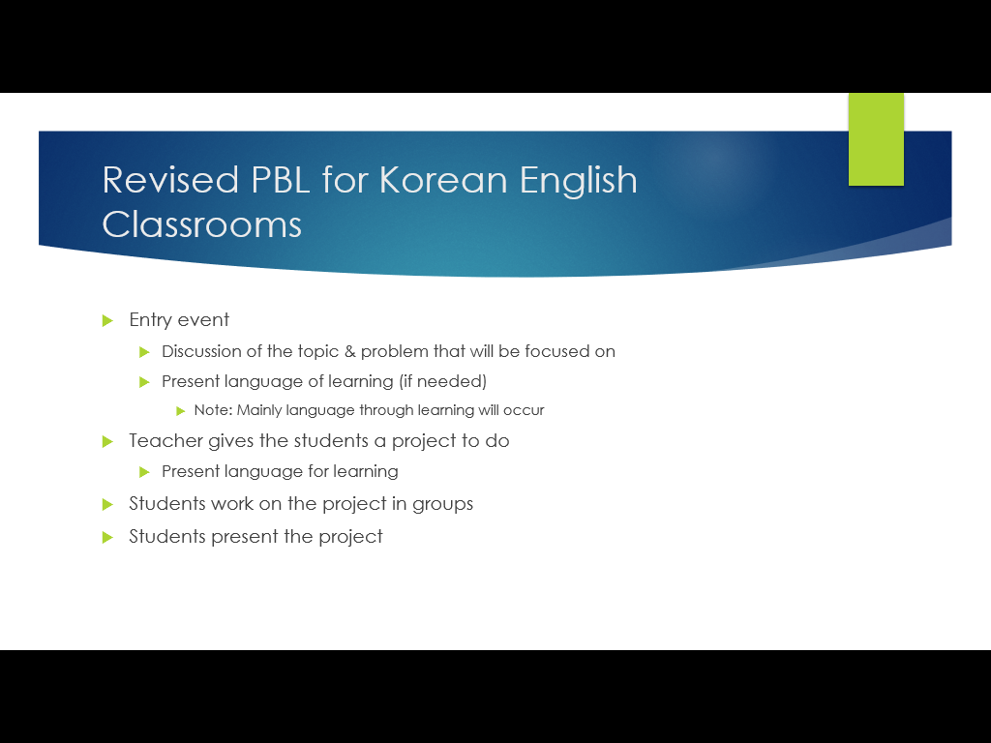
Teacher’s job
Technology
What is a problem or issue related to the topic that is relevant and relatable to my students?
What kind of project can students do to address the problem?
How will they present it?
How will it be assessed?

Slide 23
Project task ideas (try to think of more)
Design
  A new product
  A new way of doing something
  A better something (menu, phone, etc.)
Make/ Create
  A plan
  A poster
  A storybook
  A brochure
  An advertisement
  A video
  A play/ drama
Build
  A model
  A structure
Write
  A letter
  A poem
  A short story
  A book
  A speech
  Rewrite something
Prepare
  To present your ideas
  To debate
  To teach a lesson

Slide 24
Food
Travel
Health & Beauty
Other?
What is a problem or issue related to the topic that is relevant and relatable to my students?
What kind of project can students do to address the problem?
How will they present it?
How will it be assessed?
TIP:
Think about issues in your school, community, current events, student’s lives and interests.

Slide 25
How will it be presented?
As a presentation in front of the class
A performance
As a video
Group to group
Roundtable
Panel
Jigsaw
Gallery walk
Rotation fair (my favorite)
TIP:(graphic organizer for audience)

Slide 26
Project
Designing projects for your classrooms

Slide 27
Revised PBL Design Project
Turn your previous lessons into a PBL lesson.
  What is a problem or issue related to the topic that is relevant and relatable to my students?
  What kind of project can students do to address the problem?
  How will they present it?
  How will it be assessed?

Slide 28
Importance of Feedback
Providing time for feedback and revision

Slide 29
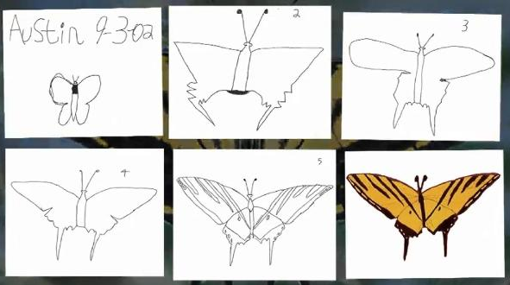
Austin’s Butterfly

Slide 30
Revisions
Reflecting on your project
Redrafting your original design
Refining your project
Building Excellence in Student Work (Austin’s Butterfly)

Slide 31
Application Task
Design a PBL style CLIL lesson

Slide 32
Useful Websites
www.bie.org
http://www.leadingpbl.org/w/page/24328306/PBL%20Gallery
https://21centuryedtech.wordpress.com/2013/09/15/the-pbl-super-highway-over-45-links-to-great-project-based-learning/
http://www.elltoolbox.com/pbl.html
http://www.mrsoshouse.com/pbl/pblin.html

