Slide 1
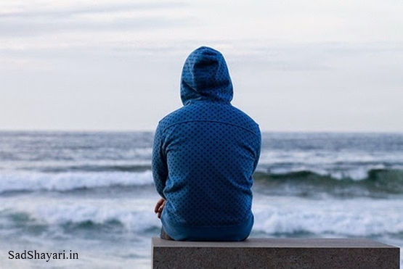
One –sided love

Slide 2
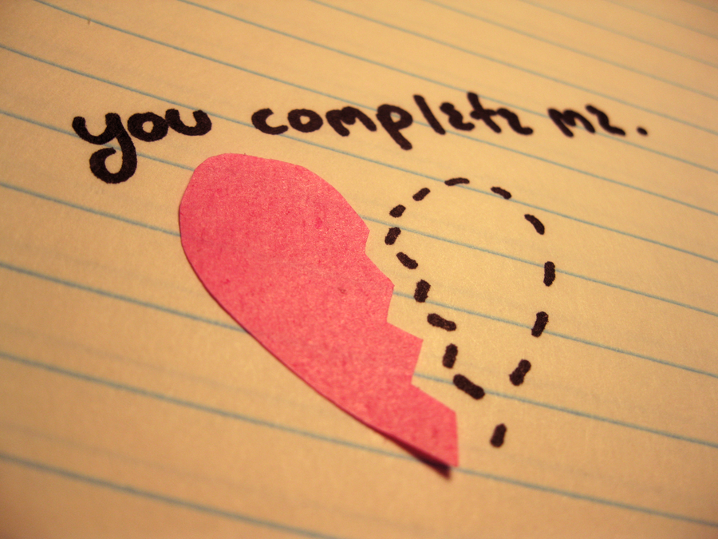
Warm-up

Slide 3
Key Words
to fall head over heals for someone (phrase)
She fell head over heals for the new guy in her class.
fantasize (verb)
He fantasized about her all day!
stalk (v) / stalking (gerund noun), stalker (noun)
He stalked her to work.
She called the police to report his stalking.
The stalker followed her to school and then to work.

Slide 4
Kevin’s Situation

Slide 5
Look at page 84
Consider what is Ok for Kevin to do, and what may be going to far!

Slide 6
Advice to Kevin
You are one of Kevin’s good friends
Write a an email to Kevin advising him on what to do about his situation.

Slide 7
Reflection
Explain what would you do in the following situations.
There is a new person in your class that you are extremely interested in. You can’t stop thinking about them day and night. You don’t know if that person has a boyfriend/ girlfriend, but you really want to go on a date with them.
You are new to class and you know that one of the people in your class is interested in you. You have just started a new relationship with someone but it is not really serious yet. The person in your class is showing their feelings more and more. You are also developing interest in that person.

Slide 8
A different kind of one-sided love
What would you do if you were in a relationship that developed into one-sided love?
At first you both loved each other but over time you realize that your relationship has become one-sided. You do everything for your boyfriend/girlfriend, but they no longer show their love for you. You love them a lot still but they are only in the relationship because of the benefits you give them.

