Slide 1
observations

Slide 2
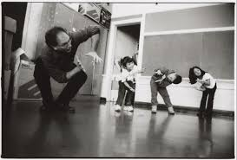
What goes in here?

Slide 3
Why are observations valuable?
What can they tell us?

Slide 4
Value of observation
The researcher is better able to understand and capture the context/ environment
Firsthand experience with the setting lets the researchers see and feel what is happening rather than guessing what the context is like
The researcher may see things that routinely escape awareness of the participant using a different method
It provides a chance to learn things that people may be unwilling to discuss in an interview

Slide 5
Thick Description

Slide 6
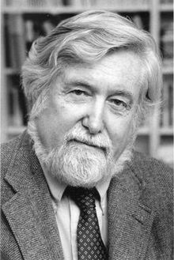
American anthropologist Clifford Geertz 1973
thick description of a human behavior is one that explains not just the behavior, but its context as well, such that the behavior becomes meaningful to an outsider.

Slide 7
The wink example
If someone winks at us without a context, we don’t know what it means.
We can report on the wink (thin description).
But if we provide a context we will know if the person is attracted to us, or that s/he is trying to communicate secretly, or that s/he has something in his/her eye.
As the context/situation changes, the meaning of the wink changes.
Thus, the more detail we have about the context the more sense we can make of the action.

Slide 8
Key point
Qualitative research requires ‘thick description’
Don’t just describe what is happening, describe the context in which it is happening.
Therefore, collect as much detail about the situation and context as possible.

Slide 9
What details are needed for thick description?
Biographical (who?)
Historical (what led to this?)
Situational (context)
Relational (what’s happening?)
Interactional (what are the meanings and relationships?)
-Denzin (1989)

Slide 10
Observation steps
Determine the purpose of the observation activity as related to the overall research objectives and the population(s) to be observed.
Select the site(s), time(s) of day, and date(s)
Get gatekeeper access, informed consent, parental consent etc.
Consider whether you will be present at the observation site, and whether you will conduct participant or non-participant observations.
Plan how you will take notes during the participant observation activity.
Prepare video or audio recording tools.

Slide 11
During observation
Record what you are observing
Video
Audio
Pictures
Drawings
Place the recording software in a non-distracting location that can still provide a good view of what you are examining
Carefully take notes on things that happen are of importance to your study
Don’t wait until after to try to make notes
Also take notes on informal conversations with staff, personal experiences, thoughts, contextual details

Slide 12
Taking notes (fieldnotes)
What are people doing?
Formally
Informally
How are they doing it?
How are they feeling?
What kind of context is it happening in?

Slide 13
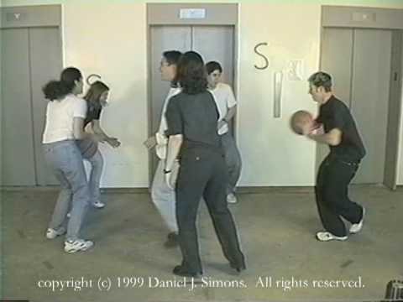
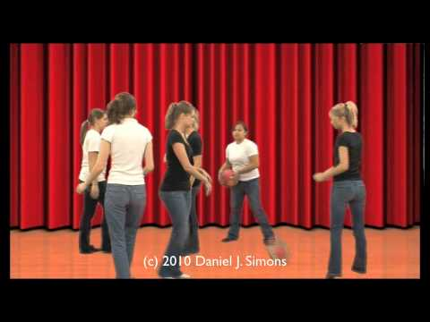
Why is it important to video record?

Slide 14
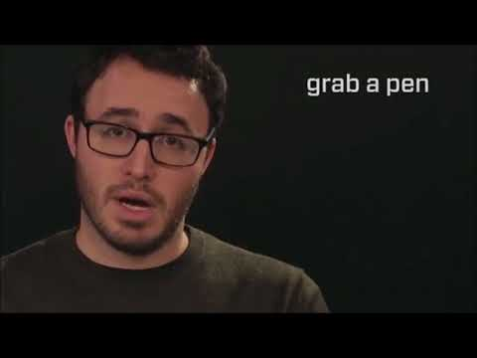

Slide 15
After Observation
Schedule time soon after participant observation to expand and clarify your notes. (debriefing/ interview/ focus group)
Type your notes into computer files and organize them carefully

Slide 16
Practice your own observation
Unstructured observation
Watch the following video of a language classroom:
What is happening within the location
Ambience, atmosphere, environment
Physical characteristics of the setting
How you are feeling and how you think this might influence what you are observing and recording
The aim of the activity is to develop a set of notes that describe the scene as much as possible.

Slide 17
Observation Video

Slide 18
Focused practice
Structured observation
Based on the unstructured observation, what are some specific features you want to focus on in detail. Now repeat the observation for a 10 minute period but only noting data that refers specifically to your focus.

Slide 19
References
Denzin, N.K. (1989) Interpretive interactionism. Newbury Park: Sage
Geertz, C. (1973) The interpretation of cultures: Selected essays. New York: Basic Books.
Parsons, R., & Brown, K. (2002). Teacher as reflective practitioner and action researcher. Belmont, CA: Wadsworth/ Thomas.

