Slide 1
Nouns
Count vs. Non-count & Using Articles

Slide 2
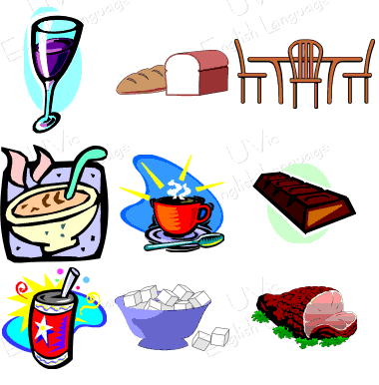
Count vs. Non-count Nouns
Count nouns have plural forms
I.e. dog, car, book
Non-count nouns do not

Slide 3
Separate the following words into count, non-count nouns or depends
garbage
belief
child
pepper
homework
chicken
husband
information
ice
smoke
jewelry
fruit
corn
mosquito
mail
money
fat
oil
traffic
advice
wolf
fish

Slide 4
Separate the following words into count, non-count nouns or depends
garbage
NC
belief
C
child
C
pepper
Both
homework
NC
chicken
Both
husband
C
information
NC
ice
NC
smoke
NC
jewelry
NC
fruit
Both
mail
corn
NC
mosquito
C
NC
money
NC
fat
Both
oil
Both
traffic
NC
advice
NC
wolf
C
fish
C

Slide 5
Count nouns
Singular
One chair I have one chair. I don’t have one chair.
a chair I have a chair. I don’t have a chair.
Plural
# chairs I have 100 chairs. I don’t have 100 chairs.
some chairs I have some chairs. I don’t have any chairs.
many I have many chairs. I don’t have many chairs.
A lot of I have a lot of chairs. I don’t have a lot of chairs.

Slide 6
Noncount nouns
Singular
some I have some money. I don’t have any money.
much I have much money. I don’t have much money.
a lot of I have a lot of money. I don’t have a lot of money.

Slide 7
much, many
Questions
much + non-count noun
many + count noun
Do you + any + count/non-count
some + count/non-count
Ex. How many friends do you have?
How much time do you have?
Do you have any new emails?
Do you have any homework today?
Do you have some money I can borrow?
Did you get some gifts for your boyfriend?

Slide 8
Make questions using the following words: How much, How many,
garbage
NC
belief
C
child
C
pepper
Both
homework
NC
chicken
Both
husband
C
information
NC
ice
NC
smoke
NC
jewelry
NC
fruit
Both
mail
corn
NC
mosquito
C
NC
money
NC
fat
Both
oil
Both
traffic
NC
advice
NC
wolf
C
fish
C

Slide 9
Take turns with a partner asking and answering questions
homework
coffee
computer
friend
soju
class
email
pet
smartphone
brother
hobby
car
sister
T.V.

Slide 10
Practice
Exercise 17 pg. 111 (#1-10)

Slide 11
Practice
Page 112 Exercise 19

Slide 12
Nouns
Using Articles pg. 114

Slide 13
When to use ‘a’, ‘an’
‘a’ and ‘an’ are used with single count-nouns
Do NOT use with non-count nouns or plural count nouns
‘a’ is used a consonant sound
‘an’ is used before a vowel sound
University, man, chocolate, unicorn, bottle of soju, beef, books

Slide 14
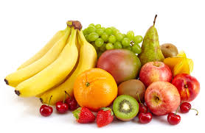
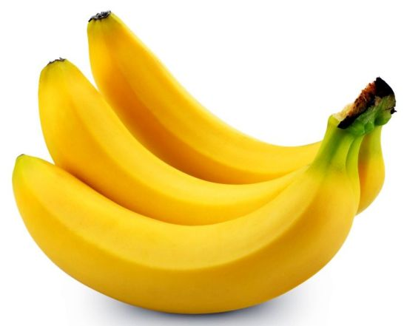
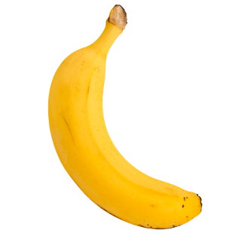
Making Generalizations
A banana is yellow = a general statement using a single example (Fact)
Bananas are yellow = general statement about all (*more common in speaking than above)
I like bananas.
I hate strawberries.
(0)Fruit is delicious = general statement about all
I like fruit.

Slide 15
Practice
Exercise 21 pg. 115

Slide 16
Using ‘a’ ‘an’ ’some’
Use ‘a’ or ‘an’ hen you are referring to nothing specific (generally speaking)
Used when the person you are talking to is not familiar with what you are referring to.
Ex. I saw a man wearing a funny hat yesterday.
I watched a movie last night
I bought a book
Use ‘some’ to refer to multiple count nouns or a small amount of a non-count noun
I saw some birds
I saw some water
I ate some bananas
I received some money

Slide 17
Practice
Page 116
Exercise 22

Slide 18
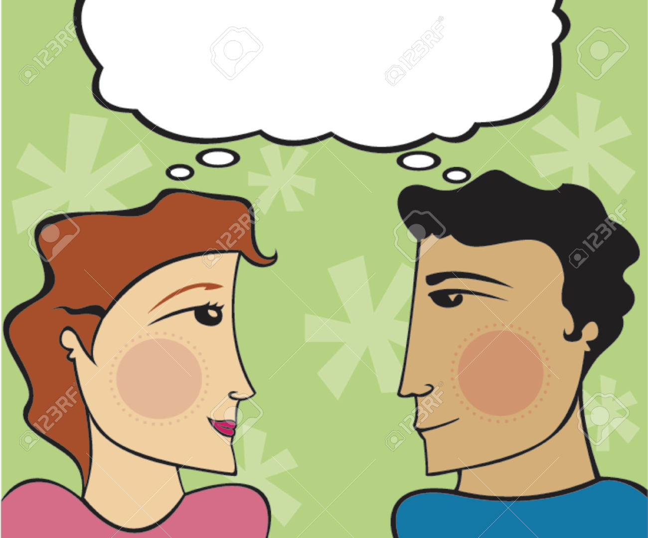
Using ‘the’
When the speaker and listener are thinking or know about the same specific thing.
I saw the man wearing the funny hat yesterday.
I bought the book.
I watched the movie last night.
I went to the library.

Slide 19
Only one
Use ‘the’ when there is only one.
Ex. I went down to the basement.
I went to the Aquarium in Okinawa vs. I went to an aquarium in Okinawa.

Slide 20
Choose the correct article in each sentence. 1)Did you bring (a, an, the) umbrella? 2)Are you looking for (a, an, the) shampoo? 3)I checked (a, an, the) mailbox again. 4)Can I have (a, an, the) spoon please? 5)I was born into (a, an, the) poor family. 6)She will come back in (a, an, the) hour. 7)Have you been to (a, an, the) Space Needle Tower in Seattle? 8)I would love to talk to one of (a, an, the) managers. 9)What (a, an, the) amazing view! 10)The helicopter landed on (a, an, the) roof of a building.

Slide 21
Page 118- 121
Exercise 26,27,28,29

Slide 22
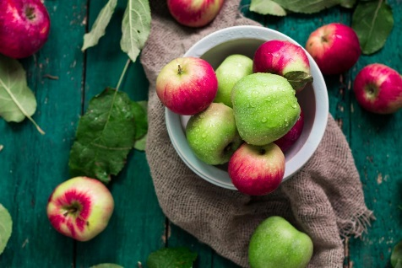
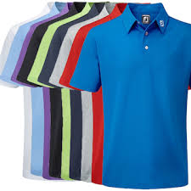
Using “of” in expressions of quantity Page 131 Exercise 45
Some apples
Some of the apples
Many books are written in English
Many of the books are written in English
I bought 9 new shirts yesterday.
Some of the shirts were too small.

