Slide 1
Nouns
Count vs. Non-count & Using Articles

Slide 2
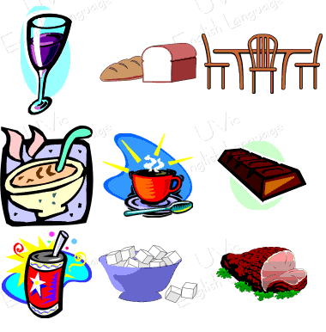
Count vs. Non-count Nouns
Count nouns have plural forms
I.e. dog, car, book
Non-count nouns do not

Slide 3
Separate the following words into count, non-count nouns or depends
garbage
belief
child
pepper
homework
chicken
husband
information
ice
smoke
jewelry
fruit
corn
mosquito
mail
money
fat
grass
traffic
advice
wolf
fish

Slide 4
Separate the following words into count, non-count nouns or depends
garbage
NC
belief
C
child
C
pepper
Both
homework
NC
chicken
Both
husband
C
information
NC
ice
NC
smoke
NC
jewelry
NC
fruit
Both
mail
corn
NC
mosquito
C
NC
money
NC
fat
Both
grass
NC
traffic
NC
advice
NC
wolf
C
fish
C

Slide 5
much, many
Questions
much + non-count noun
many + count noun
Ex. How many friends do you have? I have many friends.
How much time do you have? I have much time. (much does not sound natural though)

Slide 6
Statements much, many, a lot of
I have many + count noun I have many friends.
I have much + non-count noun I have much time.
I have a lot of + count/ non-count I have a lot of homework, I have a lot of eggs

Slide 7
much, many, a lot of
…don’t have many + count noun She doesn’t have many classes.
…don’t have much + non-count noun They don’t have much money.
…don’t have a lot of +count/ non-count noun We don’t have a lot of work today.

Slide 8
Take turns with a partner asking and answering questions
homework
coffee
computer
friend
soju
class
email
pet
smartphone
brother
hobby
car
sister
T.V.

Slide 9
Practice
Exercise 17 pg. 111

Slide 10
Nouns
Using Articles pg. 114

Slide 11
When to use ‘a’, ‘an’
‘a’ and ‘an’ are used with single count-nouns but not with non-count nouns
‘a’ is used a consonant sound
‘an’ is used before a vowel sound
University, man, chocolate, unicorn, bottle of soju, beef

Slide 12
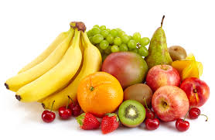
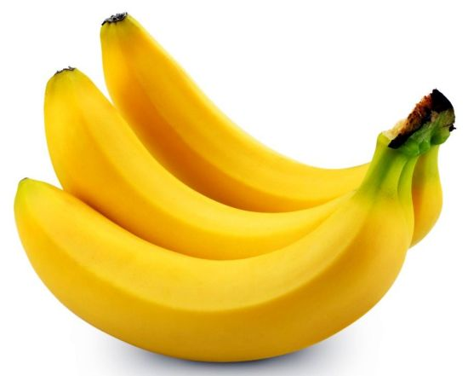
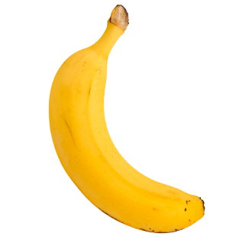
Making Generalizations
A banana is yellow = a general statement using a single example
Bananas are yellow = general statement about all (*more common in speaking than above)
(0)Fruit is delicious = general statement about all

Slide 13
Nothing specific use of ‘a’
When you are referring to nothing specific
Used when the person you are talking to is not familiar with what you are referring to.
Ex. I saw a man wearing a funny hat yesterday.
I watched a movie last night
I bought a book

Slide 14
Practice
Exercise 21 pg. 115

Slide 15
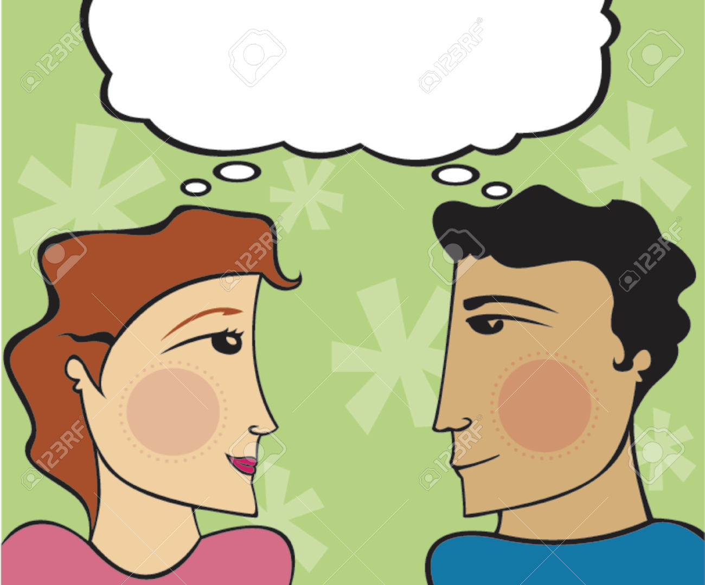
Using ‘the’
When the speaker and listener are thinking or know about the same specific thing.
I saw the man wearing the funny hat yesterday.
I bought the book.
I watched the movie last night.
I went to the library.

Slide 16
Only one
Use ‘the’ when there is only one.
Ex. I went down to the basement.
I went to the Aquarium in Okinawa vs. I went to an aquarium in Okinawa.

Slide 17
Choose the correct article in each sentence. 1)Did you bring (a, an, the) umbrella? 2)Are you looking for (a, an, the) shampoo? 3)I checked (a, an, the) mailbox again. 4)Can I have (a, an, the) spoon please? 5)I was born into (a, an, the) poor family. 6)She will come back in (a, an, the) hour. 7)Have you been to (a, an, the) Space Needle Tower in Seattle? 8)I would love to talk to one of (a, an, the) managers. 9)What (a, an, the) amazing view! 10)The helicopter landed on (a, an, the) roof of a building.

Slide 18
Page 118- 121
Exercise 26,27,28,29

