Slide 1
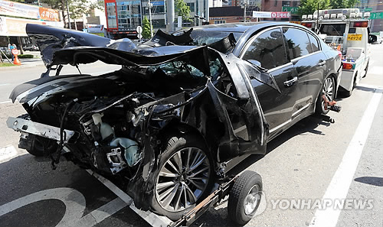
My Car was Totaled

Slide 2
Watch…

Slide 3
Group Discussion
Do you always wear a seatbelt?
Do the people you are with always wear a seatbelt?
Have you ever been in a car accident? Describe what happened.
Have you ever seen a car accident? Explain.
What do you think is the biggest cause of car accidents? Why?

Slide 4
Child Safety
Should children always wear a seatbelt? Y/N
Is it Ok for a baby to be in the front seat of a car?
Is it ok for the mom or dad to hold a baby while driving?
Is it ok to let your child put their head out of the sun roof?

Slide 5
Road Rage

Slide 6
Ask your group
Do you ever get angry when driving?
What do drivers do what makes you angry?
What do you do when you are angry?
Have you ever experienced or seen someone else with road rage? What happened?

Slide 7
Who are better driver’s men or women?

Slide 8
Driver’s Test
http://icandrive.ca/british-columbia/class-7-practice-test/

Slide 10
What 5 pieces of advice would you give …
to a teenager who is just starting to drive?

