Slide 1
Morphology
Prefix, Root, Suffix

Slide 2
The benefits of knowing
When it comes to teaching vocabulary, a little knowledge of root words, prefixes, and suffixes goes a long way.

Slide 3
Bound VS Unbound
1. Bound morphemes, which are prefixes and suffixes that cannot stand alone as words, such as geo-,re-, and –ity
2. Unbound morphemes, which are roots within more complex words that can stand alone as words, such as popular

Slide 4
Bound morpheme types
Bound morphemes that are suffixes are one of the two following types:
1. Inflection morphemes such as -ed and -s that change the tense or number of a word without changing its part of speech
2. Derivational morphemes such as -ity and -tion that change a word’s part of speech

Slide 5
Thinking Time
What are the benefits of teaching students about bound and unbound morphemes?
How can knowing common bound and unbound morphemes help them learn words?

Slide 7
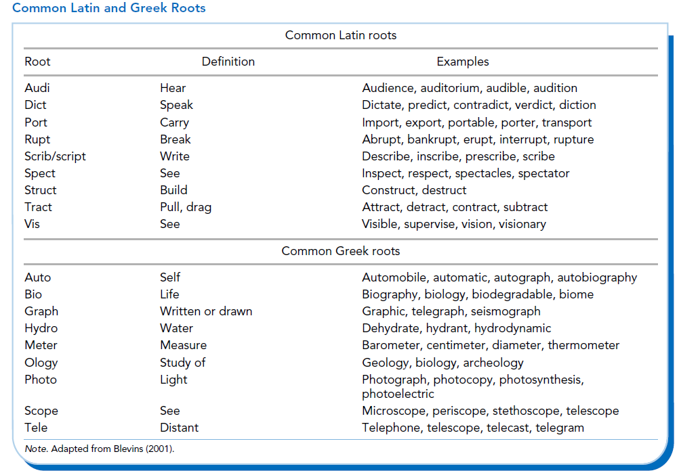

Slide 8
Working with Morphemes

Slide 9
Word flippers

Slide 10
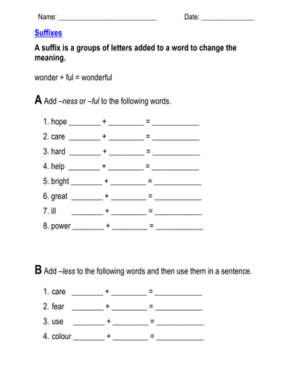
worksheets

Slide 11
Exercise A: Prefixes
Complete the sentences by writing the correct prefix in the blank space. You can use a dictionary to help you. dis- -in mis- re- un- under- 1. I just can't believe it! The story is _____believable! 2. No, that answer is _____correct. It is wrong. 3. Let's look at this information again. We should _____view it before the test. 4. I saw Allison just a moment ago, but now I can't find her! It seems that she _____appeared! 5. Oh, I'm sorry, I didn't hear you correctly. I _____understood you. 6. The subway does not go over the land like a normal train. It moves _____ground.

Slide 12
Exercise B: Adjective suffixes
Complete the words that describe the pictures below. Use the suffixes from the list. -able -ful -less 1. The first woman is very tired. She wants to rest! The second woman can't stay still. She always wants to move! She is rest_____.
2. The first dog isn't cute. He's a little scary! The second dog is very cute! He's ador_____!
3. Jason writes lots of lists, so he always remembers what he has to do. He never forgets! But Melanie can't remember anything! She's very forget___

Slide 15
Word trees

Slide 16
Useful Sites
https://www.learnthat.org/pages/view/roots.html
http://www.teach-nology.com/worksheets/language_arts/prefix/
https://resources.allaboutlearningpress.com/

