Slide 1
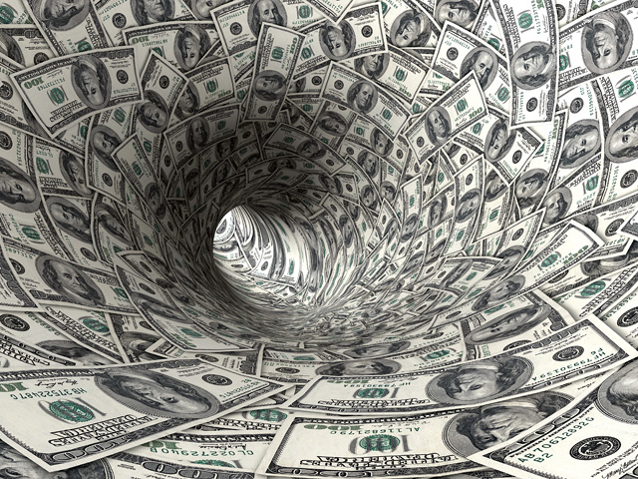
Earning Money

Slide 2
About Money
How important is money for you?

Slide 3
Money Talks
What is the craziest or strangest thing you or someone you know has done for money?

Slide 4
May’s Night Job

Slide 5
Would you do it for money?
Kiss someone
Fight someone
Jump out of an airplane
Start
Shave your head
Date someone
Take a sexy picture of yourself
Gamble
Drink something disgusting
Sell something illegal
Dress up like a clown and dance in public
Donate your blood
Finish
Model naked
Do a dare
How much money…?

Slide 6
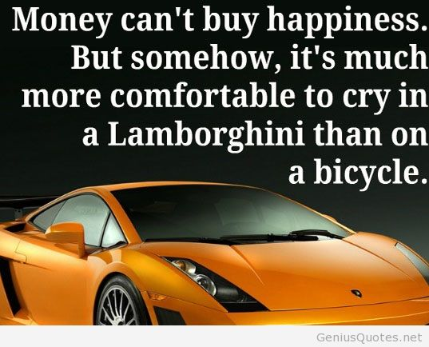
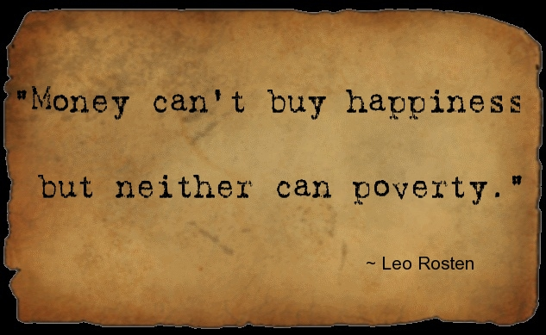
Do you think money can buy happiness?
How much money do you need to be happy?
http://www.wsj.com/articles/can-money-buy-happiness-heres-what-science-has-to-say-1415569538
http://www.ted.com/talks/michael_norton_how_to_buy_happiness?language=en

Slide 7
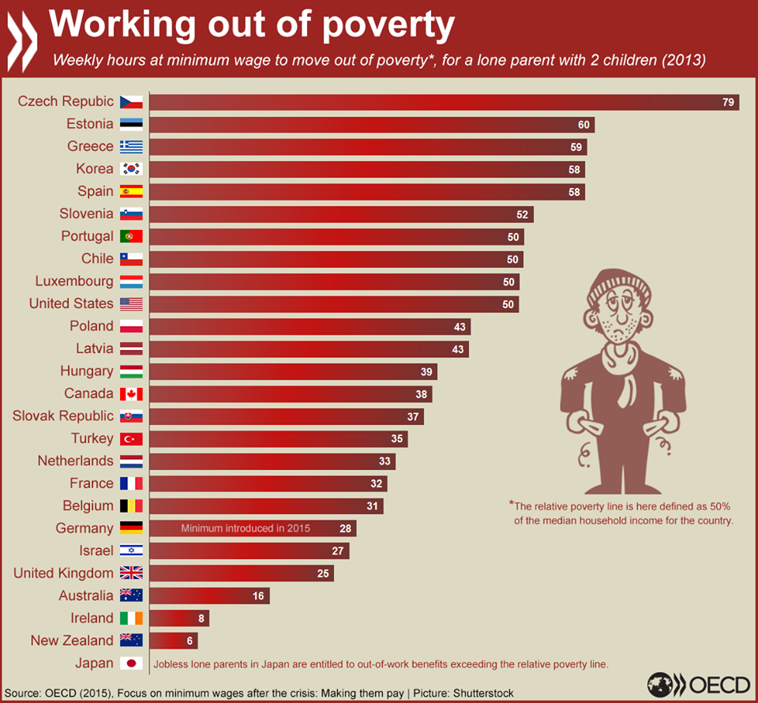

Slide 8
If you had a lot of money how would you spend it?
What would you do?
What would you buy?
Who would you spend the most on?

