Slide 1
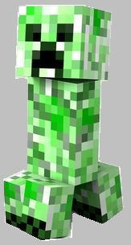
Start
New Game
Continue
Final Review
Game
Notes:
Intro Screen, put whatever text you want

Slide 2
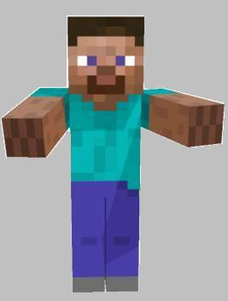
Navigation
Fire – Score Incorrect answers
(no points)
Axe – Score Correct answers
(click to show points)
Steve – Home/Forward/Answer
Notes:
Click on Steve to reveal the answer to the questions and then click on the fire or the axe depending on whether or not the students answered the questions correctly.

Slide 3
Scoring
1 point 2 points
3 points 4 points
5 points

Slide 4
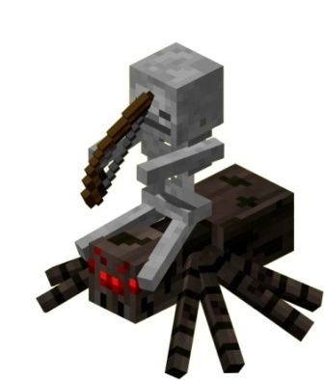
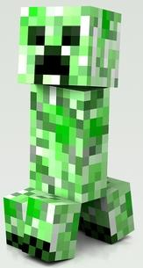
Scoring (continued)
Spider Jockey – 6 points
TNT – 10 points
Creeper – 15 points

Slide 5
E
J
O
B
G
K
A
I
M
D
N
F
C
H
L

Slide 6
Notes:
Reset slide for 1 point

Slide 7
1 point
Notes:
1 point

Slide 8
Notes:
Reset slide for 2 points

Slide 9
2 points
Notes:
2 points

Slide 10
Notes:
Reset slide for 3 points

Slide 11
3 points
Notes:
3 points

Slide 12
Notes:
Reset slide for 4 points

Slide 13
4 points
Notes:
4 points

Slide 14
Notes:
Reset slide for 5 points

Slide 15
5 points
Notes:
5 points

Slide 16
Notes:
Reset slide for TNT slide

Slide 17
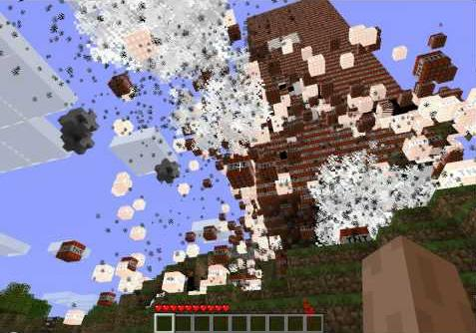
TNT!
10 Points
Notes:
TNT – team blows up their own points

Slide 18
Notes:
Reset slide for spider jockey

Slide 19
6 points
Notes:
Spider Jockey – Steals the wood from one team and gives to another

Slide 20
Notes:
Reset slide for creeper slide

Slide 21
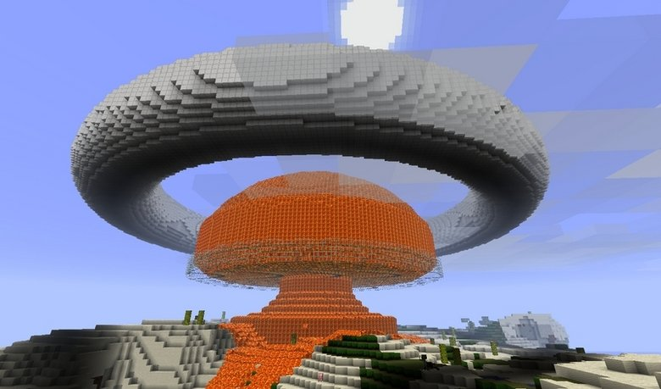
I will give you 20 points!
20 points!
Notes:
Creeper – Blows up all the pointssssssssssssss!!!!

Slide 22
Notes:
Reset slide for no points

Slide 23
No points!
Notes:
Fire – no points

Slide 24
Say the following word 3 times:
BABY
Then say:
OH

Slide 25
Which housework do you hate doing the most? Why?

Slide 26
Do you feel that men and women should be equally responsible for housework? Why or why not?

Slide 27
Why do you think that many people who live together fight over housework? What advice would you give?

Slide 28
If one of your friends was going to have a baby, what advice would you give them?

Slide 29
In your opinion what are 4 important things to have before having a baby?

Slide 30
Under what circumstances do you feel that a person should not have a baby?

Slide 31
Do you like changing dirty diapers? Why or why not?

Slide 32
Do you think money can buy happiness? Why or why not?

Slide 33
If you suddenly received a lot of money how would you spend it? Why?

Slide 34
They say that money is the root of all evil… what is your opinion?

Slide 35
Pronounce the following word:
Money

Slide 36
Spell English

Slide 37
What is Prof. G’s blood type?

Slide 38
A baby should be put to bed before what time? Why?

Slide 39
Point Distribution
1 point - 7
2 points - 6
3 points - 5
4 points - 4
5 points - 2
Switch points (spider jockey) - 2
Team loses points (TNT) - 2
All lose points (creeper) - 2
Scramble Questions
To scramble the questions, simply reorder and renumber the questions on slide 5. Otherwise, the hyperlinks may not work.
Notes:
Creeper – Blows up all pointssssssssssssss!

Slide 40
Index
Introduction . . . . . . . . . . . . . . . . . . . . . . . . 1
(Hidden) Navigation . . . . . . . . . . . . . . . . . . 2
Scoring . . . . . . . . . . . . . . . . . . . . . . . . . . . 3-4
Game Board . . . . . . . . . . . . . . . . . . . 5
Question Outcomes . . . . . . . . . . 6-23
Questions . . . . . . . . . . . . . . . . . .24-53
Point Distribution & Scramble Q’s . 54
Index . . . . . . . . . . . . . . . . . . . . . . . 55
Credits . . . . . . . . . . . . . . . . . . . . . . 56

