Slide 1
Method section

Slide 2
The Methodology Section
Comes immediately after the Literature Review.
Describes your research design choices and provides details about how the study was conducted.
https://www.sagepub.com/sites/default/files/upm-binaries/14649_Chapter5.pdf

Slide 4
Rationale for your design choices
Your methodology doesn't just describe your method; it discusses the reasons why you've chosen it, and why you believe it will yield the best results when trying to answer your research questions.
It should be very clear to your reader that the methodology you've chosen is a thoughtful and tailored response to the questions you're trying to answer.
You must also describe how your research upheld ethical research standards.
Today you must follow robust ethical guidelines to ensure that your research is acceptable and valid. Provide a thorough analysis of the ethical procedures you used to protect your research subjects. i.e. informed consent, identity protection, data protection.

Slide 5
Methodology
Subsections

Slide 6
Sample

Slide 7
3.1 Context of the study
Where did the study take place?
The context of a research gives the audience the picture of "where", "who", "what" and possibly "when" of the research. It then becomes easy for the reader to have a better understanding of the background of the research.
This study took place in …. (Quantitative/ Qualitative/ A mixture of quantitative and qualitative) data was collected from…(X participants)… during (Y) period in (Z) setting.
You can mention that the following sections will provide further details of the research design and its rationale.

Slide 8
3.2 Participants
Detailed information about who your participants were
Include relevant information
How were they recruited?
What kind of sampling procedure was use?
Refer to .pdf on my website
How many participants? Why this number?
Why were those participants specifically selected?
Explain ethical considerations in recruiting participants i.e. voluntary

Slide 9
Sampling Types
Qualitative
Purposive/ Criterion Sampling – Gathering people with a specific set of characteristics
Convenience Sampling – Gathering people who are easy for you to access
Snowball Sampling – Getting participants to suggest other participants
Representative Sample- A representative sample is a subset of a population that seeks to accurately reflect the characteristics of the larger group. (e.g., percentage of male and female English teachers in elementary schools)
Quantitative
Simple Random Sampling – Gathering participants randomly from the general population
Systematic Sample – You gather participants and then select every nth one.
Stratified Random Sampling - the population is divided sub-groups and a random sample is taken from each subgroup. (e.g., female, male, under 18, over 65, teachers, students, parents etc.)
Cluster Sampling – You divide participants into clusters and whole clusters are selected at random.

Slide 10
Qualitative Sampling

Slide 11
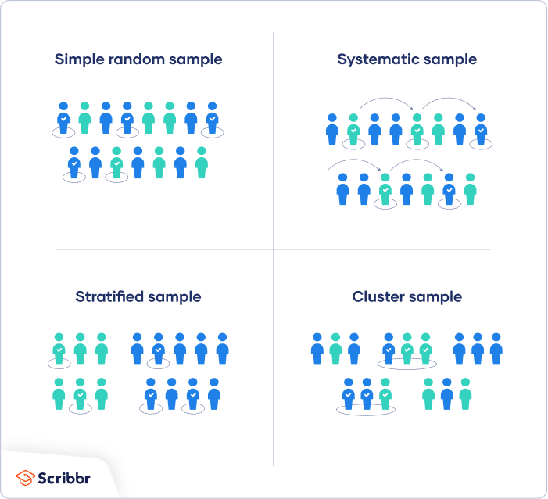

Slide 12
Wording to get you started
This study used X sampling to recruit a total of # of participants.

Slide 13
3.3 Materials/ Instruments
What was used to collect the data and why?
How was it designed?
Why?
*Be sure to include academic reference to support your design

Slide 14
3.4 Data collection procedure
a detailed description of the exact steps taken from start to finish of data collection
A justification of why each step was taken
What it intended to do
How it aligned with answering your research questions.

Slide 15
3.5 Data analysis
a detailed description of how you analyzed the data (quantitatively/ qualitatively)
Why these steps were taken
Must include references/ support from research methodology books

Slide 16
Things to be careful of
Do not provide a detailed review of methodologies.
You are describing what you did and why you chose to do that. Be sure to add support for your choices.
There is not need to go through the different definitions or history of the methods you have chosen. It is important to describe what the methods are and why they were chosen in relation to your research project.
Do not provide the actual materials you used i.e. a questionnaire, test-materials etc.; rather put them in the appendix and explain the materials in the methods section.
For your proposal write things in the future tense, for your final thesis you need to change it to the past tense.

Slide 17
Practice
Writing the participants section for an imaginary study you are doing.
You recruited 15 participants for a qualitative study. You sent emails to people you know to get participants.
You recruited 80 participants for a quantitative study. You specifically contacted 100 teachers and 100 students and from those 100 randomly selected 50 from each group.
You contacted 10 teachers with specific experience teaching project-based learning. You wanted to make sure they had at least 2 years of experience teaching project based learning in the public school classroom.

Slide 18
Data collection
You collected data through a survey. You did a pre and a post survey.
You collected data through one on one interviews that were semi-structured.
You first surveyed participants, then you interviewed them in focus groups of 4.
You observed 5 teachers in their classroom and then interviewed them after.

