Slide 1
ELT materials development
A Look at Methodological Approaches

Slide 2
Getting started
Write down as many ELT methods as you can you think of!
How many are you familiar with?
How many have you used?

Slide 3
Grammar Translation

Slide 4
Grammar Translation method
It originated from the practice of teaching Latin; in the early 1500s
It was one of the most commonly used methods until the 1950’s
It is still common in classrooms today (especially in Korea)
Students learn grammatical rules
Students apply rules by translating sentences between the languages
Advanced students translate whole texts word-for-word

Slide 5
Video Example

Slide 6
Materials in GTM
Text
Grammar rule sheets
Worksheets
Bilingual vocabulary lists
Translation activities (word-for-word)
Dictation activities

Slide 7
The Direct Method

Slide 8
The direct method
Developed in response to GTM
The Direct Method was developed on the early 1900s but was very influential in the 1950’s
Completely avoids the use of L1
Focuses on the development of oral skills.
Inductive grammar (no explicit rule learning or drilling)

Slide 9
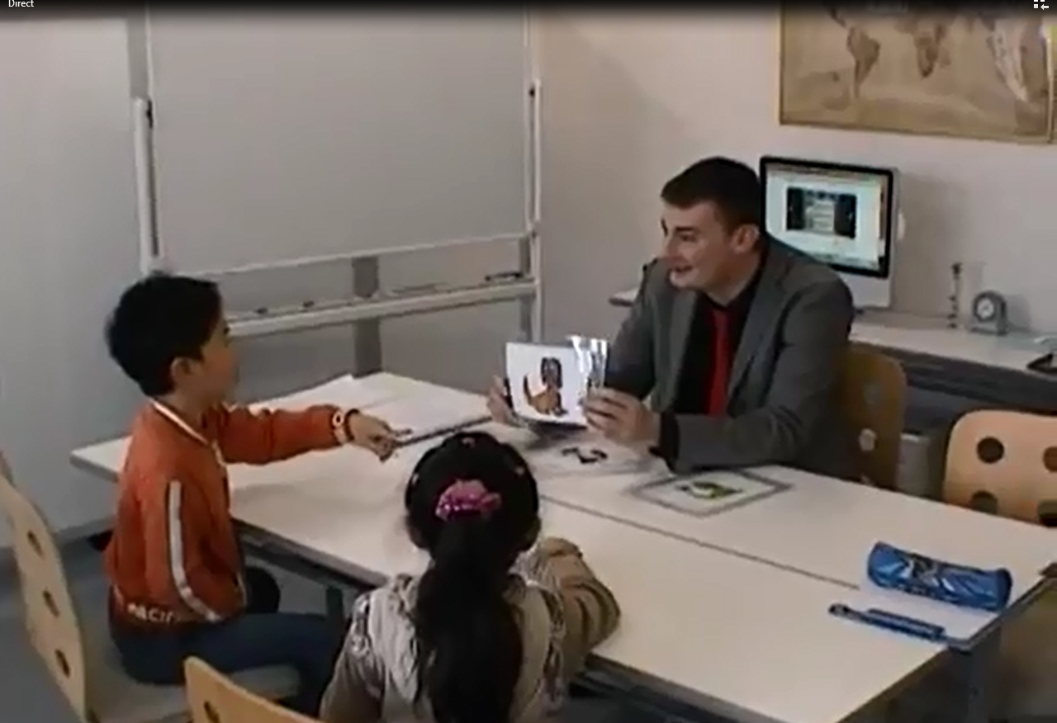
Video

Slide 10
Materials in the direct method
Everyday language focus rather than literature
Teaching concepts and vocabulary through pantomiming, real-life objects, and other visual materials
Materials usually organized into situations (shopping, eating, at the bank etc.) or by topic ( weather, hobbies, family etc.)
Flash cards
Pictures
Videos
Question answer drills
Read aloud

Slide 11
Audiolingual Method

Slide 12
Audiolingual method
Peaked in popularity in the 1960s – 1970 (developed for military
Based on behaviorist theory – conditioning and habit formation (Behaviorist learning theories of Pavlov's dog which Skinner applied to human learning)
Like the direct method, learning is directly, without using L1 to explain new words or grammar in TL (No L1 permitted)
Focus shifted from teaching vocabulary back to grammar
Implicit grammar via memorized forms

Slide 13
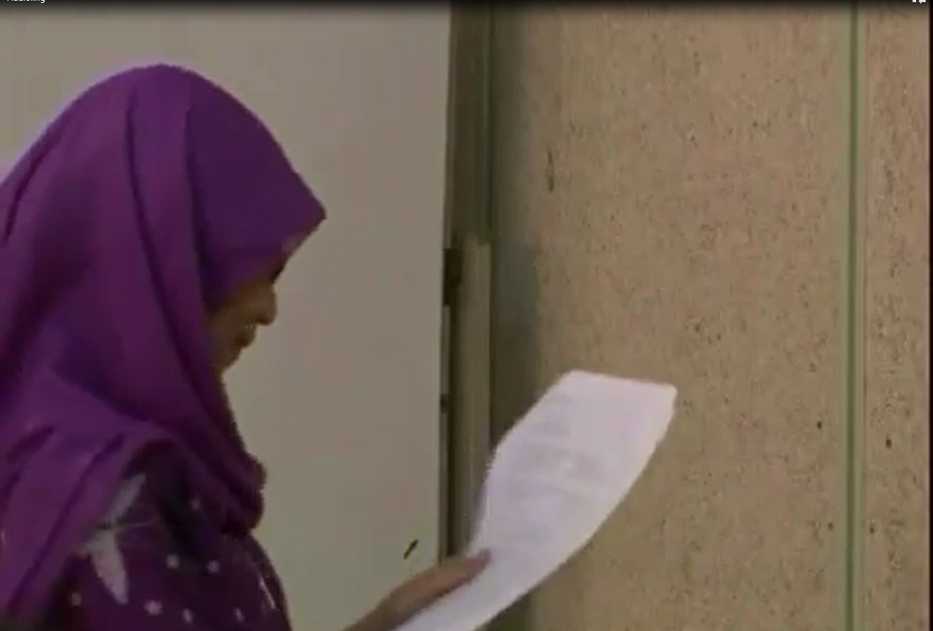
video

Slide 14
Materials in Audiolingual method
Lots of dialogues
Role-plays
Listen and repeat
Drilling (repeat the same thing over and over and over and over….)
Pattern practice

Slide 15
Communicative language teaching

Slide 16
Communicative language teaching
Grew out of sociolinguistics in the 1970s
Emphasis on the process of communication, interaction & language functions rather than forms
Being able to communicate requires more than linguistic competence; it requires communicative competence (Hymes 1971)-knowing when and how to say what to whom to make yourself understood in socially appropriate ways
L2 is learned best through interaction with others and through communicative usage of the language
L2 is learned best when students try to say something that they really want or need to say

Slide 17
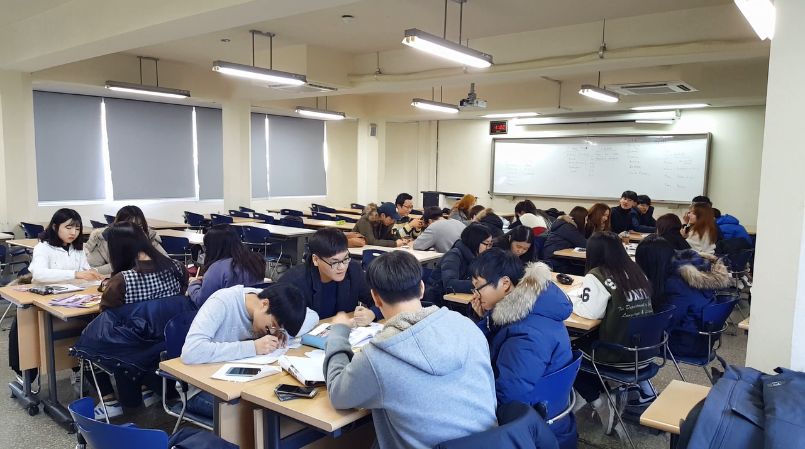
video

Slide 18
Materials in Communicative language teaching
Pair and group activities without structured language that students have to follow.
Materials concentrate using language naturally for various social purposes and in various social settings
Problem solving tasks
Drama
Team projects
Team games
Group discussions
Surveys/ Interviews
Information gap (Jigsaw)

Slide 19
Check-in
Which approach do you feel fits you the most?
Why?

Slide 20
Project-Based Learning
Eclecticism

Slide 21
Some background on PBL
John Dewey initially promoted the idea of "learning by doing“
‘‘Doing projects’’ is a long-standing tradition in American education.
Hands on learning
Educational research has advanced this idea of teaching and learning into a methodology known as "project-based learning“.
PBL responds to the need for education to adapt to a changing world (21st century skills)

Slide 22
Education in the 21st Century
The old-school model of passively learning facts and reciting them out of context is no longer sufficient to prepare students to survive in today's world.
Solving highly complex problems requires that students have both fundamental skills (reading, writing, and math) and 21st century skills (teamwork, problem solving, research gathering, time management, information synthesizing, utilizing high tech tools).

Slide 23
Learning Outcomes
PBL vs. Traditional instruction
PBL increases long-term retention of content, helps students perform as well as or better than traditional learners in high-stakes tests, improves problem-solving and collaboration skills, and improves students' attitudes towards learning (Strobel & van Barneveld, 2009; Walker & Leary, 2009).
Schools where PBL is practiced find a decline in absenteeism, an increase in cooperative learning skills, and improvement in student achievement. When technology is used to promote critical thinking and communication, these benefits are enhanced.

Slide 24
Revised PBL
Entry event
Discussion of the topic & problem that will be focused on
Teacher gives the students a project to do
Students work on the project in groups
Students present the project

Slide 25
Project task ideas (try to think of more)
Design
A new product
A new way of doing something
A better something (menu, phone, etc.)
Make/ Create
A plan
A poster
A storybook
A brochure
An advertisement
A video
A play/ drama
Build
A model
A structure
Write
A letter
A poem
A short story
A book
A speech
Rewrite something
Prepare
To present your ideas
To debate
To teach a lesson

Slide 26
Post-methods era
Eclecticism

Slide 27
Post-method era
There is no single best method
Each method has its own strengths and weaknesses
There is still a major emphasis on communicative competence
We can incorporate aspects from a variety of methodological approaches into materials development and teaching
It is important to consider what fits best rather than choosing single approach to everything

Slide 28
Video

Slide 29
Materials in the post-method era
Any and all of what has been previously mentioned
Innovative/ creative materials
Technology

Slide 30
Current trends in materials development
Based off of student input and feedback
Focus on cultural sensitivity and intercultural communication
Movement away from the native-speaker model
Movement towards comprehensible input and output
Movement towards enjoyment in the language classroom
More activities
Movement away from testing
Movement away from memorization
Less teacher talking more student talking
Maximizing student participation

Slide 31
reflection
As a materials developer what are some key points from this lesson that you must consider?
What is each method useful for?

Slide 32
Application
Storytelling with young learners
You want students to memorize set phrases
You want students to use language freely to develop their own communicative abilities
You want learners to learn from each other
You want to teach adult learners specific grammar rules
You are teaching a group of translation students
You want students to develop language skills useful for a work setting
You want to prepare students to do well on the KSAT
You are teaching a reading class
You want to develop students 4 skills in a balanced way
You want to develop communicative competence in learners

Slide 33
Reference site
http://hlr.byu.edu/methods/content/cognitive.html

