Slide 1
Developing an Extensive Reading Program at Public English Libraries for Korean low level English learners

Slide 2
‘The best way to improve one’s knowledge of a foreign language is to go and live among its speakers. The next best way is to read extensively in it.’
Nuttall. (1982).

Slide 3
ER improves reading, reading rate, vocabulary, and spelling in various aspects of L2 learning.
ER has a positive effect on the attitudes and motivation of English learners.
- Park. (2015).

Slide 4
Limitation of extensive reading
Only for learners who are able to read independently.
What about a beginner who is still difficult to read.
Traditional Grammar translation and memorizing vocabulary doesn’t work.
Young elementary school students; it can be side effect.

Slide 5
Extensive reading for low level students
It is necessary to use effective and pleasant way.
Audio assisted extensive reading
To fit low leveled reader’s stage.
Balanced literacy approach
Ing-eo ppang(잉어빵) ER program run at a local children’s center
Into pubic English library

Slide 6
Why public library?
Need a systematic reading program for novice reader.
Possible to provide practical ER guide to parents.
Possible to link to elementary school ER program

Slide 7
Aims
To implement Ing-eo ppang(잉어빵) ER program into public English library.
Can the English-language programs based on local children's centers be properly used in the library environment?
How does the environment of a beginner-friendly library affect English learning outcomes?
3) What did the program influence on the elementary students’ learning experiences?

Slide 8
Extensive reading(ER)
Pleasure Reading
DIRT (Daily Independent Reading Time) or DEAR (Drop Everything and Read)
Sustained Silent Reading (SSR)
Free Voluntary reading (FVR)
The common characteristics of ER is that a pleasurable reading situation where a teacher encourages students to choose what they want to read for themselves.
– Kim. (2011).

Slide 9
Graded reading step
Reading material is divided into stages.
To read without difficulty during the reading.
As learners improve their levels, they can select higher level books.
- Waring(2001)

Slide 10
Audio-assisted reading
The study of effect of audio-assisted reading show that
Audio-assisted reading group improve
In reading rates and comprehension
Than the silent reading group.
- Chang & Millett. (2015).

Slide 11
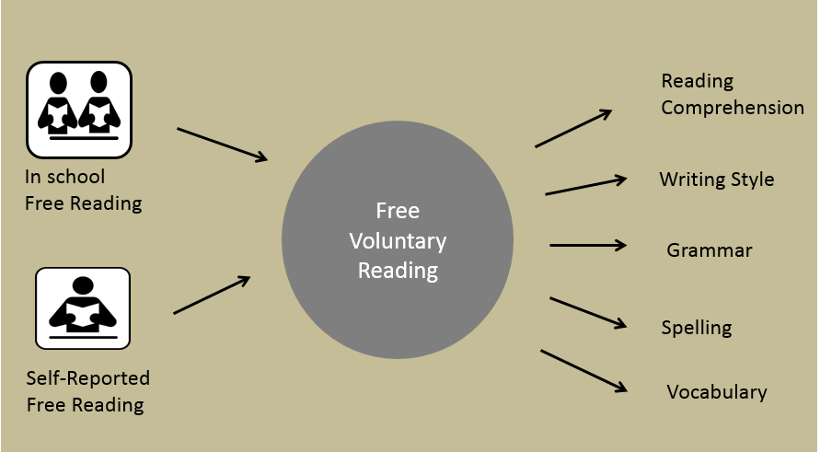
The Reading hypothesis
More reading results in better reading comprehension, writing style, vocabulary spelling, and grammatical development.
Reading is only one way to develop literacy.
– Krashen. (1993)

Slide 12
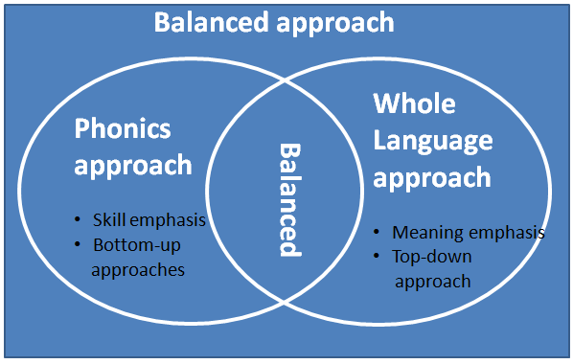
Balanced approach
Combining the best elements from phonics instruction and the whole-language approach.
Explicitly teaching the relationship between letters and sound
In reading interesting stories and writing
- Diegmueller, K. (1996).

Slide 13
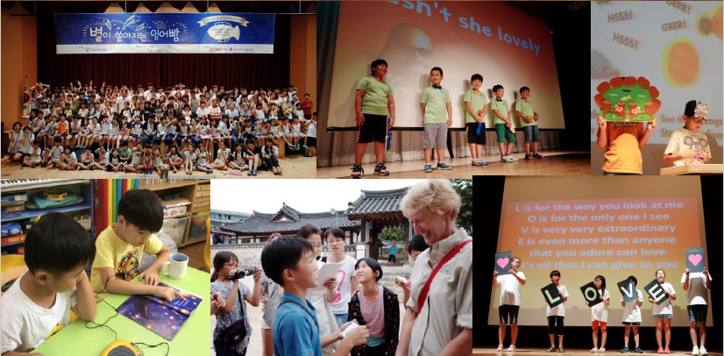
Ing-eo ppang(잉어빵) ER program
Local children center ER program
In Nowon-gu, Seongbuk-gu, Seoul
Operates by Research Institute Hope(희망연구소 배움)
Since 2012 - present

Slide 14
ERIK reading level
ERIK
reading
level
- 이병민 외. (2010).

Slide 15
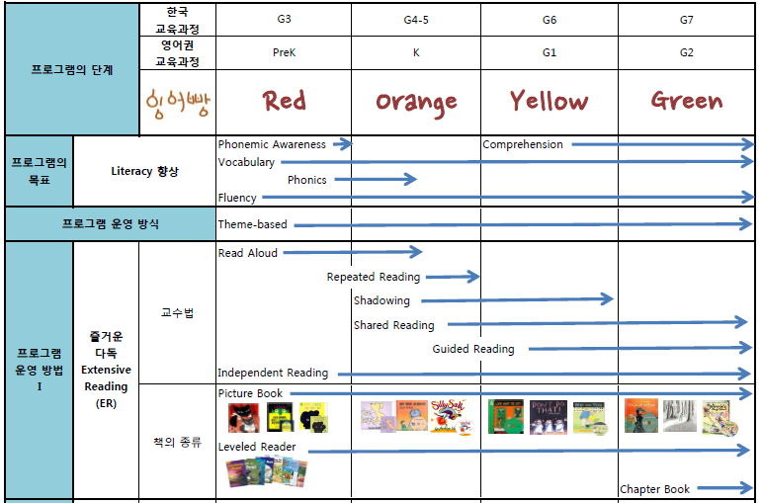
Ing-eo ppang(잉어빵) ER program
ERIK reading level - Extensive Reading (Audio assisted)
Phonics instruction
Balanced approach
Whole language approach

Slide 16
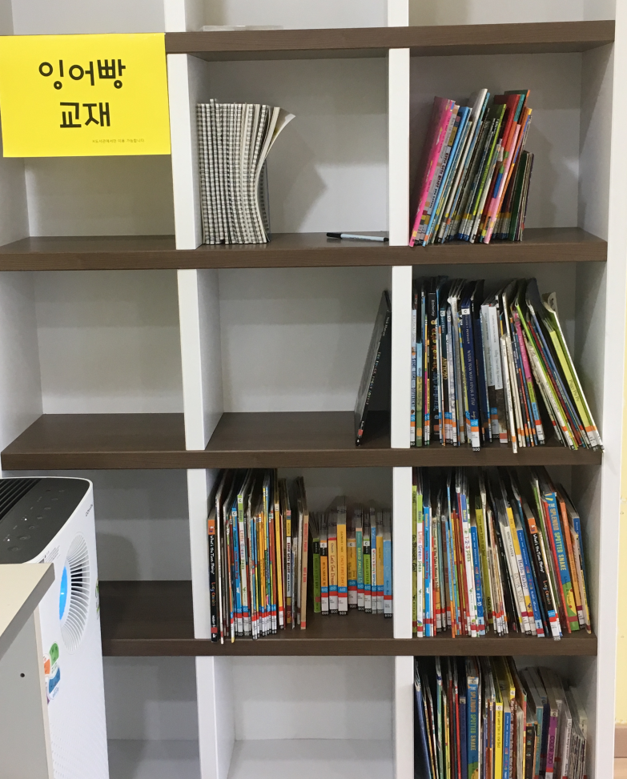
Ing-eo ppang(잉어빵) ER program
Classroom
Outside classroom
Lessons twice a week
Leveled books (monthly same theme)
Sentence, vocabulary
Phonics
Book report
Extensive reading(audio assisted)
Book report
Motivation events

Slide 17
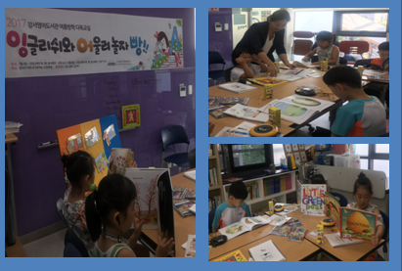
Motivation events
Book café
- a special class which is constructed to foster indepedent reading
- Like café, it creates a comfortable and pleasant atmosphere with drinks and music.

Slide 18
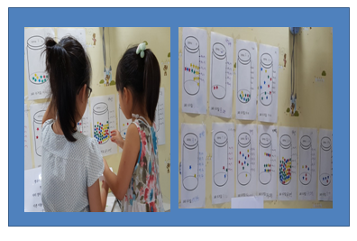
Motivation events
IR(Independent Reading) Jar
IR (independent reading through audio assist)
Students decide the amount of reading for two months
Mark target book numbers and put stickers

Slide 19
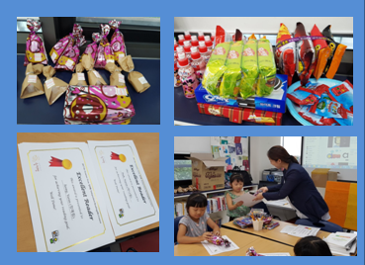
Motivation events
IR(Independent Reading) award
- Once in two months
Teacher presents certificates and souvenirs to students who achieve their own goals.
Best reader award, Excellent reader award
Notes:
교사가 학생 스스로 설정한 목표를 달성한 학생들에게 상장과 기념품을 수여한다.

Slide 20
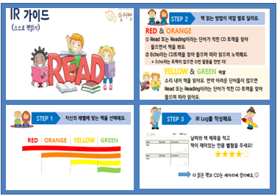
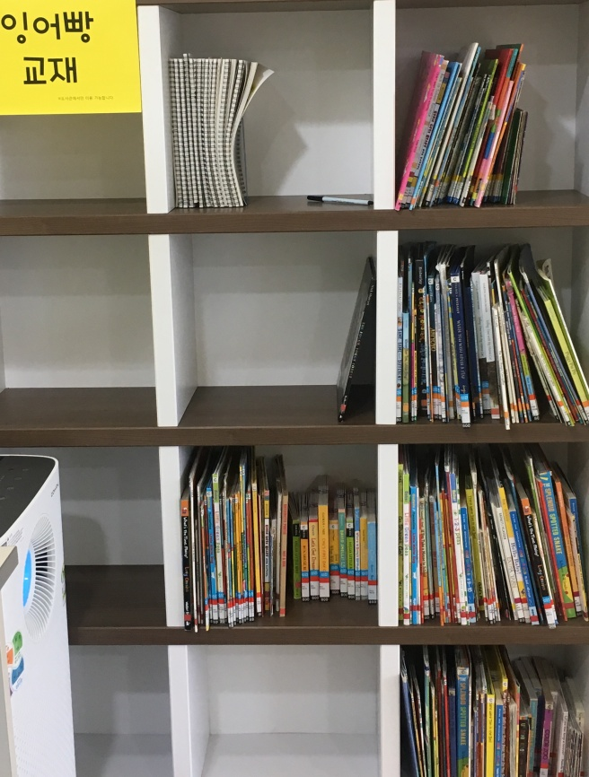
Beginners friendly ER environment
Separate book shelf
Authentic books & leveled readers
Marked levels by color (Red, Orange, Yellow)
Audio CD & CD player
Independent reading guide poster

Slide 21
Implementation
10 participants (Elementary 1st – 3rd grade)
English Library
July - August, 2017
Lesson 12 times (2 times a week, 50 minutes)
Survey (Pre and post)
Diagnostic test - ERIK(English Reading Index in Korea) 이병민 외 , (2010)

Slide 22
Participants
1
2
(alphabet knowledge)
(basic phonics)
6
(can read text )
ERIK(English Reading Index in Korea) , 이병민 외. (2010)

Slide 23
Graded reading
Level | Characteristic
Step 1 | Depending on the context, individual words and phrases can be recognized. Words or phrases can be read and understood when they are provided with pictures, sound information, and lash animations in a sentence. It depends on the recount structure of the event.
Step 2 | Can read or understand the book, when a picture book consisting of one or two sentences provides pictures, voice, sound information, and visual information, In a contextualized environment, words and phrases can be understood and read again. The sequence of events is dominant, and lessons are often introduced.
ERIK(English Reading Index in Korea) , 이병민 외. (2010)

Slide 24
Lessons
12 times (2 times a week, Tuesday & Thursday)
July
4th | 6th | 11th | 13th | 18th | 20th
The very hungry caterpillar | There was an old lady who swallow the fly | Joseph had a little overcoat | Don’t do that! Survey | Today is Monday | Book café day (personal goal setting)
Outdoor storytelling lessons for public relations |  |  |  | Diagnose test
July | August
25th | 8th | 10th | 17th | 22nd | 24th
IR parents guide day | Color me happy | How do you feel? | What do I look like? | Lots of feelings | Sophie gets angry, really, really angry… Survey IR award
 | Aa, Bb, Cc | Dd, Ee, Ff | Gg, Hh, Ii | Jj, Kk, Ll
 | - | am, ap | an,at | ed,eg
 | Theme based & literacy lesson (feeling _vocabulary, sentences)
Notes:
첫 적응기간

Slide 25
Sample lesson(50 min)
1st class, 10th, August

Slide 26
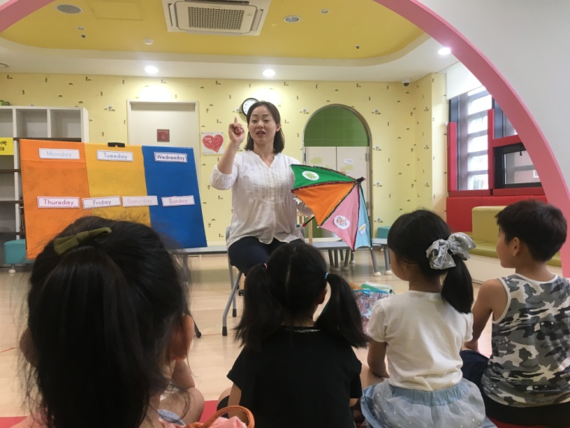
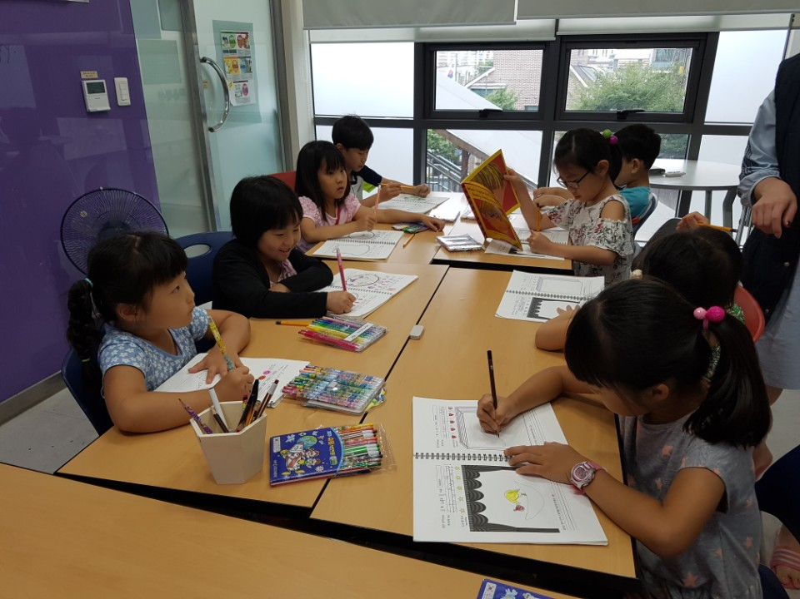
Lesson

Slide 27
Results
Did the local center based extensive reading program work on public library setting?
Post survey
Positive attitude for Extensive Reading
The classes are fun and helpful
2) How does the environment of a beginner-friendly library affect English learning outcomes?
IR result
80% of participants achieved their goal

Slide 28
Post survey result
Positive attitude for Extensive Reading
The classes are fun and helpful
Post survey
Do the classes give you confidence in English?
Did the classes help learning English?
Did you have fun with the classes?

Slide 29
2) How does the environment of a beginner-friendly library affect English learning outcomes?
Approximately 80% of participants achieved the personal goal
Rapid growth compared with local children center
Ample print environment, parents support
 | goal | IR | % | Award
Participant 1 | 10 | 12 | 120% | Excellent reader
Participant 2 | 10 | 12 | 120% | Excellent reader
Participant 3 | 12 | 12 | 100% | Excellent reader
Participant4 | 12 | 15 | 125% | Excellent reader
Participant 5 | 10 | 12 | 120% | Excellent reader
Participant 6 | 10 | 12 | 120% | Excellent reader
Participant 7 | 12 | 56 | 467% | Best reader
Participant 8 | 9 | 5 | 56% | -
Participant 9 | 9 | 3 | 33% | -

Slide 30
3) What did the program influence on the elementary students’ learning experiences?
Creating novice reader friendly ER environment
Various Motivational Events
Read aloud class based on theme based authentic books
Explicit vocabulary and phonics teaching

Slide 31
Conclusion
Through implementation of the program
Need an objective progress result
Need diversity levels
Importance of parents’ supports
More elaborate phonics instruction based on learner’s situation

Slide 32
Dr. Seuss and Geisel award

Slide 33
Thank you.

Slide 34
References
이병민 외. (2010). 영어 도서 읽기 프로그램'을 통한 학교-가정 통합 영어 교수 학습 모형 (School-Family Integrated English Instruction and Learning Model Based on Extensive English Reading Program)
Chang & Millett. (2015). Improving reading rates and comprehension through audio-assisted extensive reading for beginner learners. System. Volume 52. pp. 91-102
Day, R. R., & Bamford, J. (1998). Extensive reading in the second language classroom. Cambridge, UK: Cambridge University Press.

Slide 35
References
Diegmueller, K. (1996). The best of both words. Education Week on the Web Retrieved September 5, 2007, from: http://www.edweek.org/ew/vol15/26read.h15.
Krashen, S. D.(1993). The Power of Reading :Insights from the research Englewood: Libraries Unlimited.
Kim, H. (2011). A study of vocabulary learning through graded reading for young learners, Sookmyung Women’s University
Nuttall , C. (1982), Teaching reading skills in a foreign language. Portsmouth, NH: Heinemann
Park, J. (2015), Integrating reading and writing through extensive reading. ELT Journal, Volume70(Issue3), pp. 287-295
Waring. (1997) Graded and Extensive Reading -- Questions and Answers.from theWorldWideWeb: http://www.jalt- publications.org/tlt/files/97/may/waring.html

