Slide 1
Literature review
Summarizing & Referencing

Slide 2
Quoting, Paraphrasing, and Summarizing

Slide 3
When Quoting or paraphrasing things said by others
As stated by Name (year),…
As Name and Name discuss (year),…
Name (year) argues that….
Author (year) provides the following definition of X …
Author et al. (year) state that…
*Remember if you directly quote to add “quote” and (p. #)

Slide 4
Paraphrase the following
(Tekummru-Kisa & Stein, 2015)
There is growing agreement in the field of education that it is critical for teachers to be conscious of their own teaching action.
The critical importance of teachers being conscious of what they are doing has gained increasing support from scholars in the field of education.
(Hattie, 2009)
The more aware teachers are of themselves and their practices, the more they may be able to enhance their students’ development.
As Hattie (2009) mentions, teachers may be better able to foster their learners’ development if they have greater awareness of themselves and what they are doing in the classroom.
(Hiver & Whitehead, 2018)
Metacognition is now recognized as an important aspect of teaching and teacher development.

Slide 5
Summarizing

Slide 6
Summarizing
Highlight the key points ( cut out unnecessary detail)
List the key points
State the key points

Slide 7
Summarizing studies
Who ( what researchers?)
Investigated what ( what topic?)
With who ( participants)?
Where ( location?)
How did they collect data? (data collection methods?)
What did they find? (findings?)
How does this relate to your topic? (connection?)
Are there any problems or holes you notice? (gaps?)

Slide 8
Hopkyns, S., & Gkonou, C. (2023). Sites of belonging: Fluctuating and entangled emotions at a UAE English-medium university. Linguistics and Education, 101148.
English-medium education in multilingual university settings (EMEMUS) hosts a complex concoction of emotions amongst stakeholders. English-medium instruction (EMI) dominates higher education in the United Arab Emirates (UAE). For students, EMI creates both affordances and pressures resulting in pride, confidence, anxiety, guilt, shame, and (un)belonging. For university teachers, navigating EMEMUS can be an ‘emotion-laden process’ involving shifting identities, energy-intensive teaching methodologies, intercultural demands and ‘emotional labor’. This article presents findings from a phenomenological case study involving ten transnational university teachers and 110 Emirati undergraduate students at a UAE EMEMUS. Through metalinguistic reflections, participants discussed emotions and levels of belonging. Thematic analysis of the data revealed shifting positionalities which led to complex and entangled emotions. Intersecting identity aspects such as English proficiency, linguistic background, and language ideologies influenced emotional experiences. The article argues for greater recognition of stakeholders’ emotional labor and sociolinguistic lived realities rather than a one-size-fits-all approach to EMI.
Highlight the Key points
List the key points
State the key points

Slide 9
Useful phrases when presenting other studies
Name (year) conducted a study…
A study conducted by Name and Name (year)…
Name (year) examined/ investigated…
In an analysis of X, Name et al. (2012) found …
In a follow-up study, Name et al. (2009) found that …
In an investigation into X, Name et al. (2012) found …
In a study investigating X, name (2004) reported that …

Slide 10
Task
Try to summarize the following abstract
Highlight the Key points
List the key points
State the key points

Slide 11
Abstract
Abdel Latif, M. M. (2022). Coping with COVID-19-related online English teaching challenges: teacher educators’ suggestions. Elt Journal, 76(1), 20-33.
Although a number of studies have surveyed the challenges of remote English instruction imposed by COVID-19, a main research gap yet to be addressed is examining the relevant pedagogic experiences and suggestions given in language teacher educators’ blogs. Through analysing fifty-one blogs posted by teacher educators on four well-known language education websites, this study attempted to identify their perceived COVID-19-related online English language instruction challenges and suggested coping strategies. Analysing the blogs revealed nine main perceived online English teaching challenges associated with the teacher, learner, and online instruction implementation. To overcome these challenges, the teacher educators suggested seventeen main coping strategies pertinent to planning for online teaching, managing online classrooms, supporting students’ mental health, enhancing students’ ability to use/access technology, fostering active language learning engagement and motivation, and promoting teacher professional practices and wellbeing.

Slide 12
Teachers’ views on the qualities of effective EFL teacher educators
Rui Yuan and Yalin Hu (2017)
This research explores the qualities of effective EFL language teacher educators from the perspectives of pre- and in-service teachers at a university in China. Drawing on data from focus group interviews with these teachers (from different teacher education programmes at the university), the findings of the study demonstrate the perceived qualities of effective language teacher educators, including, in the words of some of the participants, being ‘fountains of knowledge’, having ‘eyes on the stars and feet on the ground’, and ‘providing a personal touch’. This study offers an important frame of reference for EFL teacher educators to reflect on and improve their professional practice in order o meet their students’ complex and diverse learning needs.
Highlight the Key points
List the key points
State the key points

Slide 13
Yuan and Hu (2017) conducted a study which examined the qualities effective language teacher educators from the perspective of pre- and in-service teachers in China. Data were collected through 18 students divided into three focus groups based on their major. They found that teacher educators being highly knowledgeable, practical but future oriented in their teachings, and having their own effective teaching style were perceived to be important characteristics by the participants. Their study provides a framework of reference for teacher educators to reflect on their characteristics and professional practice.

Slide 14
Teachers’ views on the qualities of effective EFL teacher educators
Rui Yuan and Yalin Hu (2017)
Authors (2017) conducted a study that investigated…
Participants from where…participated in the study.
Data were collected through ....
They found that…
They suggest that…
Highlight the Key points
List the key points
State the key points

Slide 15
SYnthesizing

Slide 17
Synthesizing literature
Bringing different sources together.
Logically organizing connecting different sources to provide a clear picture of the situation.
Requires proper referencing.

Slide 20
Jennie uses quotes from only ONE source and fails to use her own voice to make any arguments

Slide 21
Lisa picks quotes she likes from THREE sources and uses block quotes instead of using quotes to report the situation and support her claims.

Slide 22
Jisoo quotes from THREE sources but does not show how the sources interact or converse with one another and does not provide sources for their arguments in the final paragraph.

Slide 23
Rose synthesizes from FIVE sources, shows how they relate to one another, and uses them to support her points.

Slide 24
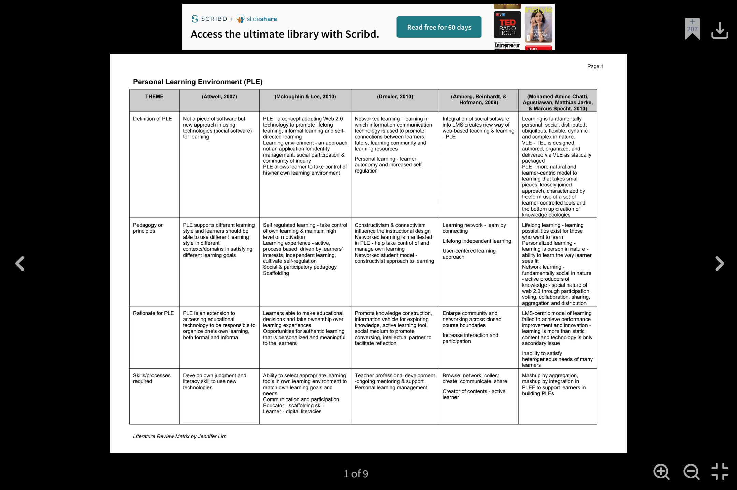

Slide 26
Writing the literature review

Slide 27
What is the purpose of a literature review
To provide a detailed background from which your study was conceptualized.
To provide a detailed background into why your study is important.
To outline the theory (framework) you are adopting in your study.
To outline the lens under which you are investigating your topic. (complexity lens, sociocultural lens)

Slide 28
A Literature review should answer the following questions
How is this topic defined?
Who are the key researchers in this area?
What key work have they done in this area?
What is the current state of knowledge?
What do we know now about this topic?
What are the problems, issues and controversies exist at present?
What further research is needed? Why is it needed?

Slide 29
Tip
Look at papers similar to yours. See what have included in their literature review.
Try to outline your key sections based on other people’s literature reviews.
Do NOT include irrelevant information in your literature review.
Everything you have in the literature review should be directly connected to the focus of your study.

Slide 30
Possible outline
Explaining the “Key Topic”
Where did this topic originate?
How has the topic been defined in the field?
What are the key components?
How does your key topic relate to other key issues in your project?
Lesson from the research
What have researchers found in regards to your topic ( both positive and negative)
What studies have been done?
What have they found?
What different perspective exist on your topic?
What have we learned thus far from the research on the topic?
What is missing? What have others suggested in regards to future research?
How does your research come out of this?
What are the gaps in the literature?
What research still needs to be done?
This may be mentioned directly or indirectly.
Based on the literature to date on this topic few studies have examined X…
As mentioned by Author (year), more research is required to understand X
Although many studies have examined X in relation to Y very little research has been done examining X’s relation to Z.

Slide 31
Literature review
writing

Slide 32
Purpose of a literature review
Tells what others have found on topic
Provides a context from which to position your paper and how it extends or advances understanding and knowledge
Demonstrates that the author is familiar with past and present thinking on a topic and understands where their work fits
Highly selective and specific, referring to other pieces of work most relevant to the argument being made
Literature Review
Justifies your research
Gives you an overview on a topic
Keeps you up to date on a topic
Provides you with a solid background knowledge base for your own future research
Establishes your credibility on a topic

Slide 33
What is a literature review
Discusses published information about a specific topic
Summarize
Critically analyze
Synthesize

Slide 34
Summarizing
A Literature Review summarizes existing current research on a specific topic
Not an exhaustive summary of all articles but only materials that are directly relevant to the narrowed topic
Not a list of articles but a recap of important information on a topic.
Draws upon the most recent, relevant, and reviewed articles

Slide 35
Synthesize
A Literature Review synthesizes existing current research on a specific topic
Identifies the controversies and differences of opinions
Finds the holes/gaps in current reproach on a topic
Uses the thesis statement to organize the summaries
Compares and contrasts articles

Slide 36
Critically analyze
A Literature Review critically analyzes existing current research on a specific topic
Does not take a study at face value but probes deeper into the study
Takes the reader’s perspective into account when reading research
Thinks about the author’s perspective in the research
Thinks about the findings in a broader context

Slide 37
Getting started

Slide 38
Synthesizing definition and providing your conceptual definition
Many scholars have provided different definitions of X over the years, for example Author (year) defines X as “…” (p. #).
Author (year) provides a slightly different description of X…
In this study X definitions will be adopted.
In this study X is defined as …

Slide 39
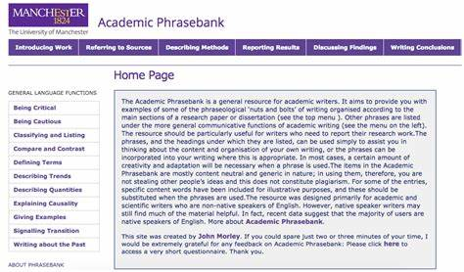
Helpful Phrases
X had been defined as….
The key features of X are….
Some people define X as A and other define X as B…
Author (year) argues that…
As Author (year) explains…
As Author (year) outlines…
As suggest by Author (year)…
Author (year) found that…
It has been found that ……..a………b…………..(author, year; author, year)
Some studies have shown that…
Some studies have suggested that….
In a study conducted by Author (year), it was found that….

Slide 40
Reporting different conceptualizations
Most researchers attribute the concept of metacognition to John Flavell. He defines metacognition as “one’s knowledge concerning one’s own cognitive processes and products or anything related to them” (1976, p. 232).
“In the available literature, metacognition is defined as a range of beliefs, thinking, understanding, behaviors and strategies for current and future actions, which are subject to social, contextual and cultural modifications as and when the location where the learning enterprise takes places changes. Metacognition in such cases is most often dynamic and systematic.”(Efklides, 2001, p. 116)
“Metacognition can be defined simply as thinking about thinking. Learners who are metacognitively aware know what to do when they don't know what to do; that is, they have strategies for finding out or figuring out what they need to do.” (Anderson, 2002, p. 2)
Numerous researchers define metacognition and its components differently and the field still awaits future theoretical work that would provide a thorough theoretical analysis and integration of the extensive literature in this area to attain a unified definition of this construct (Veenman, van Hout-Wolters, & Afflerbach, 2006, p. 122)

Slide 41
Synthesizing Studies’ findings
To date, various positive effects of interactive e-books on students’L1 and L2 reading performance have been reported with benefits including vocabulary growth (Korat & Shamir, 2007;Smeets & Bus, 2015), improvements in reading comprehension (Kao et al., 2016; Marzban, 2011a, 2011b; Takacs & Bus, 2016), and the enhancement of phonological awareness (Korat, 2009, 2010). However, negative effects have also been found relating to students reading comprehension as a result of eye fatigue from reading on a screen (Jeong, 2012), and formed habits of skimming and scanning screen content(Lenhard et al., 2017; Singer Trakhman et al., 2018). As it currently stands, understanding the impacts of interactive e-books onL2 learning is still a work in progress. Furthermore, when comparing the benefits of interactive e-book reading to paper-based reading, it is still unclear whether one form is better than the other, and in what capacity (Jeong, 2012).

Slide 42
For important studies that you feel need to be presented in full you can use the full summaries
Yuan and Hu (2017) conducted a study which examined the qualities effective language teacher educators from the perspective of pre- and in-service teachers in China. Data were collected through 18 students divided into three focus groups based on their major. They found that teacher educators being highly knowledgeable, practical but future oriented in their teachings, and having their own effective teaching style were perceived to be important characteristics by the participants. Their study provides a framework of reference for teacher educators to reflect on their characteristics and professional practice.

Slide 43
Recipe for a literature review
TIPS:
It is better to paraphrase or summarize most of the time rather than directly quoting
Use direct quotes cautiously and make sure you reference appropriately
A lit review is not jump dumping quotes on paper. It is critically presenting what others said (kind of like teaching- teacher learns the content- teaches it in their own way)
http://www.phrasebank.manchester.ac.uk/referring-to-sources/

Slide 44
Tips
Refer to others’ literature reviews ( You should have at least 6 ^^)
Look at their wording
Look at the structure
Organize your writing in a way that will make logical sense to the reader
This will challenge your summarizing a paraphrasing skills
This will take quite a bit of time and revision; Don’t try to rush it!
Don’t try to write it all at once

Slide 45
Referencing confusion?

Slide 46
Paraphrasing vS. direct citing Who to cite and when
Whitehead, G. (2017). Teachers’ voices: Obstacles to communicative language teaching in South Korea. Asian EFL Journal, 19 (4).
Since its inception in the late 1960s, Communicative Language Teaching (CLT) has grown in popularity and has had widespread adoption in ESL countries (Li, 1998). However, when policies and curricula have shifted to CLT in EFL contexts researchers have been quick to find a gap between policy and practice (Nunan, 2003).
Who do you cite? Whitehead, Li, Nunan?

