Slide 2
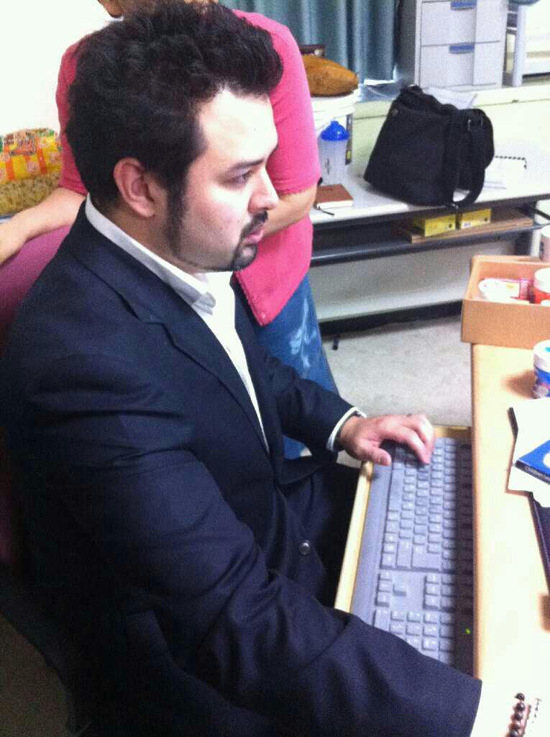
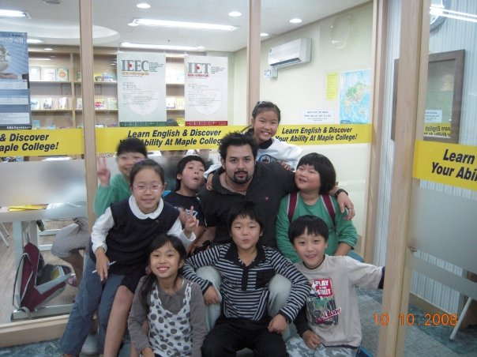
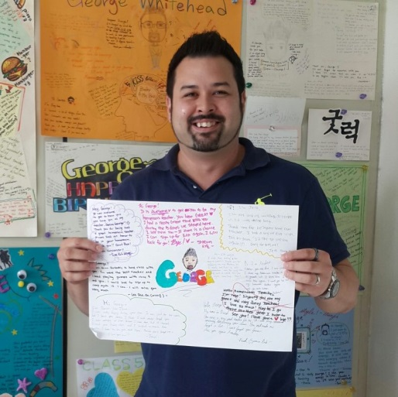
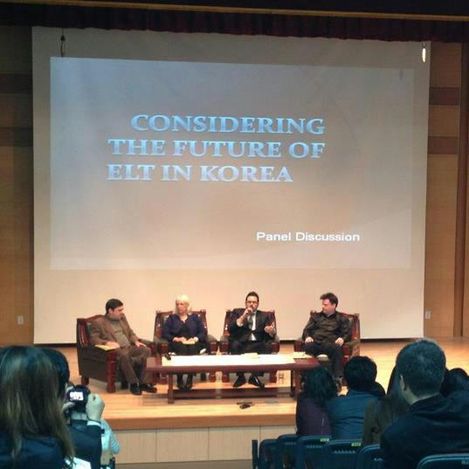
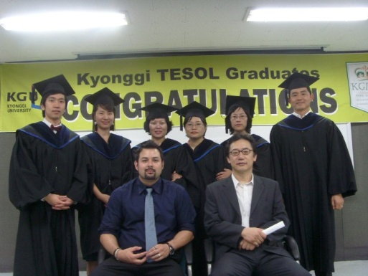
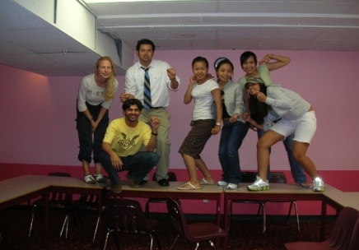
About me
George Elliott Koichi Whitehead
경일
Prof.G

Slide 3
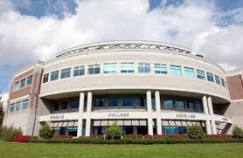
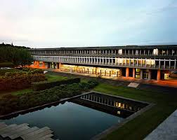
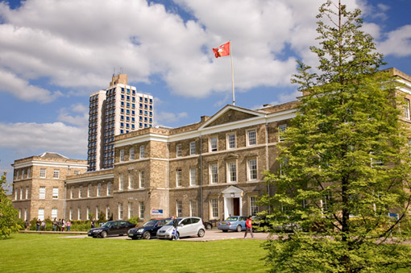
Associates of Arts
BA Linguistics
Certificate for Teaching ESL Linguistics
MA TEFL/ TESL
PhD Education (in progress)

Slide 4
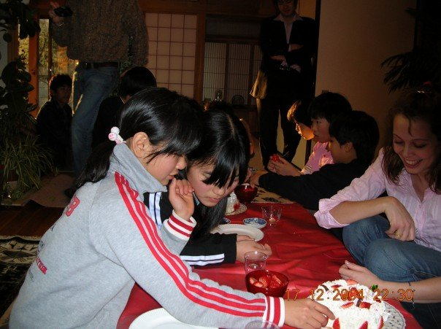
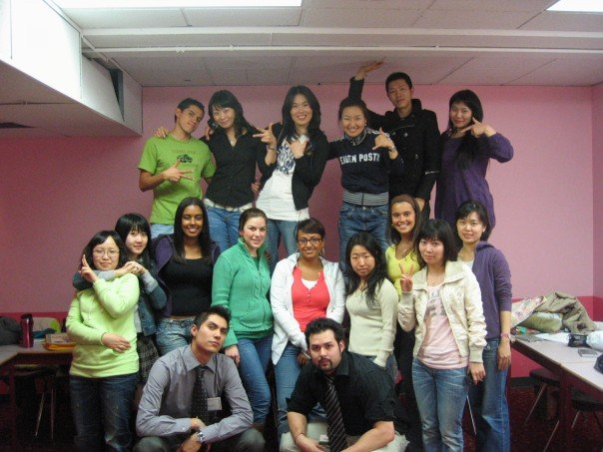
My 16 Year Career
The beginning…

Slide 5
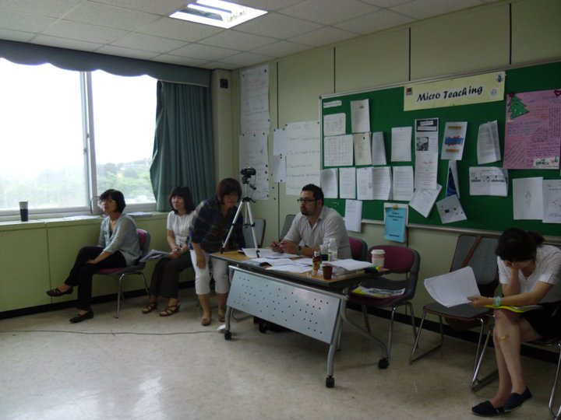
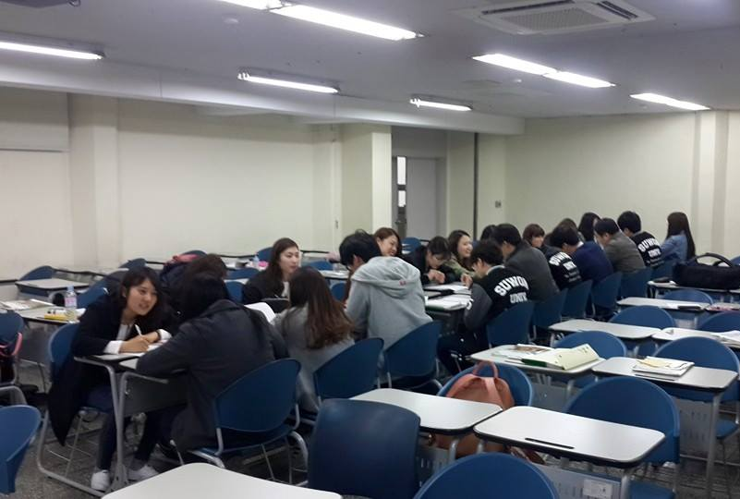
My 14 Year Career continued..

Slide 6
Additional Work
Darakwon Publishing (Author, Editor, Advisor)
Books
Gang, Y.S., Kim, H.D., Whitehead, G., Goo, Y.S., Gwon, H.Y., Han, G., & Hong, G.M. (in-press). Middle School English 1. Seoul, South Korea: Darakwon.
Gang, Y.S., Kim, H.D., Whitehead, G., Goo, Y.S., Gwon, H.Y., Han, G., & Hong, G.M. (under contract). Middle School English 2. Seoul, South Korea: Darakwon.
Gang, Y.S., Kim, H.D., Whitehead, G., Goo, Y.S., Gwon, H.Y., Han, G., & Hong, G.M. (under contract). Middle School English 3. Seoul, South Korea: Darakwon.
KSAT

Slide 7
Journal Publications
Whitehead, G. (in press). Teachers’ voices: Obstacles to communicative language teaching in South Korea. Asian EFL Journal, 18 (4).
Whitehead, G. (2016). The rise and fall of the National English Ability Test: Examining Korean high school English teachers’ perspectives. Asian EFL Journal, 19(4). 124-155.
Greenier, V., & Whitehead, G. (2016). Towards a model of teacher leadership in ELT: Authentic leadership in classroom practice. RELC Journal, 47(1), 79-95 DOI: 10.1177/0033688216631203.
Whitehead, G. (2011). English mostly. Blue Hills Journal, (9), 32-35.
Whitehead, G. (2010). TEE: Successful instructions and explanations. Blue Hills Journal, (6), 30-33.

Slide 8
Ask George!

Slide 9
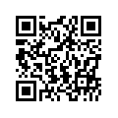
Contact
Website: profgwhitehead.weebly.com
Email: prof.gwhitehead@gmail.com

Slide 10
Intercultural Communication
with Prof. George E.K. Whitehead

Slide 11
The course
This course is designed to: 1. develop a deeper understanding of how the English language and culture are related
2. develop a critical eye for how language is taught and treated in EFL contexts
3. develop a greater awareness and appreciation for different cultures
4. develop better intercultural communication skills
5. reflect on the goals of learning English and what it means to be a good English speaker in the global era.

Slide 12
Course Topics
1. Introduction to Language & Culture 2. English as an International Language 3. Intercultural communication
4. Using L1 in EFL classrooms 5. Culture in language teaching and learning 6. Compressibility in pronunciation
7. Application project

Slide 13
Course Evaluation
Participation, Professionalism, Attendance 30 Points Reflection Task(s) 5 Points Application Project 15 Points Total 50 Points

Slide 14
Additional Details and Information
Homepage: profgwhitehead.weebly.com

