Slide 1
Language and Culture
Examining the relationship between language and culture

Slide 2
THINKING TASK
1) How would you define culture?

Slide 3
CULTURE from the Latin word ‘colere’: to build ,to care for’, to plant or to cultivate.
Culture is a fuzzy set of attitudes, beliefs, behavioural norms, and basic assumptions and values that are shared by a group of people, and that influence each member's behaviour and his/her interpretations of the "meaning" of other people's behaviour.
(Helen Spencer-Oatey, 2000)
Culture is the fabric of meaning in terms of which human beings interpret their experience and guide their action.
(Clifford Geertz)

Slide 4
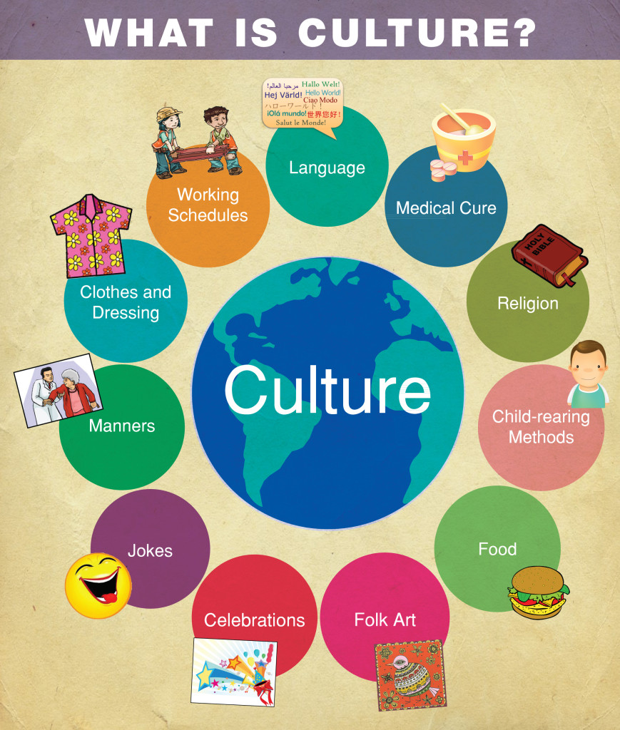

Slide 5
TYPES OF CULTURE
● CORPORATE CULTURE (the culture of a company or workplace)
● PROFESSIONAL CULTURE (the culture of a profession i.e. teachers, entertainers)
● GENDER CULTURE (the different cultures of men and women)
● AGE CULTURE (the culture of young, middle-aged, and old people)
● RELIGIOUS CULTURE (i.e. Christianity, Catholicsm, Islam, Buddhism)
● REGIONAL CULTURE (Seoul, Busan)
● CLASS CULTURE (working class, middle class, and upper class)

Slide 6
‘The Culture Onion’
C O U N T R Y
C O M P A N Y
T E A M
I N D I V I D U A L

Slide 7
Iceberg Model
Arts
Food
Games
Music
Language
Appearance
Tempo of Work
Use of Time
Incentives to Work
Policies to Work
Notions of Leadership
Body Language
Problem - Solving
Approaches
Superior/Subordinate Relationship
Rules of Hierarch
Notions of Responsibility
Status
Concept of Past and Future
Age/Sex/Occupation/Kinship

Slide 8
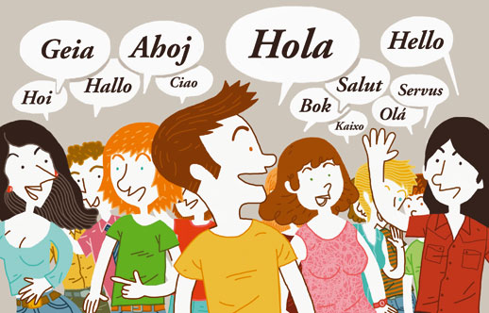
INTRACULTURAL vs INTERCULTURAL
Intracultural
1) The term intracultural is used to norms and beliefs from within one cultural group.
i.e. Cultural values and beliefs held among Korean citizens is intracultural.
Intercultural
1)The term intercultural is generally used to describe dimensions of culture that are not culture specific.
i.e. cultural dimensions applicable for all cultures.
2)Intercultural is also used to describe the culture that exists between those from different backgrounds.
i.e. English speakers

Slide 9
LANGUAGE & CULTURE
Think about the Korean language:
1) How are language and culture related?
2) Does culture affect language?
3) Does language affect culture?
Now think about learning English:
1) How is English and culture related?
2) Does culture affect language?
3) Does language affect culture?

Slide 10
REFERENCES
Spencer-Oatey, H. (2000). Culturally Speaking : Managing Rapport through Talk across Cultures. London, Continuum.

