Slide 1
Key Words

Slide 2
confiscate (v)
The guards confiscated his camera after warning him not to take pictures.
The professor confiscated his phone after he continued to use Kakaotalk during class.

Slide 3
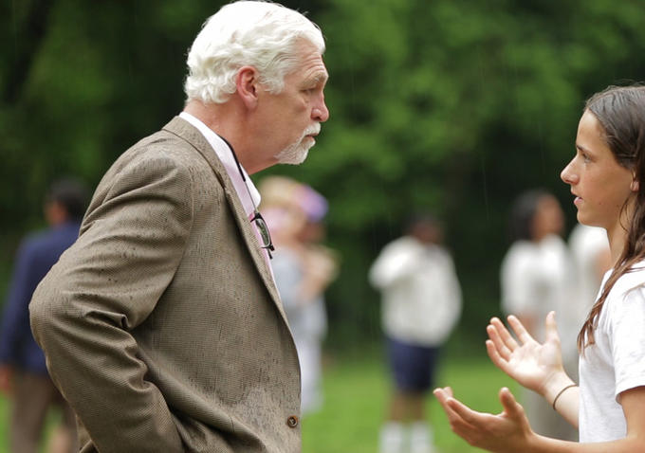
confront (v)
The professor confronted the student about cheating on the test.
The professor confronted the student about cheating on the test.
To meet face to face in an accusatory manor

Slide 4
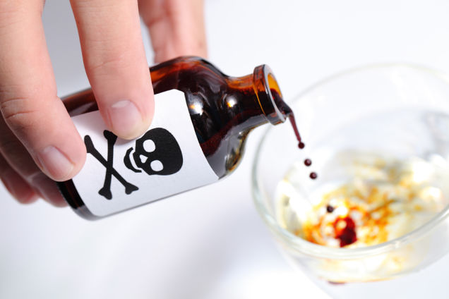
poison (v)
They tried to poison his food but the King didn’t eat it after his chopsticks changed color.

Slide 5
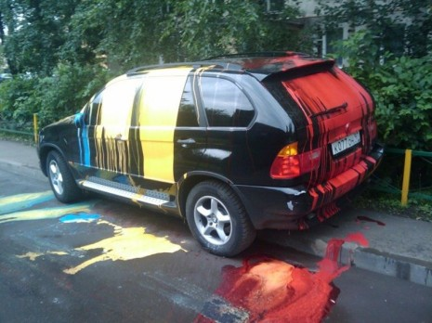
get revenge(v)
She got revenge on her cheating boyfriend by dumping paint on his car.
To get even for something negative, to payback something negative

Slide 6
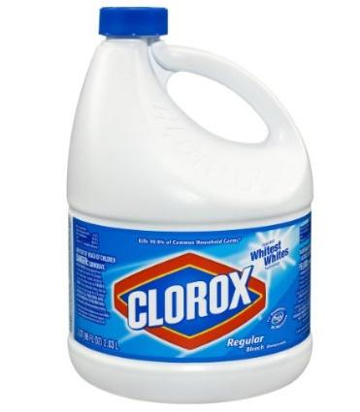
bleach (n)
They used bleach to get their clothes white.

Slide 7
12-Year-old Girl Tries to Poison Mom for Taking her iPhone Away
What are some questions you have when looking at this headline?
What do you want to know?

