Slide 1
“Western” Focused
Issue 3: Overfocus on westerners

Slide 2
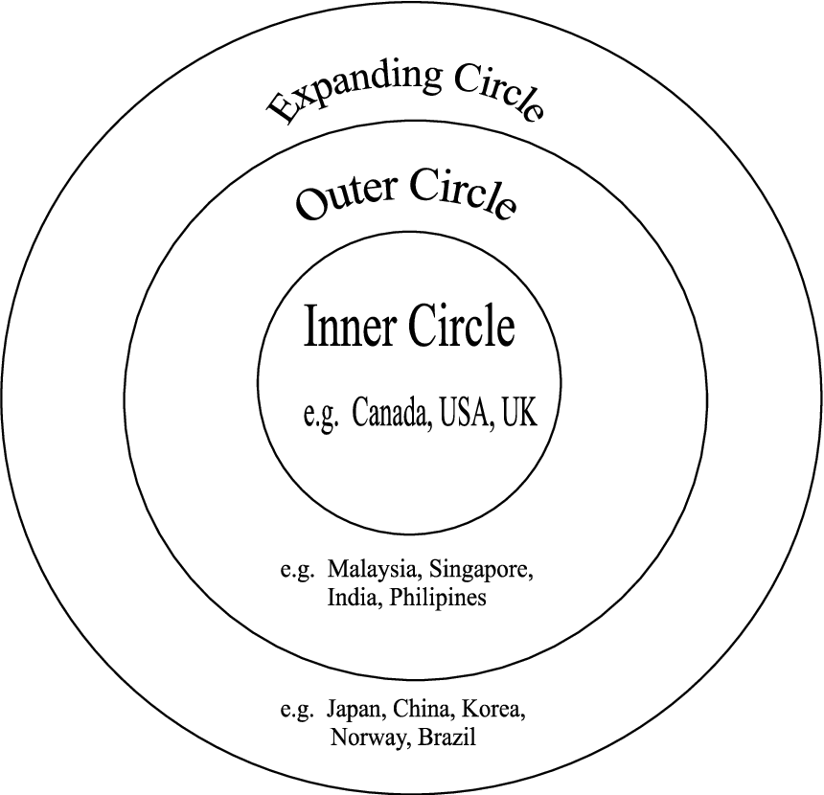
Localization of content
Historically, the English language began to spread around by native speakers of the language.
This brought with it a focus on the native speaker.

Slide 3
The McDonald’s analogy
Now, English is a global language being taught and learned in countries all over the world.
It is not longer a language attached to a native speaker.
It has become a language of the people using it.
Adopted into their country and culture

Slide 4
The issue
Some materials still tend to focus on the native speaker
Pictures
Names
Topics
Content
Materials should reflect the international situation of English as well as the local context of the teacher and learners.

Slide 7
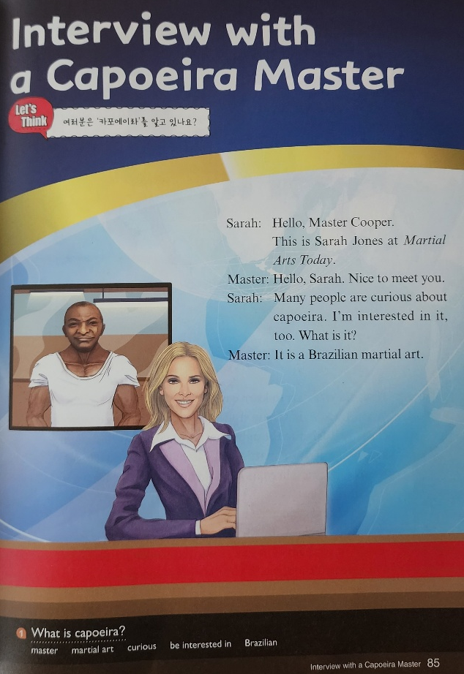

Slide 9
Inclusivity
Issue 4: Making things inclusive

Slide 10
Reflecting the present
Representing minorities
Different family situations, disabilities etc.
Considering gender prejudices (e.g., occupations)

Slide 12
Key points in materials
Authenticity – of material/ tasks
Content – Interesting for learners/ level & age appropriate/ meaningful/ relevant
Purposeful – for learning
Tasks – useful/ real-world/ promote 21st century skill development
Visuals – represent the reality of the world/ are not prejudice
Inclusivity – inclusive of various cultures/ gender/ roles etc.
Layout/ Visual appeal – attractive/ not intimidating
Organization – logical flow to the content/ lessons/ activities

Slide 13
Watch the following video
Professor Brian Tomlinson. Materials Development in TESOL: Trends and Issues

