Slide 1
Considering the broader aims of materials in language teaching
Issue 2: Beyond language

Slide 2
Critical thinking
Other than language what else can students learn/ develop in the language classroom?

Slide 3
The job of a language teacher
Goes beyond just teaching language.
Building communicative bridges and understanding between people of different languages and cultures.
Fostering global citizens.
Inspiring/motivating students to be autonomous learners.
Building students’ confidence.

Slide 4
Objectives can be more than just language focused
Physical
Emotional/ Affective
Social
Cognitive/ Metacognitive

Slide 5
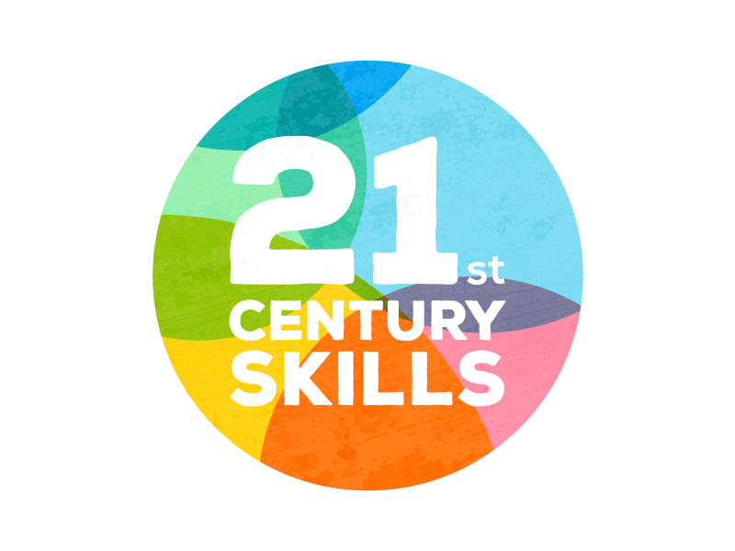
21st Century Skills
In your opinions, what skills do you think are important to succeed in our world today?

Slide 7
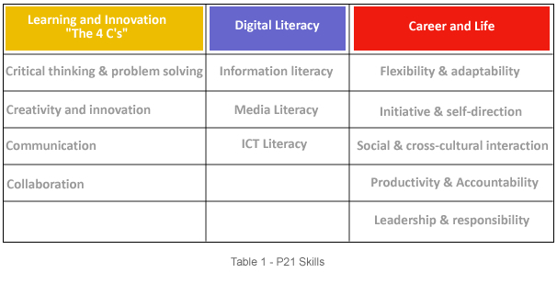
21st Century Skills – P21 Skills
In 2002 the Partnership for 21st Century Skills (now the Partnership for 21st Century Learning, or P21) was created.
It includes members of the national business community, education leaders, and policymakers

Slide 8
For a more comprehensive list
www.profgwhitehead.weebly.com

Slide 9
Education in the 21st Century
The old-school model of passively learning and reciting things from memory is no longer sufficient to prepare students to survive in today's world.
Language learning and teaching goes beyond language.
Through language learning students are learning to be part of the larger global community.
Students need both fundamental skills (language, science, math, etc. ) and 21st century skills (teamwork, problem solving, research gathering, time management, information synthesizing, utilizing high tech tools)to guide them in today’s world both domestically and internationally.

Slide 10
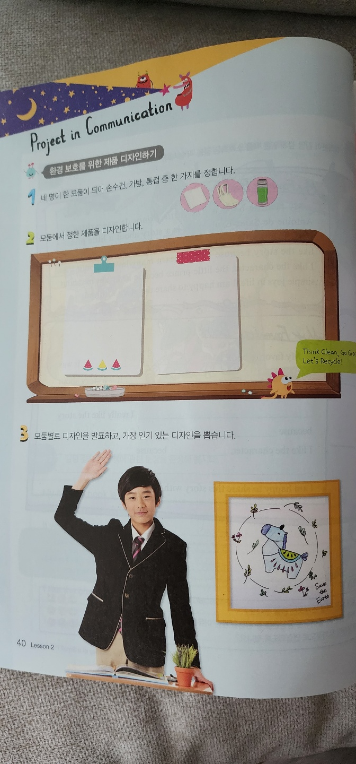
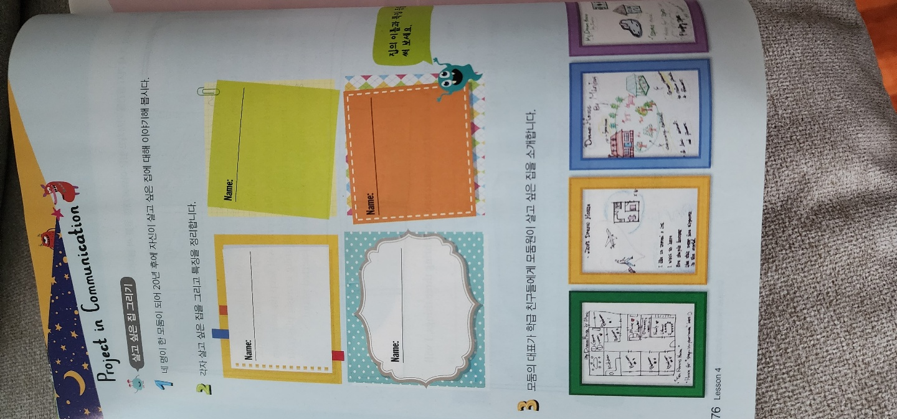

Slide 11
Critical Assessment
PUTTING WHAT WE HAVE LEARNED INTO PRACTICE

Slide 12
What is the problem with the following materials?

Slide 13
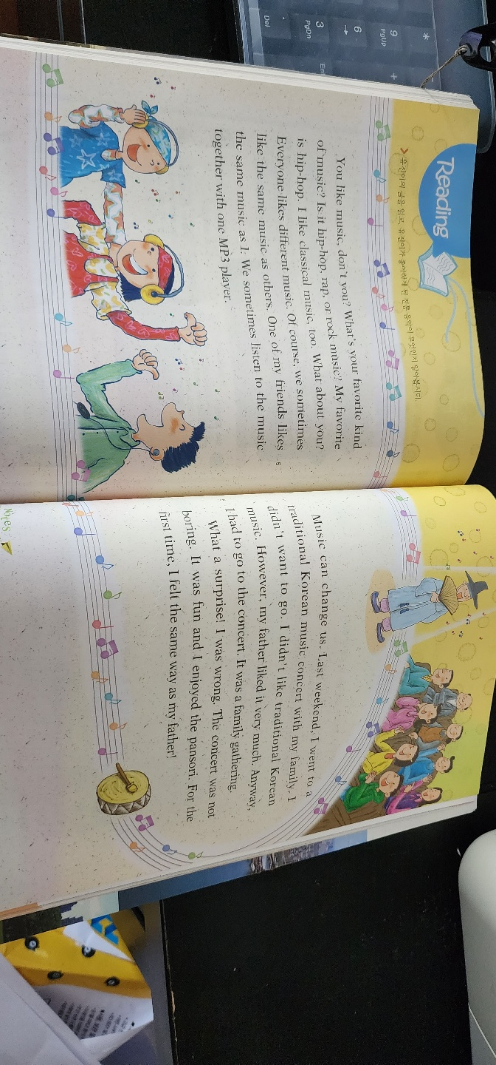
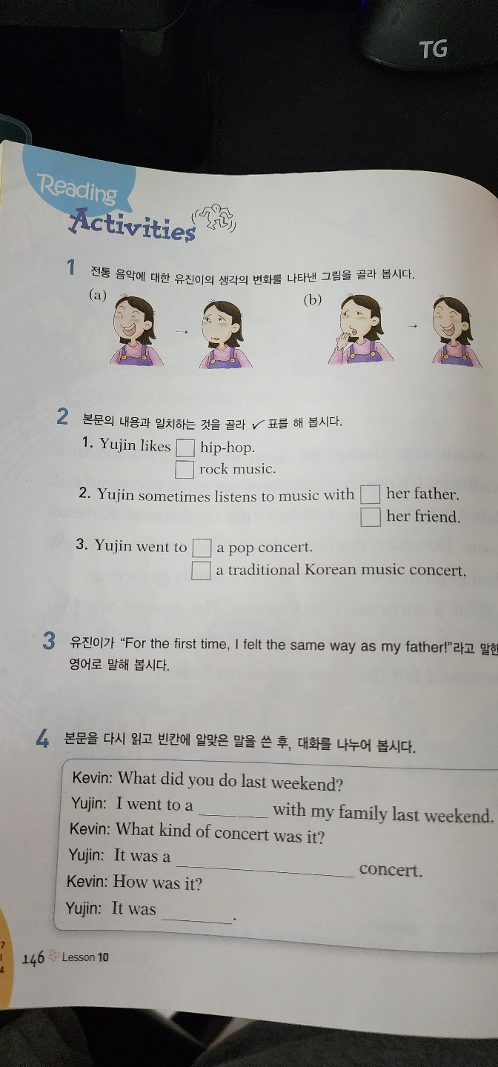

Slide 15
