Slide 1
Key Concepts & Considerations in ELT Materials Development
Setting the groundwork

Slide 2
Critical Thinking
In your opinion what are some of the problems with textbooks today?
Write down as many thing as you can think of with the people around you.
Try to provide examples if you can.

Slide 3
Relevance and Relatability in ELT Materials
Issue 1: Thinking from The students perspective

Slide 4
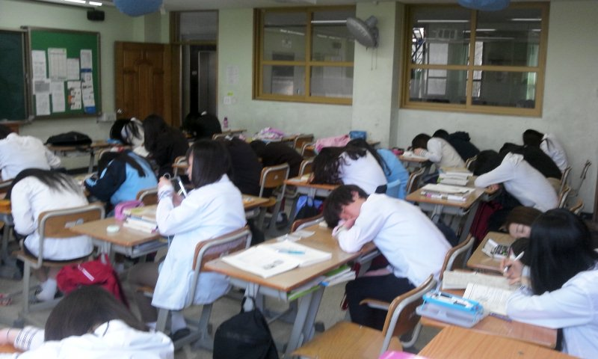
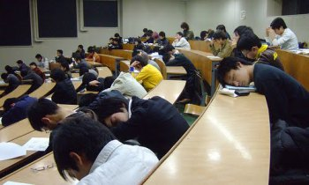
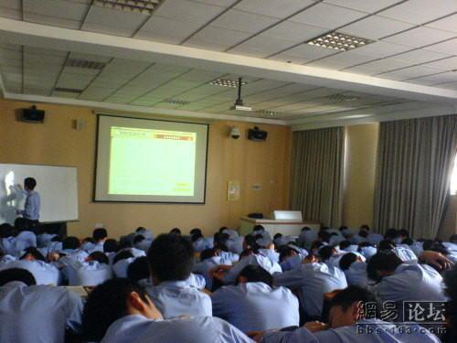
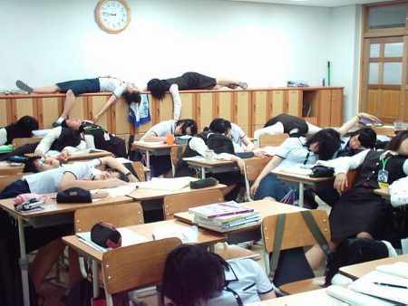
Why do classes look like this ?

Slide 5
Compelling materials
One problem with a lot of current material is that it is boring (the complete opposite of compelling)
One of the main reasons is that the content is not relevant, relatable, or interesting to the learners.
Our job when creating ELT materials is to try to make them compelling to students through the content, organization, and visual appeal.
Compelling materials lead to greater overall motivation in learners

Slide 6
Compelling Input
“Compelling means that the input is so interesting, you forget it is in another language.”
(Krashen, 2011, 2015)

Slide 7
Relating the material
Country
Students
Individuals
People
Age
Wants
Interests
Values
Needs
Interests
Life experiences
Culture & Customs

Slide 8
Compelling or Not

Slide 9
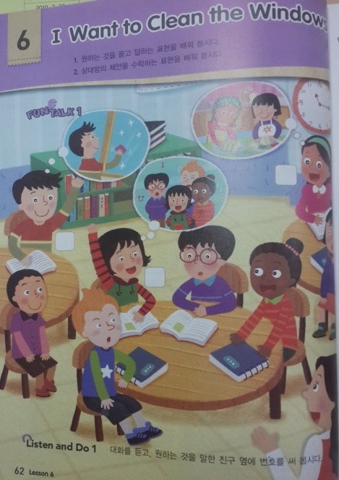
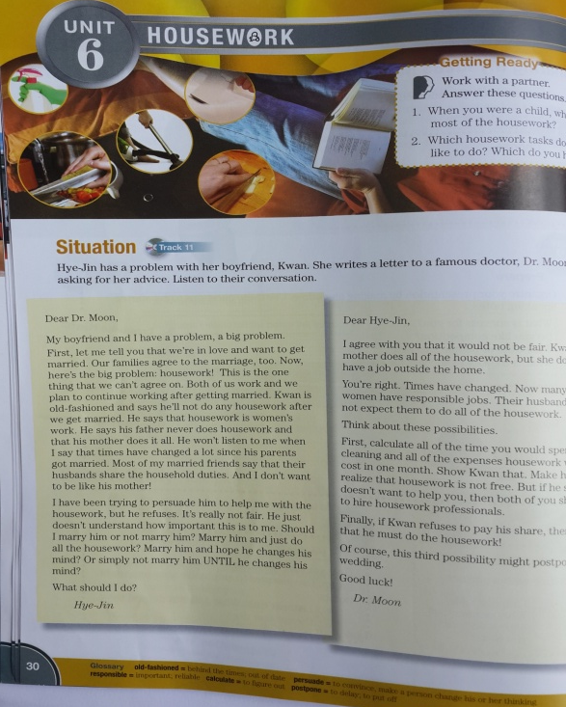
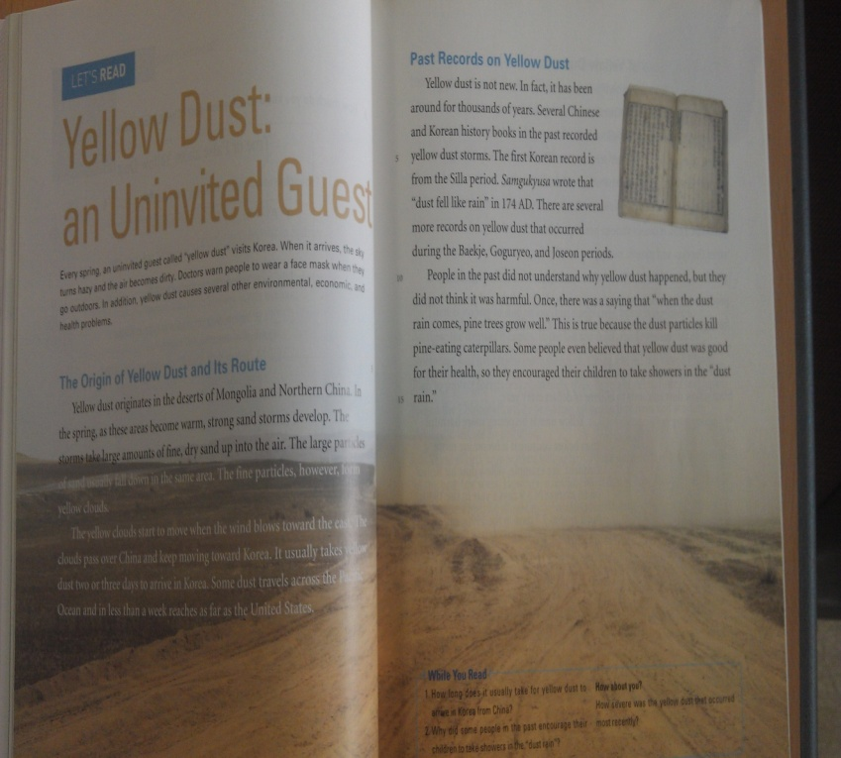
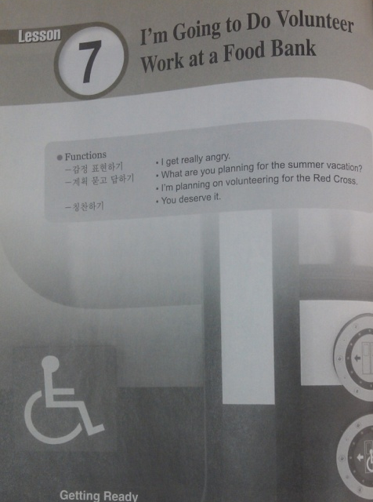
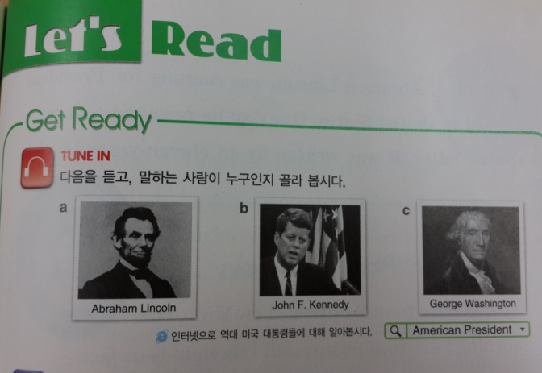

Slide 10
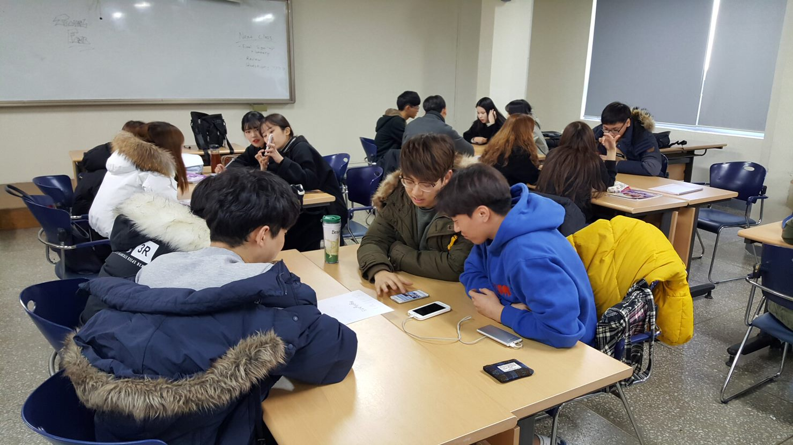
Creating Compelling Lessons

Slide 11
DO: Put yourself in the students’ position
Plan things from their perspective.
Ask yourself, if I were them would It be relevant, relatable, interesting?
Would I be excited when the teacher showed us it?
If you don’t know what is relevant, relatable, and interesting to them, ASK!!

Slide 12
DO NOT: Plan from only your point of view and assume that it is compelling
Just because you like it does not mean they will like it.
Be careful of using outdated topics/material/ characters.
Do not force what you like on the students
Don’t be offended if they don’t find it interesting… change it!

Slide 13
Compelling or Not

Slide 14
Who is compelling?

Slide 15
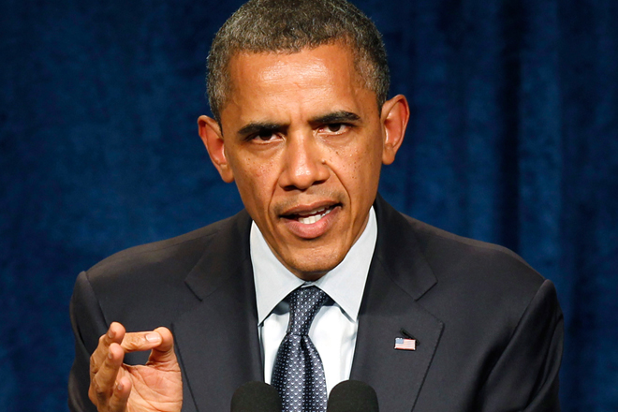
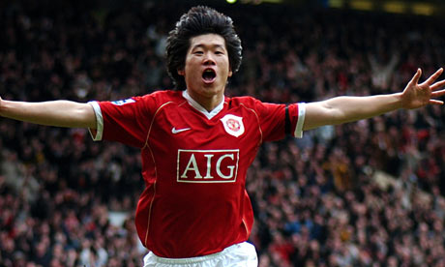

Slide 16
TASK
Make a list of “Who” would be compelling to your students right now.
Select a certain age group or grade.
Think of at least 5 people or characters.

Slide 17
What is compelling?

Slide 18
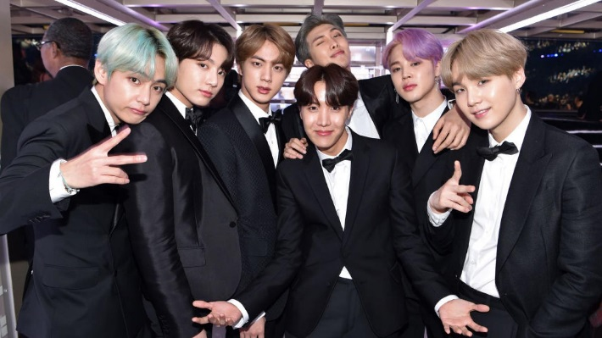
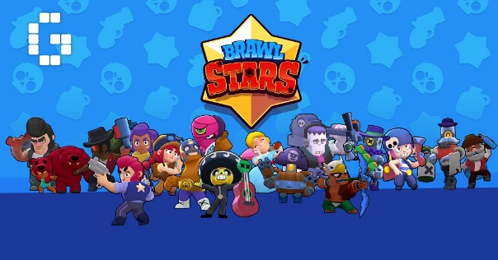

Slide 19
Compelling Examples

Slide 20
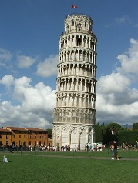
Which of the following sentences is the most compelling?
a)I have been to Italy.
b) She has eaten a spider.
c) Kim Yuna has won a gold medal.
d) Muzi and Con have kissed a gorilla.

Slide 21
Compelling or Not

Slide 22
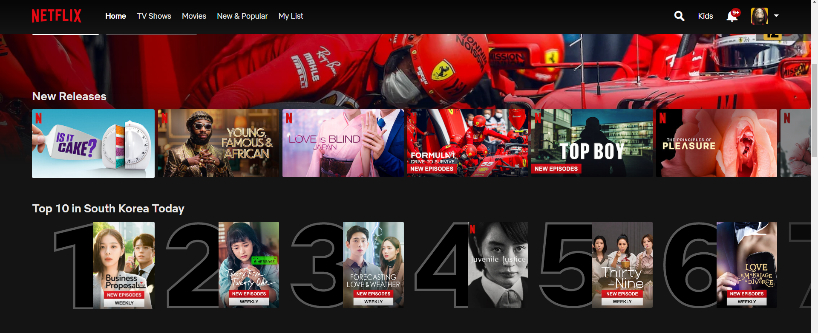

Slide 23
Compelling topics
If you were on a textbook development team and had to choose topics for 8 Chapters what topics would you choose?
Work with your group and think of 8 topics.

Slide 24
How could you make the following more compelling?

Slide 25
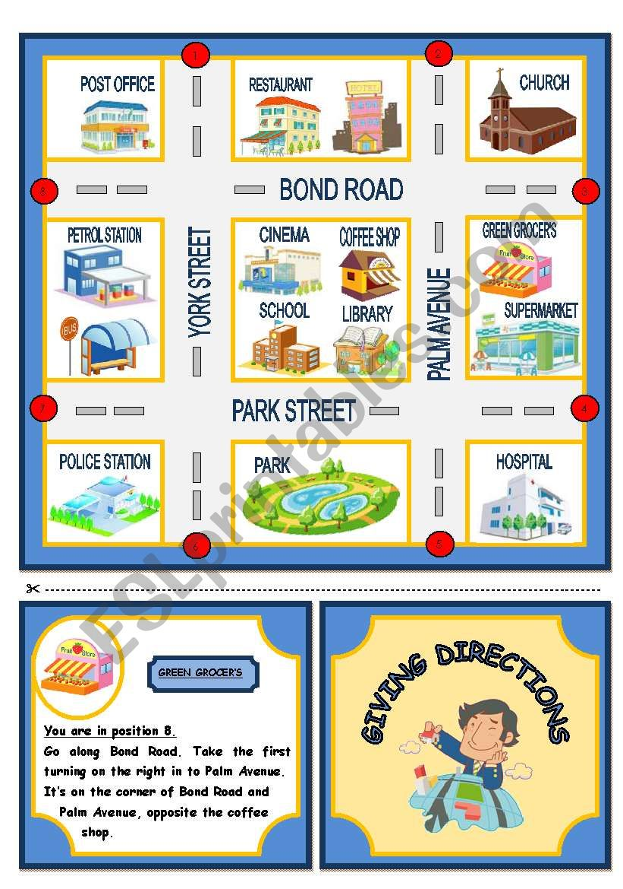
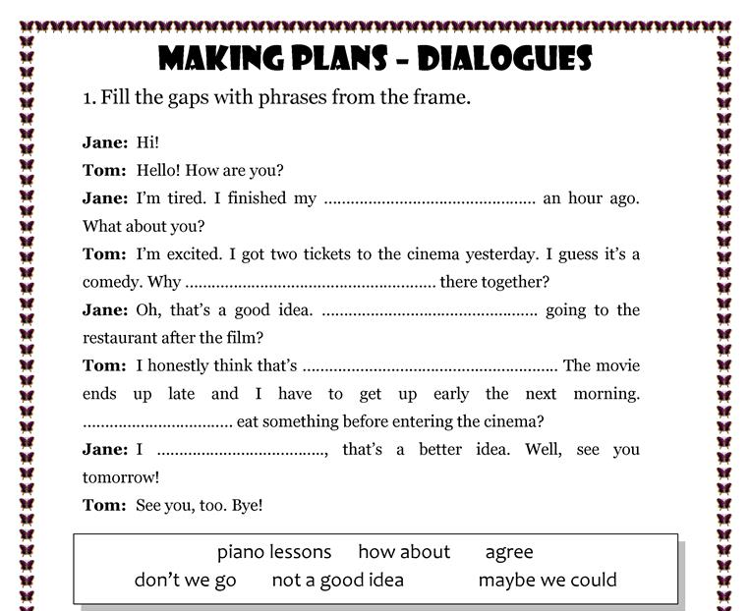

Slide 26
Needs analysis

Slide 27
Compelling topics
Don’t just guess what your students like, find out for sure!

Slide 28
Needs analysis
One of the basic assumptions of curriculum development is that a sound educational program should be based on an analysis of learners' needs.
Procedures used to collect information about learners' needs are known as needs analysis.

Slide 29
Good materials
To be relevant, relatable, and interesting to learners the content has to cater to their learning needs.
It must take into consideration stakeholders’…
purpose and aims for learning English (for business, for a test, to emigrate, for general English development etc.)
language level
preferred way to learn (individual work, groupwork, teacher-centered, student-centered etc. )
Interests/ Age / Experiences

Slide 30
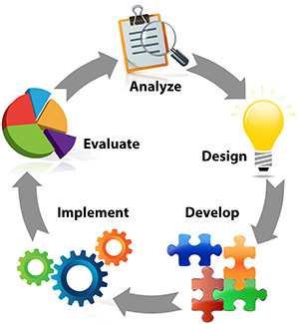
Developing your own needs analysis

Slide 31
Application Task: needs analysis
Create a needs analysis for a group of students of your choice to find out what is relevant, relatable, and interesting to them.
As homework, try to find a student that age and have them answer your questions (this can be done in their L1 rather than English)

Slide 32
References
Krashen, S. (2015). The end of motivation. New Routes, 55, 25-29.
Krashen, S. (2011). The compelling ( not just interesting) input hypothesis. The English Connection (KOTESOL), 15 (3), 1.
Prodromou, L. (1999). How to be a boring teacher. English Teaching professional, 12, 16-18.

Slide 33
