Slide 1
Key Concepts & Considerations in ELT Materials Development
Setting the groundwork

Slide 2
Critical Thinking
In your opinion what are some of the problems with textbooks today?
i.e. Boring – the topics covered in textbooks do not interest students i.e. the environment
Write down as many thing as you can think of with the people around you.
Try to provide examples if you can.

Slide 3
Some things to consider
Aims of the material
Approach being used
Content
Structure
Visual appeal

Slide 4
Considering the broader aims of materials in language teaching
Beyond language

Slide 5
Critical thinking
Other than language what else can students learn/ develop in the language classroom?

Slide 6
21st Century Skills
In your opinions, what skills do you think are important to succeed in our world today?

Slide 8
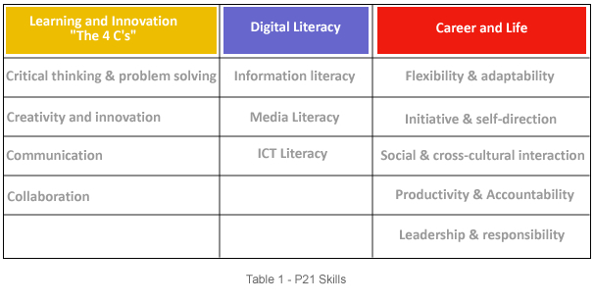
21st Century Skills – P21 Skills
In 2002 the Partnership for 21st Century Skills (now the Partnership for 21st Century Learning, or P21) was
It includes members of the national business community, education leaders, and policymakers

Slide 9
For a more comprehensive list
www.profgwhitehead.weebly.com

Slide 10
Education in the 21st Century
The old-school model of passively learning and reciting things from memory is no longer sufficient to prepare students to survive in today's world.
Language learning and teaching goes beyond language.
Through language learning students are learning to be part of the larger global community.
Students need both fundamental skills (language, science, math, etc. ) and 21st century skills (teamwork, problem solving, research gathering, time management, information synthesizing, utilizing high tech tools)to guide them in today’s world both domestically and internationally.

Slide 11
Key points in materials
Authenticity – of material/ tasks
Content – Interesting for learners/ level & age appropriate
Purposeful – for learning
Tasks – useful/ real-world/ promote 21st century skill development
Visuals – represent the reality of the world/ are not prejudice
Inclusivity – inclusive of various cultures/ gender/ roles etc.
Layout/ Visual appeal – attractive/ not intimidating
Organization – logical flow to the content/ lessons/ activities

Slide 12
Critical Assessment
PUTTING WHAT WE HAVE LEARNED INTO PRACTICE

Slide 13
What is the problem with the following materials?

Slide 14
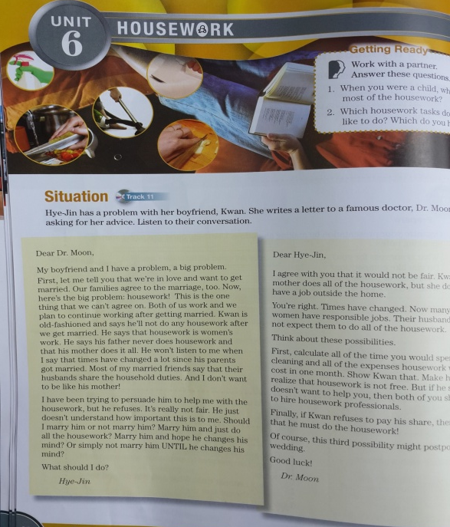

Slide 15
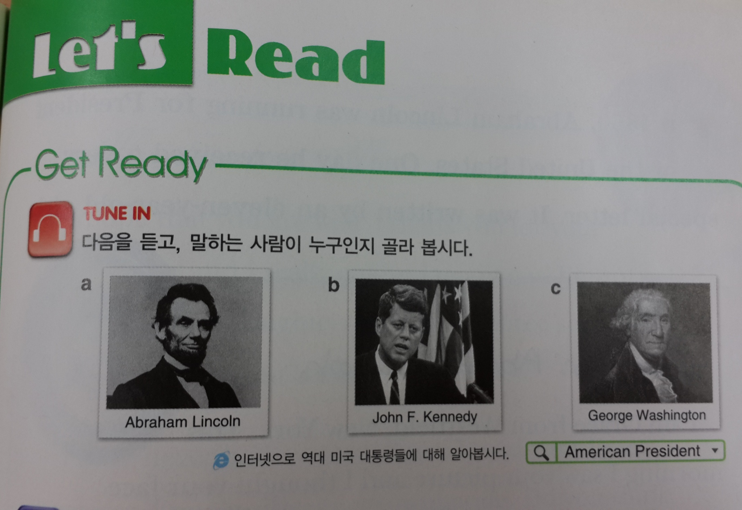

Slide 16
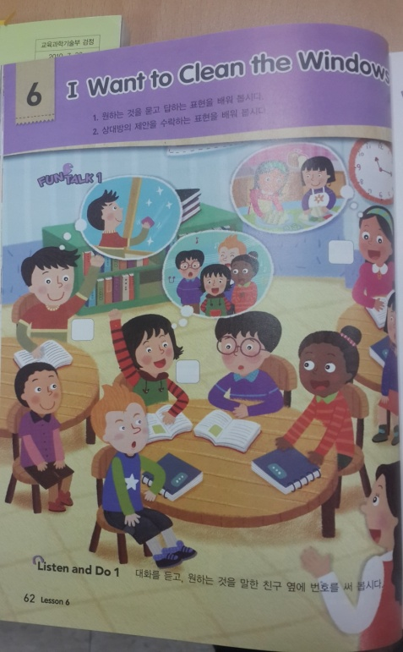

Slide 18
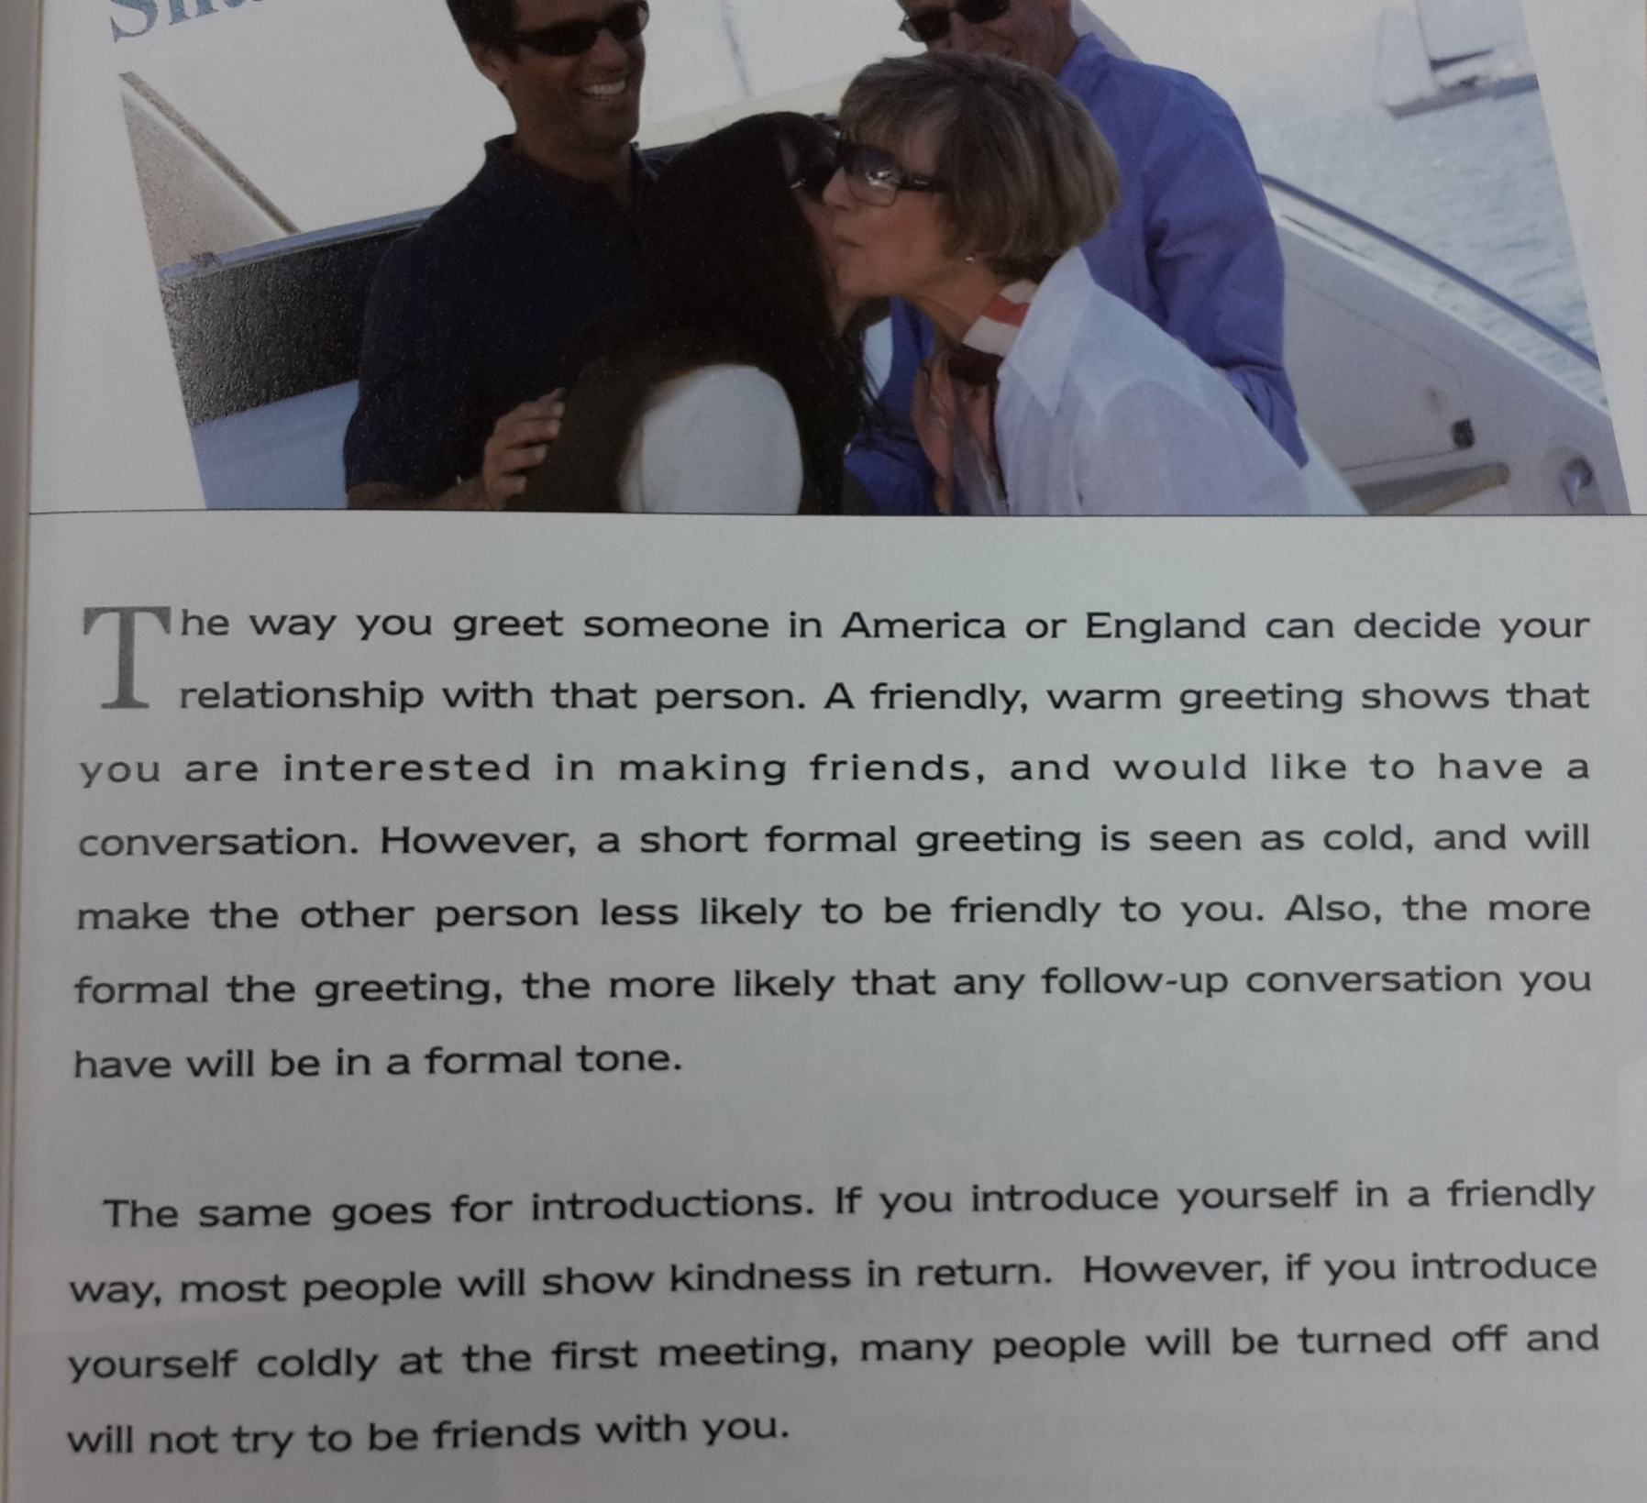

Slide 19
Reflection
Based on what we discussed in class today, what are some of the biggest problems with ELT materials in South Korea today?
After today’s lesson I want to know more about….

