Slide 1
Jobs
What do they do?

Slide 6
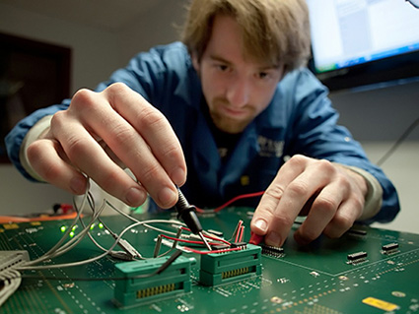

Slide 7
