Slide 1
Job Hunting
Resume, CV, Cover Letter

Slide 2
Resume vs. CV
What is the difference between a resume and a CV?

Slide 3
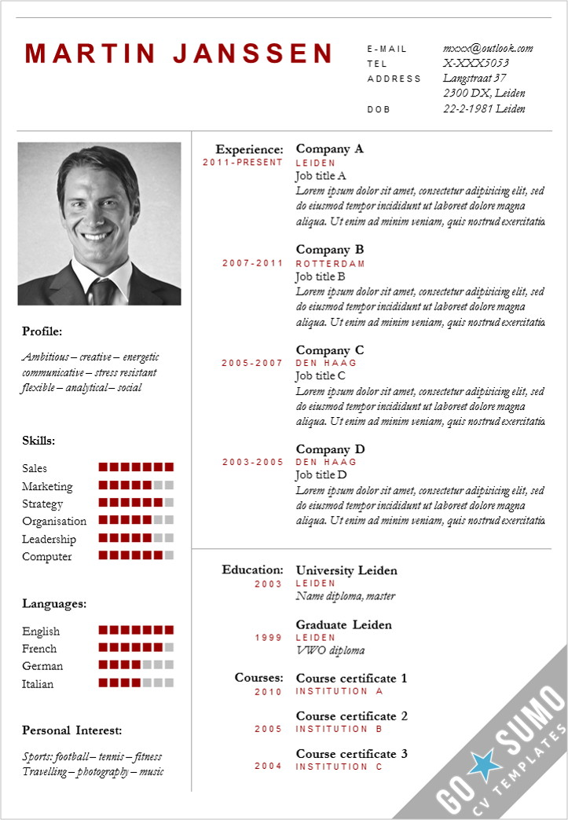
Resume
Resume is a French word meaning “summary”
It is a summary of a person’s education, skills, and work experience
It is usually 1 page long and maximum 2 pages

Slide 4
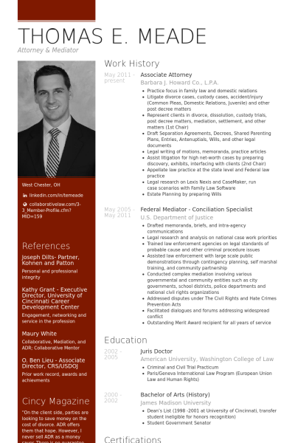
C.V. – Curriculum Vitae
Curriculum Vitae is Latin for “course of life.”
It is more detailed than a resume
Often more than 2 pages
Outlines everything the applicant has done or achieved

Slide 5
George’s CV sample

Slide 6
Creating a Resume/ CV
MS word
https://novoresume.com/

Slide 8
Cover Letter
What is a cover letter?
Why is it important?

Slide 9
Purpose of a cover letter
Helps you to stand out from other applicants
Allows you to explain why they should consider you for the position
Why you would be a good choice
Outlines your skills and abilities

Slide 10
Basics
No more than 1 page
Times Roman Font, 12 pt., single spaced
Make a pdf. if emailing to avoid others modifying it
Strive for neatness and showing your personality

Slide 11
SAMPLE
First Name Last Name Address City, State, Zip Code Phone Number Cell Phone Number Email
Name or
Title or Human Resource Manager Company Address City, State, Zip Code
Date
Dear Hiring Manager, or Ms. Smith
I am interested in the summer position at Super Store advertised in The Huntsville Times.
I have excellent communication skills and an aptitude for customer service. My past experience as a volunteer at Huntsville Hospital made it necessary for me to focus on providing quality customer service, and also enabled me to work with all types of people.
I believe that my communication skills, customer service abilities, and positive work ethic would make me an asset to your store.
Thank you for your consideration. I can be reached at email address or 256-222-2222. I look forward to hearing from you soon.
Sincerely,
Your Signature Your Typed Name
Your Contact Info
Employer Contact
Information
Date
Greeting
Introduction
What you offer them
What happens now
and close

Slide 12
Standard, conservative style This is ideal for sectors such as business, law, accountancy and retail.
Dear Mr. Black,
Please find enclosed my CV in application for the post advertised in the Guardian on 30 November.
The nature of my degree course has prepared me for this position. It involved a great deal of independent research, requiring initiative, self-motivation and a wide range of skills. For one course, [insert course], an understanding of the [insert sector] industry was essential. I found this subject very stimulating.
I am a fast and accurate writer, with a keen eye for detail and I should be very grateful for the opportunity to progress to market reporting. I am able to take on the responsibility of this position immediately, and have the enthusiasm and determination to ensure that I make a success of it.
Thank you for taking the time to consider this application and I look forward to hearing from you in the near future.
Yours sincerely

Slide 13
Seeking a position If you are checking for vacancy
Dear Mr. Brown,
I am writing to enquire if you have any vacancies in your company. I enclose my CV for your information.
As you can see, I have had extensive vacation work experience in office environments, the retail sector and service industries, giving me varied skills and the ability to work with many different types of people. I believe I could fit easily into your team.
I am a conscientious person who works hard and pays attention to detail. I'm flexible, quick to pick up new skills and eager to learn from others. I also have lots of ideas and enthusiasm. I'm keen to work for a company with a great reputation and high profile like [insert company name].
I have excellent references and would be delighted to discuss any possible vacancy with you at your convenience. In case you do not have any suitable openings at the moment, I would be grateful if you would keep my CV on file for any future possibilities.
Yours sincerely

Slide 14
Tips

Slide 15
Template
MS word “Cover letter” template
https://www.cover-letter-now.com/ (Have to pay to download though)

Slide 16
Use Key Words
Some skill keywords include: wrote, planned, programmed, designed, provided, created, built, enabled, taught and trained.
Some results oriented keywords include: increased, reduced, redesigned, upgraded, initiated, implemented, generated and produced.
Some recognition related keywords include: honored, awarded, promoted, selected, lauded for, recognized, chosen and credited.

Slide 17
Checklist
Did you check it for errors?
Did you mention skills and qualities that will make you stand out?
Did you use formal language? Dear ________ Sincerely, __________

Slide 18
Job Posting
George College
Hiring 3 English teachers to start in September 2018
Teacher must have adequate experience and skill to teach English to all ages.
Payment 5 million won per month
Applicants please send resume to gekw@hufs.ac.kr

