Slide 2
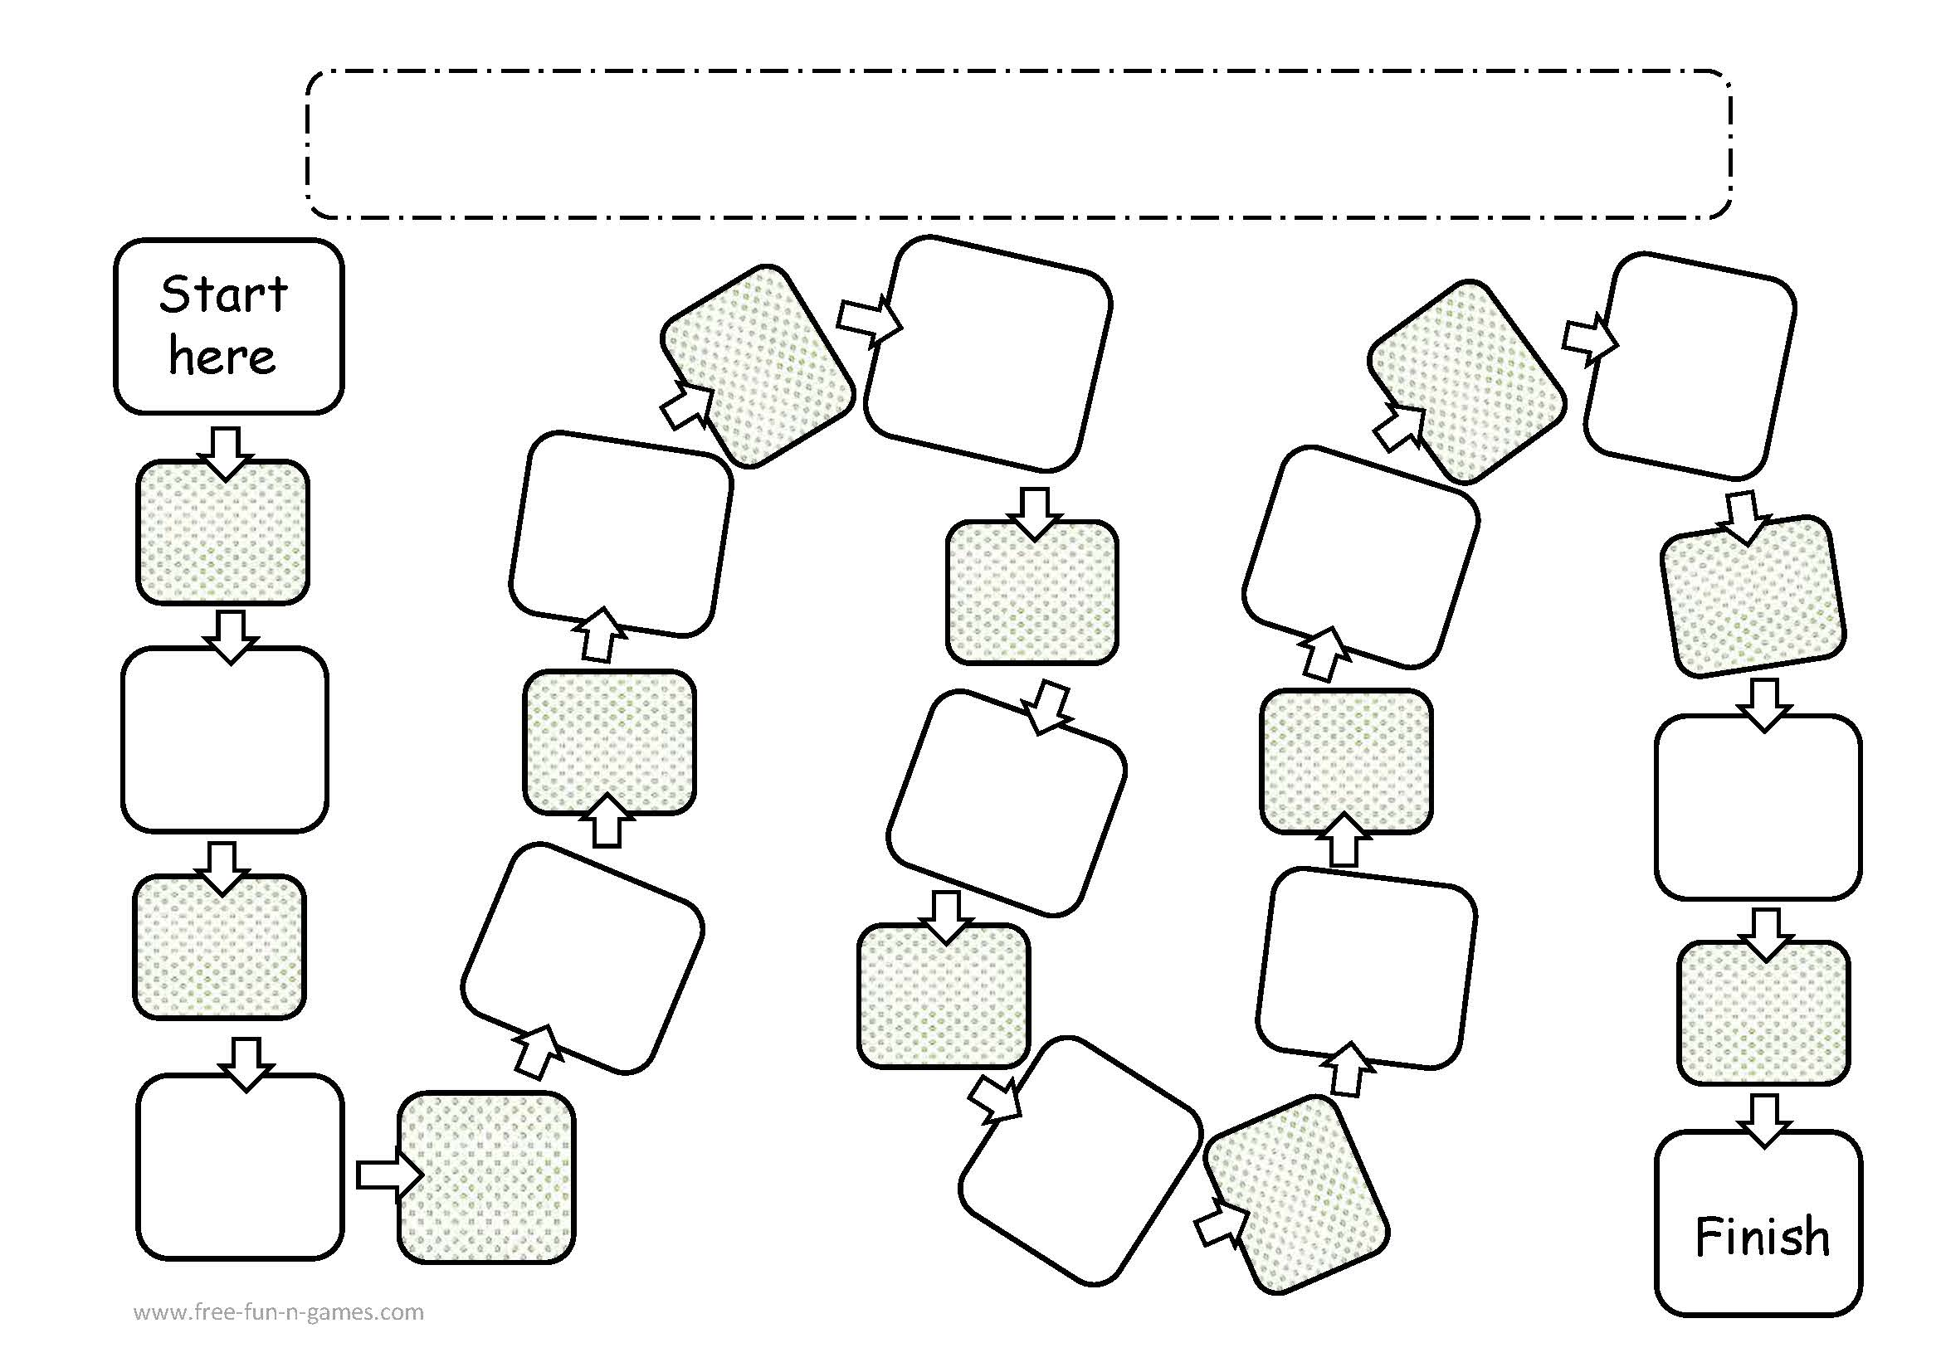
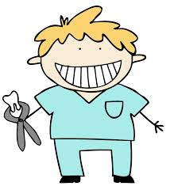
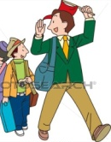
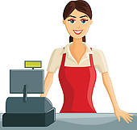
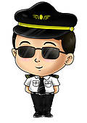
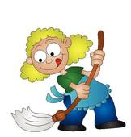
All about Jobs
What are 3 skills that you have that will help you be good at your future job?
What is a job that you would hate to do? why?
Describe your dream office. What would be in it? Where would it be located?
What is your dream job? why?
What do you think is the most important job in the world? why?
If money didn't matter, what job would you want?
What do you think is the easiest job in the world? why?
Describe your personality and how it will help you in your future job?
If you hated your job but the money was really good, what would you do? quit or stay? why?
If you could start your own business, what kind of business would you open? why?
Would you rather have stressful job that pays a lot of money, or an easy job that pays ok? why?
What do you think the most stressful job in the world is? why?

