Slide 1
Click anywhere to begin.

Slide 2
JEOPARDY
!
JEOPARDY
!

Slide 3
That Commercial is Classic
The Tabloids are Having a Field Day
Puzzle
Our Top Story Tonight
$200
$200
$200
$200
$400
$400
$400
$400
$600
$600
$600
$600
$800
$800
$800
$800
$1000
$1000
$1000
$1000

Slide 4
What is a jingle?
Give me an example

Slide 5
What is a tabloid?

Slide 6
Z y x w ?

Slide 7
What is breaking news?
Give me some breaking news from today!

Slide 8
What is an infomercial?

Slide 9
Give me a tabloid headline!

Slide 10
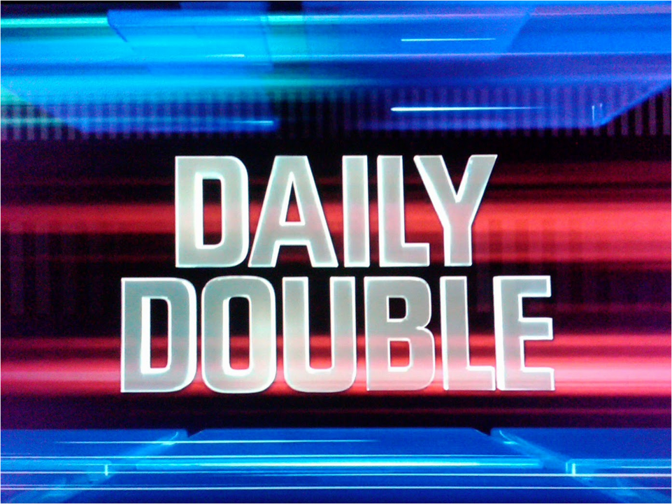
T W T F S ? ?

Slide 11
Why does the news tend to focus on negative stories?

Slide 12
Give me an example of a catchphrase

Slide 13
What percentage of tabloid headlines are accurate?
75-90 %
60-75%
10-60%
less than 10%

Slide 14
O T T F F ?

Slide 15
Give me one piece of happy news for today

Slide 16
The strategy used to sell products depends on many things. Can you name 3?

Slide 17
What are 3 differences between a tabloid and a newspaper article.

Slide 18
AS ON DJ FM AM __ __

Slide 19
Explain how the news affects us. 2 key points.

Slide 20
What are 4 types of advertising strategies used in commercials

Slide 21
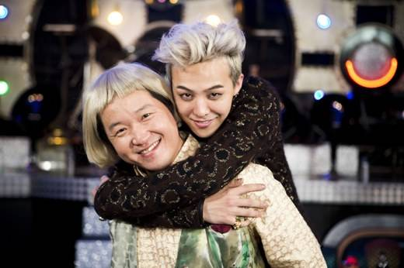
Give me a tabloid headline and 3 sentences based on this picture!

Slide 22
12, 7, 18, 10, 5, ?, 9, 1, 12, 7

Slide 23
From the video last class, give me 2 pieces of advice

