Slide 1
Click anywhere to begin.

Slide 2
JEOPARDY
!
JEOPARDY
!

Slide 3
Conflict & Resolution
War and Survival
Puzzle
I’m Moving on …
$200
$200
$200
$200
$400
$400
$400
$400
$600
$600
$600
$600
$800
$800
$800
$800
$1000
$1000
$1000
$1000

Slide 4
Tell me 4 conflict resolutions styles

Slide 5
Are you scared of a future war in Korea? Why or why not?

Slide 6
A man forgot to take his umbrella this morning. It is rainy season and he must walk home with no umbrella. Somehow he gets home without getting wet. How?

Slide 7
Tell me 4 reasons you would break up with someone and move on. Explain why.

Slide 8
Tell me about your conflict resolution style. What are the good points and bad points about your style?

Slide 9
If there was a big war in Korea would you flee the country? Why or why not?

Slide 10
Stand

Slide 11
Tell me 4 reasons that you would change the city you lived in.

Slide 12
How would you deal with the following situation:
You are at a club and someone has started a fight with your friend. You have just seen them punch your friend…

Slide 13
If you could choose 6 people in history to survive repopulate the Earth after a nuclear disaster who would it be and why?

Slide 14
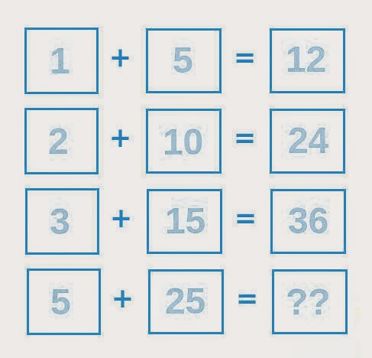

Slide 15
If you could work for free what would you do?

Slide 16
Tell me 3 things you learned by doing the Egg drop activity

Slide 17
In the future, how do you think war will be different from now? Why?

Slide 19
Tell me your why. What is your reason to work in the future?

Slide 20
How would you deal with the following situation:
You are at a company dinner. People are drinking a lot but you can’t because you are taking heavy medication. One of your coworkers keeps trying to push you to drink. You have told them 3 times that you can’t because of medication but they don’t believe you and continue to push you to drink…

Slide 21
Do you believe that war is necessary to resolve issues? Why or why not?

Slide 23
Tell me what you hope your life will be like in 7 years. What will you be doing?

Slide 24
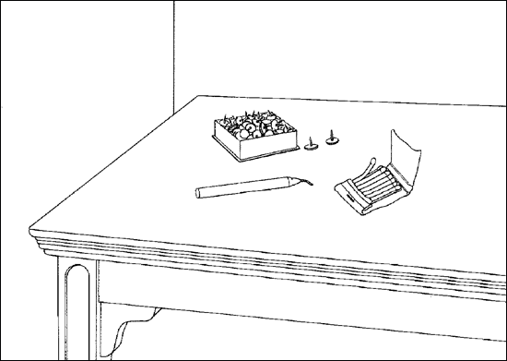

Slide 25
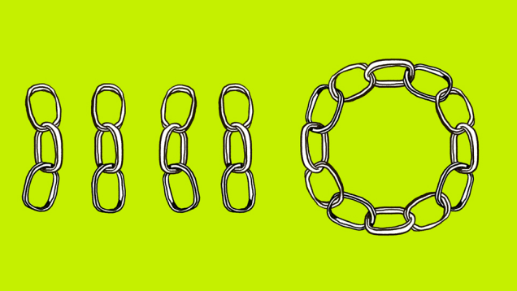
What is the minimum number of links you must cut to make the circle?

