Slide 1
Click anywhere to begin.

Slide 2
JEOPARDY
!
JEOPARDY
!

Slide 3
Key Concepts in Language Teaching
Key Points in Teaching Vocabulary
Teacher Talk
Practical Application
Receptive Lessons
Random
$200
$200
$200
$200
$200
$200
$400
$400
$400
$400
$400
$400
$600
$600
$600
$600
$600
$600
$800
$800
$800
$800
$800
$800
$1000
$1000
$1000
$1000
$1000
$1000

Slide 4
Key Concepts in Language Teaching

Slide 5
Key Points in Teaching Vocabulary

Slide 6
Teacher Talk

Slide 7
Practical Application

Slide 8
Receptive Lessons

Slide 9
Random

Slide 10
What are some individual differences in students and why it is important for teachers to consider these?

Slide 11
Describe a deductive approach and an inductive approach to teaching vocabulary.

Slide 12
Instead of saying “ Let me tell you” or “Let me explain”, you should say….

Slide 13
Other than pictures and translation what are 3 other ways you can teach meaning of words?

Slide 14
Describe a top-down vs. bottom-up approach

Slide 15
Name 3 bad teacher talk habits.

Slide 16
Describe 3 important aspects of a good language learning environment.

Slide 17
How many new words is appropriate to teach in a day? Why?

Slide 18
Give me an example of running commentary.

Slide 19
What type of word meaning relationships do the following words and phrases have?
I had butterflies in my stomach before the test.
The stairs are slippery.

Slide 20
Describe the task-feedback cycle.

Slide 21
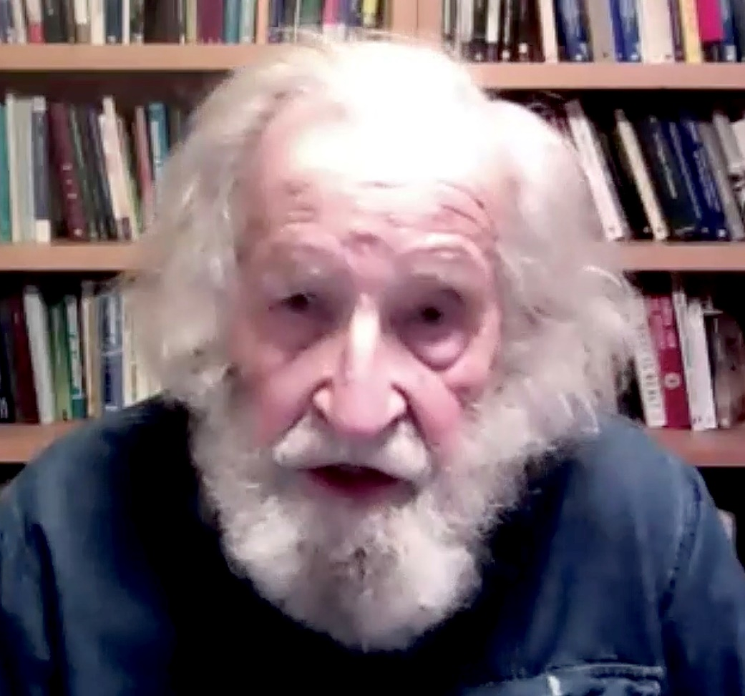
Who are they?

Slide 22
Other than teaching language what else can language teachers foster in their learners?

Slide 23
FUMP – what does it stand for and what does each letter refer to exactly

Slide 24
Get your students to do the following without speaking…
Draw a square in the middle of a piece of paper. The square should have 6 circles surrounding it. They should write their name in the top right corner.

Slide 25
What is the concept of the word ‘float’ in the following sentence? Teach the concept and CCQ it.
They throw the soccer ball in the lake to see what will happen. To their surprise it floats.

Slide 26
Why is important to take time to pre-teach the vocabulary?

Slide 27
What does TESOL stand for?

Slide 28
On the first day you meet students what should be your primary objectives?

Slide 29
It is good to get students to guess the meanings of new words? Why or why not?

Slide 30
Simplify the following…
“ I would like to examine the text on page 51 and consider core concept of the reading. I would then like to you write down what you consider that core concept to be, in your notebook”

Slide 31
Make 3 CCQs for the word “light” in the following sentence.
The bag was empty, so it was light.

Slide 32
What is the difference between intensive reading and extensive reading?

Slide 33
What is George’s blood type?

Slide 34
Describe two of the best and two of the worst classroom setups and explain why they are good or bad.

Slide 35
What is depth of knowledge and why is it an important concept to consider when teaching vocabulary words?
?

Slide 36
What are 3 key tips to make English teacher talk more comprehensible?

Slide 37
Why is it inappropriate to elicit new words from student but ok to elicit understanding of new grammar?

Slide 38
Describe the steps in a pre-while-post reading lesson.

Slide 39
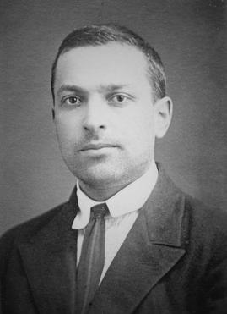
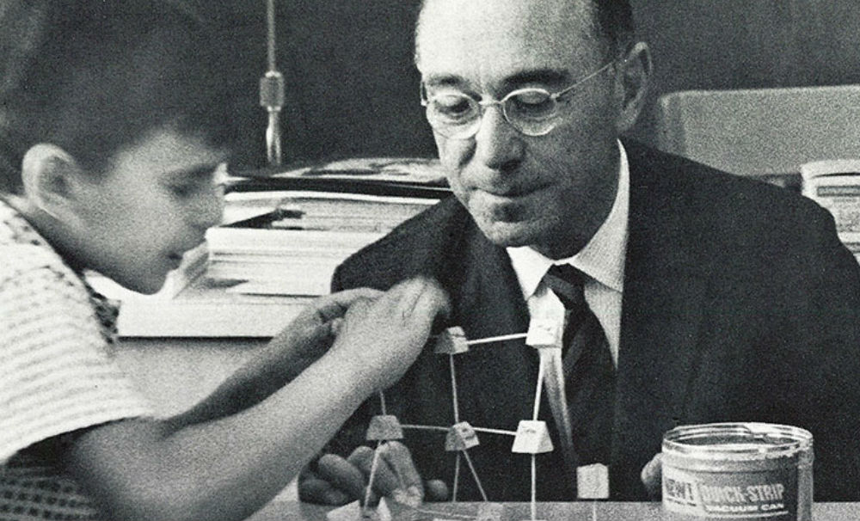
Who are they? And what concepts are they famous for?
Notes:
Dianne Larsen-Freeman , H. Douglas Brown, Jack Richards

