Slide 1
It’s all about me.
What I like!

Slide 2
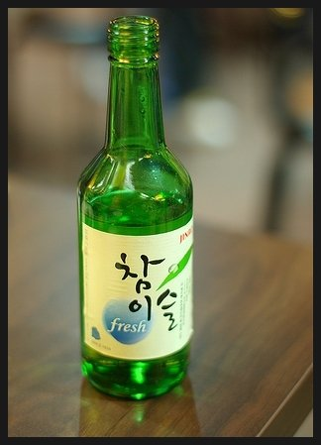

Slide 3
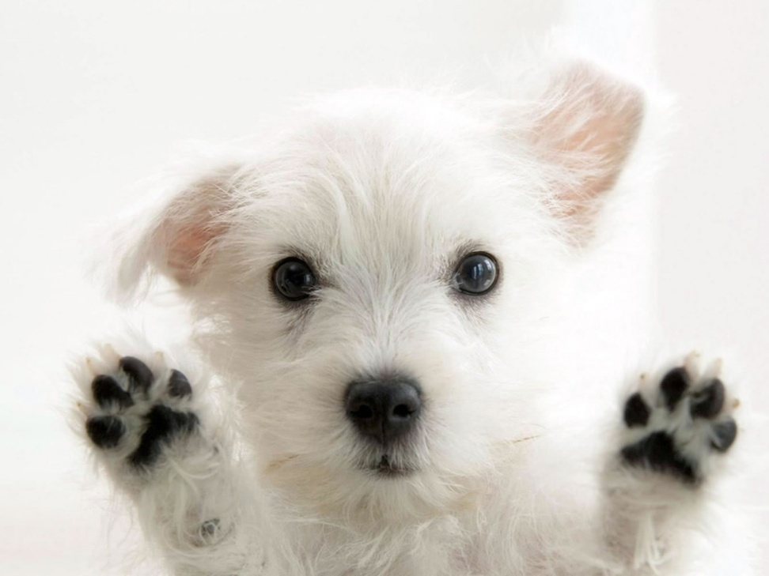

Slide 4
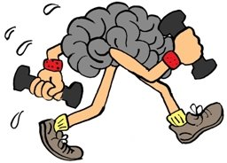

Slide 7
3 Truths and 2 Lies
Write down 5 sentences using “ I like..” and “I don’t like..”
3 sentences should be true
2 sentences should be a lie!

Slide 8
I like wine
I don’t like studying
I don’t like spiders
I like tattoos
I like singing and dancing

