Slide 1
Is the earth in danger?
The impacts of human actions

Slide 2
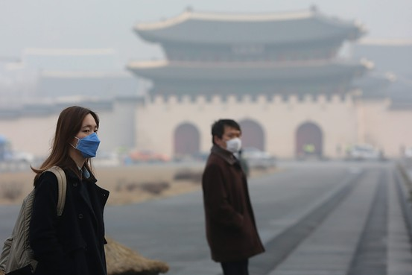
The World We Live in

Slide 3
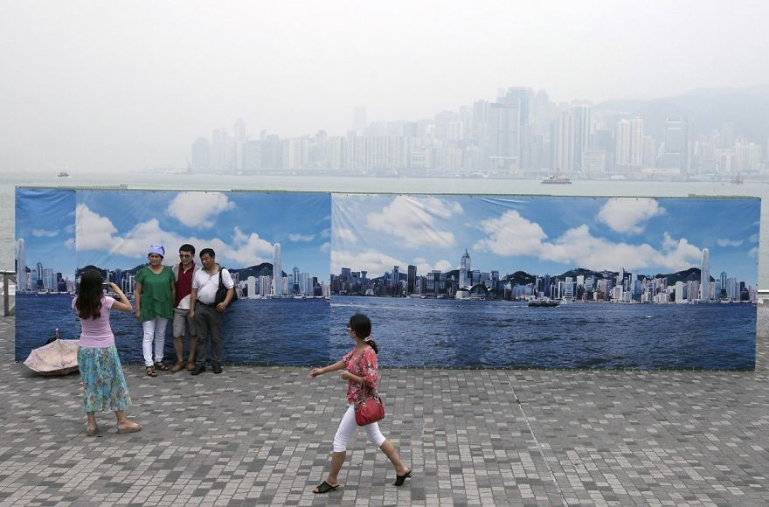

Slide 4
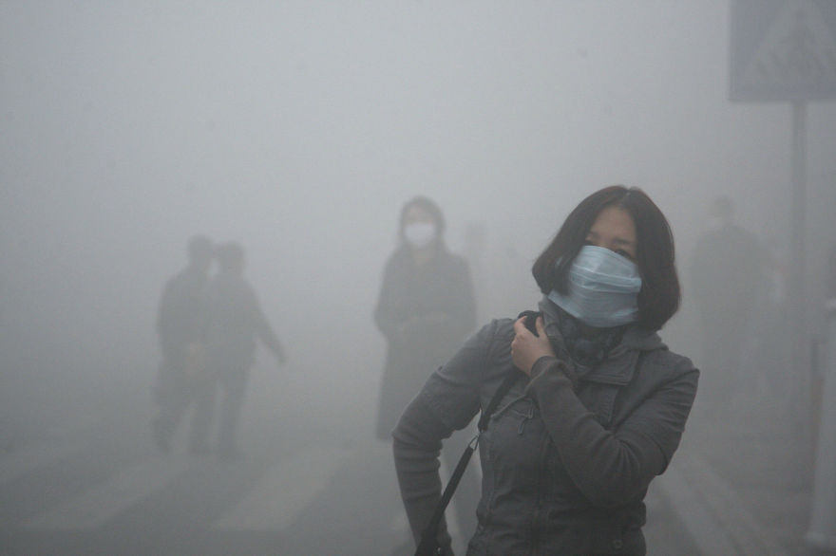

Slide 5
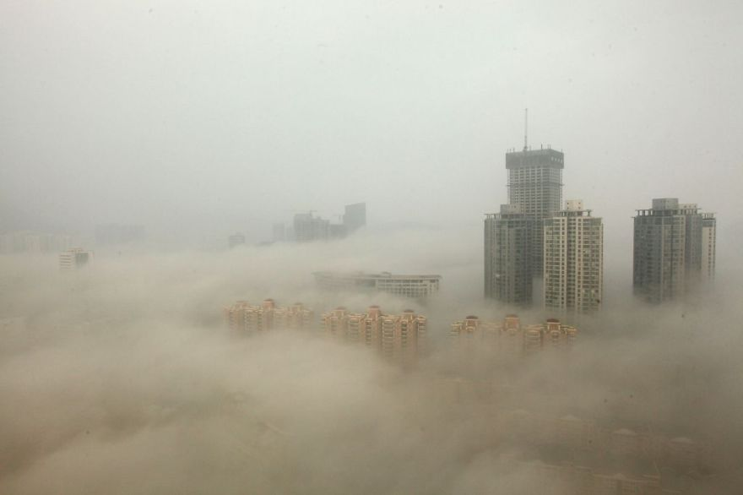

Slide 6
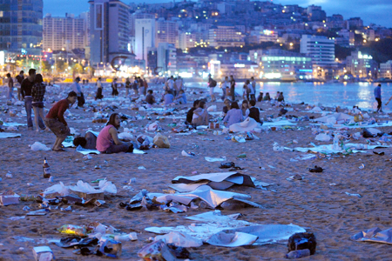

Slide 7
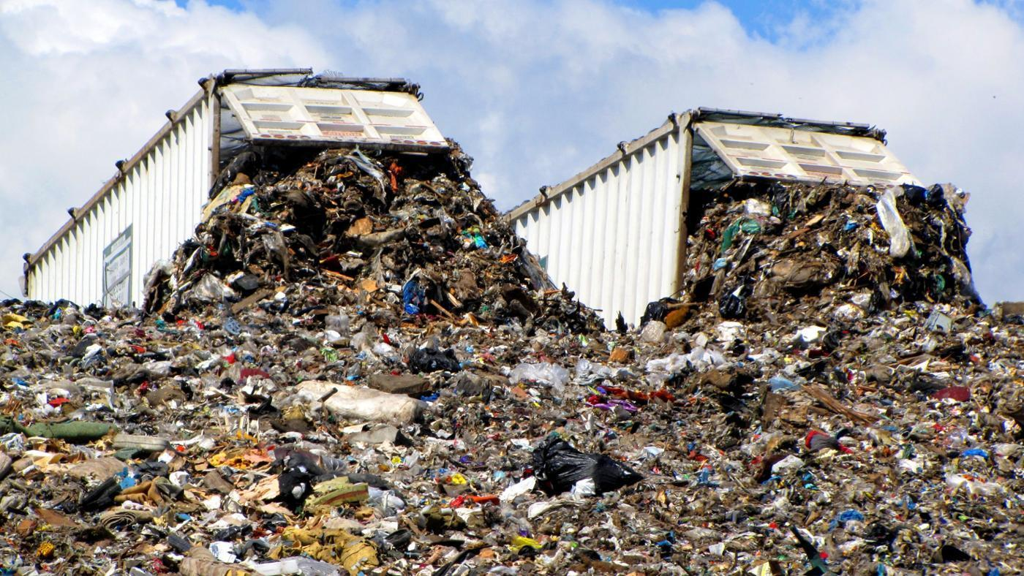

Slide 8
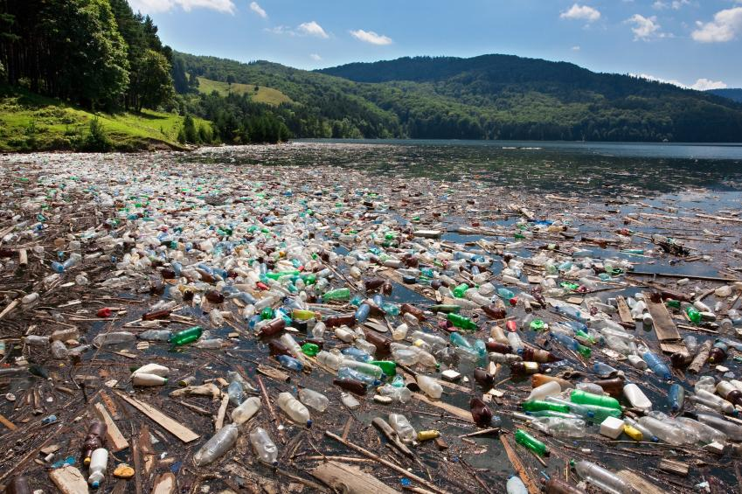

Slide 9
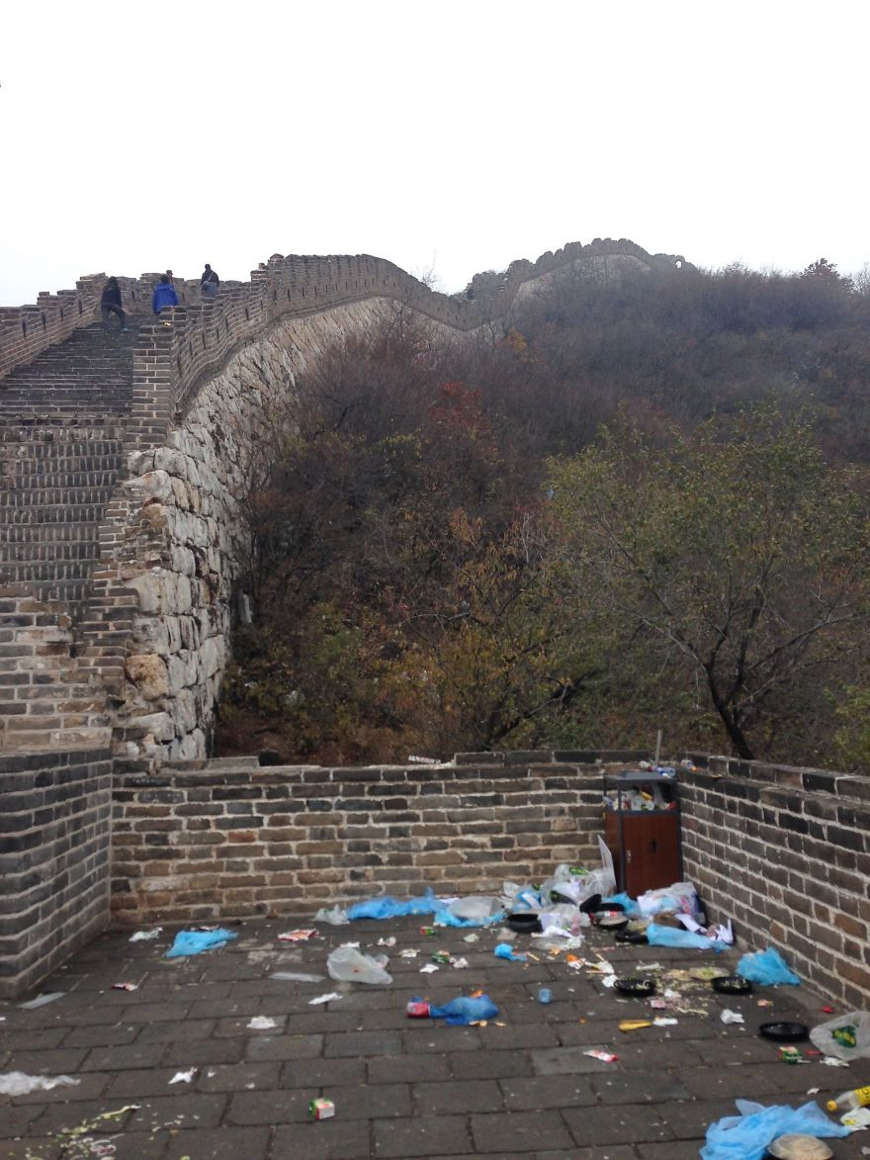

Slide 10
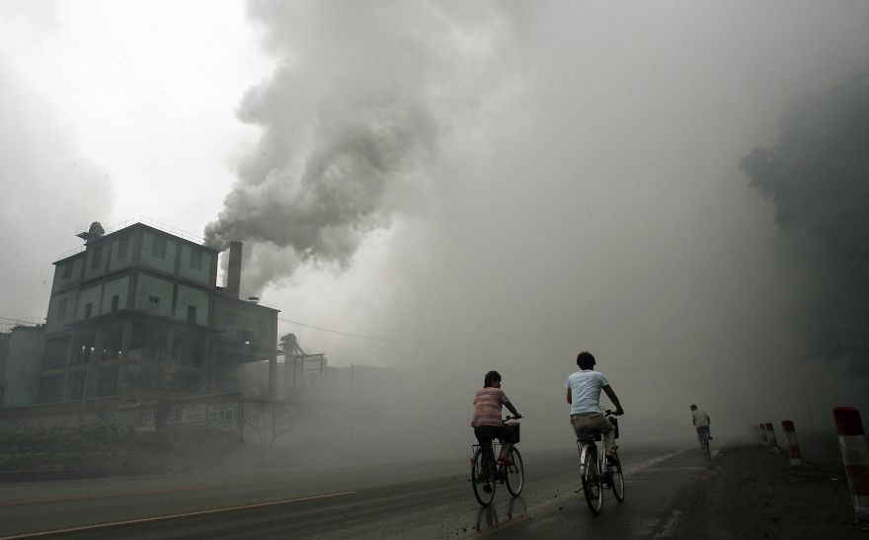

Slide 11
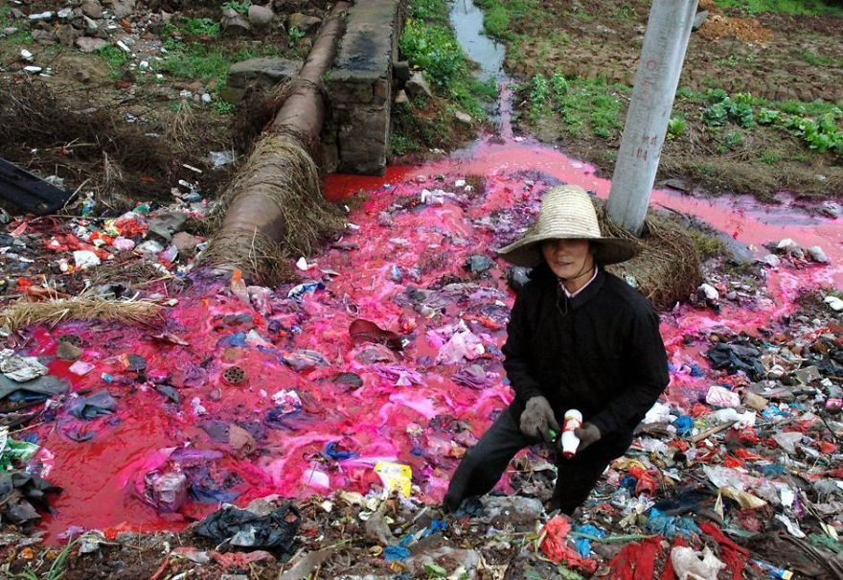

Slide 12
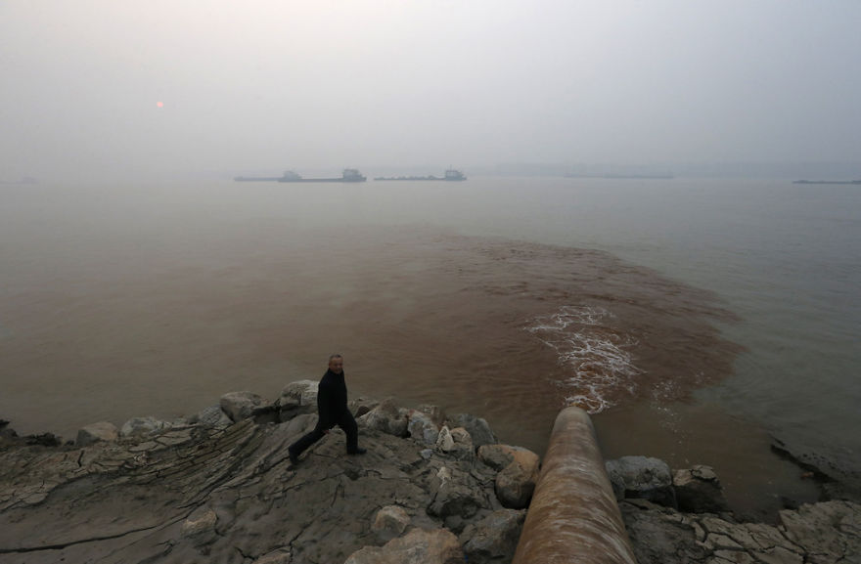

Slide 13
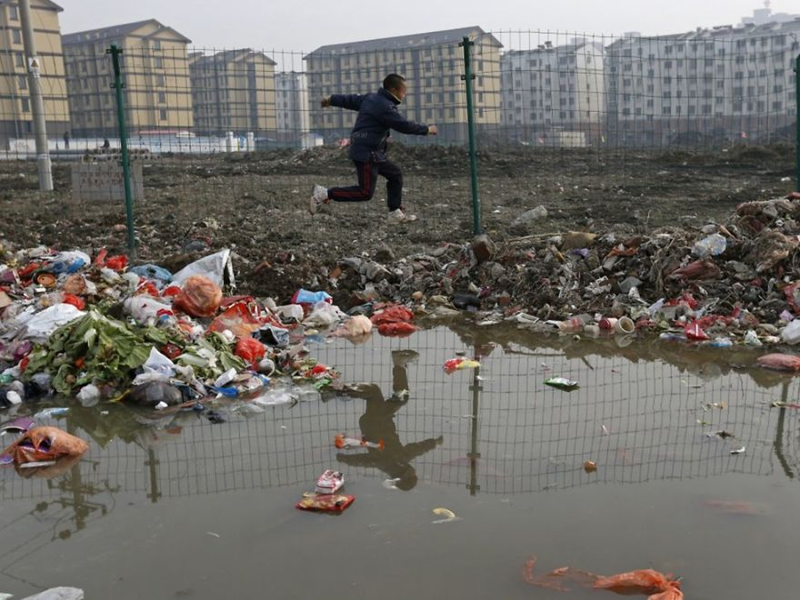

Slide 14
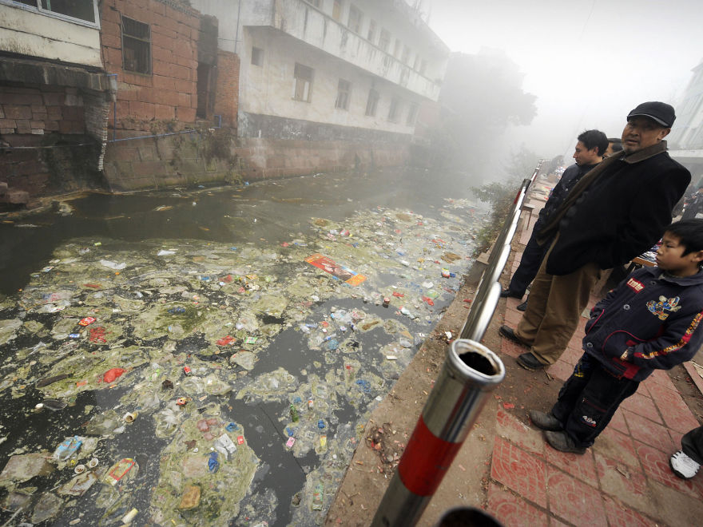

Slide 15
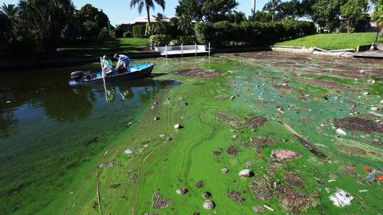

Slide 16
Survey

Slide 17
The Issues
What are some of the biggest environmental issues that are putting the earth in danger?
With your group make a list of as many issues as you can think of.

Slide 18
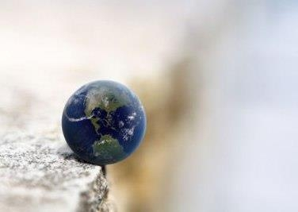
The Earth’s Tipping Point
Watch and see how many you got correct?
What did you miss?

Slide 19
The Earth’s Tipping Point
Watch and write down any words you do not know

Slide 20
9 Planetary Boundaries
Climate change
Loss of different species
Phosphorus and Nitrogen
Deforestation
Micro-dust (air pollution)
Ozone destruction
Freshwater use
Ocean acidification
Dumping toxic elements into the environment (plastics, nuclear waste, other)

Slide 21
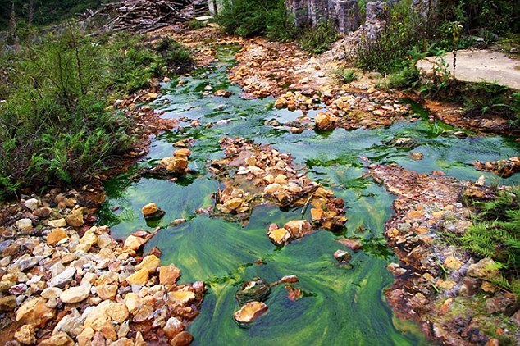
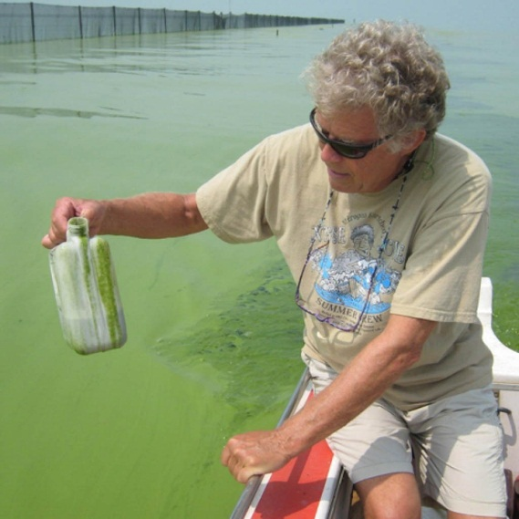
Too much nitrogen and phosphorus in the water causes algae to grow faster than ecosystems can handle. Significant increases in algae harm water quality, food resources and habitats, and decrease the oxygen that fish and other aquatic life need to survive.

Slide 22
Johan Rockström

Slide 23
Discussion
Do you think humans are doing enough to protect the planetary boundaries?
Climate change
Loss of different species
Phosphorus and Nitrogen
Deforestation
Micro-dust (air pollution)
Ozone destruction
Ocean acidification
Freshwater use
Dumping toxic elements into the environment (plastics, nuclear waste, other)

Slide 24
How can we increase people’s awareness of how their everyday habits are negatively affecting the earth?

Slide 25
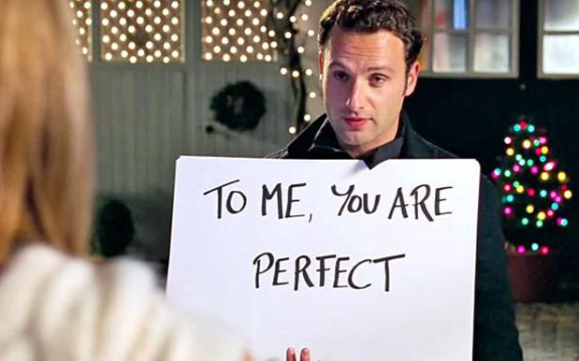
Video project
When you brush your teeth, do you let the water run?
With your group
Create a short video to raise people’s awareness of how their daily habits are affecting the earth (think of at least one habit per group member to present)
It can be done by acting/drawing/signs/ or any other creative idea you have
Wevideo
Vivavideo

Slide 26
Sample Video

Slide 27
Video project
When you brush your teeth, do you let the water run?
With your group
Create a short video to raise people’s awareness of how their daily habits are affecting the earth (think of at least one habit per group member to present)
It can be done by acting/drawing/signs/ or any other creative idea you have
Wevideo
Vivavideo

