Slide 1
Writing introductions
General to Specific

Slide 2
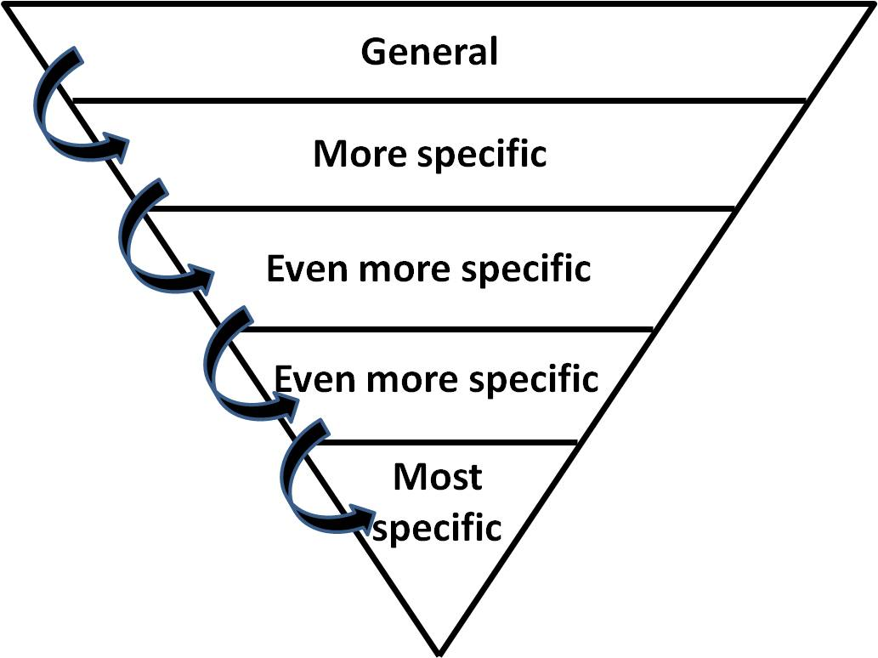
Writing and introduction or general to specific text

Slide 3
Introduction content
Sets the current situation of the topic in the field (background of the topic)
Discusses holes in the literature or the need for more research on the topic
States the context of study and relates the topic to the context in which the research is taking place
States the purpose of the study
States how the issue will be addressed
Usually starts from the general and progresses to the specific
In general the introduction should be quite not be more that 1/6 of the total paper.
Notes:
Introduction – don’t take pages to get to the point. New writers often use introductory section to warm up. No need for extensive scene setting. Brings the reader in, opens up strands of relevance, gives the reader a flavour of what is to come.

Slide 4
Introduction overview
1. Introduction (5-10 pages)
1.1 Background of the study
Background information about your topic of investigation
The situation now in the world
The situation now in your research context
Research gap / Need for the study
1.1 Purpose of the study
What are the aims of your study?
Why?
What are your research questions?
1.2 Significance of the study
What will your study contribute to the field?
Who will benefit from this research?
In what ways will they benefit?

Slide 5
What to do - go from global to local
Factors Affecting Introverted Learners’ Willingness to Speak in Communicative Classrooms
The Effects of Homework Load on Students’ Well-being
Give an overview of the history of the main topic you are interested to study.
Where did the topic come from?
How did the topic enter the field of ELT (general overview)?
How does it connect to other factors you want to include in your study?
These can be subtopics that you are exploring

Slide 6
What to do – situate your study
Factors Affecting Introverted Learners’ Willingness to Speak in Communicative Classrooms
The Effects of Homework Load on Students’ Well-being
Describe the main issue that you are focusing on.
What problem or issue drives your research?
Holes in the literature
Issues in the field

Slide 7
What to do – provide the rationale
Factors Affecting Introverted Learners’ Willingness to Speak in Communicative Classrooms
The Effects of Homework Load on Students’ Well-being
Make a strong case for why your study is important and what it will contribute .
Why is your study needed?
What will your study add to the field?

Slide 8
What not to do
Do not include lengthy descriptions of research here.
Do not include specific details of research (that belongs in the Literature Review).

Slide 10
Introduction overview
1. Introduction (5-10 pages)
1.1 Background of the study
Background information about your topic of investigation
The situation now in the world
The situation now in your research context
Research gap / Need for the study
1.1 Purpose of the study
What are the aims of your study?
Why?
What are your research questions?
1.2 Significance of the study
What will your study contribute to the field?
Who will benefit from this research?
In what ways will they benefit?

Slide 11
sample Introductions
Read and Analyze

Slide 12
Example #1
In recent years, there has been increased interest on the topic of leadership in language teaching with the hopes of strengthening English Language Teaching (ELT) professionalism by placing more attention on teachers’ evolving roles both inside and outside the classroom (see Christison & Murray, 2009; Coombe, McCloskey, Stephenson, & Anderson, 2008; Fenner, 2016; Author 2 & Author 1, 2016; Koosha, Liaghat, & Sadeghdaghighi, 2015). This has led to an emerging discussion in the field which has posited good teacher leadership as an essential component in ELT, with increasing recognition that a focus on fostering the understanding and growth of leadership can make invaluable contributions to successful teaching and learning (Coombe et al, 2008; Johnson & Burton, 2000).
At present, most of the existing literature on leadership in ELT has been concerned with program management, organizational structure, and other aspects of administration (Christison & Murray, 2009; Coombe et al, 2008; Muijs & Harris, 2003; Pennington & Hoekje, 2010; White, 2008), leaving leadership at the classroom level relatively unexplored. This may in part be due to the concepts of good leadership and good teaching possibly overlapping where good leadership may be simply viewed as a naturally embedded component of effective instruction. Although the two concepts are interrelated, we strongly believe that further attention needs to be given to leadership in its own right in order to better understand what it actually entails and how it relates to teaching practices.
Given the rapid changes in English as a second language (ESL) and English as a foreign language (EFL) teaching approaches and the growing diversity of learners and contexts, arguably some of the most essential qualities teachers can possess include a sense of empowerment in their classrooms and schools (Lieberman & Miller, 2004; McGee, Haworth, & MacIntyre, 2015), and an understanding of how to appreciate and inspire students as individuals. While there has been an explosion of research on teacher leadership in general education (see Curtis, 2013; Berry et al, 2010; Lieberman & Miller, 2004), the concept remains in its nascent stages in the ELT context, despite its importance being indicated in the growing call for more research on the topic (Christison & Murray, 2009; Shields & Sayani, 2005).

Slide 13
Example 2
Since its inception in the late 1960s, Communicative Language Teaching (CLT) has grown in popularity and has had widespread adoption in ESL countries (Li, 1998). However, when policies and curricula have shifted to CLT in EFL contexts researchers have been quick to find a gap between policy and practice (Nunan, 2003). There is widespread documentation of teacher difficulty and/or resistance to CLT largely stemming from a lack of local contextual appropriateness and local contextual constraints (Bax, 2003; Incecay & Incecay, 2009; Liao, 2006; Menking, 2001). Some of the most common obstacles reported have been; grammar based examinations (Li, 1998), the context of the wider curriculum (Burnaby & Sun, 1989), lack of trained teachers (Anderson, 1993), too much preparation time required (Chau & Chung, 1987) and learner resistance (Shamin, 1996).
For the last 20 years, South Korea has been pushing for the implementation of CLT with changes to National Curriculum objectives, and in-service teacher training programs promoting its widespread usage. However, CLT continues to fail to gain extensive implementation into public school secondary classroom, and Grammar Translation and Audiolingual methods continue to be the dominant methods used across the country (Cho, 2010; Choi, 2008; Whitehead, 2016; Woo, 2001).
As teachers are the ones at ground level, they are the ones who experience the obstacles and difficulties first hand. In order to understand the gap between CLT policy and practice in South Korean secondary classrooms, it is crucial to give in-service teachers a voice in regards to the contextual constraints and issues that they face. This study aims to do just that by examining 1) the reasons why CLT may be failing to take hold in South Korean secondary classrooms from the teachers’ perspective and 2) what can be done to support and/or facilitate the implementation of CLT in the future.

Slide 14
General outline – Questions to guide your introduction writing
Background of the study:
Where did your topic originate and why is it important to the field?
How is the topic situated in the field at present?
What is the problem area or issue you are focusing on?
What is missing in regards to research on the topic
Why is this topic important to the field and the future of the field?
How is the topic situated in your specific context?
What do we know about it in your specific context?
Why is the topic of importance in this context?
Purpose of the study:
What does your study/project aim to do?
How will study/ project address the issue?
Significance of the study:
What will your study/ project contribute to the field?
Who will benefit from your study? In what ways will they benefit?

Slide 15
readings
Chapter 2
Pages 17-28

Slide 16
Helpful Resources – click on the books

